Slide 1
Face to Face 4 – Session 4.
Dr Stuart Jones

Slide 2
Aggression.
Dr Stuart Jones

Slide 3
Aggression – is it Nature or Nurture……
Watch this video clip.
https://www.youtube.com/watch?v=zerCK0lRjp8

Slide 4
Aggression – is it Nature or Nurture.

Slide 5
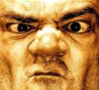
Chemical/hormonal influences
Testosterone
  Injection of testosterone will increase aggression in animals (cause and effect relationship in non-human animals)

Slide 6
Testosterone in humans
  Dabbs and colleagues
Naturally occurring testosterone levels are higher among prisoners convicted of violent crimes than those convicted of nonviolent crimes.
Once incarcerated, prisoners with higher testosterone levels violated more prison rules
Correlational: Questions about direction of causality and additional variables

Slide 7

Behaving aggressively also can increase testosterone
Additional variables: Violent prisoners may differ in many ways from less nonviolent prisoners (e.g., in stress, family history, etc.)

Slide 8
But wait……
EXPERIENCE can alter hormone levels…….
Alpha male contests (Bernstein and Gordon, 1974) – e.g. Lion vs Lion etc.
Maybe a RESULT rather than a course of behaviour.
Chess matches (Bernhardt, 1997).

Slide 9
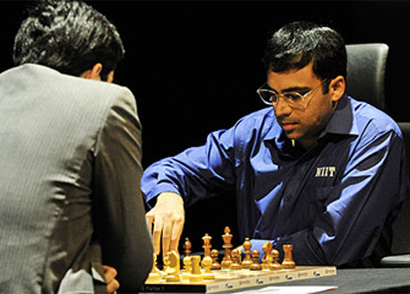
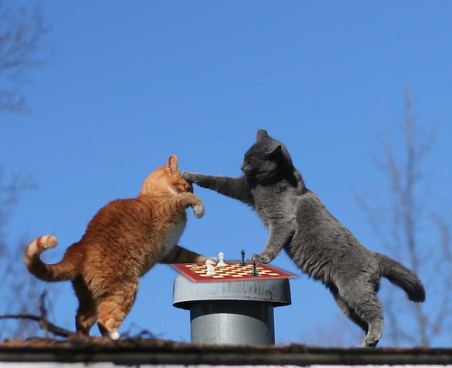
Another confounding variable.
Dominance.
Chess players and aggression, really??
Castration Studies.
  Is it against assaults or is it a lack of sexual drive.

Slide 10
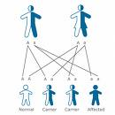
Is Aggression Genetic?
Genetic Influences on Individuals
XYY Chromosome
• Statistics
– 1 in 1000 people have an extra Y
chromosome
– 15 in 1,000 prison inmates have an extra Y
– XYY is related to crime but not to homicide

Slide 11
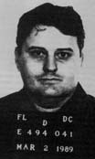
Serial Killers with Genetic Disorders
Arthur
Shawcross
IQ = 95
Bobby Joe
Long
IQ = 118
John Wayne
Gacy
IQ = 118

Slide 12
XYY Chromosome.
Theilgaard (1984)
Studies personality traits of people with XYY Chromosome with XY Controls.
XYY men found them to be taller than average males

Slide 13
XYY Chromosome.
Testosterone level – XYY Higher?
XYY men also more apt to be "clumsy" and slow witted, perhaps adding to their social frustration levels
XYY men "gave more aggressive and less anti-aggressive content in their responses compared to their controls."

Slide 14
Mood of XYY = low and pessimistic.
Relationship with others “negative” with often “unstable thoughts”.
Act more aggressively to their partners.
Impulse sporadic outburst.

Slide 15
XYY
Rigid thinking patterns – less able to be flexible and adaptable.
Harder to control himself.
Theilgaard found that yes, XYY males have aggressive tendencies, that the XYY male is more aggressive than XY males, but their aggressive tendencies do not necessarily manifest in violent behavior toward other people

Slide 16
Richard Speck
Mass murdered 8 nurses in Chicago
Defense claimed he had the XYY
Later testing found this not to be true

Slide 17
Physiological Influences
The Amygdala

Slide 18
The Amygdala
Thought to be the “aggression centre”
Is involved with associating stimuli
with reward and punishment
Removal of amygdala reduces antisocial behaviour
– 39% marked reduction
– 35% some reduction
– 21% no reduction
– 5% increase

Slide 19
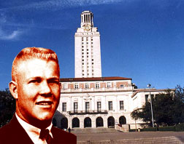
Charles Whitman
August 1, 1966
• 12:00 a.m. – killed mom
• 3:00 a.m. – killed wife
• 11:30
– Killed receptionist
– Killed two couples
– Shooting Spree
• 16 dead
• 30 wounded
http://brainmind.com/Case5.html

Slide 20

Hormones
Aggression increases after an injection of male hormones
Testosterone levels higher in people committing
unprovoked violent crimes than in non-violent crimes
After age 25
– androgen levels decrease
– violent crime rates decrease

Slide 21
Serotonin and Aggression.
Higley et al (1992).
28 monkeys (not in captivity).
Rated aggressiveness based on observations and wounds.
Most aggressive had lowest levels of serotonin.
Mice
  Minus serotonin receptor genes – less aggressive (Bouwknecht et al, 2001).

Slide 22
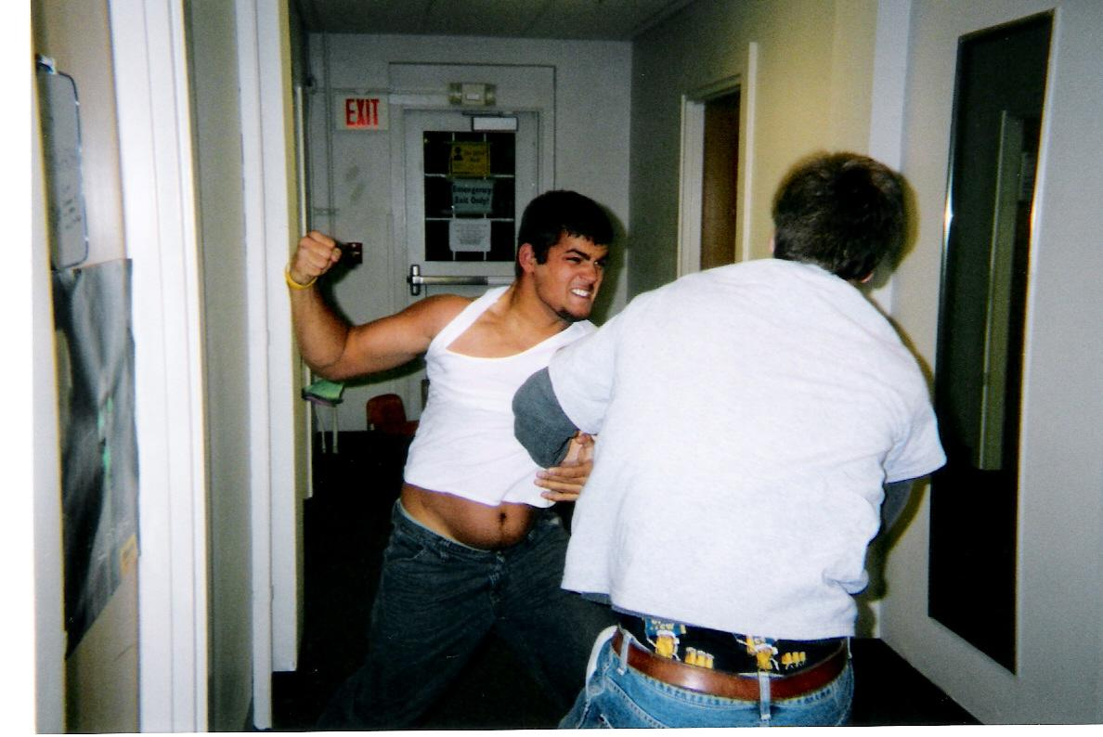
In humans.
Dimished Seratonin activity is seen in humans who become violent with Alcohol (Virkkunen and Linnoila, 1993).
US marines expelled for violence (Brown et al, 1979).
Children who torture animals (Kruesi, 1979).

Slide 23
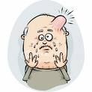
Head Injuries
• Study of death-row inmates (Lewis, 1986)
– All 15 claimed a history of head injury
– 12 of 15 showed neurological impairment
• Study of 14 death-row juvenile offenders (Lewis et al., 1988)
– All 14 had history of head injury
– 8 of 14 severe enough to be hospitalized
• Study of 16 death row inmates (Freedman & Hemenway,
2000)
– 88% (14) had history of head injury
– 88% had been physically or sexually abused
– 88% had parents who abused drugs and alcohol

Slide 24
Arthur Shawcross
Genesee River Killer
• Killed 2 children, 11 prostitutes
• Head injuries
– 09 Hit in head with stone
– 10 Hit head jumping into lake
– 16 Hit in head with discuss
– 17 Hit in head with sledge hammer
– 23 Fell from 40 foot ladder and hit
his head, was unconscious

Slide 25
David Berkowitz
Killed 6, started over a thousand fires
• Head injuries
– 7 Hit by a car, suffered
head injuries
– 7 Ran into a wall and
suffered head injuries
– 8 Hit in the head with a pipe, 4-inch gash in forehead

Slide 26
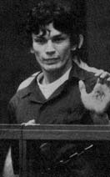
Richard Ramirez
“The Night Stalker”
Killed 14
• Head injuries
– 02 Dresser fell on his head, received 30 stitches, almost died
– 06 Hit by a swing, knocked
unconscious, caused a deep gash
– 11 Diagnosed with epilepsy

Slide 27

Professional Wrestler Chris Benoit.
2007 – Killed his wife and son.
Hours later he killed himself.
Possible causes
  Steroid Abuse (Testosterone)?
  Brain Injury?
  Environment?

Slide 28
Is aggression purely biological?
What alternative causes are there?

Slide 29
Genetic/biological vs. environment
Debate:
Aggressive behavior results from an interaction between genetic/biological factors and environmental factors, but aggression is more powerfully influenced by genetic and/or biological factors.
Aggressive behavior results from an interaction between genetic/biological factors and environmental factors, but aggression is more powerfully influenced by environmental factors.

Slide 30
Task 2
Read the following articles and try to synthesise them.
https://cms.bps.org.uk/sites/default/files/2022-11/killcross00.pdf
https://www.bps.org.uk/psychologist/volume-29/june-2016/brain-injury-and-crime
https://www.bps.org.uk/psychologist/how-does-music-make-you-feel

