Slide 1

Alexander the Great
Historical Summary

Slide 2
What are our sources?
  Diodorus
  Q. Curtius Rufus
  Plutarch
  Arrian
  Justin
  Alexander Romance?
  Inscriptions

Slide 3
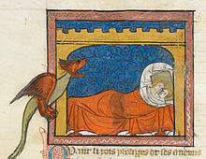
Key Narrative Features of Alexander’s Early Life
Relationship with Olympias
Nectanebo
Relationship with Aristotle
This Photo by Unknown Author is licensed under CC BY-SA

Slide 4
Alexander Birth and Propaganda
Be that as it may, Alexander was born early in the month Hecatombaeon, the Macedonian name for which is Loüs, on the sixth day of the month, and on this day the temple of Ephesian Artemis was burnt. 6 It was apropos of this that Hegesias the Magnesian made an utterance frigid enough to have extinguished that great conflagration. He said, namely, it was no wonder that the temple of Artemis was burned down, since the goddess was busy bringing Alexander into the world. But all the Magi who were then at Ephesus, looking upon the temple's disaster as a sign of further disaster, ran about beating their faces and crying aloud that woe and great calamity for Asia had that day been born. To Philip, however, who had just taken Potidaea, there came three messages at the same time: the first that Parmenio had conquered the Illyrians in a great battle, the second that his race-horse had won a victory at the Olympic games, while a third announced the birth of Alexander. These things delighted him, of course, and the seers raised his hopes still higher by declaring that the son whose birth coincided with three victories would be always victorious.
Plutarch Life of Alexander 4

Slide 5
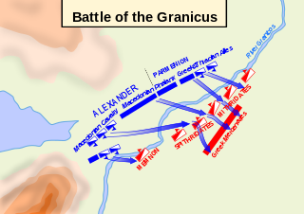
Up to
Granicus
Alexander and the Philosophers
Destruction of Thebes
Crossing the Hellespont
Battle of Granicus
This Photo by Unknown Author is licensed under CC BY-SA

Slide 6
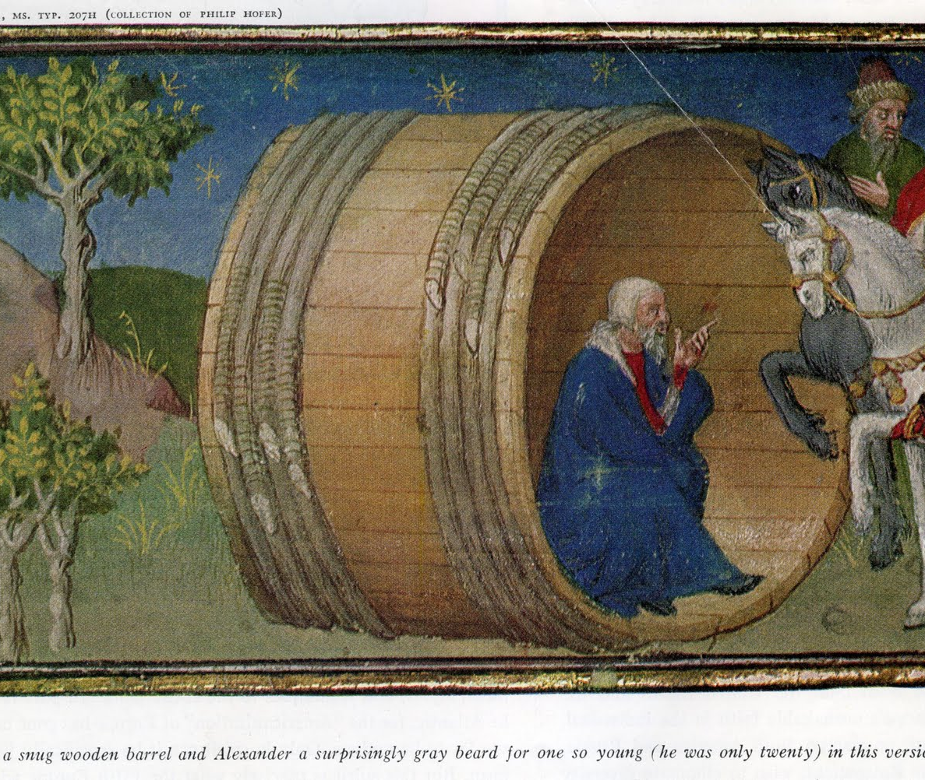
Alexander went in person to see him and found him basking at full length in the sun. When he saw so many people approaching him, Diogenes raised himself a little on his elbow and fixed his gaze upon Alexander. The king greeted him and inquired whether he could do anything for him. ‘Yes,’ replied the philosopher, ‘you can stand a little to one side out of my sun.’ Alexander is said to have been greatly impressed by this answer and full of admiration for the hauteur and independence of mind of a man who could look down on him with such condescension. So much so that he remarked to his followers, who were laughing and mocking the philosopher as they went away, ‘You may say what you like, but if I were not Alexander, I would be Diogenes.’
Plutarch Life of Alexander 14
This Photo by Unknown Author is licensed under CC BY-SA

Slide 7
Destruction of Thebes
Alexander’s principal object in permitting the sack of Thebes was to frighten the rest of the Greeks into submission by making a terrible example. But he also put forward the excuse that he was redressing the wrongs done to his allies, for the Plataeans and Phocians had both complained of the actions of the Thebans against them. As for the population of Thebes, he singled out the priests, a few citizens who had friendly connections with Macedonia, the descendants of the poet Pindar, and those who had opposed the revolt to be spared: all the rest were publicly sold into slavery to the number of twenty thousand. Those who were killed in the battle numbered more than six thousand.
Plutarch, Life of Alexander 11

Slide 8
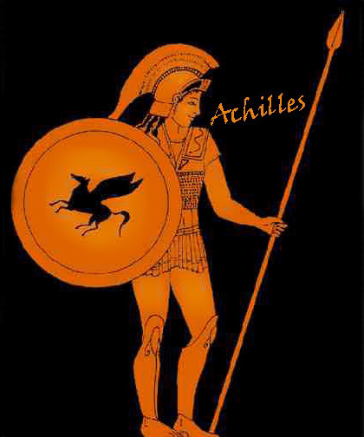
Temporarily Like Achilles
Once arrived in Asia, he went up to Troy, sacrificed to Athena and poured libations to the heroes of the Greek army. He anointed with oil the column which marks the grave of Achilles, ran a race by it naked with his companions, as the custom is, and then crowned it with a wreath: he also remarked that Achilles was happy in having found a faithful friend while he lived and a great poet to sing of his deeds after his death.
Plutarch, Life of Alexander 15
At Elaeus he offered sacrifice upon the tomb of Protesilaus, who was supposed to have been the first man of Agamemnon’s Army to set foot upon the soil of Asia when the Greeks sailed against Troy. His purpose in performing the ceremony was to ensure better luck for himself than Protesilaus had.
Arrian Anabasis 11
This Photo by Unknown Author is licensed under CC BY

Slide 9

Persian Response?
Meanwhile, the Persian satraps and generals had not acted in time to prevent the crossing of the Macedonians, but they mustered their forces and took counsel how to oppose Alexander. Memnon, the Rhodian, famed for his military competence, advocated a policy of not fighting a pitched battle, but of stripping the countryside and through the shortage of supplies preventing the Macedonians from advancing further, while at the same time they sent naval and land forces across to Macedonia and transferred the impact of war to Europe. This was the best counsel, as after-events made clear, but, for all that, Memnon failed to win over the other commanders, since his advice seemed beneath the dignity of the Persians. So they decided to fight it out, and summoning forces from every quarter and heavily outnumbering the Macedonians, they advanced in the direction of Hellespontine Phrygia. They pitched camp by the river Granicus, using the bed of the river as a line of defence.
Diodorus 17.18.2-4

Slide 10
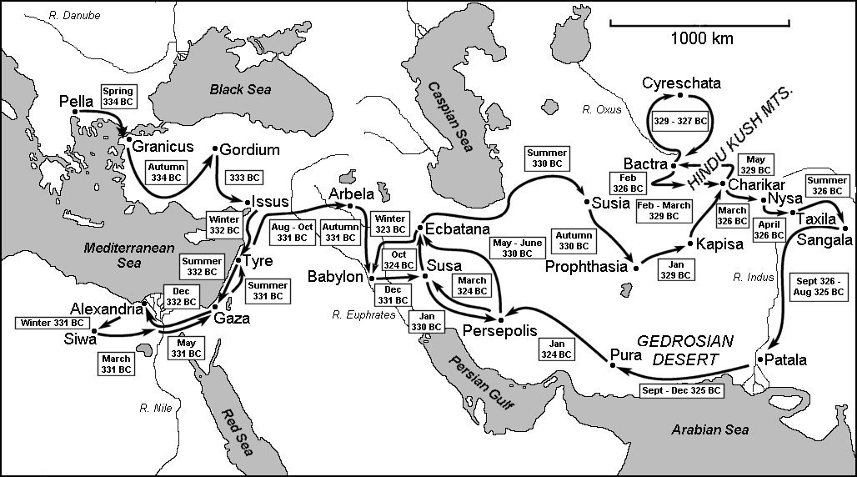

Slide 11
Fate of Asia Minor
Parmenio is to go accept the surrender of the cities of Ionia, Lydia, and Aeolis.
Oligarchies/Tyrannies are to be replaced with “democracies”
Local laws and customs to remain the same
Tribute to Persians to be removed
Cities to join the league and pay contributions to the campaign
Sacks Miletos after a siege
Disbands the Fleet: Greek Allies, Expensive, No Retreat/No Surrender

Slide 12
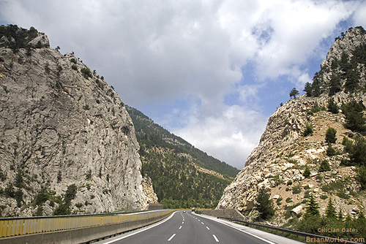
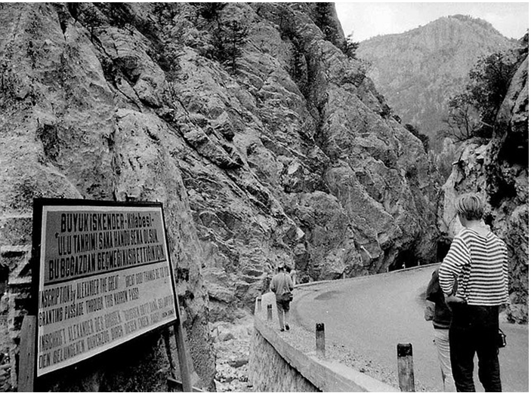
Darius v Alexander: Round 1
Darius gathers troops in Babylon
Alexander is in Cappadocia in August
Alexander must pass through the Cilician Gates
Before the highway, barely wide enough for 2 camels to pass each other

Slide 13
Cilician Gates
Arsames does not put all his forces across the gates
Leaves a small force and then devastates the land behind the gates
Wrong lessons learned from Granicus
Alexander marches through the gates largely unopposed

Slide 14
Battle of Issus
Darius takes a defensive position on the north bank of the Pinarus river
Alexander has to win: a draw is as good as a loss
Alexander marches the 12 miles to Issus

Slide 15
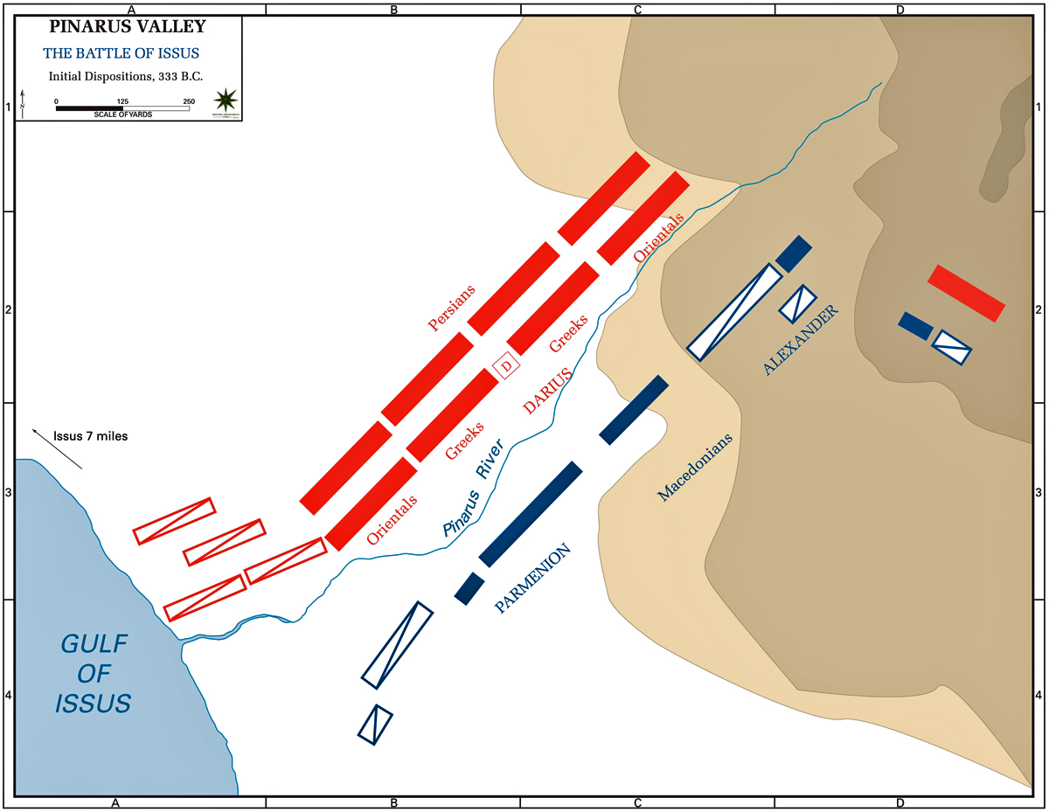

Slide 16
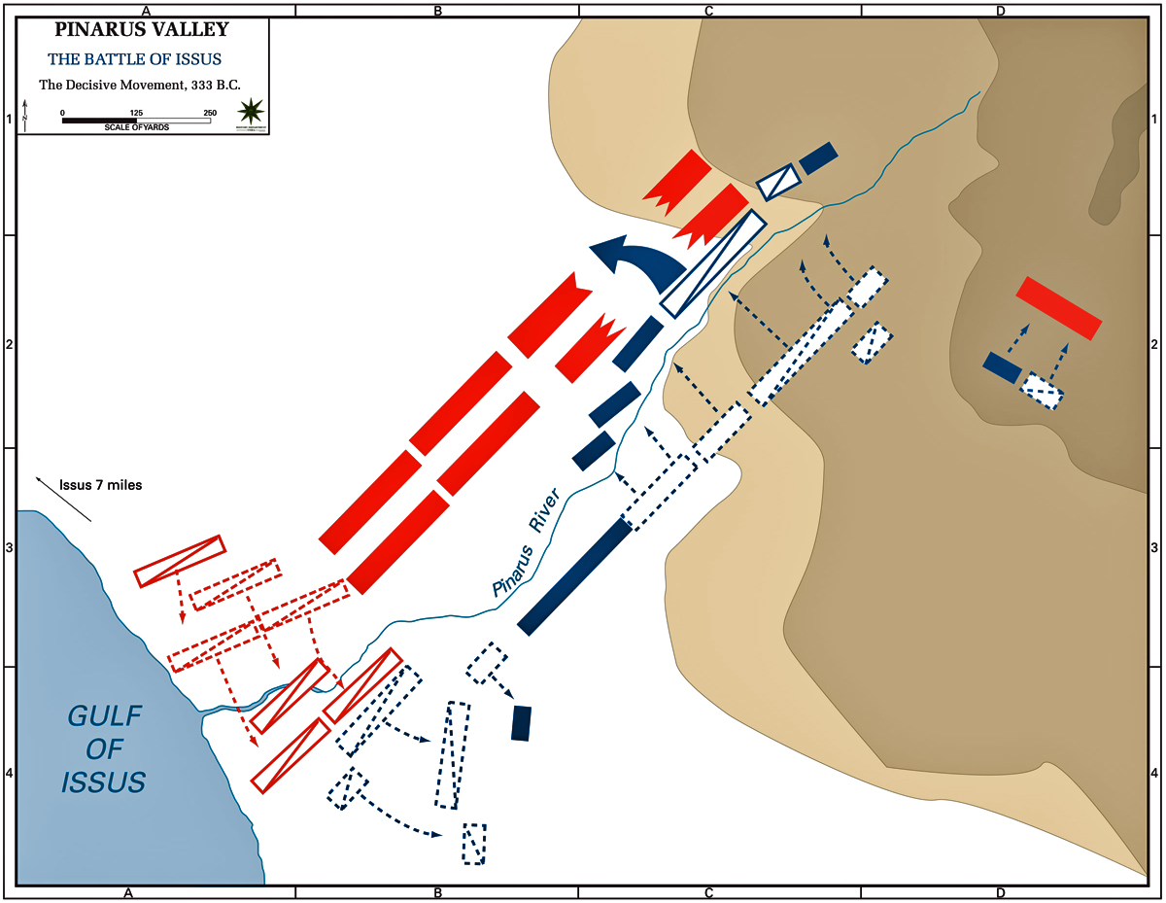

Slide 17
Darius escapes
Alexander breaks through arches on the right flank
Battle in centre goes well for Persians
Alexander goes towards Darius, who flees
Alexander turns to pursue, but receives message that the Phalanx needs help
Alexander turns his cavalry into the flank of the mercenaries
Chaos ensues

Slide 18
Darius’ plans
Control Aegean
Give money and ships to King Agis in Sparta
Retake the Hellespont
Support revolts in Cappadocia and Paphlagonia

Slide 19
Tyre
Asks Tyre to surrender
They kill his heralds
Alexander needs the city so that it can no longer be a base for the Persian fleet
Alexander decides to build a mole to attack the island

Slide 20
Alexander needs a fleet
Sidon
  10 triremes from Rhodes
  10 from Lycia
  3 from Soli
  80 from Sidon
  120 warships from the kings of Cyrpus
Alexander nearly catches the Tyrian fleet
Now can blockade Tyre
Can finish the mole protected
Tyrians devise increasing numbers of weapons against Alexander’s attacks

Slide 21
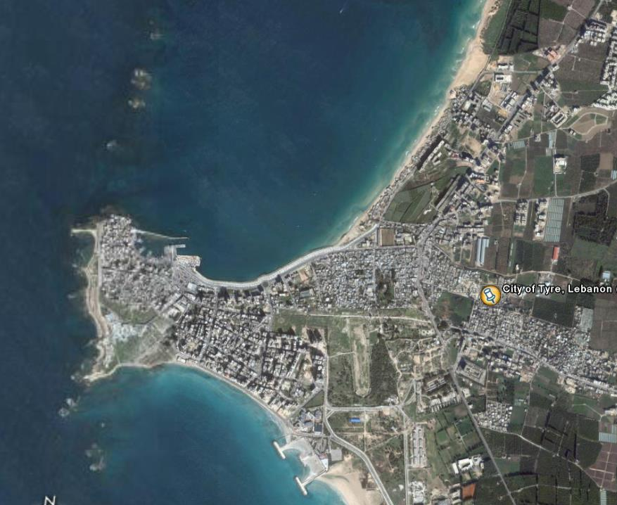
Tyre
City is eventually taken
Siege lasts over 6 months
Destructive violence once walls are breached
30,000 survivors sold into slavery
2,000 men of military age crucified

Slide 22
Darius’ Letter
10,000 talents for Darius’ family
All territory west of the Euphrates to the Aegean
Marriage to Darius’ daughter
“These proposals were made known at a meeting of Alexander’s personal advisers, and Parmenio, according to all reports, declared that were he Alexander he would be happy to end the war on such terms and be done with any further adventures. ‘That,’ replied Alexander, ‘is what I should do were I Parmenio; but since I am Alexander, I shall send Darius a different answer.’
Arrian 2.26

Slide 23
Surrender of Phoenicia
Every city south of Tyre to Egypt surrender
Except Gaza
Siege Gaza (2 months)
Slaughter defenders

Slide 24
Gaza to Egypt
Gaza to Pelusium in a week (130 miles)
Alexander greeted as liberator
Must not offend local religious sensibilities
Coronation in Memphis?
  Alexander romance
  Alexander connections with Nectanebo (last Pharaoh)
  Olympias and the snake
Restoration of Karnak and Luxor

Slide 25
Alexandria
While the king was enjoying the symmetry of the design, suddenly a huge flock of birds appeared from the river and the lagoon, descended upon the site and devoured every grain of the barley. Alexander was greatly disturbed by this omen, but the diviners urged him to take heart and interpreted the occurrence as a sign that the city would not only have abundant resources of its own but would be the nurse of men of innumerable nations, and so he ordered those in charge of the work to proceed while he himself set out to visit the temple of Ammon.
Plutarch Life of Alexander 26

Slide 26
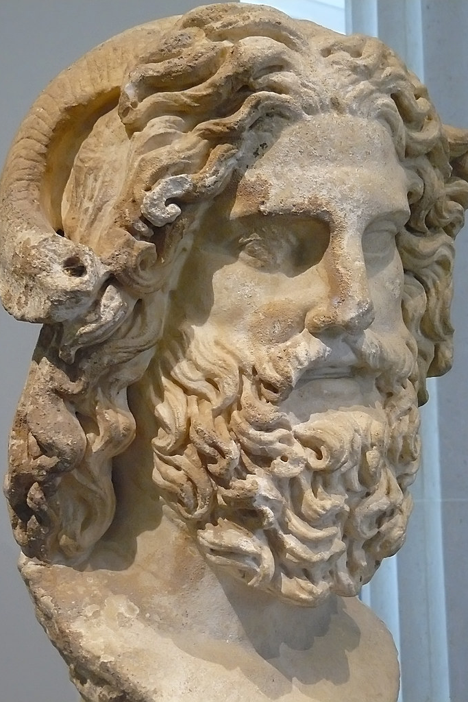
‘O paidion’ or ‘o pai Dios
Alexander’s first question was to ask whether any of his father’s murders had escaped punishment. At this the high priest commanded him to speak more guardedly, since his father was not a mortal. Alexander therefore changed the form of his question and asked whether the murderers of Philip had all been punished, and he added another inquiry concerning his own empire, and asked whether he was destined to rule over all mankind. This, the god replied, would be granted to him, and he also assured him that Philip’s death had been completely avenged, whereupon Alexander dedicated some magnificent offerings to the god and presented large sums of money to his priests.
Plutarch Life of Alexander 27
This Photo by Unknown Author is licensed under CC BY-SA-NC

Slide 28
The Road to Gaugamela
Back to Tyre
Heads towards Babylon
Darius plans for battle at Cunaxa
  Orders a scorched earth policy
Alexander does not follow the easiest route so as to avoid a battle there
4 possible crossings for Alexander, so Darius sends scouts to all of them

Slide 29
Darius picks a battlefield
Gaugamela: Darius clears the field of trees, rocks etc.
He does not occupy the hills three-miles to the NW
Alexander finds Darius, but first rests his troops
Darius attempts to bribe Alexander’s officers
Darius’ wife dies (in childbirth?)

Slide 30
Darius’ offer
Euphrates west
10,000 talents for the Persian prisoners
“Alexander told his companions of this offer, whereupon Parmenio said, ‘I would accept those terms if I were Alexander.’ ‘So would I, by Zeus,’ retorted Alexander, ‘if I were Parmenio!’
Plutarch Life of Alexander 29

Slide 31
Darius’ Army
Mostly armoured cavalry: 34,000 v 7,250
Chariots
Scythed chariots (Artaxerxes had used them at Cunaxa)
Alexander delays a day to scout the battlefield
“They therefore went to the king as soon as he had performed his sacrifice and tried to persuade him to attack by night, so as to conceal from his men the most terrifying element in the coming struggle, that is the odds against them. It was then that Alexander gave them his celebrated answer, ‘I will not steal my victory’.
Plutarch Life of Alexander 31

Slide 32
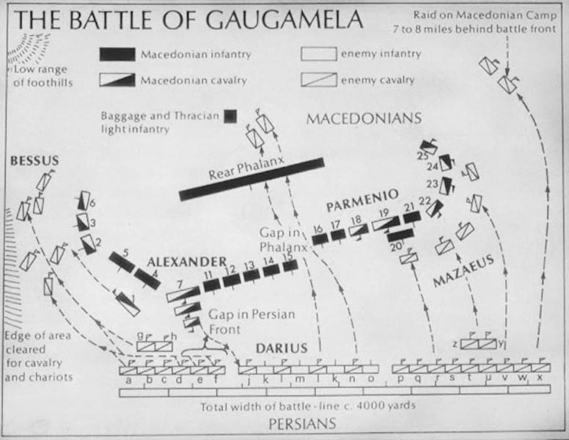
Notes:
Alexander was going to be outflanked, and knew it. There were no mountains to protect him as at Issus and no sea. Persian line overlapped his by nearly a mile. Special variations on his normal battle lines. Mercs on right wing, masked with cavalry. Both wings of the battle line go back at 45 degree angles, league infantry and rest of mercs in rear
This plan is essentially reused by Marlborough at Benheim and Napoleon at Austerlitz
Plan – draw cavalry to the flanks as much as possible. When flanks are fully committed, he strikes at the centre
All timing: Darius has to move first, Alexander has to strike at the right moment, he moves too quickly he is stopped, too slowly his wings collapse

Slide 33
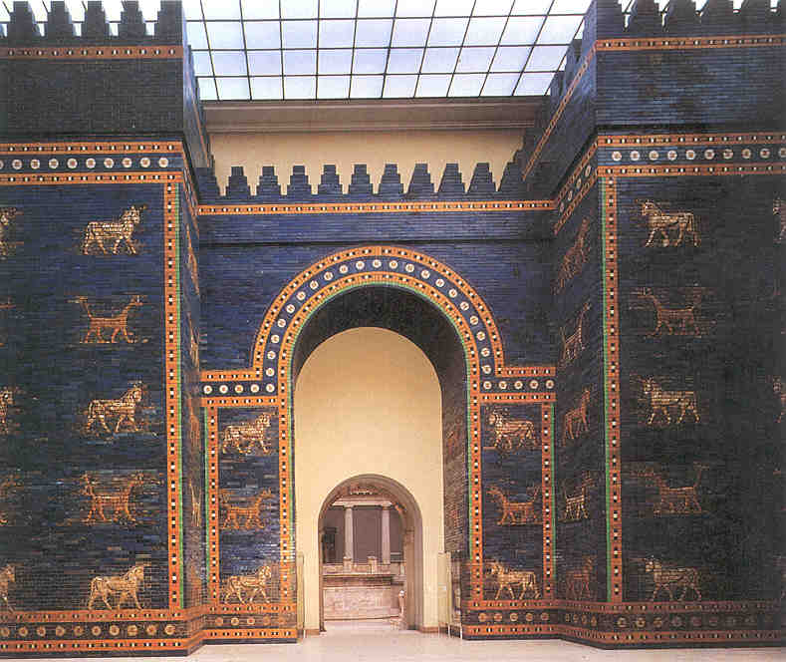
Aftermath
Alexander proclaims himself ‘Lord of Asia’
Conquest rather then even most tenuous liberation
Marches to Babylon which surrenders

Slide 34
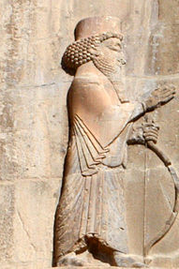
Persian opposition?
Problems of becoming the Great King
  Not Zoroastrian
  Not a member of the seven noble families
  Easy prey for pro-Persian propaganda
Kill Darius and marry into the royal family
This Photo by Unknown Author is licensed under CC BY-SA
Notes:
By the Sassanian period Alexander is presented as the destroyer of the faith, interestingly this helps him come to be presented as a follower of the faith in the Islamic forces that overthrew the Sassanians

Slide 35
MONEY!!!!
Susa
Persepolis
40-50,000 talents of gold of silver bullion
9,000 in coined money
‘Tyrannicide’ statue
Riches of other sorts
Spends winter in Susa
Treasury vaults: 120,000 talents
Bedchamber: 8,000 talents
= Thucydides has the income of the Athenian Empire at its height at 500 talents a year.
=The money Alexander has taken at Susa and Persepolis is roughly 300 years worth of the income of the Athenian Empire at its height.

Slide 36
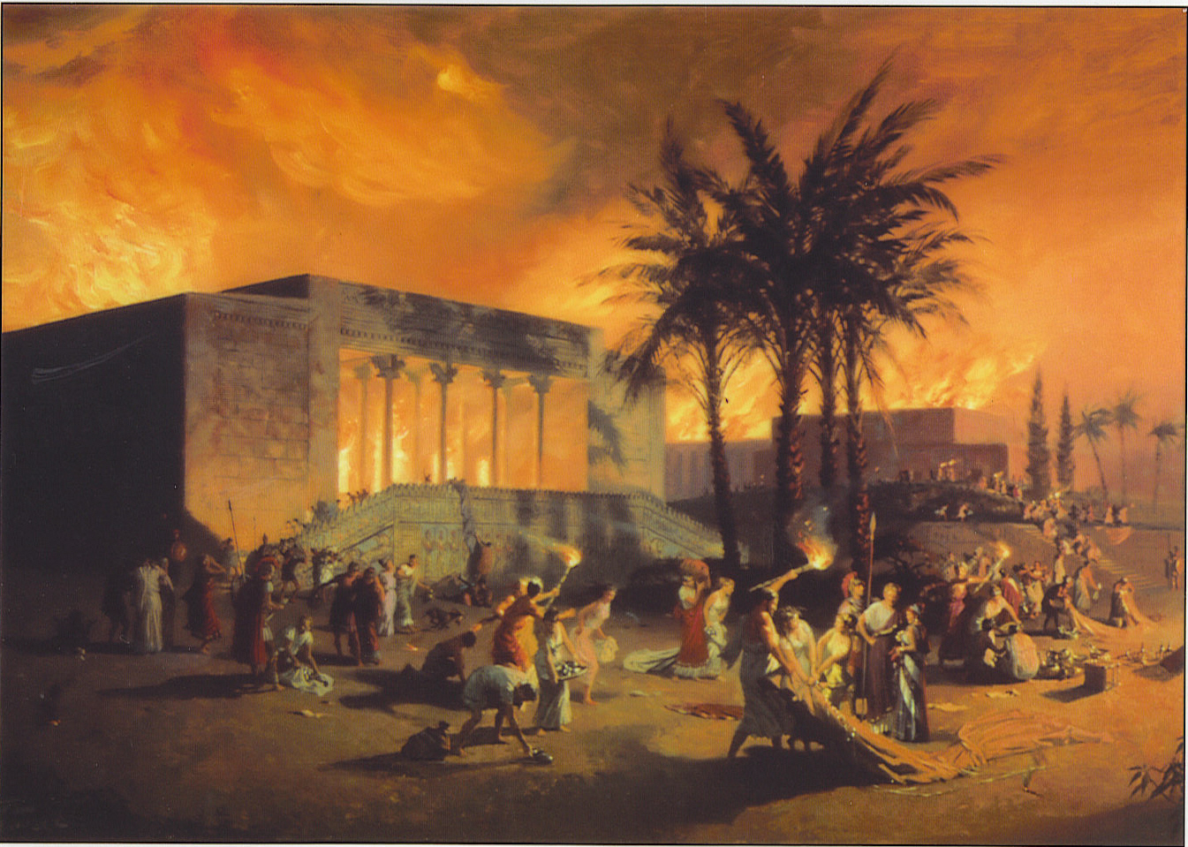
Burning of Persepolis
According to a number of historians it was in this way that the place was burned down, that is on impulse, but there are others who maintain that it was an act of deliberate policy.
Plutarch Alex. 38

Slide 37
A final battle with Darius?
After 4 months around Persepolis, Alexander begins to pursue Darius
Darius building an army?
Darius retreats towards Bactria
All league troops are released
  Cavalry get a bonus of 1 talent
  Infantry get 1,000 drachmas
  Anyone who re-enlisted gets 3 talents on enrolment

Slide 38
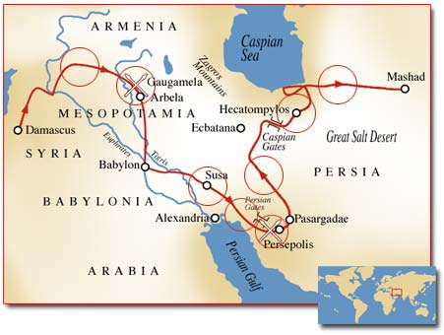
Chasing Darius
Darius retreats through the Caspian gates and heads towards Hecatomplylus
Alexander in pursuit, as he gets closer sped increases

Slide 39
Bessus, satrap of Bactria
Dispute in Persian camp, Darius resign and Bessus replace him?
Bactrians and East – Loyal to Bessus
Persians and Greek Mercenaries – Loyal to Darius

Slide 40
A new Great King?
Bessus deposes Darius and takes him captive
Persians and Greeks leave, but quickly come back
Bessus now Artaxerxes IV
Can Alexander reach the rebels and capture Darius?
Alexander appears to cover 50 miles in a day to catch the Persians

Slide 41
Death of Darius
In the historians, a Macedonian reaches Darius before he dies, but not Alexander
In the Alexander Romance, it is Alexander who catches Darius. Darius then offers Alexander his kingdom and his daughter in marriage

Slide 42
Hunting Bessus
Alexander must now act as Great King
Bessus hunted as a rebel, not as a successor to Darius
Mercenaries and Persians slowly desert Bessus
Alexander pursues him into Parthia
Parmenio’s son Nicanor gets sick and dies, Philotas is left behind to arrange funeral with instructions to catch up

Slide 43
Adoption of Persian Customs
Adoption of some Persian court traditions
Adoption of diadem (perhaps not actually Persian)
No adoption of trousers, but adoption of other Persian clothing
No pointed tiara
2 signet rings
  1 Macedonian
  1 Darius’

Slide 44
East is East and West is West and never the twain shall meet
Macedonians dislike the adoption of Persian customs
Dislike the allowance of Persians to the campaign
Alexander allows troops to marry

Slide 45
Into Legend
It was here that he was visited by the queen of the Amazons, according to the report we have from many writers…There is also a story that many years afterwards, when Lysimachus had become king of Macedonia, Onesicritus was reading aloud the fourth book of his history, which contained the tale of the Amazon, at which Lysimachus smiled and asked quietly, ‘I wonder where I was then.’
Plutarch Life of Alexander 46

Slide 46
The Eastern Campaign
Alexander goes through Arachosia, crosses the Hindu Kush
One of the satraps retained in place by Alexander, rebels and is killed
Alexander moves into Bactria

Slide 48
Spitamenes
Soghdian baron, supporter of Bessus, decides Bessus is no longer useful so arrests him and offers him to Alexander
Bessus is then bound and tied to a post, Alexander marches his troops past him, then has him sent to Zariaspa where his ears and nose are cut off, then public execution in Ecbatana before the Medes and the Persians

Slide 49
Soghdian War
Spitamenes traps the troops that Alexander had sent against him and slaughters them
Alexander moves quickly and drives off the siege at Maracanda, Spitamenes retreats to wage a guerrilla war
Alexander winters in Zariaspa

Slide 50
Death of Cleitus
Meanwhile as Cleitus still refused to give way, his friends with great difficulty pushed him out of the banqueting room. But soon afterwards he came in by another door, and, as he did so, recited in a loud and contemptuous voice this line from Euripides’ Andromache
Alas, what evil customs reign in Greece
At this Alexander seized a spear from one of his guards, faced Cleitus as he was drawing aside the curtain of the doorway, and ran him through. With a roar of pain and a groan, Cleitus fell, and immediately the king’s anger left him. When he came to himself and saw his friends standing around him speechless, he snatched the weapon out of the dead body and would have plunged it into his own throat if the guards had not forestalled him by seizing his hands and carrying him by force into his chamber.
Plutarch Life of Alexander 51

Slide 51
Death of Spitamenes
After 2 campaigning seasons, Alexander is finally able to deprive Spitamenes of supplies
Spitamenes allies with Massagetae, they give up and kill him (or according to Curtius his wife does)

Slide 52
Soghdian Rock
He had called on them to discuss terms, and offered to allow them to return unmolested to their homes on condition of surrendering the stronghold; but their answer to the offer was a shout of laughter. Then in their barbaric lingo they told Alexander to find soldiers with wings to capture the Rock for him, as no other sort of person could cause them the least anxiety. As a result of this Alexander proclaimed that he would give a price of twelve talents to the first man up, eleven to the second, and ten to the third, and so on to the twelfth, who would receive 300 gold darics.
Arrian Anabasis 4.19

Slide 53
Rhoxane
Alexander marries the daughter of Oxyartes
Move to consolidate the alliances of the Bactrian barons?
Merger of East and West

Slide 54
Proskynesis
Chares of Mitylene says that on one occasion at a banquet Alexander, after he had drunk, passed the cup to one of is friends, who took it and rose so as to face the shrine of the household; next he drank in his turn, then performed proskynesis toward Alexander, kissed him and resumed his place on the couch. All the guests did the same in succession, until the cup came to Callisthenes. The king was talking to Hephaestion and paying no attention to Callisthenes, and the philosopher, after he had drunk, came forward to kiss him. At this Demetrius, whose surname was Pheido, called out, ‘Sire do not kiss him; he is the only one who has not made obeisance to you.’ Alexander therefore refused to kiss him, and Callisthenes exclaimed in a loud voice, ‘Very well then, I shall go away the poorer by a kiss.’
Plutarch Life of Alexander 54

Slide 55
Into India
Very bad historical information available to Alexander
Only Dionysus and Heracles had had some success in conquering India
Alexander hopes to rival both

Slide 56
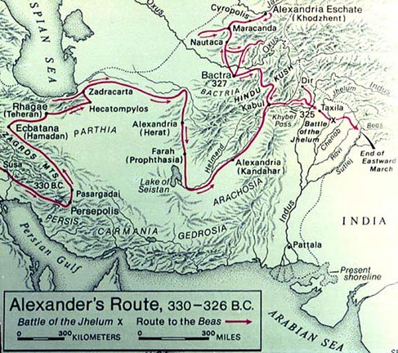

Slide 57
Violent Resistance
Most towns offer violent resistance rather than surrender:
Now the best fighters among the Indians were mercenaries…So he concluded a truce with them when they were in one city, allowed them to leave, and then attacked them on the march and annihilated them. This action remains a blot on his career as a soldier: on all other occasions he observed the normal usages of war and behaved like a king.
Plutarch Life of Alexander 59

Slide 58
Equal to the gods?
Surrender of Nysa
  Association with Dionysus
  People who make wine (rare in the region)
  Sacrifice goats for religious purposes
Rock of Aornus
  “not captured” by Heracles
  Alexander captures it

Slide 59
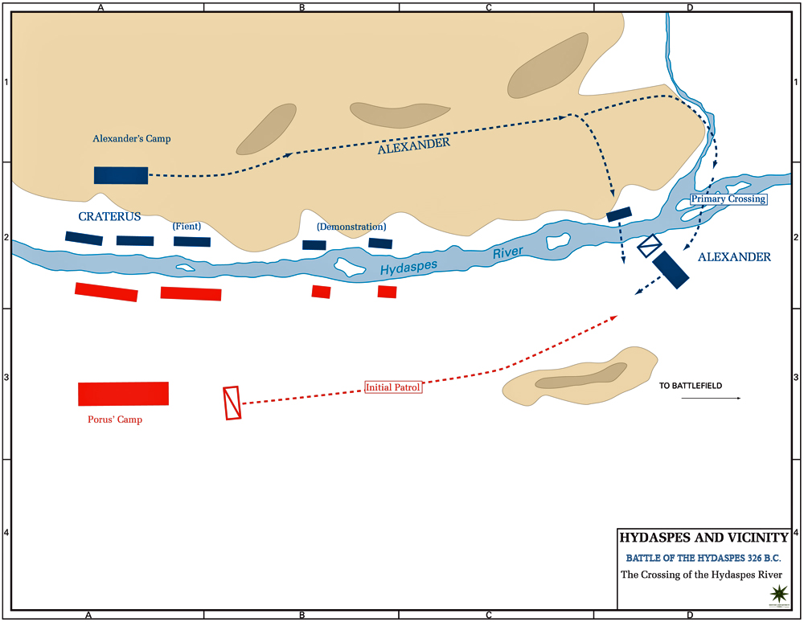
Notes:
Battle at the Hydaspes River
Porus uses elephants to disrupt Alexander’s lines
Elephants are extremely useful against horses
Alexander hides his intentions on how to cross the river
Alexander moves his troops constantly, particularly at night
Porus stops following his every movement
Attack must be a surprise
Prepare a feint in the centre
Main force goes upstream to a crossing
Everything almost goes wrong as they disembark on a jetty not on the bank

Slide 60
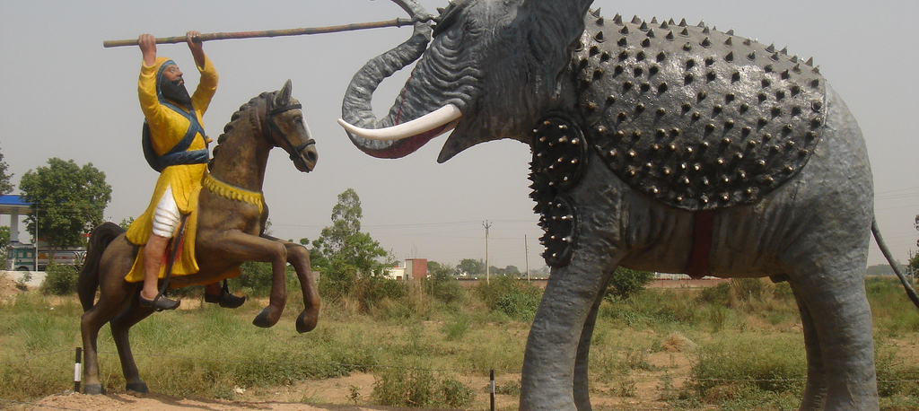
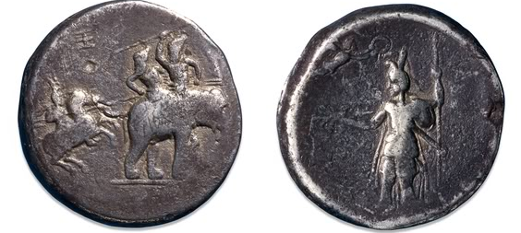
Battle with Porus
This Photo by Unknown Author is licensed under CC BY-SA

Slide 61
When two strong men stand face to face tho’ they come from the ends of the earth
Alexander, informed of his approach, rode out to meet him, accompanied by a small party of his Companions. When they met, he reined in his horse, and looked at his adversary with admiration: he was a magnificent figure of a man, over seven feet high and of great personal beauty; his bearing had lost none of its pride; his air was one of a brave man meeting another, of a king in the presence of a king, with whom he had fought honourably for his kingdom.
Alexander was the first to speak, ‘What,’ he said, ‘do you wish that I should do with you?’
‘Treat me as a king ought,’ Porus is said to have replied.
‘For my part,’ said Alexander, pleased by his answer, your request shall be granted. But is there not something you should wish for yourself? Ask it.’
‘Everything,’ said Porus, ‘is contained in this one request.’
Arrian Anabasis 5.19

Slide 62
The end of the adventure
All this he accounted adverse to his project, and he saw only one hope of gaining his wish, if he might gain the soldiers' great goodwill through gratitude. Accordingly, he allowed them to ravage the enemy's country, which was full of every good thing. During these days when the army was busy foraging, he called together the wives of the soldiers and their children; to the wives he undertook to give a monthly ration, to the children he distributed a service bonus in proportion to the military records of their fathers. When the soldiers returned laden with wealth from their expedition, he brought them together to a meeting. He delivered a carefully prepared speech about the expedition against the Gandaridae but the Macedonians did not accept it, and he gave up the undertaking.
Diodorus 17.94

Slide 63
The long road home
Craterus has been building a fleet, it is now ready, Nearchus commands the fleet
Alexander starts to make his way to the Indian ocean
3 columns move south, under the commands of Craterus, Hephaestion and Philip

Slide 64
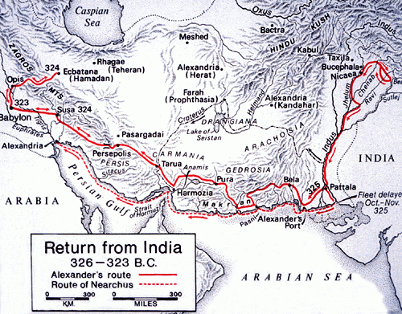

Slide 65
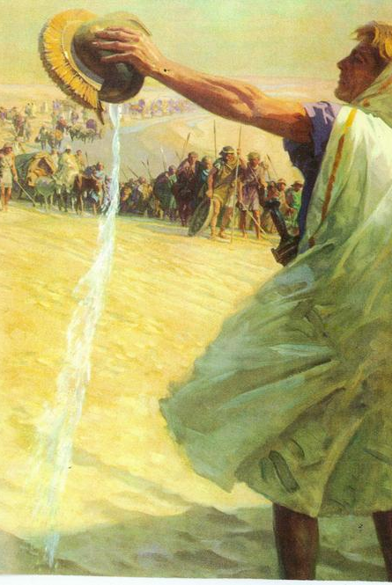
Leadership?
It was all he could do to keep going, but he did so, and the result (as always) was that the men were the better able to endure their misery when they saw that it was equally shared. As they toiled on, a party of light infantry which had gone off looking for water found some – just a wretched little trickle collected in a shallow gully. They scooped up with difficulty what they could and hurried back, with their priceless treasure, to Alexander; then, just before they reached him, they tipped the water into a helmet and gave it to him. Alexander, with a word of thanks for the gift, took the helmet and, in full view of his troops, poured the water on the ground. So extraordinary was the effect of this action that the water wasted by Alexander was as good as a drink for every man in the army. I cannot praise this act too highly; it was proof, if anything was, not only of his power of endurance, but also of his genius for leadership.
Arrian Anabasis 6.26
This Photo by Unknown Author is licensed under CC BY-NC-ND

Slide 66
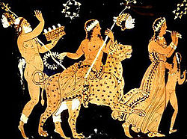
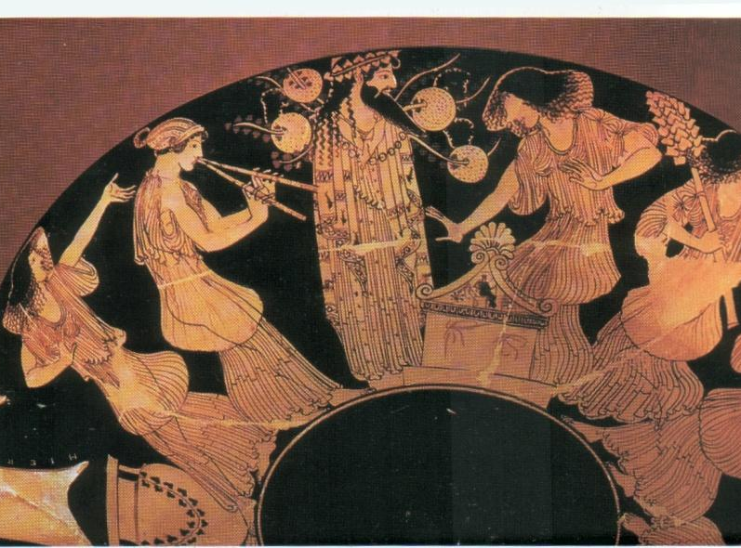
Dionysiac Procession?
According to Plutarch, having made it out of the desert and receiving supplies he leads his men on a seven day Dionysiac procession.
Plutarch Life of Alexander 67
This Photo by Unknown Author is licensed under CC BY-SA
This Photo by Unknown Author is licensed under CC BY-NC-ND

Slide 67
Unity of Mankind?
Re-organisation of the army
  Companion cavalry reduced from 8 to 4 (plus a new one)
  Iranians fully integrated
  30,000 Persian youths who Alexander sent to receive Macedonian training now return
  ‘All this was a cause of deep resentment to the Macedonians, who could not but feel that Alexander’s whole outlook was becoming tainted with orientalism, and that he no longer cared for his own people or his native ways.’
  Arrian 7.6.5

Slide 68
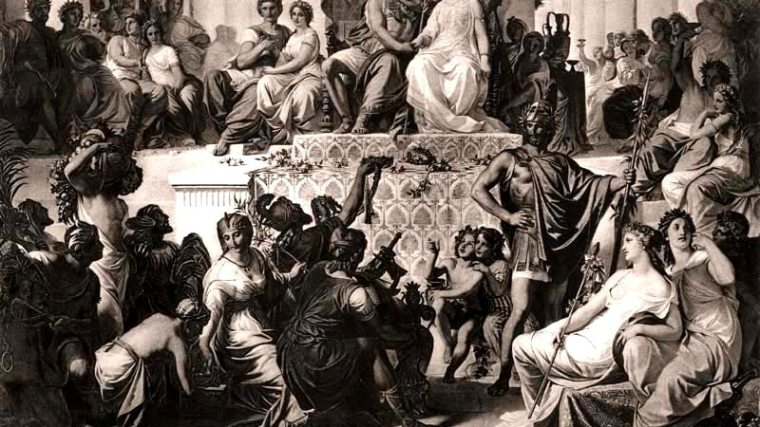
Mass Weddings at Susa
Here at Susa he held wedding ceremonies for his Companions; he also took a wife himself – Barsine (Stateira), Darius’ eldest daughter, and according to Aristobulus, another as well, namely Parysatis, the youngest daughter of Ochus. He had already married Roxane, daughter of Oxyartes of Bactria. To Hephaestion he gave Drypetis, another of Darius’ daughters and sister of his own wife Barsine, as he wanted to be uncle to Hephaestion’s children; to Craterus he gave Amastrine, daughter of Darius’ brother Oxyatres, and to Perdiccas a daughter of Atropates, governor of Media. The bride of Ptolemy (of the Guard) was Artacama, daughter of Artabazus, and Eumenes, the King’s secretary, had her sister Artonis; Nearchus was given the daughter of Barsine and Mentor, Seleucus the daughter of Spitamenes of Bactria [Apame]. Similarly, the other officers – to a number of eighty all told – were given as brides young women of the noblest Persian and Median blood. The marriage ceremonies were in Persian fashion… There proved to be over 10,00 other Macedonians who had married Asian women; Alexander had them all registered, and every man of them received a wedding gift.
Arrian Anabasis 7.5
This Photo by Unknown Author is licensed under CC BY-SA

Slide 69
Mutiny at Opis
Alexander assembles his Macedonian troops and announced the imminent demobilization of:
‘all men unfit through age or disablement for further service.’
  Arrian Anabasis 7.8.1
Near riot
Alexander recalls the work of his father and everything that they had done.

Slide 70
Alexander’s response
‘You all wish to leave me. Go then! And when you reach home, tell them that Alexander your king, who vanquished Persians and Medes… tell them, I say, that you deserted him and left him to the mercy of barbarian men, whom you yourselves had conquered. Such news will indeed assure you praise upon earth and reward in heaven. Out of my sight!’
Arrian Anabasis 7.11

Slide 71
A new army?
Alexander hides in his tent for 2 days
3rd day, invites the Persians to him and divides the commands amongst them
Soldiers see this and beg Alexander for forgiveness and to be taken back into service
Alexander takes them back

Slide 72
Disbanding the army
Alexander then demobilises those too old or disabled
11,000 veterans discharged
Active pay until they get home
1 talent bonus
All native wives and concubines and children to be left behind
Alexander wants a new mixed race of children who will be trained as soldiers, loyal only to him
Craterus is to lead this group back to Greece and:
‘to assume control of Macedonia, Thrace and Thessaly, and assure the freedom of Greece’ - Arrian 7.12.4

Slide 73
Antipater’s Response
Sends Cassander to Alexander
Does Cassander make a deal with Craterus?
Remove Alexander?

Slide 74
Death of Hephaestion
Alexander moves from Opis to Ecbatana
Giant festival to Dionysus
Hephaestion gets very drunk and falls ill
Follows doctor’s advice of a strict plain diet and starts to get better
Eats a whole chicken and a half gallon of wine
He gets really sick and then dies

Slide 75
Alexander’s Grief
Then there is the story – to me quite incredible – that he personally drove for a short distance the funeral carriage with Hephaestion’s body in it; and, again, that he ordered the shrine of Asclepius in Ecbatana to be razed to the ground…. Most authorities have said that he ordered sacrifice to be always offered to Hephaestion as a demi-god, and some declare that he sent to inquire of Ammon if he would permit sacrifice to be offered to him as a god; but Ammon refused.
Arrian Anabasis 7.14

Slide 76
Alexander’s final campaign
Brief campaign against the Coassaeans, a mountain tribe near Ecbatana.
Persian kings had paid them tribute for safe passage
Alexander eliminates them in 5 weeks
Alexander marches to Babylon

Slide 77
Alexander in Babylon
Alexander warned by the Chaldaean priests not to enter Babylon
Alexander camps outside the city
Alexander meets delegates from all over
Plans campaign against Arabia
Preparation for Hephaestion’s funeral
Brief entrance to Babylon, loses diadem either a sailor or Seleucus retrieves it and places it on his head

Slide 78
Final Banquet
Banquet for Nearchus
Alexander wishes to go home (unusual)
Alexander goes to the party of Medius (a Thessalian)
Alexander drinks more and gets carried home
High-fever, next day goes drinking (May 31st)
June 6th clearly ill

Slide 79
June 7th
The Macedonians now believed that he was dead: they thronged the doors of the palace and began to shout and threaten the Companions, who were at last obliged to let them in. When the doors had been thrown open they all filed slowly past his bedside one by one, wearing neither cloak nor armour.
In the course of this day too Python and Seleucus were sent to the temple of Serapis to ask whether Alexander should be moved there, and the god replied that they should leave him where he was.
Plutarch Life of Alexander 76

Slide 80
Poison?
They say that Antipater, who had been left by Alexander as viceroy in Europe, was at variance with the king's mother Olympias. At first he did not take her seriously because Alexander did not heed her complaints against him, but later, as their enmity kept growing and the king showed an anxiety to gratify his mother in everything out of piety, Antipater gave many indications of his disaffection. This was bad enough, but the murder of Parmenion and Philotas struck terror into Antipater as into all of Alexander's Friends, so by the hand of his own son, who was the king's wine-pourer, he administered poison to the king.
Diodorus 17.118.1

Slide 81
June 10th 323 BC: To the strongest
When he, at length, despaired of life, he took off his ring and handed it to Perdiccas. His Friends asked: "To whom do you leave the kingdom?" and he replied: "To the strongest." He added, and these were his last words, that all of his leading Friends would stage a vast contest in honour of his funeral. This was how he died after a reign of twelve years and seven months.
Diodorus 17.117.3-5

