Slide 1
Resilience

Slide 2
Beliefs about resilience
What do you believe about resilience?
Can you share one example from your own experience where you have shown resilience?
How important is resilience as a human capacity?
Do we all possess the same amount of resilience?
What factors make some more resilient than others?

Slide 3
Resilience
According to James and James (2012) resilience is an unevenly distributed variable of behaviour and emotional functioning that enables children and young people (and adults) differentially to cope with, and adapt positively to, adverse circumstances and experiences, thereby enhancing to various degrees their negative effects and enabling positive adjustments to be made, even in conditions of risk.
Resilience refers to a capacity to do well despite adverse experiences (Gilligan 2000, p. 37).

Slide 4
Resilience
As a concept applied to children and young people, resilience has perhaps emerged from, and been most prominent in, discourses about child abuse and protection.
It has become more important in the context of childhood/youth studies, however, because of the opportunity it offers to focus on children’s agency, their adaptive and coping abilities and their competence, in contrast to dominant adult discourses that tend to focus on their vulnerability and need for protection.

Slide 5
Affected by both personality and environmental factors, resilience should be considered as a process or a phenomenon rather that as a personality characteristic of an individual.
Resilience is associated with having a good sense of self-efficacy, and self esteem and ego strength, giving the ability to make choices and exercise degree of control.
The attributes of each child in terms of intelligence, temperament and coping skills are also important.

Slide 6
However, such characteristics are a product not only of the wider environment in which the child/young person is raised and the experiences to which they are exposed, including the impact of factors such as poverty.
They are also associated with the formation of secure emotional attachments in early life (particularly with mothers), with positive family functioning, and with having and using social support when needed.
Thus, important risk modifiers are the attributes of an individual child, the influence of their family, and the social and community context in which they live.

Slide 7
Some references on Resilience..
Many studies on human resilience have focused on how contextual factors may act as buffers against stressful life events and adversity (Cicchetti et al. 1993; Cowen et al. 1994; Hurd and Zimmerman 2010; Luthar 1991). However, it has also long been assumed that there must be a genetic component in human resilience against stress and adversity (Rutter 2003). Moderate to strong genetic effects have been reported in twin studies for several normal personality traits and competencies (Ganiban et al. 2008; Kandler et al. 2009; Koenig et al. 2008; Nes et al. 2006; Raevuori et al. 2007; Vernon et al. 2009) as well as in exceptional talents (Haworth et al. 2010; Vinkhuyzen et al. 2009).

Slide 8
Resilience and Youth and Community Work
See this article from Youth and Policy Journal
https://www.youthandpolicy.org/articles/re-membering-resilience/
The link between resistance and resilience is one which I think is a good starting point for reclaiming the term from the neo-liberals who see it as an underpinning theory for the ‘stoic’ acceptance of austerity and disadvantage. My enthusiasm for the concept remains, and in spite of calls to ‘resist’ resilience (Neocleous, 2013), or arguments that ‘resilience is futile’ (Diprose, 2014), I hold on to my initial excitement about this term and its possibilities in relation to Youth Work.
What do you think ab out the concept of resilience and young people?

Slide 9
Joseph Rowntree Foundation
Parenting and resilience report
https://www.jrf.org.uk/sites/default/files/jrf/migrated/files/parenting-resilience-children.pdf

Slide 10
Examples of risk and protective factors
Risk | Protective
Childhood factors Birth injury/disability/low birth weight Insecure attachment Poor social skills | Childhood factors Social skills Attachment to family School achievement
Family Factors Poor parental supervision and discipline Parental substance abuse Family conflict and domestic violence Social isolation/lack of support networks | Family Factors Supportive caring parents Parental employment Access to support networks

Slide 11
Examples of risk and protective factors
Risk | Protective
School factors School failure Negative peer group influences Bullying Poor attachment to school and recognition of achievement | School factors Positive school climate Sense of belonging/bonding Opportunities fro some success at school
Community factors Neighbourhood violence and crime Lack of support services Social or cultural discrimination | Community factors Access to support services Community networking Participation in community groups

Slide 12
Risk and protective factors
The influence of any of these factors on outcomes is very complex.
It may be that some risk factors are more important than others and the same reasoning for protective factors.
The research on these issues is still struggling with refining the analysis to the extent that the key factors are isolated, but it is not there as yet.
Another complication is that experiences will differ and the impact of risk or protective factors will be dependent on the individual and mediated by the impact of socio-economic background, their gender and /or ethnicity and their abilities or disabilities.

Slide 13
A key research finding from British studies (Rutter et al., 1998) is that young people from very disadvantaged backgrounds can develop resilience through forming a close relationship with a supportive adult, through a positive school experience or being given an opportunity to find a ‘turning-point’ or (importantly from the perspective (of youth work) through an opportunity to have some autonomy and control when participating in activities.

Slide 14
Developing Resilience
The characteristics of resilience listed below can be used as a useful guide:
Good health Hope
Easy-going temperament Social support
Sociability Problem-solving ability
Self-efficacy Internal locus of control
Confidence Appraisal skill
Flexibility in goal setting Optimism
Ability to mobilise resources.

Slide 15
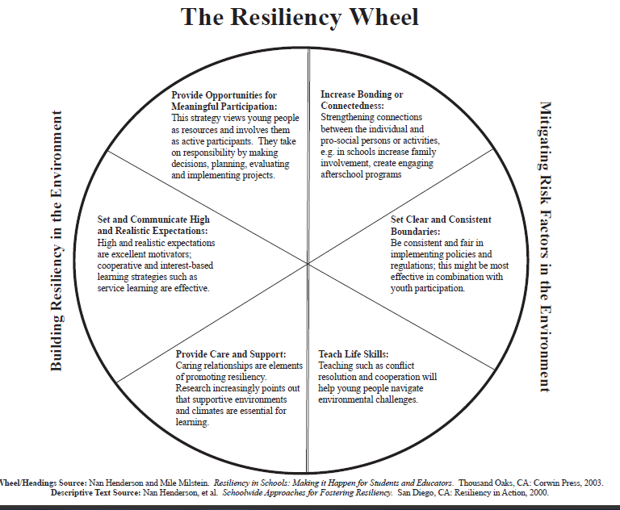

Slide 16
Reference List
James, A.L and James, A. (2008) Changing childhood in the UK: reconstructing discourses of risk and protection, in A James and A.L. James (eds), European Childhoods: Cultures, Politics and Childhoods in Europe. Basingstoke: Palgrave Macmillan.
Thompsen, K (2002) Building Resilient Students California: Corwin Press

