Slide 1

EMPL4012
Researching and analysing Data

Slide 2
Content
Summary of key components module
Harvard referencing
Learning outcomes

Slide 3
Summary of Module
What have we learned about Data Handling
We have examined how initial ‘raw data’ (letters and numbers with no specific meaning) are transformed into Information
We have learned how possession of certain Information can bring us Knowledge - and ultimately - Wisdom
We know we can act upon that Knowledge to effect change if we so wish

Slide 4
We have explored several methods of collecting Data using both primary and secondary sources
We have learned about Inferential and Descriptive Statistics and have a basic understanding of Central Tendency (Mean, Median and Mode) and Dispersion (Standard Deviation and Variance)
We know how to use these statistics to produce graphs and charts to illustrate our data meaningfully

Slide 5
Summary of Module
We know how to interrogate the Data in an article or report to extract only the Information relevant to our enquiry from the article - We can be Discerning
We know how and where to seek out statistical or graphical evidence which will back up our claims - or refute them - depending on the point of view of the question
We can now draw all of these strands together to produce a report arguing both sides of a question and provide evidence for each point of view.

Slide 6

Referencing Your Work

Slide 7
What is a reference?
Why reference?
When to reference
How to reference
    Within your assignment
    At the end of your assignment

Slide 8



Referencing in Context
Assignment
Evidence to support your ideas or argument
Acknowledge sources used
Briefly, in your text
In full, at the end
Read and Take Notes
Paraphrase
Direct
quote

Slide 9
What is a Reference?
An acknowledgement that you have referred to (cited) information from published sources in your own work.
In other words, a recognition that you have borrowed other people’s work, ideas or opinions.

Slide 10
Why Reference?
Shows off your research!
Published evidence to support your own ideas/argument/point of view or give examples
Plagiarism - using other people’s work and ideas as your own without acknowledgement
Copyright
Helps others to trace your information sources
Part of the marking scheme

Slide 11
When to Reference
A particular theory, argument or viewpoint
Statistics, examples, case studies
“Direct quotations” - writer’s exact words. Use sparingly!
Paraphrasing

Slide 12
How to Reference
There are various systems for referencing
Harvard system (Author/Date) is the most popular and recommended at the University
You need to reference in two places:
    Brief details only, within the main body of your assignment
    Full details, in the reference list at the end of your assignment

Slide 13
How to Reference:
Direct Quotations
AUTHOR, DATE, PAGE NUMBER(S)
As Brown (2002, p.136) states, “The critical breakthrough was achieved by Thomas Hunt Morgan.”
According to Brown (2002, p.136), “The critical breakthrough was achieved by Thomas Hunt Morgan”
Thomas Hunt Morgan has recently been described as achieving “the critical breakthrough” (Brown, 2002, p.136)
Larger quotes (3 lines +): Start quote on new line and indent.

Slide 14
Useful verbs and phrases for introducing direct quotes
As X states/ believes/ suggests /indicates/ points out / observes/ explains/ argues/ outlines/ contradicts / proposes, “…….”.
For example, X has argued that “……”.
According to X, “…….”.
X suggests/ believes/ observes that “…..”.

Slide 15
How to reference paraphrases
AUTHOR, DATE
Thomas Hunt Morgan made the connection between partial linkage and the behaviour of chromosomes when the nucleus of a cell divides. This breakthrough was proved to be critical (Brown, 2002).

Slide 16
Referencing at the end of your assignment
References or Bibliography – what’s the difference?
Reference list – a single alphabetical list by author of everything you have specifically mentioned in your assignment. (Requirement for all University assignments)
Bibliography – a list of sources you have read but not specifically mentioned in your assignment.(Not required)

Slide 17
What information do I need to include to reference a book?
Name(s) of the Author(s)/Editor(s)
Date published
Full title
Edition (if applicable)
Where it was published (Town or City)
Who published it

Slide 18
Referencing books
Using the title page (not the front cover) note the:
Author(s) R.R. Jordan
Title Academic Writing Course
Year of Publication © 1999
Edition (if not the first) 3rd edition
Place of publication Harlow
Publisher Pearson Education Limited
Jordan, R. R. (1999) Academic Writing Course. 3rd ed. Harlow: Pearson Education Limited.

Slide 19
Book Reference Example
Authors
Year of Publication
Title
Edition
Place of publication
Publisher
Christensen, P. and James, A. (Eds) (2008) Research with Children: Perspectives and Practices. 2nd Edition. London: Falmer Press
Comma
Full stop
Brackets
Underline
Full stop
Colon

Slide 20
Referencing 2 Authors
In the assignment:
  Both authors’ surnames and date.
  Doherty and Horne (2002)
In the reference list:
  Doherty, T.L. and Horne, T. (2002) Managing Public Services. London: Routledge

Slide 21
Referencing More Than 2 Authors
In the assignment:
The first time used all authors’ surnames and date.
  Cohen, Manion, and Morrison (2007)
Afterwards, if used again:
  1st author’s surname followed by et al and date.
  Cohen et al (2007)
In the reference list:
  List all authors in order as listed on the source material
  Cohen, L., Manion, L. & Morrison, K. (2007) Research Methods in Education. 6th Edition. London: Routledge

Slide 22
Referencing Journal/Magazine Articles
Author J Mercer
Year of publication 2004
Title of article Making the news
Title of journal Media History
Volume number (if present) 10
Part/issue number (if present) 3
Page number(s) 187-199
Mercer, J. (2004) Making the news. Media History. 10 (3): pp187-199.

Slide 23
Journal Referencing Example
Author
Date
Article Title
Journal Title
Vol
Issue
Pages
Mercer, J. (2004) Making the news. Media History. 10 (3): pp187-199.
Comma
Full Stop
Brackets
Underline
Brackets
Colon

Slide 24
Referencing a Web Site
Author/editor/organisation
Year written (or last updated)
Title of page accessed
URL (web page address)
Date you accessed it
Avoid unreliable, untrustworthy sources
For future reference, print and keep a copy of the web pages used

Slide 25
Examples of web sources to avoid
pschycology.about.com
simplypschycology.org
www.ehow.com
Wikipedia

Slide 26
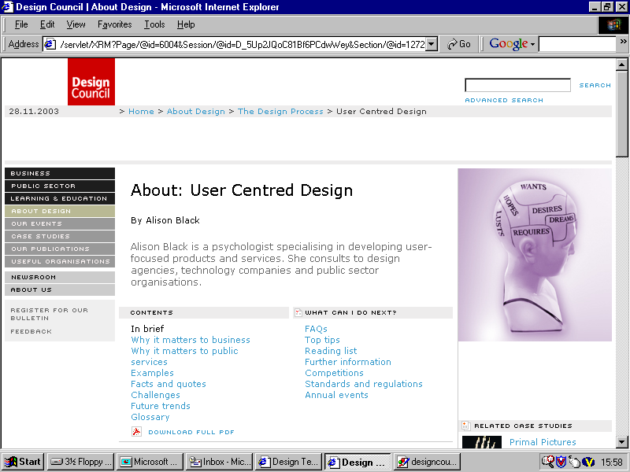
URL
Date Accessed
Title
Author
Black, A. (2003) About: user-centred design [online] Available at: <http://www.designcouncil.org.uk/webdav/ servlet/ XRM?Page /@id=6004&Session/@id=D_5Up2J QoC81Bf6PCdwWey&Section/@id=1272> [Accessed 28th November 2003]

Slide 27
Web Referencing Example
Author
Available at
Year of Publication
Full Web Address (url)
Title of Page Accessed
Online
Date Accessed
Department of Health (2002) A health service of all the talents: developing the NHS Workforce. Consultation document on the Review of Workforce Planning [online] Available at http://www.doh.gov.uk/pdfs/workforce.pdf (accessed 17 July 2002)
Square brackets
Brackets
Format as it appears on Web page
Brackets
Underline
In the assignment reference to Department of Health (DoH) (2002) or www.doh.gov.uk – Web address can only be used at the end of a sentence.
In the reference list include the name of the organisation at the beginning of the reference not the web address.

Slide 28
More Examples
Clean Water Network (no date) Water quality standards. [online] Available at: http://www.cwn.org/cwn/issues/waterquality/index.cfm [Accessed 4th April 2005]
McKendrick, M. (2003) ‘Infectious diseases and the returning traveler – experience from a regional infectious diseases unit over 20 years’ Journal of Applied Microbiology. 94: pp25S-30S
Thompson, N. (1998) Promoting Equality: Challenging discrimination and oppression in the human services. Basingstoke: Palgrave
EuroParl (2005) Welcome to the European Parliament. [online] Available at: http://www.europarl.eu.int/presentation/default_en.htm [Accessed 3rd March 2005]

Slide 29
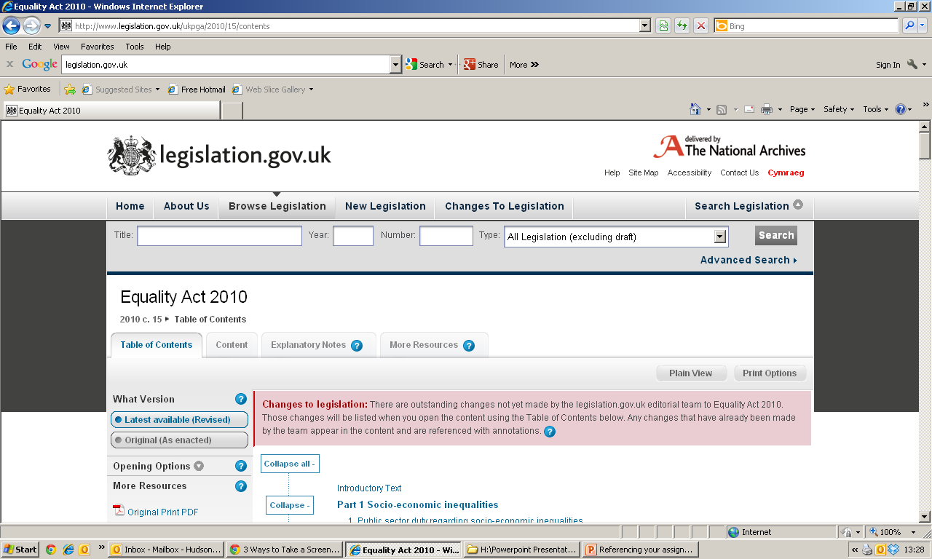
Exceptions to the Rule
The National Archive, (2010) Equality Act 2010. [Online] Available at: http://www.legislation.gov.uk/ukpga/2010/15/contents [Accessed 27th August 2014]

Slide 30
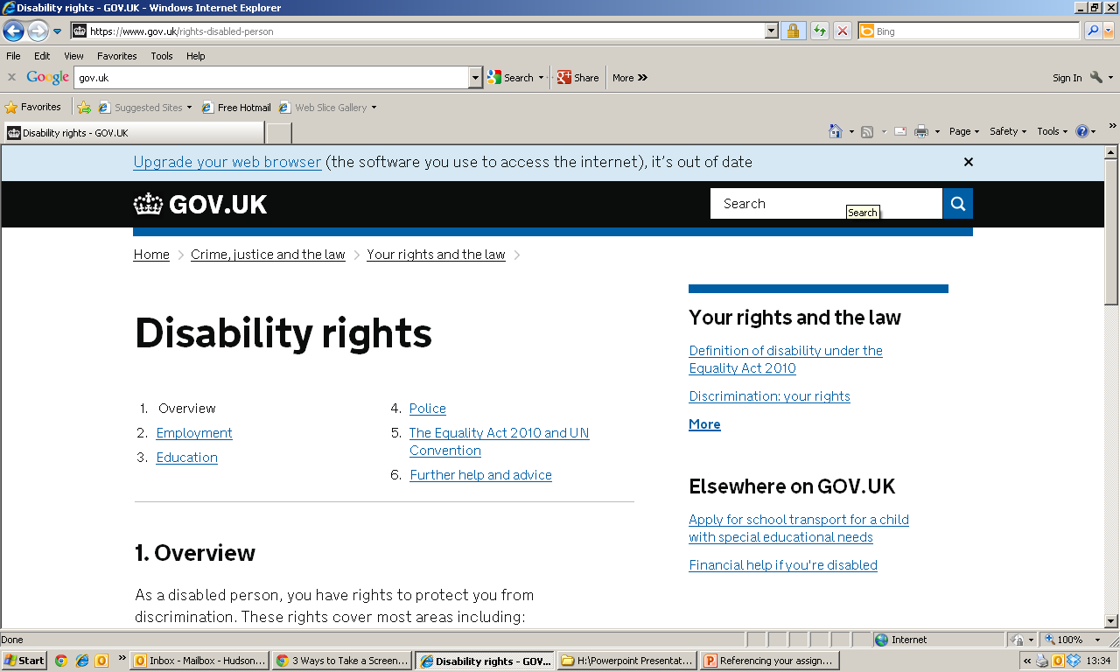
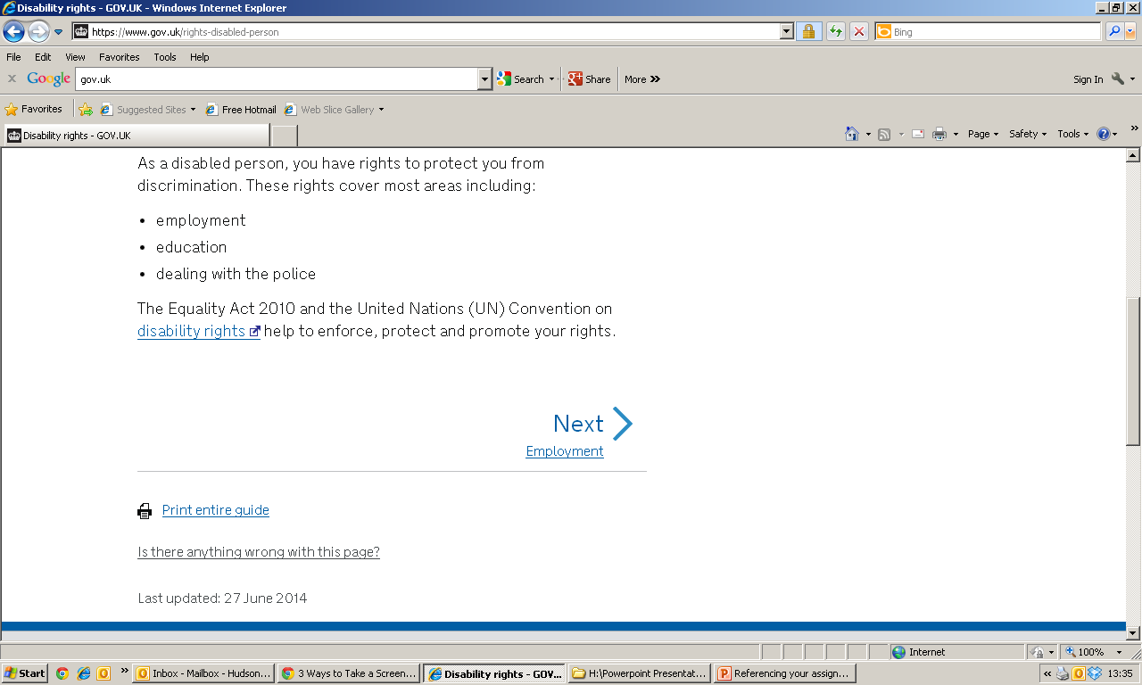
Exceptions to the Rule
Gov.uk (2014) Disability Rights. [Online] Available at: https://www.gov.uk/rights-disabled-person [Accessed 26th August 2014]

Slide 31
Now have a go yourself
Try referencing:
A book
A journal article
A website

Slide 32
Books
Fawcett, J. (1989) Analysis and Evaluation of Conceptual Models of Nursing. 2nd Ed. Philadelphia: F.A Davis Company
Doel, M. & Best, L. (2008) Experiencing Social Work Learning from Service Users. London: Sage Publications

Slide 33
Journal Articles
Melander-Wikman, A., Faltholm, Y. & Gunvor, G. (2008) Safety vs. privacy: elderly persons’ experiences of a mobile safety alarm. Health and Social Care in the Community.16(4):337-346
Young, A., Temple, B., Davies, L., Parkinson, G. & Bolton, J. (2008) Disabled children (0-3 years) and integrated services - the impact of Early Support. Health and Social Care in the Community. 16(3): 222-233

Slide 34
Websites
Shelter Cymru (2008) Building Future Wales [online] Available at http://www.sheltercymru.org.uk/shelter/home/ [Accessed 25th November 2008]
Rhondda Cynon Taf Teaching Local Health Board (2008) Working to Improve the Health and Healthcare of the People of Rhondda Cynon Taf [online] Available at http://www.wales.nhs.uk/sites3/home.cfm?orgid=264 [Accessed 25th November 2008]

Slide 35
Learning Outcomes
Identify and evaluate appropriate sources of information;
Apply an appropriate level of competence with workplace data handling;
Interrogate primary and secondary sources of information to construct an argument/ resolve a problem;
Demonstrate the effective use of various IT approaches, key numerical and statistical skills necessary for gathering and handling information.

Slide 36
Q/A?

