Slide 1
BA International Hotel Management
M5X01924
Management and Organisational Behaviour
Week 3 Lecture 1

Slide 2

In this session, we will consider…..
What is an organisation?
Types of Organisations
Organisational Environment
Porter’s 5 forces

Slide 3

What is an organisation?
The planned co-ordination of the activities of a number of people for the achievement of some common, explicit purpose or goal, through division of labour and function, and through a hierarchy of authority and responsibility

Slide 4

What is an organisation?
The organization of the 21st century will be characterized by unprecedented complexity and will require a different breed of leader.

Slide 5

What is an organisation?
The essence of organizations has shifted and will continue to shift from focusing on structure to capability.

Slide 6

What is an organisation?
Capability represents what the organization is able to do and how it does it rather than the more visible picture of who reports to whom and which rules govern work . . .

Slide 7

What is an organisation?
. . . will operate in the future to identify and nurture a handful of critical capabilities

Slide 8
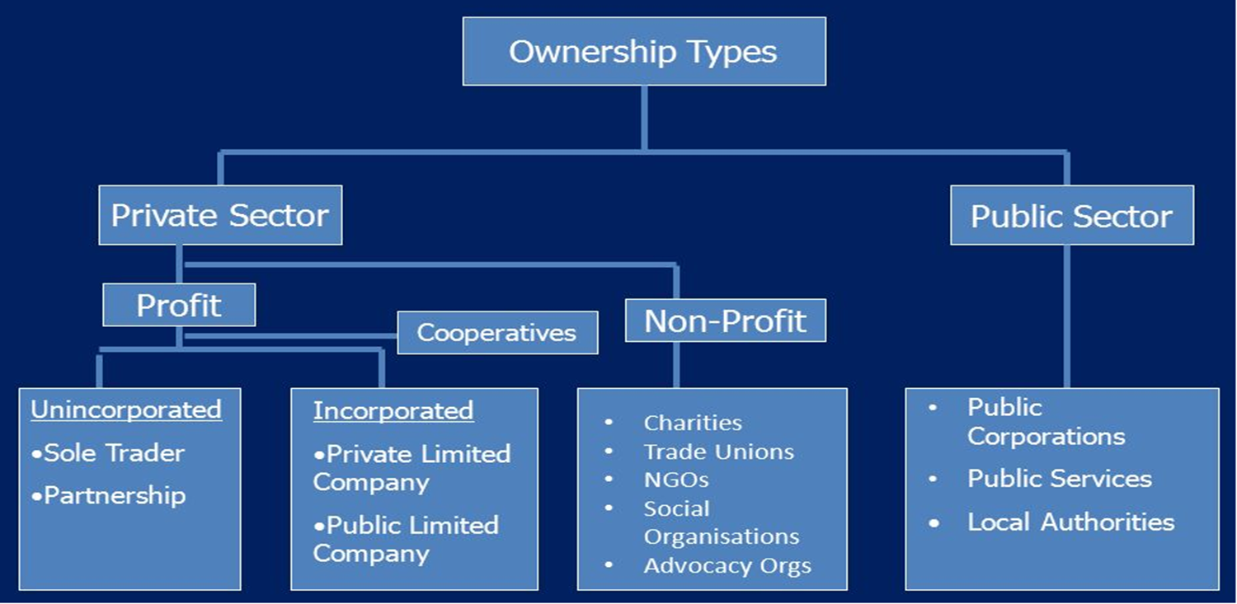
Types of Organisations

Slide 9
Business Organisation
Please Complete the worksheet 1.1 on the Module and discuss your views with fellow students.

Slide 10

Business Environment
A business does not operate in a vacuum.
It has to act and react to what happens outside the factory and office walls (external factors or influences).

Slide 11

Business Environment
These will affect the main internal functions of the business and possibly the objectives of the business and its strategies.
Anything that can impact on the activities of a business .

Slide 12
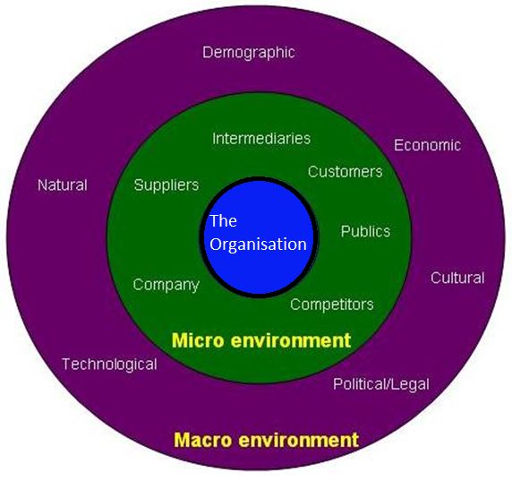
Elements of Business Environment

Slide 13
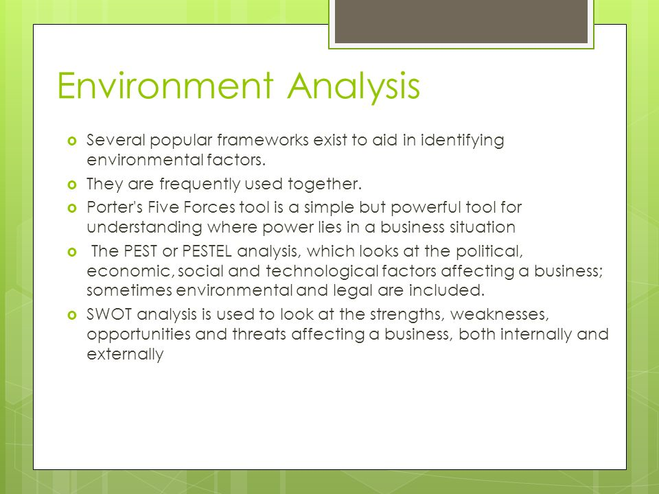
Analysis of Business Environment

Slide 14
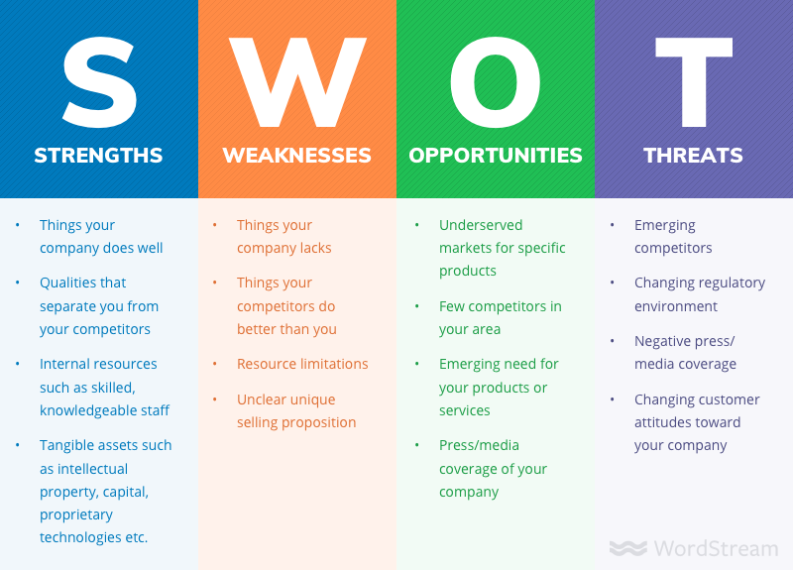
Analysis of Business Environment

Slide 15
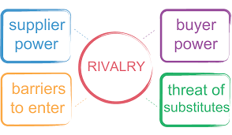
What is Porter’s 5 forces?

Slide 16

Background Information
Developed by renowned a professor - Michael E. Porter in his book “Competitive Strategy: Techniques for Analyzing Industries and Competitors“ in 1980.

Slide 17

Background Information
Highly regarded as an important tool in analyzing the industry structure.
The model identifies the forces that shape an industry.

Slide 18
The 5 Forces
Bargaining power of Customers
Bargaining power of Suppliers
Rivalry among existing competitors
Threat from substitutes
Threat from new entrants

Slide 19
The 5 Forces
Professor Porter explains 5 forces in…
https://www.youtube.com/watch?v=mYF2_FBCvXw

Slide 20
Case Study
Read the report on Moodle on Costa coffee

Slide 21
Classroom Debate
Propose:
Porter’s 5 forces does not impact the culture of an organisation
Oppose:
Porter’s 5 forces does impact the culture of an organisation
Notes:
Instructions:
Divide the class in to 2 groups one will be the proposers and the other opposes
Provide 15 minutes for preparation.
Each member of the group will have 1 minute to express their views/findings. (All members have to take part in the debate)
No formal scoring is required, but scores will help to add an element of competitiveness and more engagement.

Slide 22


Summary
Can you explain:
What organisation is?
Types of organisation?
What is business environment?
What are elements of business environment?

Slide 23
Summary
Can you explain:
What are the 5 forces?
What are the factors that will influence the 5 forces?
Does the 5 forces affect the culture of an organisation?

Slide 24

Next Session
The organisational Structures

