Slide 1
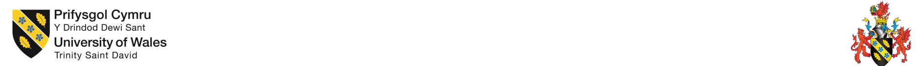
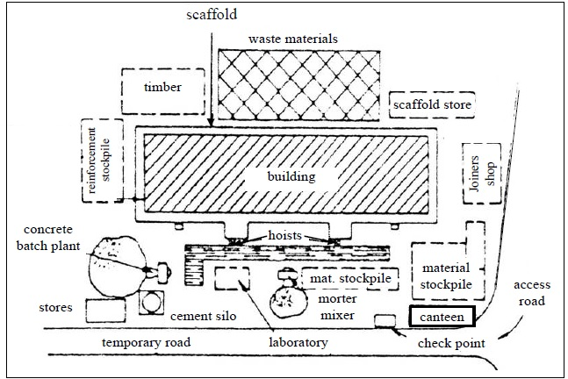
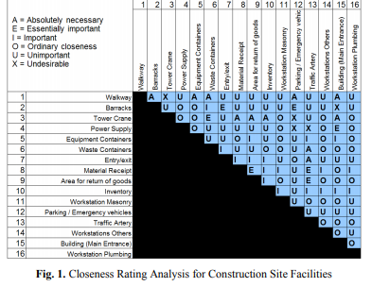
Jacob Passmore
1706871
Delay Analysis and The Management of Claims
Site Layouts on Complex Projects
What Are Site Layouts?
Case Study
Contractors prepare site layout plans as part of their mobilisation activities before starting work on site.
“Having an efficient construction site layout can significantly impact the productivity, cost and safety of a construction project. Construction site layout planning is therefore recognized as a critical step in construction planning by researchers. In literature this is often described as an optimization process where some objectives (e.g. safety, cost savings) are pursued within the constraints of the site and facilities requirements. Such models are usually complex and difficult for practitioners to apply, and usually result in each project having its unique site layout plan. The authors challenge this by proposing a standard layout template that can easily be utilized in planning of multiple construction sites. It is argued that each site should be treated as a factory and that similarity between sites should be pursued due to the nature of the construction industry. The template has been developed in collaboration with a Norwegian contractor, utilizing the action research approach.” (Sjøbakk, 2016)
As sites can be very complex places involving the coordination and movement of large quantities of materials as well as high-value products, plant and people, they are a crucial part of construction management. The effective and accurate layout of a site can help ensure that the works are carried out in an efficient and safe manner.
Careful planning and placement of temporary buildings will help minimise commuting times, noise, waiting times and so on to help make the facility a more secure workspace and a higher staff morale.
“The constructor has implemented the new site layout and introduced it in the company as its way to arrange facilities. The project presented a doable solution for site arrangement which was developed together with the company. This increases the possibility for it to be used on a regular basis. At all construction sites a lot of time is spent on searching for materials and tools, and we suggest that this waste is reduced with the suggested model. After experience is gained, adjustments to the first developed layout can be made” (Sjøbakk, 2016)
Four main processes are included in site layout planning
Identifying the facilities required for the site.
Determining the capacities of those facilities and other restrictions.
Establishing the services inter-relationships.
Optimizing facilities layout on site.
Plans for site layout may involve positions and sizes of:
Problems caused by poor layout of the site may include:
Site offices
Welfare facilities
Off-loading and storage areas
Entrances, temporary roads, separate pedestrian access
Vehicle wheel washing facilities
Hoarding details
Signage
Site security systems
Locations of cranes with radii and capacities
Information and communications technology installations
Temporary utilities
Inappropriate storage which can cause product and material damage.
Bad Plant Sitting.
Poor Welfare facilities
Providing insufficient rooms.
Service not sufficient.
Questions regarding protection and health.
Bad wayfinding (because of complicated configurations or unsuitable signage).
Workers demoralised, delays and costs increased.

Slide 2
References
Designingbuildings.co.uk. 2019. Site Layout Plan For Construction. [online] Available at: <https://www.designingbuildings.co.uk/wiki/Site_layout_plan_for_construction> [Accessed 14 May 2020].
Sjøbakk, B., 2016. Proposing A Standard Template For Construction Site Layout: A Case Study Of A Norwegian Contractor. [online] Hal.archives-ouvertes.fr. Available at: <https://hal.archives-ouvertes.fr/hal-01417500/document> [Accessed 12 May 2020].

