Slide 1

Personal Development Plan (PDP)
SABINA BEGUM ACCA4025 2220780

Slide 2
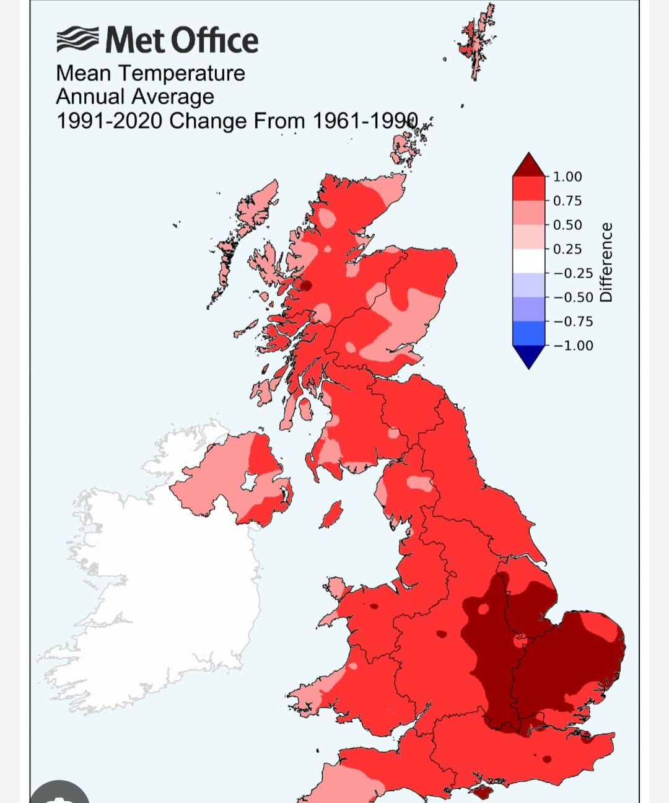
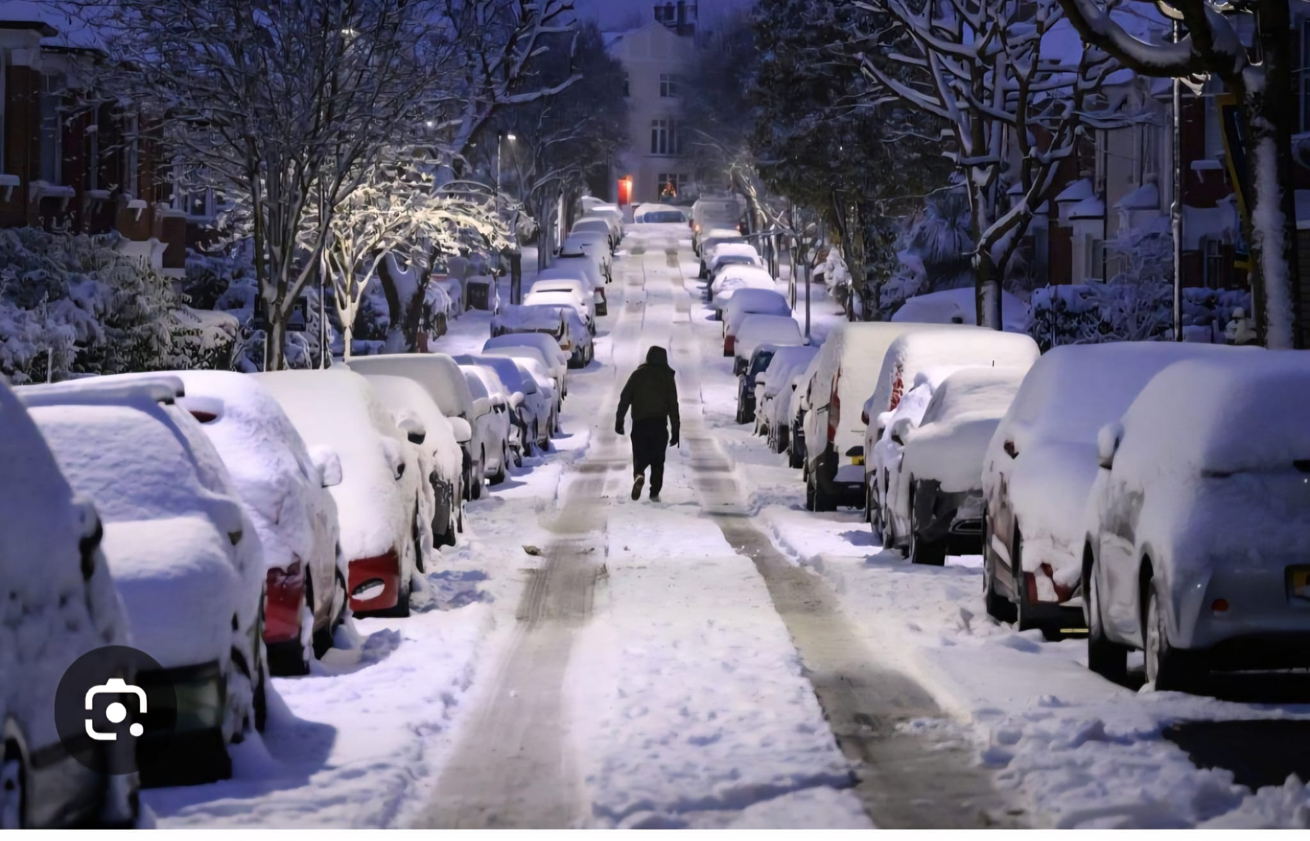
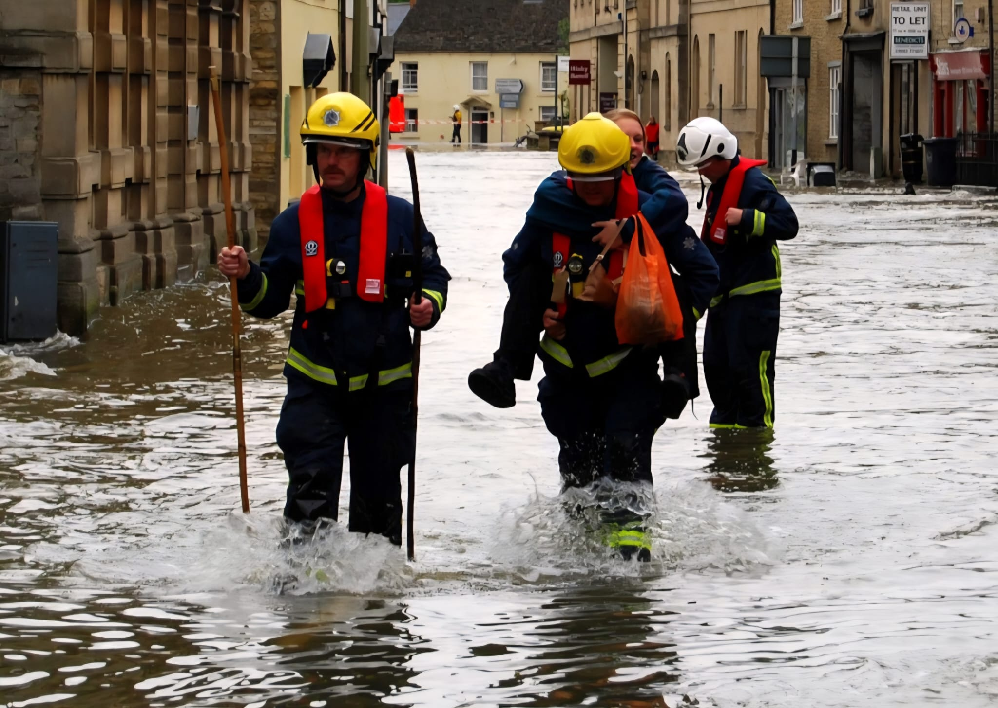
INTRODUCTION
I found this module quite interesting because I like making videos, To male effective slides I had to create a clear concise and visually consistent presentation which was a little hard for me because I kept laughing. My presentation was about climate change in England I decided to talk about the glaciers melting around the world which is very concerning and in England we have heavily flooding around the coast line which destroys people’s properties and businesses.
I talked about the pollution in England which was caused by vehicles and the fumes from factories which caused green house gases around the world, I was talking about when it is sunny in England everyone feels very hot and they enjoy going to their local beach to have a lot of sun and fun after completing this presentation I was worried about the climate change in England and was thinking joining some group where we can help making it safe for the future generations

Slide 3
SELF EVALUATION
Your Assessment Results:
Strengths: Team Player, Good Communicator, Analytical Thinker, Creative Problem-Solver, Self-Motivated and Independent Worker, Detail-Oriented and Precise, Strong Leadership Qualities, Proficient in Data Analysis, Proficient in Graphic Design, Proficient in Project Management Tools
Weaknesses: Needs Improvement in Time Management
Traits: Extroverted: Outgoing and Social, Moderate Stress Handler, Preferred Learning Style: Visual, Prefers Group Study, Does Not Prefer Solo Study

Slide 4
What are your long-term goals? | What are your specific career goals? | What are the key skills needed for each one of your goals? | What skills do you need to work on? | What actions are you going to take? | When are you going to complete your training by?
A career in I.T. IT Teacher | Learn about graphics design, English & Maths | Experience in applications such as computers cloud security | Good computing skills spoken written skills | Complete level 4 program and do time management, so I can do more works at home on my own | 12 months
 | Learn about web cyber security in school | Problem solving skills, attention to detail | English, Maths and IT Skills non-verbal body language | Take time out of my day to learn cyber security so I can later teach it | 27 months
 | Learn about web development | Teamwork at school, strong creative skills/ability | Working in a team skills | Develop my teamwork skills as a teacher that way I can teach my students what I know about team skills | 45 months
 | Job employment | Self management skills | Ability to work under stress | Listen more and focus on body language. Having positive mindset, share enthusiasm and ability to display resilience under stress. | 60 months

Slide 5
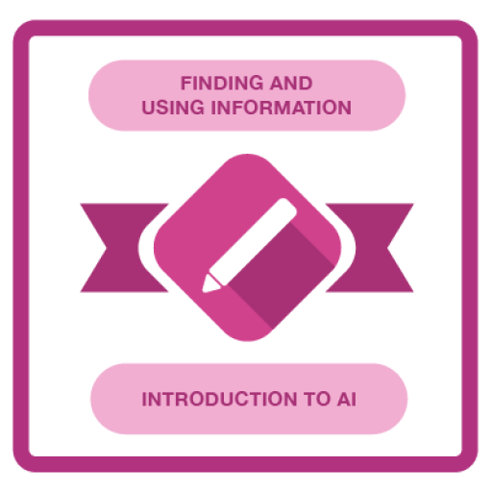



GOAL PROGRESS
Add 3 – 4 badges from any of the homework badges completed in Weeks 2 - 4
Course Title
Course Title
Course Title
Course Title

Slide 6
UNIT 4 TOPIC SUMMARY
I needed a little bit of help setting up my presentation mainly help with recording my video to match my slides I followed the guide step by step and completed it ,it was funny I kept forgetting my words and lines for the presentation. I completed a presentation on climate change in England

Slide 7
CONCLUSION
Provide a summary of the key points and learning outcomes
Throughout my experience with the presentation, I learnt new skills such as how to trim the video and import onto my slide also make it play automatically and adjust each slide transaction time so they all move on their own when the video ends that way I don’t have to keep going between slides and it moves by itself. As we were making the video I learnt I had to stay a professional person because sometimes I would stop and start laughing

Slide 8
References
[1] Primary sources by Dimbleby
[2] Barrientes to Effective 2021
[3] Darrel Wilson’s 2026 YouTube Guide
[4] Moodle: Library infoskills

