Slide 1
Person Centred Practice
SJSS6004
Joanne Davies

Slide 2
What is Person Centred Practice?
Consider discussing in your peer study groups
Discuss the phrase Person Centred Practice.
Is it a phrase you are familiar with?
Have you come across it in your work?
What do you think it means?

Slide 3
Person Centred Practice (PCP)
‘a process for continual listening and learning, focusing on what is important to someone now and in the future, and acting upon this in alliance with their family and friends’
(Department of Health, 2001)

Slide 4
Person Centred Practice
Developed in services for adults with learning disabilities
Embedded in current H+SC policy in the UK
Increasingly used in health and social care and in schools within reviews and transition planning
Strategy used by the third sector

Slide 5
Person Centred Practice
Person centred practice should not be a one off event
  It assumes that people have futures;
  that their aspirations will change and grow with their experiences
  therefore the pattern of supports and services that are agreed now will not work forever!

Slide 6
Person Centred Planning
A process of
  continual listening, and learning;
  Focussed on what is important to someone
    now
    for the future;
  Acting upon this in alliance with their family and friends

Slide 7
PCP Requirements
Should be a flexible and responsive approach to meet peoples changing circumstances
The person is always at the centre
The person is listened to, and respected

Slide 8
If you were invited to decide whether you would prefer to deliver person centred care or something more standardised:
What would you decide?
Why?
What would your patients/residents/clients think of this?
Person Centred vs System Centred
https://www.youtube.com/watch?v=y77y7XW8GtE

Slide 9
Being ‘Person Centred’
Working in a person centred manner requires that ‘we’ should have ‘proper regard’ for the needs and experiences of the individual. Challenging us to find out what people really need/want
What are THEIR GOALS?
What do we need to negotiate for on their behalf?
(NMC, 2015)

Slide 10
Key Premises of Person Centred Care
  Underpinning assumptions look at
  Therapeutic Relationships
  Rapport
  Expertise
  Patient Responsibility
  Knowing the ‘Person’
  Positive Relationships
  Communication (Sharma et al. 2015)

Slide 11
The main features of person centred planning are that it advocates social inclusion and is specifically formulated to assist an individual to make the changes that they want to make in their lives, not changes that other people, such as health care professionals, think are necessary or appropriate, or indeed, cost effective and easiest!
Everything is done with transparency and in partnership with the individual (Sanderson, 2000)

Slide 12
What are Person Centred Approaches?
A range of approaches which share common values and principles to answer two fundamental questions:
Who are you, and who are we in your life?
What can we do together to achieve a better life for you now, and in the future?

Slide 13
Person Centred Care
Person Centred Care
An obvious thing that comes naturally?
To be Person Centred is ‘synonymous with understanding and helping’

Slide 14
PCP is NOT…
Simply a collection of new techniques for planning to replace other methods such as Individual Programme Planning
It is based on a completely different way of seeing and working with people with disabilities or those who are potentially excluded
  It is fundamentally about sharing power and community inclusion

Slide 15
Who Would Benefit from a Person Centred Approach?
Discuss…
PCC and Dementia https://www.youtube.com/watch?v=o0jpWKjYwHg
What is a PCP meeting? https://www.youtube.com/watch?v=jsnQEAyP8Rk
Person centred planning - Future Choices – Reviews- Leonard Cheshire Disability https://www.youtube.com/watch?v=4tLfjPbFJcY

Slide 16
Person-Centred Principles and Person-Centred Practice Framework
The Health Service Executive (Ireland) developed these principles and framework in their guide to making a positive change to the way Health and Social Care is delivered-
People’s Needs Defining Change (2016) (Updated, 2018)
https://www.hse.ie/eng/staff/resources/changeguide/resources/change-guide.pdf

Slide 17
Person Centred Principles
Principle 1 Being person-centred means affording people dignity, respect and compassion, whether service user or provider.
Principle 2 Being person-centred means the person is a partner in their own health care, and the health and wellbeing of the person is the focus of care, not their illness or conditions.
Principle 3 Being person-centred means offering co-ordinated care, support or treatment across multiple episodes of treatment, care and therapy over time and across services.
(HSE, 2016)

Slide 18
Person Centred Principles
Principle 4 Being person-centred means offering personalised health and social care, support or treatment, for example by incorporation the person’s family knowledge, values, beliefs and cultural backgrounds into the planning and delivery of care
Principle 5 Being person-centred means being enabling where systems and services are oriented towards supporting persons to recognise and build upon their own strengths, preferences and goals, to achieve their full potential.
Principle 6 A person-centred health and social care system supports the person to make informed decisions about, and successfully manage, their own health and social care at the level they choose, including choices about when to let others act on their behalf.
(HSE, 2016)

Slide 19
Person Centred Principles
Principle 7 Being person-centred means collaboration between the person, their family and staff to influence policy and service design and development, and be partners in evaluation.
Principle 8 Achieving a person-centred culture requires a change in behaviour and mindset supported by a system that puts the person at its heart.
Principle 9 Being person-centred means a whole system approach to health and social care that values people, innovation, learning and teamwork throughout the organisation and demonstrates appreciation and respect for the unique contribution that people make regardless of position or status
(HSE, 2016)

Slide 20
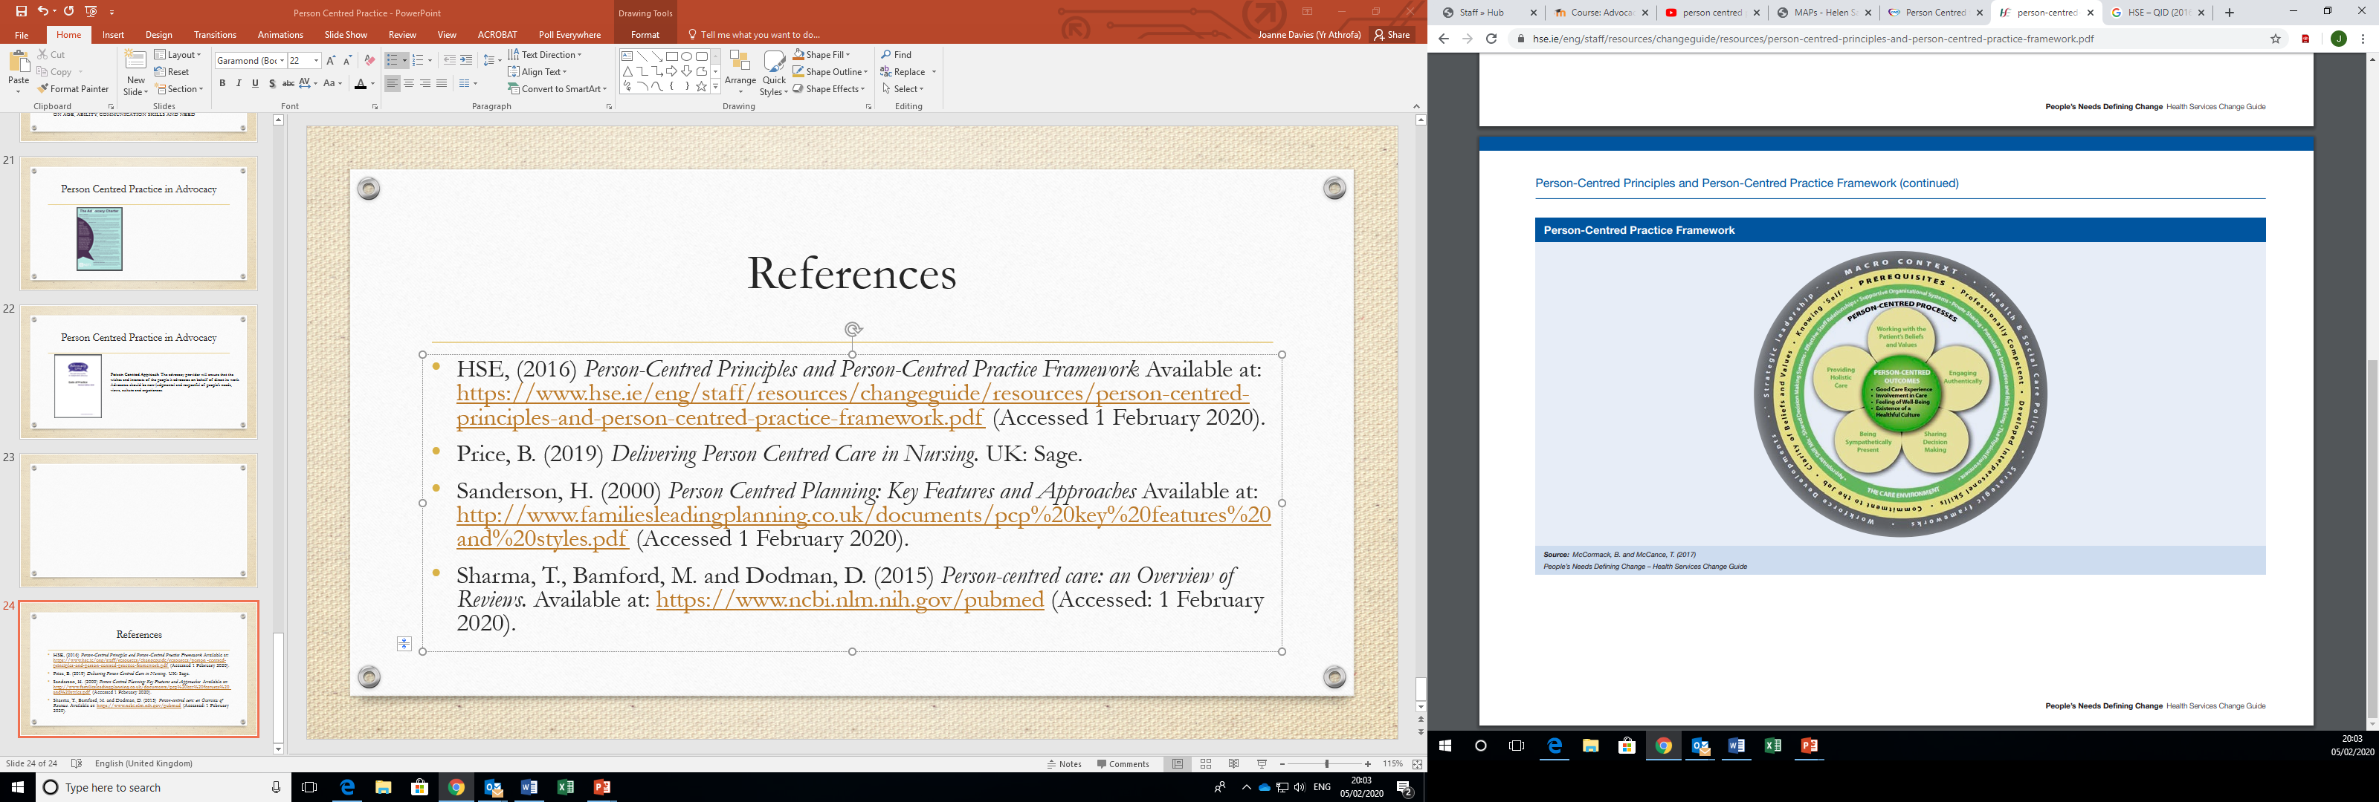
(McCormack and McCance, 2017)

Slide 21
Person Centred Planning
Used by
  Advocates
  Self-advocates
  Families
  Friends
  Paid support staff
  SHOULD BE USED BY EVERYONE!!

Slide 22
Tools Used in PCP
MAPS (Map Action Planning System) http://helensandersonassociates.co.uk/person-centred-practice/maps/
PATHS (Planning Alternative Tomorrows with Hope) http://helensandersonassociates.co.uk/person-centred-practice/paths/
Relationship Circle http://helensandersonassociates.co.uk/person-centred-practice/person-centred-thinking-tools/relationship-circle/

Slide 23
Tools Used in PCP
PCP Multi media tools ##https://www.youtube.com/watch?v=9M0SBJ_MTtw
‘This is Me’ https://www.alzheimers.org.uk/get-support/publications-factsheets/this-is-me
Advance Statements http://www.cwp.nhs.uk/about-us/our-campaigns/person-centred-framework/recovery-toolbox/advance-statement/
THE MOST EFFECTIVE TOOL SHOULD BE SELECTED DEPENDING ON AGE, ABILITY, COMMUNICATION SKILLS AND NEED

Slide 24
Key Features of
Person Centred Planning
The plan reflects what is important to the person, their capacities, and what support they require
  Focus on capacities
  Identifying supports
  A shared understanding – rethinking the role of the professional
  Discovering what is important to their person

Slide 25
Key Features of
Person Centred Planning
PCP results in actions that are about life, not just services, and reflect what is possible, not just what is available
  a shared commitment to action
  these actions have a bias towards inclusion
  By articulating the tension between what is important to the person and what is happening now
    PCP creates a sense of urgency and a commitment to work for change
  It can change what people think and do
  from the small things they do to assist the person with everyday tasks
    to the big things they do to help the person have a better life

Slide 26
Key Features of
Person Centred Planning
Family members and friends are partners in planning and the person is consulted throughout the planning process but…
The person is always at the centre
  The person is consulted throughout the planning process
  The person chooses who to involve in the process
  The person chooses the setting and timing of meetings

Slide 27
Person Centred Planning
Requires that practitioners have a
  flexible and responsive approach to meet peoples` changing circumstances
  guided by the principles of good planning rather than a standard procedure
Practitioners need to be
  problem solving in partnership with the person and their family and friends

Slide 28
PCP in Legislation
Embedded in key legislation
UK Government
Welsh Assembly
NHS
Third Sector

Slide 29
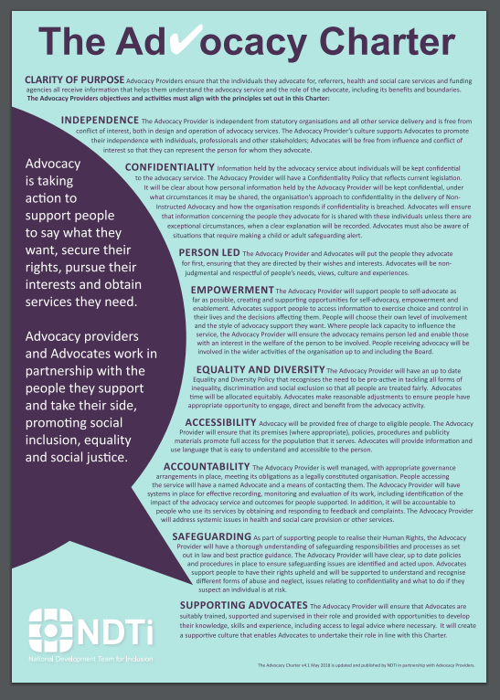
Person Centred Practice in Advocacy
PERSON LED The Advocacy Provider and Advocates will put the people they advocate for first, ensuring that they are directed by their wishes and interests. Advocates will be non-judgemental and respectful of people’s needs, views, culture and experiences.
https://www.ndti.org.uk/uploads/files/Advocacy-Charter-A3.pdf

Slide 30
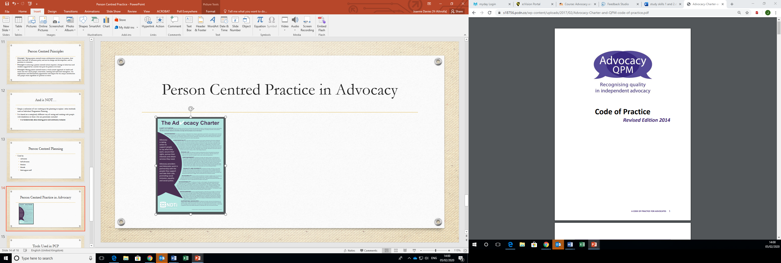
Person Centred Practice in Advocacy
Person Centred Approach
Advocacy providers should be aware of their duties and responsibilities under relevant human rights and equality legislation including the Equality Act 2010, Human Rights Act 1998 and other relevant wider policies that promote personalisation and person centred care and support.
https://qualityadvocacy.org.uk/wp-content/uploads/2018/05/Code-of-Practice-1.pdf

Slide 31
References
HSE, (2016) Person-Centred Principles and Person-Centred Practice Framework Available at: https://www.hse.ie/eng/staff/resources/changeguide/resources/person-centred-principles-and-person-centred-practice-framework.pdf (Accessed 1 February 2020).
McCormack, B. and McCance, T. (2017) People’s Needs Defining Change – Health Services Change Guide Available at: https://www.hse.ie/eng/staff/resources/changeguide/resources/person-centred-principles-and-person-centred-practice-framework.pdf (Accessed: 1 February 2020).
Price, B. (2019) Delivering Person Centred Care in Nursing. UK: Sage.
Sanderson, H. (2000) Person Centred Planning: Key Features and Approaches Available at: http://www.familiesleadingplanning.co.uk/documents/pcp%20key%20features%20and%20styles.pdf (Accessed 1 February 2020).
Sharma, T., Bamford, M. and Dodman, D. (2015) Person-centred care: an Overview of Reviews. Available at: https://www.ncbi.nlm.nih.gov/pubmed (Accessed: 1 February 2020).

