Slide 1

Employee Engagement
Student name: Ionut birladeanu
Student number: 2121940
Module: Operating Hotel Facilities BMIH4006
Lecturer: Kathryn Roberts

Slide 2

Table Of Content
Introduction
Employee engagement in Hotel Industry definition of engagement
Zinger model of engagement
Organisational perspective of Employee engagement
Scientific perspective of Employee engagement
Drivers of engagement
Continue
Benefits of Employee engagement
Conclusion
References

Slide 3
Introduction
The presentation shows the employee engagement is essential in the hospitality sector. (Bridger, 2022).
Notes:
The presentation focuses on the value of employee involvement in the hospitality industry. The hotel industry in the UK has a major role in the revenue collected in a single year. Employee engagement is an essential element in the development of the organisation and the employees (Bridger, 2022). The presentation includes the definition of employee engagement, a theoretical model of engagement, drivers of engagement, benefits of engagement and the best practices of employee engagement in the hotel industry.

Slide 4

Employee engagement in Hotel industry
It reflects the dedication and enthusiasm of employees towards work.
Contributes critically towards organisational growth (Saks and Gruman, 2021).
Ensures job satisfaction and boosts employee morale.
Makes employees more productive (Okolo, 2018).
Notes:
Employee engagement is defined as the emotional commitment an employee has to an organization and its goals, according to Forbes. It refers to how enthusiastic, as well as committed personnel, is to their profession. The employee needs to be dedicated towards work as it will influence productivity and makes the organisation collect large revenues from their efficient work. Individuals that are involved care about their jobs and the organization's achievement and feel that their initiatives count (Saks and Gruman, 2021). A motivated staff is in it for much more than just a paycheck and may think that their effectiveness and, thus, their health, are strongly connected to and necessary to the success of the company as a whole (Okolo, 2018). This will help the employee to attain career advancement and better opportunities for the future.

Slide 5
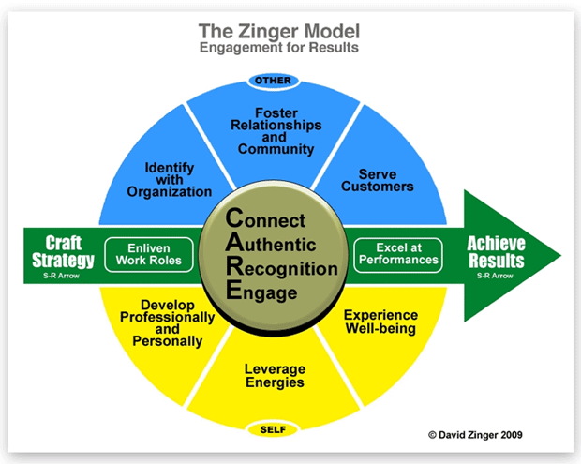
Zinger model of engagement
(Source: Kwon and Kim, 2020)
Notes:
The ultimate goal of Zinger's approach is to accomplish the desired outcomes, which are higher levels of employee retention; yet, the process is extremely well accompanied by a set of other processes. Through carefully thought-out tactics, managers need to focus on both themselves and the industry's workforce. This involves many elements such as achieving results, crafting tactics, living their role, excelling at work, being connected to the organisation, being unique, proper engagement in work, and appreciating the employee's efforts, they are recognised through the name of the organisation, provides efficient services to the customers, develop their skills to gain career advancement, the ultimate role of the model is to balance the work-life and make employees happy (Kwon and Kim, 2020).

Slide 6
Organisational perspective of Employee engagement
Engagement- Engaged employees know the preferences of the customer.
Productivity- Total turnover of the hotel industry in the UK is £19.4 million in 2017 (Samantaray and Sahu, 2018).
Profit- Grows three times faster than fellow competitors (Hussainy, 2020).
Notes:
The engagement of the employees from the organisational point of view seems to be very significant as it directly affects the productivity of the organisation. The profitability is also estimated through the efficiency of the engaged employees (Samantaray and Sahu, 2018). Organisational growth is affected by direct as well indirect purposes due to employee engagement. It becomes a vital part which ensures the development of the organisation (Hussainy, 2020).

Slide 7
Scientific perspective of Employee engagement
Proper safety measures make an employee more dedicated towards work (Guan and Frenkel, 2018).
The availability of appropriate tools makes them efficient.
The meaningfulness of the vision of the organisation increases productivity (Duthler and Dhanesh, 2018).
Notes:
The scientific measures show the importance from the employee's point of view. The engagement is driven by safety availability, safety and meaningfulness (Guan and Frenkel, 2018). The outcomes of these drivers make the employees more dedicated and productive, which influences the growth of the organisation as well as the individual. This perspective focuses on the scientific parameters that are required in the work environment to increase their growth mutually (Duthler and Dhanesh, 2018).

Slide 8
Drivers of engagement
Organisational performance- The employees get motivated when they get to know that their company is outperforming the market and as a result of which they are willing to perform well and engage more towards their roles (ErajesvariePillay, 2018).
Leadership- Efficient leaders make efforts to involve the employee in the decision-making process. The employee feels connected with the organisational authorities and tries to give their best for organisational growth (Bhutto et al., 2021).
Notes:
Many drivers influence employee engagement in the organisation. The employee is the key element of organisational growth which is sustained through suitable strategies (ErajesvariePillay, 2018). Organisational performance and leadership contribute efficiently to employee engagement (Bhutto et al., 2021).

Slide 9
ContiCONTINUEnue
Management- The relationship between the manager and employee plays a crucial part in the development and retention of the employee in the organisation. The retention level of employees is directly connected with the managers.
Teamwork- The collaborative approach assists in performing well as a team. The employees get more engaged when they work effectively with supportive co-workers. It helps in maintaining healthy relationships with other employees at the workplace (Kumar and Kumar, 2020).
Environment- The environment at the workplace affects the employee professionally as well as mentally. An organisation with a suitable work system and wide job opportunities have more employee retention (Shin and Perdue, 2022).
Notes:
The drivers that contribute more to employee engagement are managerial authorities and their relationship with employees, working as a team and sharing experiences and skills with co-workers influences retention, the environment of the workplace also attracts the employees and makes them show enthusiasm towards their work (Parent and Lovelace, 2018). The workplace where everyone works with a collaborative approach refreshes the thoughts of the individual and they feel like family and support each other and share their experience to relate more rather than only to professional life but as good friends (Shin and Perdue, 2022).

Slide 10
BENEFIT OF EMPLOYEE ENGAGEMENTengagementagement
Income approach from employees increases.
Reduced pressure at work.
Decreased risk of failure (Parent and Lovelace, 2018).
Strong corporate image and ambassadorship.
Simpler hiring of employees (Sifatu et al., 2020).
Notes:
Employee engagement is beneficial and important for any organisation. The benefits of employee engagement are an increase in the income approach of the employees, reduced pressure of work, fewer failures and building a strong corporate image of the organisation (Parent and Lovelace, 2018). This all factors contribute to the growth of the organisation. The organisation and employee both grow and attains better opportunities in the future (Sifatu et al., 2020).

Slide 11
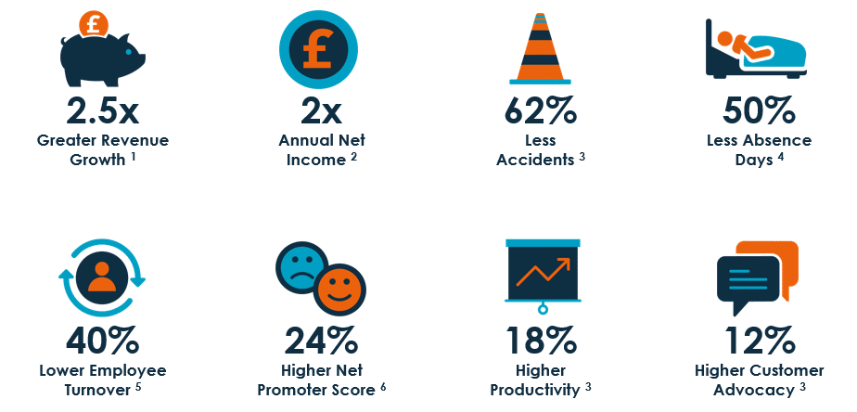
Conclusion
( Source: Ismail, Iqbal and Nasr, 2019)
Notes:
Revenues collection increases 2.5 times more, and the annual net income of employees increases by two times. The safety concerns that attract employee gets reduced by the best practices (Ismail, Iqbal and Nasr, 2019). Employee involvement increases. The best practise ensures a high productivity of 18% in the fiscal year which improves the market position of the employees. The net promoter score gets increased by 24%. Customer accuracy and satisfaction get influenced by employee engagement.

Slide 12
References
Bhutto, T.A., Farooq, R., Talwar, S., Awan, U. and Dhir, A., (2021) Green inclusive leadership and green creativity in the tourism and hospitality sector: serial mediation of green psychological climate and work engagement. Journal of Sustainable Tourism, 29(10), pp.1716-1737.
Bridger, E.,(2022) Employee engagement: A practical introduction (Vol. 24). Kogan Page Publishers.
Duthler, G. and Dhanesh, G.S., (2018) The role of corporate social responsibility (CSR) and internal CSR communication in predicting employee engagement: Perspectives from the United Arab Emirates (UAE). Public relations review, 44(4), pp.453-462.
ErajesvariePillay, D.S., (2018) The impact of employee engagement on organisational performance â€“A case of an insurance brokerage company in Gauteng. IOSR Journal of Business and Management, 20(6), pp.66-76.
Guan, X. and Frenkel, S., (2018) How HR practice, work engagement and job crafting influence employee performance. Chinese Management Studies.
Hussainy, S.S., (2020) Review on Motivational Theories & Models: Its application for Employees’ Retention in Organizations. International Journal of Business and Applied Social Science, 6(1), pp.40-46.
Ismail, H.N., Iqbal, A. and Nasr, L., (2019) Employee engagement and job performance in Lebanon: the mediating role of creativity. International Journal of Productivity and Performance Management, 68(3), pp.506-523.
Kumar, J. and Kumar, V., (2020) Drivers of brand community engagement. Journal of Retailing and Consumer Services, 54, p.101949.
Kwon, K. and Kim, T., (2020) An integrative literature review of employee engagement and innovative behavior: Revisiting the JDR model. Human Resource Management Review, 30(2), p.100704.
Okolo, D., (2018) An exploration of the relationship between technostress, employee engagement and job design from the Nigerian banking employee’s perspective. In An exploration of the relationship between technostress, employee engagement and job design from the Nigerian banking employee’s perspective: Okolo, Deborah.
Parent, J.D. and Lovelace, K.J., (2018) Employee engagement, positive organizational culture and individual adaptability. On the Horizon.
Saks, A.M. and Gruman, J.A., (2021) Advanced introduction to employee engagement. Edward Elgar Publishing.
Samantaray, M.R. and Sahu, P.K., (2018) Corporate practices in employee engagement.
Shin, H. and Perdue, R.R., (2022) Customer nontransactional value cocreation in an online hotel Brand community: driving motivation, engagement behavior, and value beneficiary. Journal of Travel Research, 61(5), pp.1088-1104.
Sifatu, W.O., Sjahruddin, H., Fajriah, Y., Dwijendra, N.K. and Santoso, A., (2020) Innovative work behaviors in pharmacies of Indonesia: role of employee voice, generational diversity management and employee engagement. Systematic Reviews in Pharmacy, 11(2), pp.725-734.

