Slide 1
TRSK5001
Research Methods for Theology and Religious Studies
Film

Slide 2
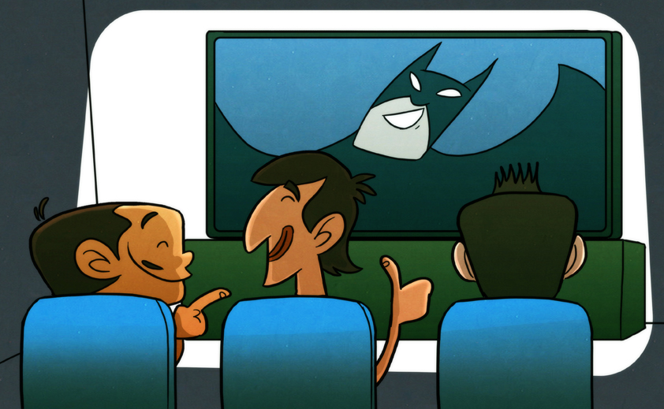
Watching a Film
Notes:
The first questions we have to ask is, ‘what is it we are doing when we watch a film?’ and ‘why do we consider watching films at all?’ in the context of a Theology and/or Religious Studies programme of study. In answering the question, we need to be aware that some of the answers could be applied to other forms such as the novel, to television programmes, to websites and even to video games. It is to be remembered, then, that some, if not all, of what we say, methodologically, about watching films are not exclusive to the cinema and can be said of other genres too. But we are (1) looking at methods from the context of watching films and (2) looking at what scholars and commentators and critics have said about issues of method when they have said so from the context of the cinema.

Slide 3
2009
174 million visits to cinema (up 5.6% on 2008)
DVD and Blue Ray sales = £2.167 billion (down 10% on 2008)
Leisure
Escapism v. Reality
Entertainment
Place for discussion about values
Notes:
FILM WATCHING AS PART OF CULTURE
In 2009, 174 million visits to the cinema were recorded in the UK – the equivalent of nearly three trips for every person in the country. This was a 5.6% increase on the figure in 2008. It demonstrates that for at least some people, cinema going is a part of their routine.
The sales of DVD and Blue Ray in 2009 fell by 10% on 2008, but still reached a massive £2.167 billion. Of course, there is no guarantee that films and tv series and other kinds of dvd/blue ray are watched, but at least it suggests that films might play a big part in home entertainment.
There are, of course, other ways of watching films too; terrestrial and satellite channels, for example.
The primary reason for watching a film is, of course, for leisure. They are entertainment tools. It is worth saying this first of all, and it is worth saying that there is nothing necessarily wrong with that. People have leisure time, it is there for them to relax from the daily routine and the world of work, and these things are physically, emotionally, psychologically – dare we even say spiritually? – important.
The fact that people are returning to the cinema can be analysed further. From the early 1990s, the cinema has been transformed, largely by the existence of multiplex facilities around the country all of which offer people what we might call the ‘cinematic experience’. This is something that does encompass watching a film on a big screen, with surround sound and – increasingly – in 3D while seated in what are fairly comfortable seats these days. But it goes beyond that to the external aspects too. The cinematic experience seems to include ‘pick n mix’ sweets, a hot dog, nachos, popcorn, an oversized drink (largely filled with ice cubes) and Ben and Jerry’s ice cream.
All this suggests that watching films is a leisure activity associated with escapism. Escapism is not necessarily a bad thing. In this sense it simply represents an alternative reality, experienced or witnessed for a few hours before someone returns to real reality in the world. The film in some senses transports the viewer into a narrative that is not the viewer’s own, and would not in any other sense be part of the viewer’s experience. Providing that the viewer does not think he or she remains in that alternative existence, then it is not a terribly dangerous thing to do.
At this level, the cinema is nothing more than entertainment, but in saying this we ought not be too dismissive of entertainment itself.
At another level, when people leave the cinema, they very often start to discuss what they have seen on the screen. This discussion may be at a sophisticated or a very banal level. But the discussion might also touch upon things of importance. And here we begin to see that film serves – or at least potentially serves – an alternative purpose to entertainment.

Slide 4
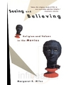

‘Congregations became audiences as film created a new public sphere in which under the guise of entertainment values are formulated, circulated, resisted and negotiated’
Notes:
The American scholar of religion, Margaret Miles, makes the point in this way:
‘Congregations became audiences as film created a new public sphere in which under the guise of entertainment values are formulated, circulated, resisted and negotiated’.
These issues focus on film reception. In other words, how it is that audiences respond to what they see on the screen. The point Miles makes can be supported by anecdotal evidence, but we need to be aware that – as far as I can see – no empirical work has been done to support these claims. In other words, scholars think this is what is going on, but they have never really asked audiences how they have responded to what they see on film.

Slide 5
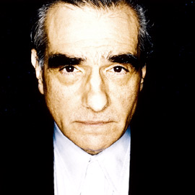
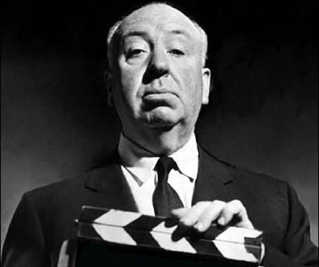
Notes:
Another consideration has to be what might be termed ‘authorial intent’. We have to be aware that everything we see on the screen, the story (narrative), the plot, the characterisation, the casting, the cinematic shot, the music and so on, are all picked by the director for a purpose. In film studies this leads to what is called ‘auteur criticism’, where it is asked what kind of style a particular director brings to all his or her films. An ‘auteur’ (from the French meaning ‘author’) is defined as ‘a filmmaker whose individual style and complete control over all elements of production give a film its personal and unique stamp.’
Studies have done this for Martin Scorcese, Alfred Hitchcock and others.

Slide 6
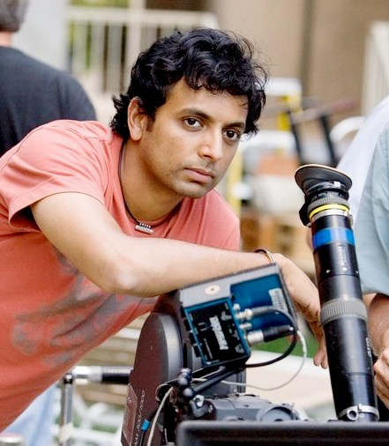
Manoj Nelliyattu Shyamalan
(M. Night)
The Sixth Sense (1999)
Signs (2002)
The Village (2004)
False realities
Fluttering curtains
Cellar scenes
Notes:
We could do it, too, for M. Night Shyamalan. Born in India (Manoj Nelliyattu Shyamalan) but raised in Philadelphia, his film credits include The sixth Sense (1999), Signs (2002), Unbrekable (2000), The Village (2004), Lady in the Water (2006). Shyamalan’s films all seem to follow a similar pattern where they create in the viewer’s minds a picture of reality which turns out not to have been real at all. He is also noted for using fluttering curtains and cellar scenes as places where important plot information is disclosed. (Make of that what you will!)

Slide 7
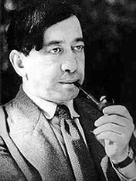
Siegfried Kracauer
Films come into their own when they record and reveal physical reality. Now this reality includes many phenomena which would hardly be perceived were it not for the motion picture camera’s ability to catch them in the wing ... I assume, then, that films are true to the medium to the extent that they penetrate the world before our eyes.
Notes:
This takes us back to a debate in early cinematography between two critics who had alternative views about what film was meant to achieve.
Siegfried Kracauer represented what was termed the ‘realist school’ which held that in film there is no interpretation of reality but reproduction of reality.
Films come into their own when they record and reveal physical reality. Now this reality includes many phenomena which would hardly be perceived were it not for the motion picture camera’s ability to catch them in the wing ... I assume, then, that films are true to the medium to the extent that they penetrate the world before our eyes.
Thus for the realist school, there is no interpretation, but the portrayal of reality enables us to grasp reality at a more profound level than we would otherwise do with the naked eye. The creation of fantasy worlds would have been frowned upon. Film was to look at the world and in so doing teach us something new about it.

Slide 8
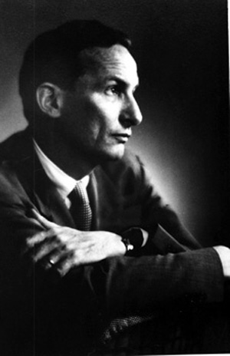
Formalist / Expressionist
Notes:
Andre Bazin disagreed and said that the attempt to show reality and nothing more could only result in the representation of reality.
The ‘formalist or expressionist school’, represented by Rudolf Arnheim, suggested that film only represents its subject by in some senses interpreting it. It is a creative and therefore artistic medium. The images on the screen may appear familiar – even in fantasy – but they are purposely selected and shaped in a particular way. As a result, reception in itself is not enough in order to find meaning in a film. Instead, the production of a film and the imagination and intent of those producing it, have to be taken into account as well.

Slide 9
Analogy
‘a similarity between like features of two things, on which a comparison may be based.’
Biblical stories
Religious characters
Doctrinal themes
Notes:
METHOD 1: ANALOGY
An analogy is ‘a similarity between like features of two things, on which a comparison may be based’. We understand something by the fact that it is similar to something else. But part of that understanding is based on the fact that it is also different to that other thing.
Many scholars have opted for the analogical approach: to see similarities in films to biblical stories, biblical or theological themes. Let me suggest a few examples:

Slide 10
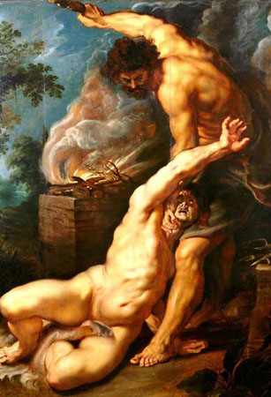
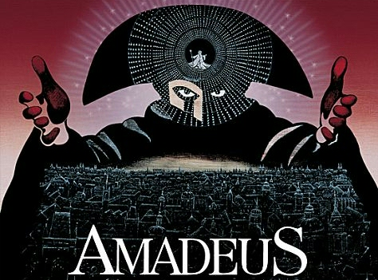
Notes:
Amadeus
In a combination of brilliant colour, magnificent scenery, effective characterization and exquisite music, Peter Schaffer’s play Amadeus was translated to the silver screen by Milos Forman in 1984. Empire accurately described the film as ‘a truly memorable, devastating experience’ and it won a total of eight Academy Awards including that of Best Picture. The narrative presents the court composer, Antonio Salieri (F. Murray Abraham) as the one who plotted the downfall, if not also the murder, of the precociously talented and, according to the film, lecherous, infantile and ill-mannered Wolfgang Amadeus Mozart (Tom Hulce).
The plot is, of course, fictitious, for Salieri became Mozart’s enemy only in a later poem by Alexander Pushkin. Nevertheless, Gregory Allen Robbins contends that the film is ‘a masterpiece of drama which reveals deep truths about the human condition’ revolving around human inequality and the way this drives pride to become envy and ultimately the desire to destroy. As the plot thickens and the audience is drawn into Salieri’s homicidal ambitions, so they are carried away by the sheer genius of his younger adversary and the sublime beauty of his music, emphasized in the film by the further fiction that Mozart composed by merely transcribing the melodies he heard in his head.
For Robbins, the film is an allegory of the story of Cain and Abel, that ‘the Lord had regard for Abel [Mozart] and his offering, but for Cain [Salieri] and his offering he had no regard’ (Gen. 4:4-5, NRSV). The film can certainly be perceived as a meditation on pride, jealousy, anger and disappointment all of which can lead to the most extreme of actions. But whether the audience is drawn into the inequality and injustice of life as perceived by Salieri or amazed at the sheer talent of Mozart and shaken by his unsympathetic treatment by the establishment, the film remains absorbing as it cleverly spins its narrative and intersperses it with stunning imagery and beautiful sound. For the most part the audience is beguiled and moved to the extremes of emotion, especially as the haunting strains of the Lacrimosa Dies Irae (On this day full of tears) from the Requiem accompany the perfunctory and somewhat lonely disposal of Mozart’s corpse in an unmarked grave beyond the Vienese city walls, while the rain pours down almost as a sign of divine pathos in the absence of any corresponding human mourning.

Slide 11
Christ figure
Character who has a mysterious or miraculous origin
Character who gathers around (him) a number of followers
Character who is martyred in order that salvation or liberation comes to others in the film
Notes:
Perhaps the most common of analogies is the idea of a Christ figure: where a main character in a film takes on the characteristics of Christ.
Ronald Holloway says: ‘The Christ figure in allegory follows the main thread of the Christ story, while disguising it through a surface narrative and relying on the viewer to provide the necessary continuity. The figure is strong enough to exist by itself, but points to a meaning far beyond this existence for its ultimate truth’.
The Christ figure is
a character who might have some kind of mysterious or miraculous existence. In many Cowboy films, for example, the main character is seen riding into town at the beginning of the film and out into the sunset at the end. Some have commented that this is similar to the idea of virgin birth and ascensions.
a character who might gather around him a number of followers as ‘disciples’. One example here might be Cool Hand Luke where Luke, played by Paul Newman, is sentenced to hard labour for a very minor offence and becomes the leader of the other prisoners on the chain gang.
a character who is ultimately martyred in a way that brings salvation or liberation to other characters in the film.

Slide 12
ORIENTATION – DISORIENTATION – REORIENTATION
CREATION – FALL – REDEMPTION
BIRTH – CRUCIFIXION – RESURRECTION
Notes:
HOWEVER:
Analogy is a basically weak – not to mention uninspiring – way of approaching film. The truth is that narrative form means that virtually any story with a beginning a middle and an end will be an analogy of the biblical story.
ORIENTATION – DISORIENTATION – REORIENTATION
CREATION – FALL – REDEMPTION
BIRTH – CRUCIFIXION – RESURRECTION
And the idea of the Christ figure is often pushed far further than it can in all honesty go. This can be seen in one scholar’s affirmation that in Robert Bresson’s film, Au Hasard Balthasar, a story of a donkey’s life, where the donkey is looked after, then mistreated and finally shot when part of an elaborate but failed attempt at smuggling contraband, he is a Christ figure!

Slide 13
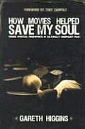
Transcendental Style
‘At its best, as the most immediate, inescapable art medium, film can transport you to what the founder of the Iona Community, George MacLeod, called a “thin place,” where the lines between harsh reality and the transcendent is so subtly blurred that for a moment, or if you’re lucky, moments, you find it difficult to tell the difference.’
Notes:
METHOD 2: TRANSCENDENTAL STYLE
Gareth Higgins, in HOW MOVIES HELPED SAVE MY SOUL
‘At its best, as the most immediate, inescapable art medium, film can transport you to what the founder of the Iona Community, George MacLeod, called a “thin place,” where the lines between harsh reality and the transcendent is so subtly blurred that for a moment, or if you’re lucky, moments, you find it difficult to tell the difference.’

Slide 14
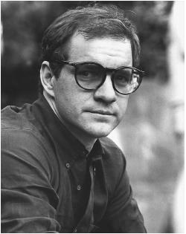
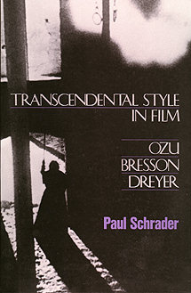
Notes:
The question is, how does film suggest a transcendental style to us? The term was coined by an American, Paul Schrader, who thought it up while writing an undergraduate dissertation on a Film Studies course in the early 1970s.
Schrader made a study of three directors. For our purpose, it is his comments on the Frenchman Robert Bresson that are of most significance.
Bresson had rejected the use of the conventional means of conveying to the audience what was going on: plot, acting, characterization, camerawork, music, dialogue, editing and so on are all reduced to a minimum in order for the ordinariness, the reality, of a scene to shine through. In other words, there is an attempt to avoid the interpretation of reality by recording reality itself. In so doing, in recording reality, the possibility is opened up for the transcendent to break through.

Slide 15
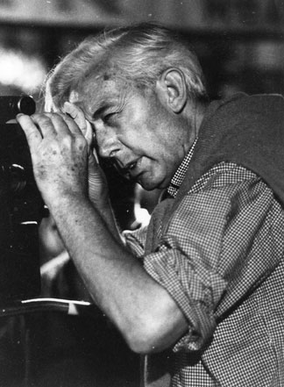
The everyday
Disparity
Stasis
Notes:
Having said that, there are characteristics of ‘transcendental style’.
The everyday: a meticulous representation of the dull, banal, commonplace, of everyday living. The everyday celebrates the bare threshold of existence, those banal occurrences which separate the living from the dead, the physical from the material, those occurrences which so many people equate with life itself. But there is a moment of redemption to come in which the ordinary is transcended.
Disparity: an actual or potential disunity between man and his environment which culminates in a decisive action.
Stasis: a frozen view of life which does not resolve the disparity but transcends it.

Slide 16
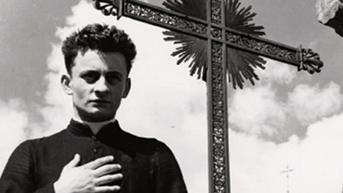
Notes:
Diary of a Country Priest
The film “recounts the story, told in the first person, of the parish priest of Ambricourt, a young man who has had little success in his parish and who is dying of stomach cancer. From the beginning we are aware that this is a film about the everyday. The priest even mentions this as he talks to himself and fills the pages of his diary. We are not party to a long and elaborate plot: we do not watch a series of bizarre or extraordinary events. Instead, we watch the priest going about his everyday tasks of visiting his parishioners, of holding a catechism class, of celebrating Mass, and we see his sense of alienation from those around him, his parishioners and his fellow clergy.
There are, of course, analogies to be made. Because of his illness, the young priest can only eat bread and wine. The reference is not merely to physical sustenance but to the Eucharist and its overtones. For some commentators, Bresson represents more transparently than any other of his films the passion and death of Christ, thus creating in the priest an eloquent Christ-figure. Lloyd Baugh continues ‘Though the priest’s physical suffering is important, Bresson builds the suffering servant-Christ analogy mostly on the basis of the man’s moral and psychological suffering, his experience of isolation, of being in a sense imprisoned. He is imprisoned by his illness, his physical suffering; his social exclusion, he is almost totally isolated from the people to whom he is to minister, causing him to have severe doubts about his vocation and his effectiveness; his struggle with evil and sinfulness.

Slide 17
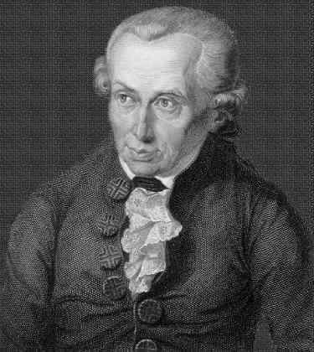
Imaginative journeys
‘empirical imagination’
‘transcendental imagination’
Notes:
METHOD 3: IMAGINATIVE JOURNEYS
One of the reasons that I don’t like the idea that we should define which films are meaningful and which ones are not, is that the medium is geared towards engaging our imaginations. And our imaginations can be engaged by such a variety of different means, and not everyone will respond to the same stimulus in the same way. However, I have argued that the way to consider a theological interpretation of film, and the theological value of film, is by talking about the imagination.
In the history of thought, there was always a place for imagination, but it was often considered to be a bit dubious. It belonged to the shadow realm. For Plato, it was phantasia – a word that gives us ‘fantasy’, and for Plato constituted ‘inferior knowledge’ – and was to be differentiated from gnwsis – pure knowledge. However, as ‘pure knowledge’ is restricted to the gods, the best that human beings can hope for is ‘inferior knowledge’.
The imagination’s function, according to many philosophers, was to bring an order to our mental concepts. If memory brought to mind experiences as they actually occurred, then imagination was able to draw on different parts of different experiences and invent new things. As such, imagination had a duel function which we can see in Kant’s distinction between the ‘practical’ or ‘empirical imagination’ and the ‘productive’ or ‘transcendental imagination.’
‘empirical imagination’: enables us to identify objects and thus to live in the world. Thus Imagination is necessary for ordinary, ‘practical’ living
‘transcendental imagination’: enables us to be creative or constructive Imagination is necessary in order to change our conditions of existence
Trevor Hart has argued that ‘a disciplined imagination’ can lift ‘us out of ourselves and relocate us temporarily somewhere else; to show us things we had not seen before, or familiar things now looking quite different because viewed from an unfamiliar perspective’. From this it is reasonable to suggest that such imaginative experiences do not leave us untouched. Hart continues that it is through the imagination that human beings are granted ‘the capacity to transcend the boundaries of our own particularity and to engage with otherness in ways which plot something of its difference, before finally returning to ourselves with our horizons broadened and our “self” in some sense more rounded and complete through the venture’. After such an imaginative experience of otherness, we return to ourselves where we discover that ‘while we are the same person we were, our personhood has nonetheless been transfigured by the experience. We have seen and tasted more of reality than we had previously, and the texture and colour of our own world presents itself differently as a result’.

Slide 18
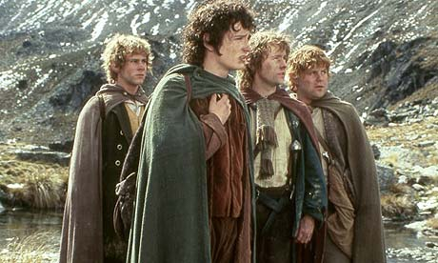
‘Frodo, Sam, Pippin and Merry enter a world of elves, dwarves, trolls and orcs. At the end of their journey, they return from that experience to their home in the “real world” ennobled to be heroes’ (Russell Dalton)
Notes:
Russell Dalton has argued:
‘Frodo, Sam, Pippin and Merry enter a world of elves, dwarves, trolls and orcs. At the end of their journey, they return from that experience to their home in the “real world” ennobled to be heroes’
The point is that the audience imaginatively accompanies them on this journey.

Slide 19
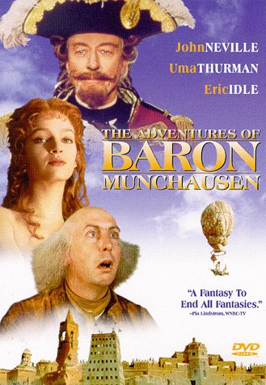
Notes:
Let me finish with another example:
Terry Gilliam’s marvellous The Adventures of Baron Munchausen (1988) opens with the Henry Salt and Son Players (Bill Patterson) performing a theatrical version of the mythical Baron’s adventures in an apparently European city besieged by ‘the Turk’. The play is interrupted by the surprising and unwelcome arrival of the Baron himself (John Neville) who disrupts the performance and begins to correct the errors and lies presented by the acting company by telling his own story to the audience as the mortar shells fall outside the theatre. The film has declared that this was the late eighteenth century, the ‘Age of Reason’, where the somewhat miraculous occurrences which the Baron has experienced, along with his rather cavalier attitude towards death, have a certain relevance as distraction in the theatre, but certainly cannot have any resonance with what is reasonably and therefore actually possible. The Baron declares that the siege is his responsibility as it stemmed from a successful wager he had had with the Sultan and, as he is ultimately responsible for beginning the war, he will end it. Initially he is believed only by Sally Salt (Sarah Polley – in fact Henry Salt has no son, but he advertises his acting company as such because it is ‘traditional’), bringing to mind either the susceptibility of the childish mind or the childlike willingness to trust (reminding us, perhaps, of Jesus saying that only those who accept it as a child will enter the Kingdom of God, Mk. 10:15).
As he tells his story, accompanied by Sally, so we are transported first of all to the moon, where he meets his former companion Berthold (Eric Idle) who was able to run faster than a speeding bullet. Having escaped the meglamaniacal and demented King of the Moon (Robin Williams), so we follow the Baron to the centre of Mount Etna where he meets the god Vulcan (Oliver Reed) who, though currently embroiled in an industrial dispute with his workers, is engaged in producing all manner of weapons of war. It is here that he discovers another of his former companion, Albrecht (Winston Davies), the man who was stronger than any other. Having been expelled by Vulcan for cavorting with his wife, the goddess Venus (Uma Thurman), the Baron and his companions are swallowed by a sea monster in whose belly he is reunited with Adolphus (Charles McKeown), who was possessed of amazing eyesight and was the best shot in the world, and the diminutive Gustavus (Jack Purvis) who could hear better than any man and, being possessed of an extraordinary set of lungs, had the ability to create a wind which could blow away anything in its path. They eventually return to the besieged city and, through a variety of cunning and a partial restoration of their former powers (for they are all much older and fatigued than they were on the Baron’s previous adventures) they manage to repel the enemy and free the city. In the clichéd fashion of traditional fantasy, the audience is then transported back to the besieged city, where the Baron, still standing on the stage, is soliloquizing to what is left of the audience in the theatre.
The film appears to be an attack on the rather bland and unimaginative world of reason and scientific principle where there can be no alternative ending to the siege but heavy defeat and many casualties. Indeed, the ‘Turk’ is far superior to the citizens both in numbers and in the technology of war. Reason is represented by the prefect, the Right Ordinary Horatio Johnson (Jonathan Pryce) who is convinced that, in the name of progress and rational thought, there can be no room for the Baron and his tall stories. ‘He won’t get far on hot air and fantasy,’ he confidently exclaims as the Baron, on a quest to be reunited with his former companions and win the war, escapes the siege in a hot air balloon made from women’s underwear. Nevertheless, having completed his tale, the Baron leads the people to the city gates which he demands to be opened. When they are, the viewers (and the citizens) find that the armies of the ‘Turk’ have fled. The city is free.
The film is a journey through the imagination where all things impossible seem to occur: travel to the moon, an audience with the gods, the existence of sea monsters, the defeat of a whole army by a handful of aged and virtually decrepit men. The scenery, the narrative and the characterization are all exaggerated – perhaps something to be expected from a director who began his career as the animator in the Monty Python team – but something which constantly reminds the viewer that this is not the portrayal of reality. The Adventures of Baron Munchausen succeeds in creating a different world, another dimension where the audience is able to see and experience things not otherwise available to them. It could be dismissed as mere fantasy and escapism, it is, after all, a story, a fictional creation. And yet there seems to be a rather more important message underlying the rather far-fetched exploits of the Baron. Despite the apparent superiority of ‘pure reason’ in the living of life, there needs to be room for the fantastic, for the imaginative, for the telling of stories. At the very least, this offers the opportunity to be released from the pressing problems of the moment. Yet, as we take this journey into the imaginative world of Baron Munchausen, so we discover on our return that the situation in the ‘real world’ has been transformed. We are led to the conclusion that narrative holds the power of transformation, not only through the distraction and hope which it directly inspires, but also indirectly in a miraculous, mysterious, if not also ontological, sense.

Slide 20
Entertainment, escapism, reality
Audience and Auteur
Analogy
Transcendental style
Imaginative journeys

