Slide 1

My presentation
Plamedy Maketa

Slide 2
What will I cover?
What is the meaning of absenteeism & How it can affect many others
And many more…
Pestle analysis & cause effect

Slide 3
What is “absenteeism”?

Slide 4


Absenteeism
According to (Collier, 2018) When an employee is away from work on a regular basis it is referred to as absenteeism. This does not include paid leave or times when a company has given employee time off.

Slide 5
Nature & Impact of staff absenteeism in organisations
When employees take too many days off from work, other employees are forced to compensate for them, and the task is not completed properly. The firm must determine if the absence is involuntary or voluntary, with involuntary referring to any illness or other unavoidable reason for the employee's inability to report to work. When an employee is absent from work without cause, the manager must be concerned. This type of absence necessitates the gathering of any paperwork.
According to (Factors of Absenteeism and Impacts on Organizations, 2018) Workers who are absent from work pay the company a lot of money and reduce the company's earnings. Unforeseen absences from work, such as an employee's casual illness, can have a significant impact on a company's per-day production. Employees in any organisation have 5.4 unscheduled absences each day, which is a typical problem.

Slide 6
Nature & Impact of staff absenteeism in organisations (Continued)
The absence of an employee has a negative impact on the completion of any project or can cause it to be delayed. If an individual is absent from work, the job of the absent employee must be covered by a temporary worker or the employee's supervisor. The employee's absence slows but does not stop the bleeding. In an organisation, replacing an employee is less efficient and can be expressed as a percentile as follows:
During unplanned incidental absences, employees are 71% more productive. During planned absences, employees are 79 percent more productive. During extended absences, you'll be 80 percent more productive. The output of four to eight co-workers was lowered by 19%.
(Factors of Absenteeism and Impacts on Organizations, 2018)
The following are some of the hidden costs associated with absenteeism for businesses:
The employee's productivity has been lost due to his or her absence.
Overtime to cover for absent staff Employees' overall productivity has decreased. Expenses for temporary assistance Loss of business or disgruntled customers are both possibilities. Morale issues are a common occurrence in the workplace. Furthermore, according to the IHC, 13.4 million working days are missed each year due to stress, anxiety, and depression, and 12.3 million due to back and upper limb issues.
They’re many other impacts such as motivational loss, poor performance, personal life & many other aspects.

Slide 7
Addressing the complex problem (Cause & effect)
Fatigue, alienation, and situations that may necessitate adjustments, such as childcare or sickness. These challenges should be addressed as soon as possible by MCHT . Or if an employee is frequently "spaced out," this might indicate a lack of motivation and enthusiasm in their job.
These factors that I’ve named are known as the cause of absenteeism and clearly the effect has taken its toll since said before is costing a million each year which is otherwise known to be the effect.
Also, absenteeism has many other causes that not been touched on such as, team performance & loss in revenue
In this situation the main problem is absenteeism, as it’s costing MCHT, £1 million each year, and leading to many problems such as poorer quality of service which will eventually deteriorate members of the public going to the MCHT.
According to (Cushard, 2022) the cause of absenteeism ”can affect individual productivity. Simply put if someone works less, they’re likely to be less productive”.
What the MCHT should do is find out the root problem that is causing the employees to do these things. The root problem of absenteeism is due to several things, to name a few could be,

Slide 8
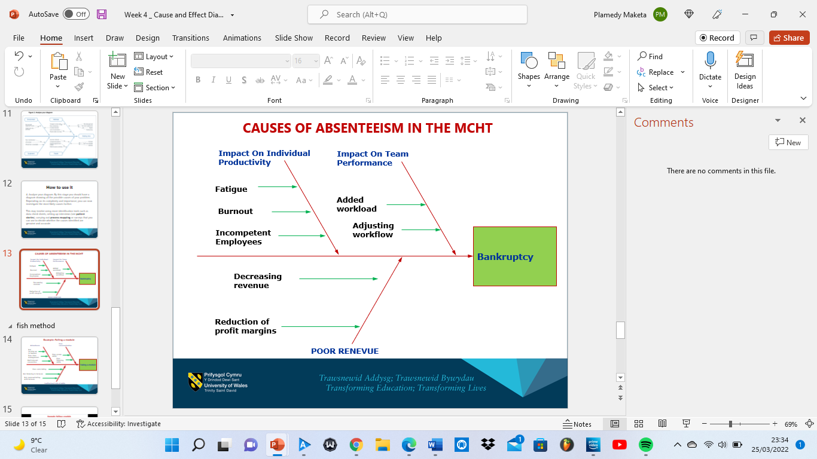
Addressing the complex problem (continued)
If we analyse the problem using a fishbone diagram. We can easily and clearly detect the harm that absenteeism does towards the MCHT
As you can see all these problems relating to absenteeism can ultimately end up with the MCHT being bankrupt and having to shut down if things continue since they’re losing millions and they’re shutdown will affect several families.

Slide 9
A PESTLE ANALYSIS
Economic: Following the financial crisis of 2008, the entire world has been hit by a recession. Of course, the United Kingdom was not exempt to the economic downturn, and the NHS has suffered as a result. The NHS is thought to have been in financial problems for more than a decade (due to economic reasons as much as regulatory ones). This makes it difficult for the NHS to offer patients with high-quality care. The most obvious manifestation of this is a severe shortage of qualified personnel. The NHS has never been a particularly appealing workplace for clinical practitioners due to lacklustre compensation. Thus, with insufficient funds to pay employees and not the best systems money can buy this can deter them from work therefore increase of absenteeism will be inevitable.
Sociocultural: Patients' expectations have never been higher than they are now, thanks to the emergence of social media (which allows information to circulate rapidly than before) and enhanced educational institutions. Patients have a greater understanding of the treatment options accessible to them, and in industrialised countries (such as the United Kingdom), government organisations are expected to spend no money on treatment. While this decreases mortality and is, once again, a largely beneficial move, it does present new challenges for the NHS, since it is expected to offer better care than ever before.
We then look at a pestle analysis that correlates to the complex problem we’re currently facing. According to (Bush, 2022) that correlates with the NHS as a whole
Political : The choice of the United Kingdom to exit the European Union will have far-reaching ramifications for society, including public institutions such as the NHS. There have been several articles written theorizing on how Brexit would affect the NHS, but nothing is certain just yet. For example, there are questions over how EU-made drugs and equipment would be imported into the United Kingdom. This factor can lead to absenteeism because they’re not enough resources to go around to every healthcare centre including the MCHT, which can heavily demoralise employees.
Notes:
Brexit, Eco Downturn, High expec

Slide 10
PESTLE ANALYSIS (Continued)
Legal: Litigation is becoming more common around the world in a variety of situations. Patients (or family members) who are dissatisfied with the quality of their care are turning to the courts for retribution now more than ever. The NHS is no new to this occurrence: the UK has experienced an increase in the number of healthcare-related litigation, and the trend shows no signs of slowing down. Sadly, the healthcare system will be obliged to invest in costly legal defences and pay out multiple settlements as a result of this. Leaving small time centres such as MCHT, borderline broke which can result in absenteeism.
Environmental: According to (Oung, 2019) In keeping with government objectives, the NHS is leading by example in terms of sustainable development and decreasing natural resource use. NHS providers generated over 590,000 tonnes of garbage in 2016/17. Only 15% of this garbage is disposed of in landfills, with the remaining 23% recycled.
Sociocultural (Continued): With this patients that expect better treatment but won’t be able to find it in a treatment centre such as MCHT and not being backed absenteeism can be considered as these centres aren’t backed by the government enough.
Technological: Healthcare is progressively improving as new technology are produced left, right, and centre. Scanning equipment is much more inexpensive than ever before, making it a must-have in healthcare facilities. Disease is being reduced by the development of various tools and instruments for treating or managing conditions. Ultimately, these advancements in healthcare technology are beneficial to all parties involved. Not only do patients receive better care, but government agencies such as the NHS can speed up and automate more clinical procedures.

Slide 11
Solutions To Absenteeism For The MCHT
1. Improving employee & workplace well-being (Lopez, 2019)
2. Provide merit for hard work along with balance (Lopez, 2019)
If the MCHT improve this, Employees who are enthusiastic about their jobs are happy.
A corporation that prioritises health and quality of life will have a more skilled workplace. Because of their improved health, they have fewer sick days and are less likely to call in sick. Especially in an emotionally draining place like the hospital making the work scene better for the staff will boost morale within the workplace.
A reward scheme for perfect attendance should be offered by a company.
Recognising excellent work is the first step in quality staff management. As a result, MCHT work moral will increase, along with the feeling of ownership among The MCHT employees.
To encourage being present, one should look towards enhancing employee satisfaction.

Slide 12
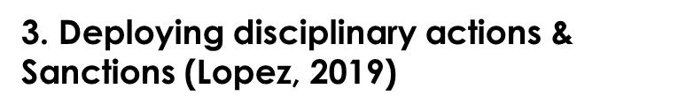
Solutions To Absenteeism For The MCHT & Conclusion (Continued)
The MCHT Should consider the following:
Using a time and attendance system, create trigger mechanisms for reviewing attendance. In the event of an absence, follow disciplinary or capability processes. The decision between these two is based on the size and scope of your organisation and workforce. Too many doctor's notes could be used as a trigger mechanism to start reviews. Managers should be alerted that they need to intervene and explain business resources and procedures. And, if necessary, lay out the steps they'll take if the situation persists. If the absenteeism continues, disciplinary action will be taken. For repeat offenders, dismissal may be appropriate.
In conclusion I believe that this is best option to deter absenteeism due to that feeling that you may get fired for not turning up will leave you getting fired. It will make sure that the employees of the MCHT will arrive for work since if they don’t, they won’t receive their wages. They’re many more options MCHT can take in order to deteriorate absenteeism such as better flexible schedules or a robust method to managing things, but ultimately it will always depend on the mental health and state of mind of the employees of MCHT it is their decision, and it comes down to whether they’re motivated or not.

Slide 13
THANK YOU FOR LISTENING TO MY PRESNENTATION!
By Plamedy Maketa

Slide 14
Bibliography
Bush, T., 2019. PESTLE Analysis of the NHS. [online] PESTLE Analysis. Available at: <https://pestleanalysis.com/nhs-pestle-analysis/> [Accessed 25 March 2022].
Roy, B., 2021. Employee Absenteeism And The Role Of Effective Management. [image] Available at: <https://blog.vantagecircle.com/employee-absenteeism/> [Accessed 26 March 2022].
Collier, E., 2018. Workplace Absenteeism. [online] The Hub | High Speed Training. Available at: <https://www.highspeedtraining.co.uk/hub/reducing-absenteeism-in-the-workplace/> [Accessed 26 March 2022].
Cushard, B., n.d. The Impact of Absenteeism. [online] Spark. Available at: <https://www.adp.com/spark/articles/2017/01/the-impact-of-absenteeism.aspx> [Accessed 25 March 2022].
Taiwo, B., 2021. https://tcbassociates.com/2021/10/08/financial-toll-of-absenteeism-on-a-business/. [image] Available at: <https://tcbassociates.com/2021/10/08/financial-toll-of-absenteeism-on-a-business/> [Accessed 26 March 2022].
Oung, C., 2019. The environment needs to be higher up the NHS agenda. [online] The Nuffield Trust. Available at: <https://www.nuffieldtrust.org.uk/news-item/the-environment-needs-to-be-higher-up-the-nhs-agenda#:~:text=With%20support%20from%20its%20Sustainable,water%20use%20and%20waste%20management.> [Accessed 26 March 2022].
Ukessays.com. 2018. Factors of Absenteeism and Impacts on Organizations. [online] Available at: <https://www.ukessays.com/essays/management/factors-of-absenteeism-and-impacts-on-organizations-management-essay.php> [Accessed 26 March 2022].
Lopez, J., 2019. Absenteeism: 6 key steps to effectively reduce it. [online] Kiwihr.com. Available at: <https://kiwihr.com/blog/absenteeism> [Accessed 26 March 2022].

