Slide 1
Business Plan
NAME : Michelle Alderman
STUDENT ID : 2438756
MODULE CODE : LCLM4006
MODULE TITLE : Enterprise and Entrepreneurship
ASSIGNMENT TITLE: Business plan presentation
LECTURER : Konstantina Mari

Slide 2
Table of Contents
Introduction
Business overview
Legal format and management structure
PESTEL Analysis
Marketing Strategies
Finances
Conclusion
References

Slide 3

Introduction
This presentation is to show you the creation, operation, and financial viability of Home From Home Respite Care
Notes:
When introducing yourself remember to Keep the introduction section concise but impactful. The goal is to establish trust and confidence in your ability to lead the business successfully. Remember to focus on relevant information that aligns with your business idea and creates a positive impression of you. You may include the following information.
Name and Role: Start by stating your name and your position or role in the company. If you are the founder or one of the key team members, mention your title (e.g., CEO, Co-founder).
Background and Experience: Briefly share your relevant background and experience. Highlight any expertise, qualifications, or achievements that demonstrate your capability to lead and execute the business idea effectively.
Passion and Motivation: Explain why you are passionate about the business and the problem you are solving. Share your vision for the company and what drives you to pursue this venture.
Connection to the Industry: If you have a personal or professional connection to the industry in which your business operates, share that information. It could be an experience, personal story, or a passion for the industry that led you to start this venture.
Keep the introduction section concise but impactful. The goal is to establish trust and confidence in your ability to lead the business successfully. Remember to focus on relevant information that aligns with your business idea and creates a positive impression of you and your team.

Slide 4


Business Overview
What is my business?
A small, family-run respite care home for the elderly
Provides short-term care for individuals when family carers need a break
Services offered:
24/7 care and supervision
Personal care support
Companionship
On-call medical support
Nutritional healthy meals

Slide 5

Unique Selling Points (USP)
Home-like environment
Small capacity ensures personalised care tailored to individuals
Flexible short-term stays
Strong emotional support for both residents and families

Slide 6
Legal Structure: It will be a Limited company
Owner-managed business
Small care team Manager + 2 – 3 Care Assistants
Cook/Kitchen staff
Cleaner
Legal Format and Management Structure
Notes:
Refer to week 3 slides: Legal format of Enterprises & Building a Founding team

Slide 7
PESTEL Analysis
PESTEL Factor 1 – Political
Government regulations in the care sector
Need to register with the Care Quality Commission
Impact:
The business must meet strict standards which increases credibility but could add compliance costs
Notes:
Apply PESTEL analysis taught in week 4:
Analyse the following factors:
Political – Government policies, regulations, tax laws, trade restrictions.
Economic – Inflation, interest rates, economic growth, consumer spending.
Social – Demographics, cultural trends, lifestyle changes, education.
Technological – Innovation, digital transformation, automation.
Environmental – Sustainability, climate change regulations, waste management.
Legal – Employment laws, intellectual property rights, industry-specific regulations.
2. Align PESTEL with Business Strategy
After identifying key external factors, explain how they impact your business and what strategies you will adopt to mitigate risks or leverage opportunities.

Slide 8
PESTEL Factor 2 – Economic
Rising cost of living in the UK
Increased demand for affordable care
Impact
Higher running costs (staff, utilities)
But strong demand for respite care for the elderly

Slide 9
PESTEL Factor 3 – Social
Ageing population in the United Kingdom
More families needing temporary care support
Impact:
Growing market demand
Opportunity for fast business growth

Slide 10
Marketing Strategies
Marketing Strategy 1 - Digital Marketing​
Social media ​
Simple website with service info​
Purpose:​
Reach families searching for care options​
Build trust through reviews and testimonials

Slide 11
Marketing Strategy 2 - Local Networking
Partner with:
GP surgeries
Hospitals
Community medical centre's
Purpose
Referrals from trusted professionals
Build local reputation

Slide 12
Financials
Funding
Break-even point
Financial Forecast

Slide 13
Funding Requirements
Total Funding Needed:
£42,700 Loan from bank
Startup Costs Include:
Property setup - £22,700
Furniture & equipment - £15,500
Linen and consumables - £2,000
Licensing & insurance - £2,500

Slide 14
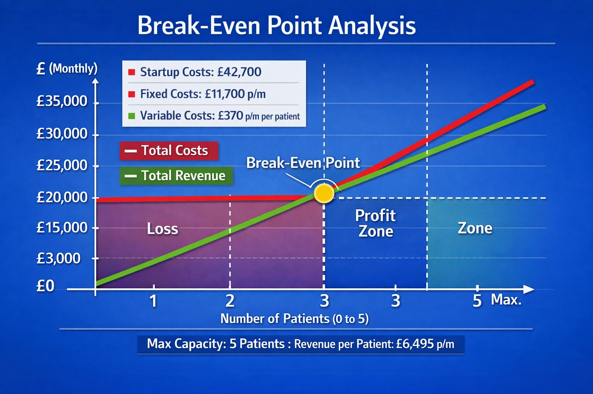
Break-even point will be at 2 – 3 months at maximum capacity

Slide 15
Financial Forecast
Investment needed = Total Startup Cost + (Operational Cost – Revenue up to the break-even point)
Investment capital needed = £42,700
 | Jan | Feb | Mar | Apr | May | Jun
Fixed | £11,700 | £11,700 | £11,700 | £11,700 | £11,700 | £11,700
Variable cost | £1,850 | £1,850 | £1,850 | £1,850 | £1,850 | £1,850
Total cost | £13,550 | £13,550 | £13,550 | £13,550 | £13,550 | £13,550
Revenue | £32,475 | £32,475 | £32,475 | £32,475 | £32,475 | £32,475
Profit/loss | -£23,775 | -£4,850 | +£14,075 | +£33,000 | +£51,925 | +£70,850
Notes:
Investment needed = Total Startup Cost + (Operational Cost– Revenue ) - up to the break-even point

Slide 16
Conclusion
Home from Home Respite Care Home provides a compassionate, valuable service. This business not only aims to achieve financial success but also contributes to social value by supporting vulnerable elderly individuals and their families.
Overall, it is well-positioned to be an established trusted care provider.

Slide 17
References
Burns, P. (2016). Entrepreneurship and Small Business. Palgrave.
Care Quality Commission (2026) Care Quality Commission Guide. Available at: www.cqc.org.uk/news/our-new-assessment-approach-update-january-2024 (accessed: 18/04/2026).
Kotler, P., & Keller, K. (2016). Marketing Management (15th ed. ). Pearson Education.
Scarborough, N. (2014). Entrepreneurship.
UK Government (2026). Starting a Care Business.

Slide 18

Questions?

