Slide 1
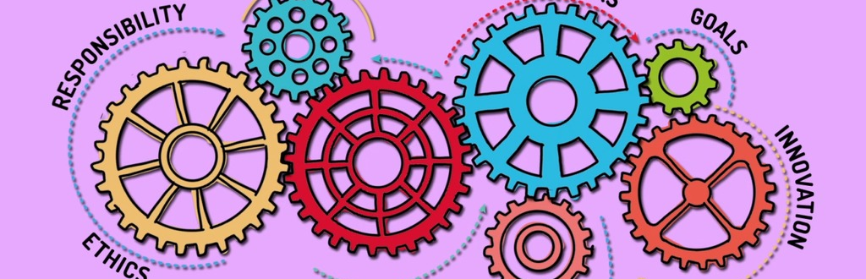
BMMB7007
Human Resource Management
Campus MBA (FT/PT)
Lecture 2
Dr Rachel Cook

Slide 2
Today:
Strategic HRM
Organisational design and culture

Slide 3
What is Strategic HRM (SHRM)?
Strategic HRM refers to HR that is co-ordinated and consistent with the overall business objectives in order to improve business performance (CIPD, 2021)
SHRM focuses on actions that differentiate the business from its competitors (Purcell, 1999)
Long-term view
People are a vital part of organisational success
HR representation at senior level – problematic?
Notes:
Strategic human resource management (SHRM) provides a framework linking people management and development practices to long-term business goals and outcomes. It focuses on longer-term resourcing issues within the context of an organisation's goals and the evolving nature of work. It also informs other HR strategies, such as reward or performance, determining how they are integrated into the overall business strategy.
It helps ensure that the various aspects of people management work together to drive the behaviour and climate needed to create value and meet performance targets. It focuses on longer-term people issues, matching resources to future needs, and large-scale concerns about structure, quality, culture, values and commitment. It must also be a response to the evolving nature of work itself.
Strategic HRM emphasises the importance of HR – and the people in the business – to the success of an organisation. Businesses with an emphasis on strategic HRM may have an HR representative in the boardroom or advising/feeding back to senior executives, and may also make use of HR business partners. Strategic planning presents great challenges and opportunities for HR professionals.
Many HR leaders in large companies are involved in strategic decision-making and participate on the organisation's strategy team. In contrast, HR professionals in many SMEs are not often involved in organisational or functional strategic planning. So, to achieve long-term strategic HR objectives, and to be a key player in the organisation's strategic planning process, some HR departments may need to convince senior management of the value and contribution HR can provide.
So, some of the key characteristics of SHRM are: 1) The use of planning; 2) A coherent approach to the design and management of HR systems; 3) Matching HRM activities to business strategy; and, 4) Seeing people as a strategic resorurce.
The idea of strategic HRM started around the early 1990s, when academics developed definitions such as:
The undertaking of all those activities affecting the behaviour of individuals in their efforts to formulate and implement the strategic needs of business (Schuler)
The pattern of planned human resource deployments and activities intended to enable the organisation to achieve its goals (Wright and McMahan).
Boxall and Purcell describe strategic HRM as being concerned with explaining how HRM influences organisational performance. They also argue that strategy is not the same as strategic planning because: Strategic planning is the formal process that takes place, usually in larger organisations, defining how things will be done. Strategy, by contrast, exists in all organisations (even if it’s not written down and articulated) and defines the organisation’s behaviour and how it attempts to cope with its environment. Strategic HRM can include a number of individual HR strategies, for example: To deliver fair and equitable reward. To improve employee performance. To streamline organisational structure. In themselves these are not ‘strategic HRM’. Rather, strategic HRM is the overall framework that determines the shape and delivery of the individual strategies, systematically linking people with organisations by integrating HRM strategies into organisational strategies to deliver organisational success.

Slide 4
Benefits of SHRM
Avoiding costly and disruptive surprises that interfere with achieving goals
Addressing key issues in a timely manner to avoid crises
Promoting employee productivity and overall organisational success
Providing a sense of direction to positively affect how work gets done
Keeping employees focused on organisational goals
Providing a strategic focus to guide training and development initiatives
Giving leaders tools to help focus and implement their strategic initiatives
Notes:
There’s no single HRM strategy that will deliver success in all cases. Organisations must define their own unique strategy according to their specific context, culture and objectives. People professionals are instrumental in applying their expertise to understanding organisational circumstances.
That said, the closer the alignment between HR and an organisation's overall business strategy, the better the company's ability to maintain competitive advantage. Rigorous research, planning and development involving workforce culture, behaviours and competencies promote the successful execution of business strategy.
Particular benefits of HR strategic planning include the following: BOARD

Slide 5
SHRM and performance
Research emphasises the importance of fit
‘The premise is that, in some shape or form, HR policies have an effect on HR practices and these in turn influence staff attitudes and behaviours which will, in turn again, impact on service offerings and customer perceptions of value’ (Storey, et al., 2009)
Job design and skill development
OCBs and discretionary behaviour
Can we be sure?
Notes:
Since around the mid-1990s, the CIPD and other organisations have been gathering evidence of the impact of people management practices on business performance. Much emphasis has been placed on the importance of ‘fit’. In other words, HR interventions should align with both each other and other organisational strategies for maximum impact.
Storey et al (2009: 4) observed that: ‘The premise is that, in some shape or form, HR policies have an effect on HR practices and these in turn influence staff attitudes and behaviours which will, in turn again, impact on service offerings and customer perceptions of value.’
The main areas of practice agreed to have an impact on performance are around job design and skills development. Making sure the right people have the skills they need to do their jobs well. Sounds simple, but what’s the reality?
The CIPD ‘people and performance model’ emphasises the importance of individual HR strategies fitting with each other and operating within a strategic framework that incorporates both people and business issues, but also identified that individual HR practices alone do not drive better business performance. For example, highly skilled individuals with valuable human capital can only generate value if they also have positive relationships with their managers in a supportive environment with strong values. All these factors will promote OCBs and ‘discretionary behaviour’, that is, the willingness of the individual to perform above the minimum necessary or give extra effort. Hence strategic HRM should take account of the need to foster employee engagement and related states, such as motivation and commitment, all of which support organisational performance
Much research has been carried out showing that good HRM practice and firm performance are correlated, but not necessarily causation:
Guest et al (2000) commented that the research still left uncertainties about cause and effect.
Paauwe (2009) - although progress has been made on the link between HRM and performance, significant methodological issues exist regarding the understanding of this relationship. While it may be possible to observe HRM inputs in the form of HR practices and to measure firm performance outputs, it may be difficult to ascertain, through research, what happened in between – that is to say what HR practices directly translated into firm performance outputs. This is the so-called ‘black box’. But this links to the CIPD that says there isn’t a single HR strategy or practice that can carry success and it must be a combination of things.

Slide 6
SHRM and human capital management
Human capital management
‘The knowledge, skills, and abilities that workers possess and which have been acquired through education, training, and experience both within and beyond the workplace’ (Heery and Noone)
HCM can complement and strengthen SHRM
People analytics/HR analytics/Workforce analytics
Notes:
The term ‘human capital’ describes people’s potential to create value for their organisations.
Heery and Noon define Human Capital as ‘the knowledge, skills, and abilities that workers possess and which have been acquired through education, training, and experience both within and beyond the workplace’.
Human capital management then treats people as assets rather than costs. It focuses on adopting an integrated and strategic approach to managing people, which is the concern of all stakeholders in an organisation, not just people management professionals. How people are treated matters.
Human capital management can complement and strengthen strategic HRM by:
Clarifying the links between what people do in their jobs, the value they create, and business strategy. This includes not just what people do day to day, but also how they bring innovation into operational tasks or management processes.
Strengthening the belief that people are assets rather than costs.
Drawing attention to the significance of ‘management through measurement’ - the aim being to establish a clear line of sight between HR interventions and organisational success.
Providing guidance on what to measure, how to measure and how to report on the outcomes of measurement (this is often known as ‘human capital metrics’).
Underlining the importance of using the measurements to prove that superior people management is delivering superior results and to indicate the direction that HR strategy should follow.
Reinforcing attention on the need to base HRM strategies and processes on the requirement to create value through people and thus further the achievement of organisational goals.
Emphasising the role of HR specialists as business partners.
This links to people analytics - The term people analytics is often used to describe the use of data about people to solve business problems. It is sometimes known as HR analytics or workforce analytics. The quality of strategic HRM is best shown by collecting key performance indicators that show the impact of strategic practices on both the HR function and the wider organisation. People analytics is crucial for understanding these outcomes, and especially for developing insights which further drive strategic decision making. The absence of people analytics capabilities makes the delivery of effective strategic HRM difficult, and more likely to fail. So it’s important that HR functions are developing their strategic activity build a firm foundation of people analytics practices.

Slide 7
Criticisms of SHRM
Hard to implement at organisational level
HR being able to prove its worth
HR lacking representation at senior level
Relies on abilities of HR dept
Notes:
Critics of SHRM say that it is a good idea in theory but often hard to implement at the organisational level. Translating the organisation’s objectives and values into tangible initiatives that can be driven by the HR department is a complex problem underlying SHRM.

Slide 8
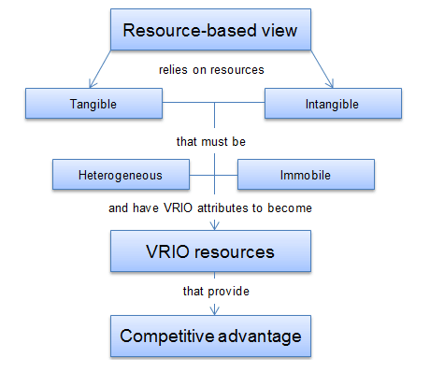
People as a strategic resource
Notes:
What is the RBV then? The resource-based view (RBV) of the firm is an approach to achieving competitive advantage. The concept was developed by Barney (1991).
Resource-based SHRM can produce what Boxall and Purcell (2016) refer to as ‘human resource advantage.’ The aim is to develop strategic capability. This means strategic fit between resources and opportunities, obtaining added value from the effective deployment of resources, and developing managers who can think and plan strategically in the sense that they understand the key strategic issues and ensure that what they do enables the strategic goals of the business to be achieved.
In RBV model, resources are given the major role in helping companies to achieve higher organizational performance.
There are two types of resources: tangible and intangible.
Tangible assets are physical things. Land, buildings, machinery, equipment and capital – all these assets are tangible. Physical resources can easily be bought in the market so they confer little advantage to the companies in the long run because rivals can soon acquire the identical assets.
Intangible assets are everything else that has no physical presence but can still be owned by the company. Brand reputation, trademarks, intellectual property are all intangible assets. Unlike physical resources, brand reputation is built over a long time and is something that other companies cannot buy from the market. Intangible resources usually stay within a company and are the main source of sustainable competitive advantage.
The two critical assumptions of RBV are that resources must also be heterogeneous and immobile.
Heterogeneous. The first assumption is that skills, capabilities and other resources that organizations possess differ from one company to another. If organizations had the same amount and mix of resources, they could not employ different strategies to outcompete each other. What one company would do, the other could simply follow and no competitive advantage could be achieved. Therefore, RBV assumes that companies achieve competitive advantage by using their different bundles of resources – companies which are exposed to the same external and competitive forces (same external conditions) are able to implement different strategies and outperform each other. These days, particularly relevant to technology. (SAMSUNG VS APPLE)
Immobile. The second assumption of RBV is that resources are not mobile and do not move from company to company, at least in the short-run. Due to this immobility, companies cannot replicate rivals’ resources and implement the same strategies. Tangible assets could be mobile over a longer period of time. But intangible resources, such as brand equity, processes, knowledge or intellectual property are usually immobile.
VRIO framework: VRIO framework is the tool used to analyse firm’s internal resources and capabilities to find out if they can be a source of sustained competitive advantage. Go through this in next slide.
All of this then leads to competitive advantage: superior performance relative to other competitors in the same industry or superior performance relative to the industry average.
Wright et al (2001) noted that there are three important components of HRM that constitute a resource for the firm and are influenced by HR practices or the HR system:
1. The human capital pool comprised of the stock of employee knowledge, skills, motivation and behaviours
2. The flow of human capital through the firm – the movement of people and of knowledge
3. The dynamic processes through which organisations change and/or renew themselves.
They suggested that HR practices are the primary levers through which the firm can change the pool of human capital as well as attempt to change the employee behaviours that lead to organisational success.
Resource-based strategic HRM can produce what Boxall and Purcell (2003) referred to as human resource advantage. The aim is to develop strategic capability. This means strategic fit between resources and opportunities, obtaining added value from the effective deployment of resources, and developing people who can think and plan strategically in the sense that they understand the key strategic issues and ensure that what they do supports the achievement of the business’ strategic goals.

Slide 9
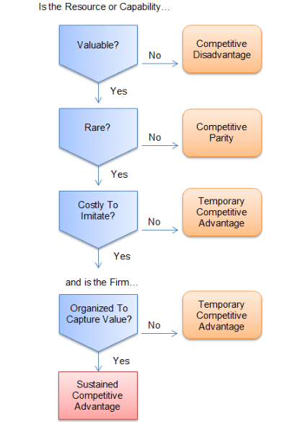
VRIO Framework
Notes:
Although, having heterogeneous and immobile resources is critical in achieving competitive advantage, it is not enough alone if the firm wants to sustain it.
In order to understand the sources of sustained competitive advantage, firms are using many tools to analyse their external (Porter’s 5 Forces, PEST analysis) and internal (Value Chain analysis, BCG Matrix) environments. One of such tools that analyze firm’s internal resources is VRIO analysis.
The tool was originally developed by Barney (1991;1995) in his work ‘Firm Resources and Sustained Competitive Advantage’. Barney says that a resource must possess four attributes in order to become a strategic asset and a source of sustained competitive advantage:
VALUABLE
RARE
IMPERFECTLY IMITABLE
ORGANISED
A resource or capability that meets all four requirements can bring sustained competitive advantage for the company.

Slide 10
People as a strategic resource
Notes:
Where do people fit them?

Slide 11
Activity: HRM and the RBV
Can people be considered
Valuable?
Rare?
Imperfectly imitable?
Non-substitutable?

Slide 12
HRM and Culture
Mullins, 2016: “How things are done around here”
Johnson, 2013, as cited in Mullins, 2016: “It embodies the ethos and values of a particular organisation, which are expressed through the way it operates and the practices it undertakes”
Hofstede, 2001: “Culture is the collective programming of the mind that distinguishes the members of one group or category of people from another”
Notes:
Whether you can define it or not, you know that culture exists. It's that something that hangs in the air and influences how work gets done, critically affects project success or failure, says who fits in and who doesn't, and determines the overall mood of the company.
Culture often becomes the focus of attention during periods of organisational change – when companies merge and their cultures clash, for example, or when growth and other strategic change mean that the existing culture becomes inappropriate, and hinders rather than supports progress.
In more static environments, cultural issues may be responsible for low morale, absenteeism or high staff turnover, with all of the adverse effects those can have on productivity. All of which become HR’s problem. Similarly, organisational culture is an important concept to the people profession. The work of HR, L&D and OD influences, and is influenced by, organisational culture because, at its heart, every organisation is made up of human relationships and human interactions. Culture is therefore central to the role of the profession and must be managed and developed accordingly.
Definitions above: Like HRM, no absolute consensus
Fortunately, while corporate culture can be elusive, approaches have been developed to help us look at it. Such models can play a key role in formulating strategy or planning change:
Good read: https://www.hrmagazine.co.uk/content/insights/why-culture-is-critical-in-the-post-covid-world

Slide 13
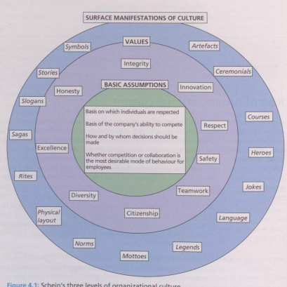
Notes:
Schein 1992
The surface level of culture is the most visible. Anyone coming into contact with it can observe it:
Artefacts are organisational attributes that can be seen, felt and heard by the uninitiated observer, including the facilities, offices, décor, furnishings, dress, and how people visibly interact with others and with organisational outsiders
Ceremonials are formally planned, elaborate, dramatic sets of activities of cultural expression, e.g. opening events, prize-givings, graduations, religious services
Courses and workshops are used to instruct, induct, orient and train new members in company practices
Heroes are characters, living or dead, who personify the values and beliefs; who are referred to in company stories, legends, sagas, myths and jokes; and who represent role models that current employees should emulate
Jokes are humorous stories intended to cause amusement, but their underlying themes carry a message for the behaviour or values expected of organizational members
Language is the particular form or manner in which members use vocal sounds and written signs to convey meaning to each other. It includes both specialist technical vocabulary related to the business (jargon), as well as general naming choices
Legends are handed-down narratives about wonderful events based on company history, but embellished with fictional details. These fascinate employees and invite them to admire or deplore certain activities
Mottoes are maxims adopted as rules of conduct. Unlike slogans, mottoes are rarely, if ever, changed.
Norms are expected modes of behaviour that are accepted as the company's way of doing things, thereby providing guidance for employee behaviour
Physical layout concerns things that surround people, providing them with immediate sensory stimuli, as they carry out culturally expressive activities
Rites are elaborate, dramatic sets of activities that consolidate various forms of cultural expression into one event. They are formally planned events such as annual staff performance reviews
Sagas are historical narratives describing the unique accomplishments of groups and their leaders. They usually describe a series of events that are said to have unfolded over time and which constitute an important part of an organization's history
Slogans are short, catchy phrases that are regularly changed. They are used for both customer advertising and also to motivate employees
Stories are narratives describing how individuals acted and the decisions they made that affected the company's future. Stories can include a mixture of both truth and fiction
Symbols refer to any act, event, object, quality or relationship that serves as a vehicle for conveying meaning.
Espoused values - the professed culture of an organisation's members. Company slogans, mission statements and other operational creeds are useful examples
Basic underlying assumptions - which are unseen and not consciously identified in everyday interactions between organisational members. Even people with the experience to understand this deepest level of organisational culture can become accustomed to its attributes, reinforcing the invisibility of its existence.

Slide 14
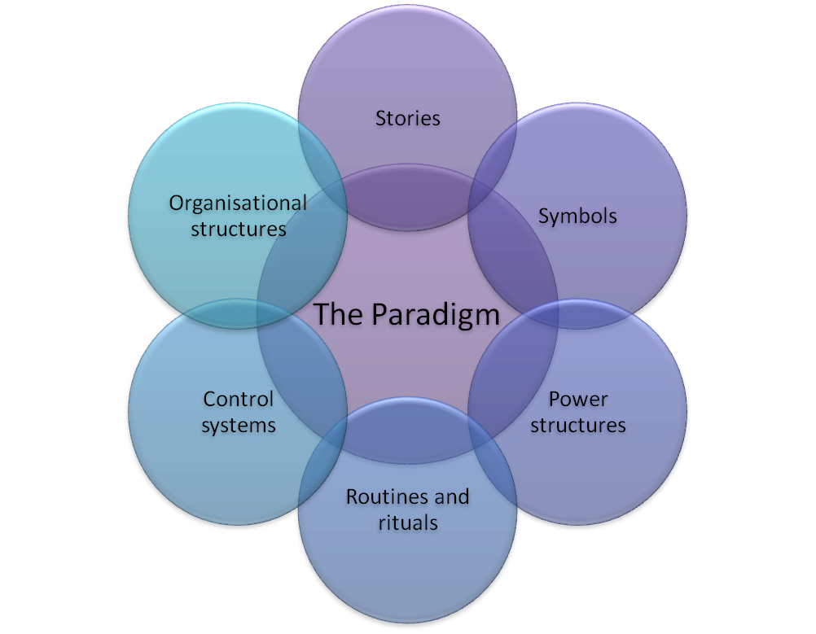
Notes:
Cultural Web
The Cultural Web identifies six interrelated elements that help to make up what Johnson and Scholes call the "paradigm" - the pattern or model - of the work environment. By analysing the factors in each element, you can begin to see the bigger picture of your culture: what is working, what isn't working, and what needs to be changed. The six elements are
Rituals and Routines - The daily behaviour and actions of people that signal acceptable behaviour. This determines what is expected to happen in given situations, and what is valued by management.
Stories - The past events and people talked about inside and outside the company. Who and what the company chooses to immortalize says a great deal about what it values, and perceives as great behaviour.
Symbols - The visual representations of the company including logos, how plush the offices are, and the formal or informal dress codes.
Control Systems - The ways that the organisation is controlled. These include financial systems, quality systems, and rewards (including the way they are measured and distributed within the organisation.)
Power Structures - The pockets of real power in the company. This may involve one or two key senior executives, a whole group of executives, or even a department. The key is that these people have the greatest amount of influence on decisions, operations, and strategic direction.
Organisational Structure - This includes both the structure defined by the organisation chart, and the unwritten lines of power and influence that indicate whose contributions are most valued.

Slide 15
Handy’s Four Types of Organisational Culture
Power Culture
Role Culture
Task Culture
Person Culture
Notes:
Charles Handy (1999), following work by Harrison (1972), presented organisational cultures as classified into four major types: the power culture, the role culture, the task culture, and the person or support culture.
Handy’s approach may help you understand why you have been more comfortable in some organisations than others.
Interestingly, although Handy chooses to talk about culture, he shows the organisational structures associated with his culture types. This maybe because of the difficulty of drawing something as diffuse as culture, but it also reinforces the fact that culture and structure are interrelated.

Slide 16
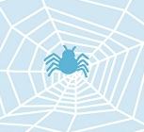
Power Culture
• Culture relies on central figure
• Central figure communicates outwards
• Found in small organisations
• Quick decision making
• Can respond to change and outside threats
• Hard to maintain once the business starts to expand
• Vigorously pitted against change
Notes:
Handy illustrates the power culture as a spider’s web, with the all-important spider (owner/manager/’chief’) sitting in the centre, because the key to the whole organisation sits in the centre, surrounded by ever-widening circles of intimates and influence. The closer you are to the spider, the more influence you have.
Power is concentrated among a few people, and your relationship with that person matters a lot more than your title.
Downward or ‘push’ feedback. No voice mechanisms in place to allow employees to feedback.
Because they are less formalised and most people have direct access to the manager/owner. Very early stage startups with charismatic leaders tend to be Power Cultures, but you'll find them in other types of organisations as well. Fashion, publishing, and film come to mind. In fact, "The Devil Wears Prada" and the documentary "The November Issue" are perfect depictions of Power Cultures. Apple under Steve Jobs and the early days of Facebook were Power Cultures. Since access to the leader(s) means so much, you can expect a lot of jockeying to be the Chief's BFF.
Little bureaucracy means decisions are made quickly, which can be an advantage. However, the calibre of the decision maker directly affects the quality of the decisions made.
Quick decisions mean organisations can respond to change and threats.
Quick decisions can lack focus on long-term consequences, meaning it can be difficult to maintain this culture as a business expands. Likewise, organisations with a power culture are heavily dependent for their continued success on the abilities of the people at the centre; succession is a critical issue.
You'll flourish in a Power Culture if you make relationships easily, can work in an less-structured environment, and don't mind (or actually enjoy) the political wrangling.

Slide 17
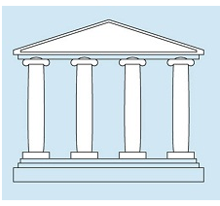
Role Culture
Most common and readily recognised
Based on job/role rather than personalities
Traditional hierarchical structure
Well-defined roles
Change relatively slow and only brought about by fear
Can adapt but this ability restricted and will thus face problems surviving a dramatic change
Notes:
In role culture, power derives from a person's place or role within a highly structured organisation.
The role culture can be illustrated as a building supported by columns and beams: each column and beam has a specific role to playing keeping up the building; individuals are role occupants but the role continues even if the individual leaves.
This is the most common type of organisation and is the easiest to recognise
This type of organisation is characterised by strong functional or specialised areas coordinated by a narrow band of senior management at the top and a high degree of formalisation and standardisation; the work of the functional areas and the interactions between them are controlled by rules and procedures defining the job, the authority that goes with it, the mode of communication and the settlement of disputes.
Role Cultures are highly bureaucratic with detailed rules about how people and departments interact with each other, customers and vendors. Large, well-established companies like insurance companies and banks tend to have Role Cultures because they have to. You have to deal with too many people in the organisation for personal relationships to develop, so who gets to make decisions and who is in control is determined by title. Also, policies and procedures are formalised into operating manuals so that interactions are ritualised. This is a traditional hierarchy.
The workflow and decision-making procedures are documented in employee manuals which don't leave a lot of room for innovation or interpretation. This means that management can be sure that roles are well-defined and that tasks will get done without requiring a lot of thought or innovation on the part of the employees.
Role Culture companies will provide you with a lot of stability, certainty and continuity. But Role Culture companies may have trouble adapting to, or generating, change. Every change in workflow has to be carefully considered, the impacts weighed and then documented, and employees have to be trained in the new methods.
If you like well-defined jobs with explicit expectations, a Role Culture organisation is the one for you. However, this culture is frustrating for ambitious people who are power orientated, want control over their work or are more interested in results than method. Such people will be content in this culture only as senior managers. The importance of Handy’s role culture is that it suggests that bureaucracy itself is not culture-free.

Slide 18
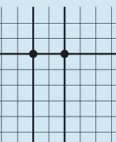
Task Culture
Management’s basic concern – continuous and successful solution of problems
Flexible structure – can be tailored according to task in hand
Suitable for rapidly changing organisations where groups are established for short term basis
Individual knowledge rather than rank and position - autonomy
Can be difficult to control
Most medium and large professional services, accounting, law and consulting firms (like PwC, Deloitte, Bain, etc.)
Notes:
Task culture is job-or project-oriented, and its accompanying structure can be best represented as a net. Some of the strands of the net are thicker or stronger than others, and much of the power and influence is located at the interstices of the net, at the knots. Task cultures are often associated with organisations that adopt matrix or project-based structural designs.
1. The emphasis is on getting the job done, and the culture seeks to bring together the appropriate resources and the right people at the right level in order to assemble the relevant resources for the completion of a particular project. A task culture depends on the unifying power of the group to improve efficiency and to help the individual identify with the objectives of the organisation.
2 & 3.Task culture depends on teamwork to produce results. Groups, project teams or task forces are formed for a specific purpose and can be re-formed, abandoned or continued. The organisation can respond rapidly since each group ideally contains all the decision-making powers required. The task culture is therefore appropriate when flexibility and sensitivity to the market or environment are important, where the market is competitive, where the life of a product is short and/or where the speed of reaction is critical. Against this must be set the difficulty of managing a large organisation as a flexible group, and of producing economies of scale or great depth of expertise.
4. Individuals find that this culture offers a high degree of autonomy, judgment by results, easy working relationships within groups and mutual respect based on ability rather than on age or status. Individuals’ knowledge is valuable in this culture.
5. Control in these organisations can be difficult. Essential control is retained by senior managers, who concentrate on the allocation of projects, people and resources, but they exert little day-to-day control over methods of working or procedures, without violating the norms of the culture. This works well in favourable circumstances and when resources are available for those who can justify using them. However, when resources are not freely available, senior managers begin to feel the need to control methods as well as results, and team leaders may begin to compete for resources, using political influence. Morale in the work groups tends to decline and the job becomes less satisfying in itself, so that employees begin to reveal their own objectives. This necessitates the introduction of rules and procedures, the use of position or the control of resources by managers to get the work done. So the task culture has a tendency to change to a role or power culture when resources are limited or when the whole organisation is unsuccessful.
Most managers, certainly at the middle and junior levels, prefer to work in the task culture, with its emphasis on groups, expert power, rewards for results and a merging of individual and group objectives. It is most in tune with the current trends of change and adaptation, individual freedom and low status differentials – but it may not be an appropriate culture for all circumstances.

Slide 19
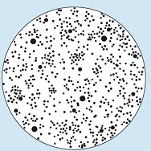
Person Culture
More unusual culture
Structure and culture built around individuals
Influence is shared and the power base is usually expert
Examples:
  Small law or accounting office,
  Barristers chambers
  GP Practice
  Professional practices
Notes:
1 & 2. Person culture is an unusual culture. It is not found in many organisations, yet many people espouse some of its values. This type of culture is illustrated by a loose cluster or a constellation of stars. In this culture the individual is the focal point; if there is a structure or an organisation, it exists only to serve and assist the individuals within it, to further their own interests without any overriding objective.
3.. Clearly, not many organisations can exist with this sort of culture, or produce it, since organisations tend to have some form of corporate objective over and above the personal objectives of those who comprise them. Furthermore, control mechanisms, and even management hierarchies, are impossible in these cultures except by mutual consent. An individual can leave the organisation, but the organisation seldom has the power to evict an individual. Influence is shared and the power base, if needed, is usually expert; that is, people do what they are good at and are listened to for their expertise.
4. Person Cultures are typically found in professional partnerships, at least in the past. Here, the lawyer/doctor/accountant who leads a practice bring in the clients, although they may or may not have the personal expertise to deliver the services.
Person Cultures differ from Power Cultures in that they are a collection of fiefdoms which aren't arranged into a single hierarchy.
If you want to work in a small law or accounting office, you'll be working in a Person Culture.

Slide 20
Deal and Kennedy (1982)
6 cultural elements:
History
Values and beliefs
Rituals and ceremonies
Stories
Heroic figures
The cultural network
Notes:
In their work on the subject of culture, Deal and Kennedy suggested that the basis of corporate culture was an interlocking set of six cultural elements:
History – A shared narrative of the past lays the foundation for corporate culture. The traditions of the past keep people anchored to the core values that the organisation was built on.
Values and Beliefs – Cultural identity is formed around the shared beliefs of what is really important, and the values that determine what the organization stands for.
Rituals and Ceremonies – Ceremonies are the things that employees do every day that bring them together. Examples include Friday afternoon get-togethers or simply saying goodbye to everyone before you leave for the day.
Stories – Corporate stories typically exemplify company values, and capture dramatically the exploits of employees who personify these values in action. Stories allow employees to learn about what is expected of them and better understand what the business stands for.
Heroic Figures – Related to stories are the employees and managers whose status is elevated because they embody organisational values. These heroes serve as role models and their words and actions signal the ideal to aspire to.
The Cultural Network – The informal network within an organisation is often where the most important information is learned.
See some overlap with Schein’s model.

Slide 21
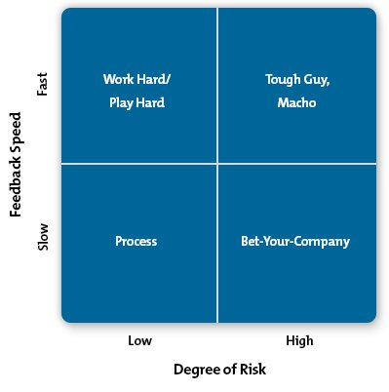
Deal and Kennedy’s Culture Types
Notes:
By examining these six cultural elements across a variety of organisations, Deal and Kennedy identified four distinct types of cultures and two marketplace factors that they felt influenced cultural patterns and practices.
The two factors are:
The degree of risk associated with a company's key activities.
The speed at which companies learn whether their actions and strategies are successful – i.e. feedback. By ‘feedback’, Deal and Kennedy do not mean just bonuses, promotions and pats on the back. They use the term much more broadly to refer to knowledge of results.
They believed that the risk involved in making a poor decision and the time it takes to find out whether a decision is the right one, both have a bearing on how cultural elements develop and influence an organisation's employees.
Deal and Kennedy present these factors in a 2 x 2 matrix that identifies the four culture types, as shown in the figure above.
Four types of culture
Work Hard/Play Hard – This culture is the world of sales (among others). Employees themselves take few risks; however, the feedback on how well they are performing is almost immediate. Employees in this culture have to maintain high levels of energy and stay upbeat. Heroes in such cultures are high volume salespeople. Interestingly, this culture recognises that one person alone cannot make the company. They know it is a team effort and everyone is driven to excel. Contests among employees are common here, as they drive everyone to reach new heights.
Tough-Guy, Macho – This culture contains a world of individualists who enjoy risk and who get quick feedback on their decisions. This is an all-or-nothing culture where successful employees are the ones who enjoy excitement and work very hard to be stars. The entertainment industry, sports teams and advertising are great examples of this cultural type. Teamwork is not highly valued in this culture, and it's a difficult environment for people who blossom slowly. This leads to higher turnover, which impedes efforts to build a cohesive culture. Thus, individualism continues to prevail.
Bet-Your-Company – Here, the culture is one in which decisions are high risk but employees may wait years before they know whether their actions actually paid off. Pharmaceutical companies are an obvious example of this culture, as are oil and gas companies, architectural firms and organisations in other large, capital-intensive industries. Because the need to make the right decision is so great, the cultural elements evolve such that values are long-term focused and there is a collective belief in the need to plan, prepare and perform due diligence at all stages of decision making.
Process – In this culture, feedback is slow, and the risks are low. Large retailers, banks, insurance companies and government organisations are typically in this group. No single transaction has much impact on the organisation's success and it takes years to find out whether a decision was good or bad. Because of the lack of immediate feedback, employees find it very difficult to measure what they do so they focus instead on how they do things. Technical excellence is often valued here and employees will pay attention to getting the process and the details right without necessarily measuring the actual outcome.

Slide 22
The influence of HRM on culture
Benefits packages
KPIs in place (line managers)
Training and development opportunities
Recruitment, selection and onboarding
Renumeration and reward
Policies and procedures
Notes:
Benefits on offer can impact culture much more directly than some may realise. For example, providing a generous parental leave package will go a long way toward creating a culture that is supportive of parents or providing a flexible workday or remote work option can influence how the organisation judges performance, encouraging judgement based on outcomes, not hours.
The key performance indicators (KPIs) in place make a big difference in how employees work and how they’re judged, which, in turn, impacts how they interact with one another. HR can have a direct impact on KPIs through training and influence on the supervisory staff.
How much training is on offer and how it is communicated will directly impact whether an organisation is viewed as being friendly to employee development. The type of training on offer also matters. Providing things like inclusivity training, empathy training, and training on listening skills sends a clear message about the types of skills the employer values, for example.
Recruiting in a way that emphasizes cultural fit can also be an option. This can be accomplished through how the interview is conducted, the types of questions that are asked, and the emphasis put on that fit. HR is often either directly or indirectly responsible for creating onboarding and training programs, so this is another area where HR professionals can start to have an impact.
Pay, particularly incentive schemes and bonus structures, can have an impact on employee behaviour and motivation levels, which directly impacts the culture. HR teams can greatly influence pay through discussions with organisational leadership about market norms and the like and with the creation of pay grades or bands throughout the organisation.
What HR pols and procedures are, and what they say about the focus. Employee wellbeing, for example.

Slide 23
Developing/Changing culture
Change and Stability Management module relevant here
Convey the vision and need for change
Employees need a voice
Incremental change and time to process
Fear of the unknown
Change models – Lewin, Kotter, etc.
Notes:
Committing to cultural change in an ever-evolving work environment is vital, particularly given the high rate of failure among change initiatives. To maximise the benefits and ensure the commitment, engagement and retention of their people, organisations must ensure that culture change is managed properly.
When attempting to make cultural change, there are several things that organisations should consider:
Convey the vision and need for change to the wider organisation: the relatively small number of people involved in initiating change take time and care when doing this and can therefore easily justify their decisions. Those hearing about change for the first time, however, do not share this privilege. Organisations need to ensure employees connect with the vision and need for change and understand its benefits, rather than feeling the negative effects of an upheaval.
Grasp the potential of key stakeholders: As well as managers as key enablers of their staff, leaders of networks and employee resources groups must be involved in the implementation of culture change to ensure its success. Working alongside those who share the organisation’s vision will be more conducive to creating shared values than parachuting in new leaders.
Avoid immediately reorganising: Instead, clarify the vision and ensure there are management roles and systems that support this vision.
https://www.forbes.com/sites/stevedenning/2011/07/23/how-do-you-change-an-organizational-culture/?sh=75c105f239dc

Slide 24
Case study example:
The Children’s Trust Southampton
Background:
Established 2008 – statutory requirement
Main focus – develop arrangements for working across organisational and agency boundaries to improve the outcomes for children, young people and their families
Partnership, not organisation
Questions:
What were the drivers of change? Why did these drive change?
What were the key culture change activities?
What difficulties arose during the culture change?
What was effective?
Notes:
It is important to note that the trust is not an organisation but a partnership, and thus the trust itself does not have employees, but the trust’s workforce are all staff working in organisations/agencies as part of the partnership.
In particular, why were leaders as change agents important?

Slide 25
Culture in the future
Read CIPD – People profession 2030: a collective view of future trends
  On Moodle

Slide 26
Today:
Strategic HRM
Organisational design and culture

