Slide 1
Presentation
30th March
Maggie

Slide 2
previous academic knowledge and experience
My major: English Education & Ancient Chinese
My working experience: working as a lecturer in a university for national minorities in China

Slide 3
Research Question
The moderating effect of culture on social commerce acceptance: a comparative study between two ethnic groups in China.
- The social commerce acceptance model, Hofstede’s cultural dimensions and Triandis & Gelfand’s individualism and collectivism scale (1998) will be considered in the research. Selecting Han Chinese and Tibetan holding the value of Confucianism and Tibetan Buddhism respectively leading to their different concept of collective as participants, the empirical study will identify in which ethnic group the social commerce is more possibly succeed.

Slide 4
The conceptual confusion of social commerce(Kem Z.K. Zhang,2016)
two major types of social commerce:
(1) social networking sites that incorporate commercial features to allow transactions and advertisements. (eg. P. Chatterjee, 2011)
(2) traditional e-commerce websites that add social tools to facilitate social interaction and sharing. (eg. Y Huang et al, 2010).

Slide 5
Literature review
the study of social commerce fall into three categories:
social commerce and organizations,
social commerce and advertising,
social commerce and e-WOM
(Xiaolin et al, 2016)

Slide 6
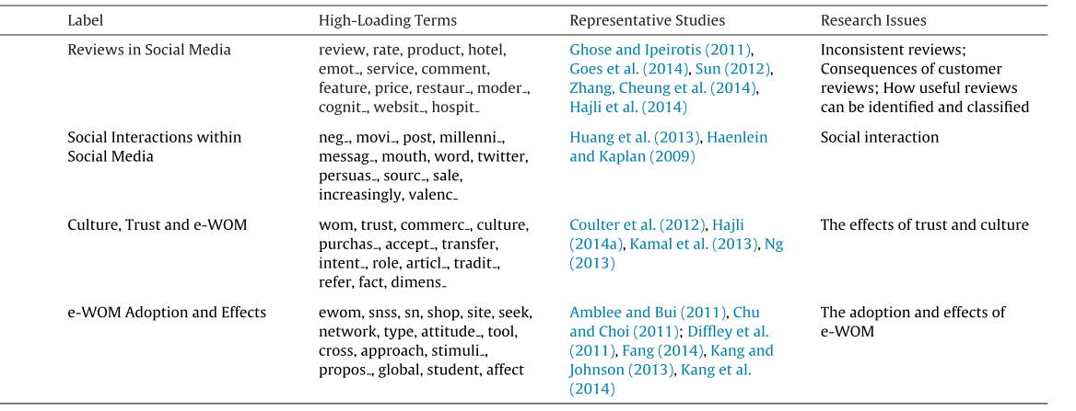
Social commerce and e-wom (adapted from Xiaolin Lin et al, 2016)

Slide 7
Justification for choice of the topic
e-commerce modifies China greatly from the perspective of economics, sociodemography, anthropology, sociology.
My passion on the cultural differences of different nationalities in China.
Duplicating an existing study but try to do something different- Ng(2013)

Slide 8
Justification of the proposed methodological approach
Quantitative research
Quantitative research relating to the positivism paradigm (Denzin & Lincoln, 1994) usually collect data and transform it into numbers for statistical analysis and conclusions. Opposite to qualitative research, quantitative research tends to transform from general to specific, like verifying the theories, identifying variables to study (Creswell, 1994 ).
As a dominating research form in social science, the quantitative research approach is objective and comparatively far away from human bias. It provides a wide range of samples with speed and efficiency. However, it is not very helpful in forming theories and lacks flexibility (Asterby Smith et al, 2018).

Slide 9
Justifications of selecting positivism
The research paradigm adopted in my research is positivism, a deterministic philosophy in which causes effects or outcomes (Creswell, 1994). The empirical research seeks to identify the causal relationship between variables to predict reality (Golafshani, 2003). The purpose of positivism research is to explain other than understand and has no personal bias. One of its major elements is theory verification (Creswell, 1994) which is relating to my research exploring the impact of the culture referring to Hofstede’s cultural dimension

Slide 10
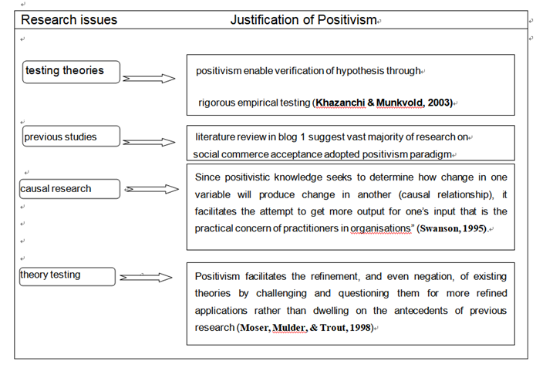
Justifications of selecting positivism

Slide 11
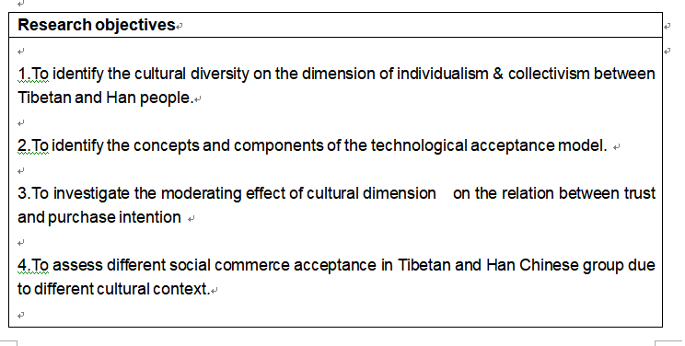
The Research objectives

Slide 12
Research model and hypotheses
The theoretical frameworks adopted in previous research on social commerce acceptance:
technology acceptance model
the theory of reasoned action
the theory of planned behavior
the unified theory of acceptance and use of technology.

Slide 13
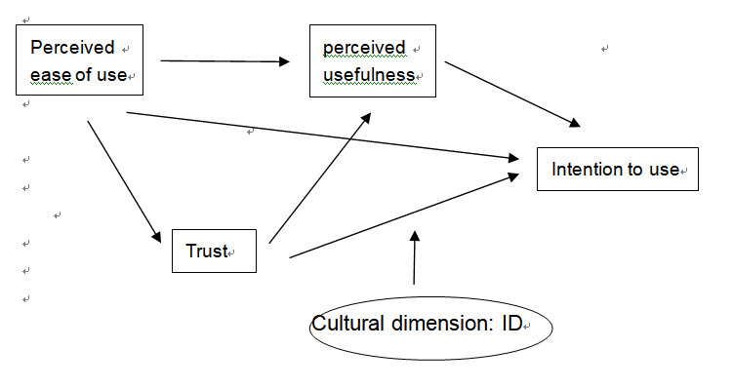
Research model: technology acceptance model following Gefen (2003) ’s study

Slide 14
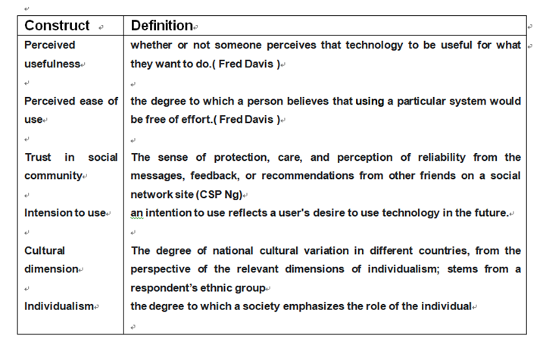
the constructs of the social commerce acceptance model.

Slide 15
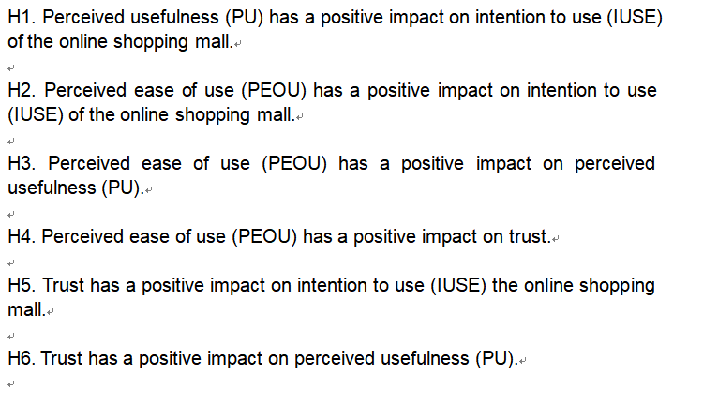
Technology acceptance model following Gefen (2003) ’s study,

Slide 16
Because collectivistic societies emphasize strong relationships, their members are sensitive to the in-group and out-group boundary (HC Triandis, 1995) and individualists tend to like meeting new people (HC Triandis. et al, 1988 P323-328).
H7 Culture characterized by the dimension of collectivism vs. Individualism is the moderator on the relation between the trust and intention to use, such that the impact is more salient in Tibetan than in Han Chinese.

Slide 17
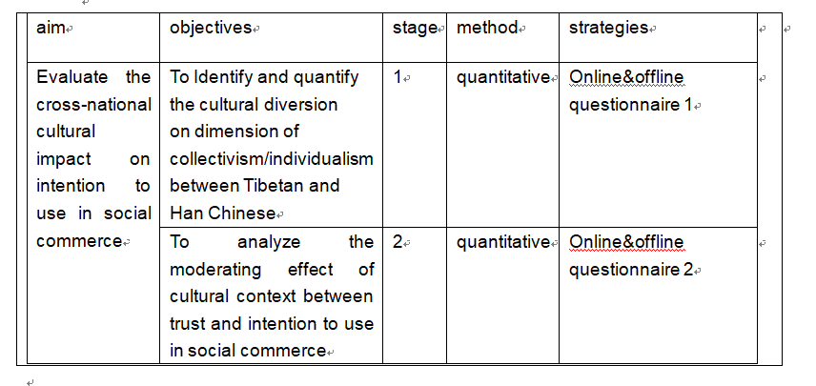
Matching of research objectives with research approaches

Slide 18
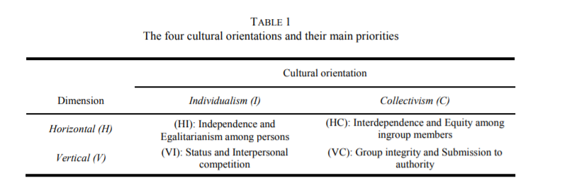
Stage1- following Triandis & Gelfand’s individualism and collectivism scale (1998) - horizontal (H) and vertical (V) individualism (I) and collectivism (C)- “Our studies were performed at the individual level of analysis.”

Slide 19
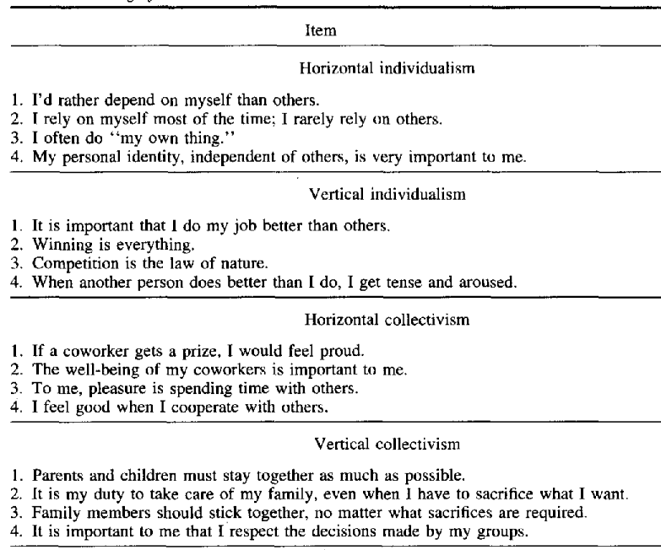
Triandis & Gelfand’s (1998)

Slide 20
Why not to follow Hofstede’s framework to identify the cultural differences on dimension of ID:
inadequate number of cultures (Geert Hofstede, 2001).

Slide 21
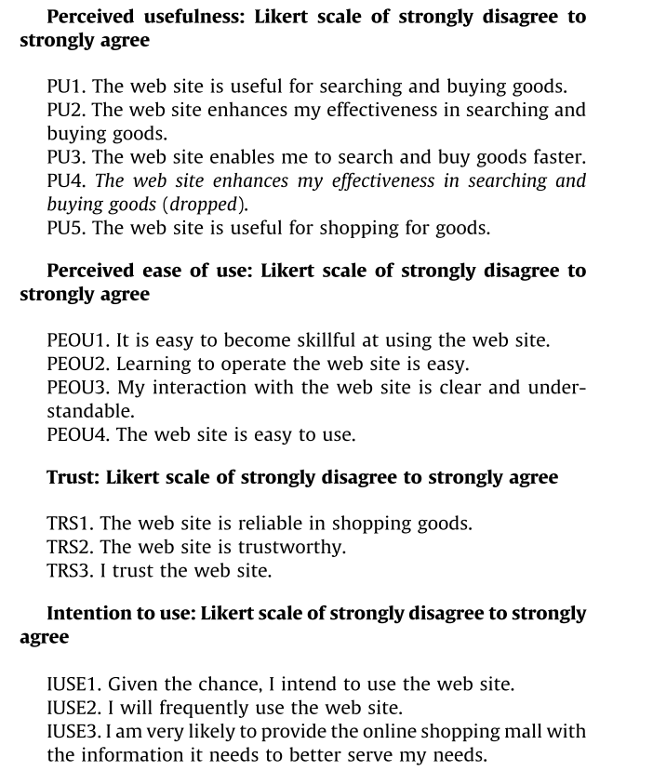
Stage2- following Cheolho (2009)

Slide 22
Ethical risk consideration
Flinders (1992) suggested that ethical considerations involve research phases of design, data collection and reporting. To research cross-national participants, both Seedhouse’s Ethical Grid (2007) helping determine right from wrong(Gray, 2010) and Flinders Ethical Frameworks (1992) will be adopted. The four layers demonstrated in Figure 3 will be considered in the process of research.

Slide 23
Thank you

Slide 24
Bibliography
AILON, G., 2008. Mirror, mirror on the wall: Culture's consequences in a value test of its own design. Academy of management review, 33(4), pp. 885-904.
BENNETT, N., DUNNE, E. and CARRÉ, C., 1999. Patterns of core and generic skill provision in higher education. Higher education, 37(1), pp. 71-93.
BOWEN, G.A., 2009. Document analysis as a qualitative research method. Qualitative research journal.
BRYMAN, A., 2006. Integrating quantitative and qualitative research: how is it done? Qualitative research, 6(1), pp. 97-113.
CARROLL, A.B., 1991. The pyramid of corporate social responsibility: Toward the moral management of organizational stakeholders. Business horizons, 34(4), pp. 39-48.
CHINESE CULTURE CONNECTION, 1987. Chinese values and the search for culture-free dimensions of culture. Journal of cross-cultural psychology, 18(2), pp. 143-164.
CLEVELAND, M. and LAROCHE, M., 2007. Acculturaton to the global consumer culture: Scale development and research paradigm. Journal of business research, 60(3), pp. 249-259.
COULTER, K.S. and ROGGEVEEN, A., 2012a. Like it or not. Management Research Review, .
, .
CRANE, A., MATTEN, D. and MOON, J., 2010. The emergence of corporate citizenship: historical development and alternative perspectives. Corporate citizenship in Deutschland, , pp. 64-91.
CRESWELL, J.W. and POTH, C.N., 2016. Qualitative inquiry and research design: Choosing among five approaches. Sage publications.
DENSCOMBE, M., 2008a. Communities of practice: A research paradigm for the mixed methods approach. Journal of mixed methods research, 2(3), pp. 270-283.

Slide 25
EASTERBY-SMITH, M., THORPE, R., JACKSON, P.R. and JASPERSEN, L.J., 2018. Management and business research. Sage.
FLINDERS, D.J., 1992. In search of ethical guidance: Constructing a basis for dialogue. Qualitative studies in education, 5(2), pp. 101-115.
FRIEDMAN, M., 2007. The social responsibility of business is to increase its profits. Corporate ethics and corporate governance. Springer, pp. 173-178.
FRIEDMAN, R., 1984. Strategic management: A stakeholder perspective.
GARDNER, K., 2015. Chevron's gift of CSR: moral economies of connection and disconnection in a transnational Bangladeshi village. Economy and Society, 44(4), pp. 495-518.
GARRIGA, E. and MELÉ, D., 2004. Corporate social responsibility theories: Mapping the territory. Journal of Business Ethics, 53(1), pp. 51-71.
GEFEN, D., KARAHANNA, E. and STRAUB, D.W., 2003. Trust and TAM in online shopping: An integrated model. MIS quarterly, , pp. 51-90.
GOLAFSHANI, N., 2003. Understanding reliability and validity in qualitative research. The qualitative report, 8(4), pp. 597-607.
GREGAR, J., 1994. Research Design (Qualitative, Quantitative and Mixed Methods Approaches). Book published by SAGE Publications, 228.
HAENLEIN, M. and KAPLAN, A.M., 2009. Flagship brand stores within virtual worlds: the impact of virtual store exposure on real-life attitude toward the brand and purchase intent. Recherche et Applications en Marketing (English edition), 24(3), pp. 57-79.
HAJLI, M.N., 2014. The role of social support on relationship quality and social commerce. Technological Forecasting and Social Change, 87, pp. 17-27.

Slide 26
HAJLI, N., 2018. Ethical environment in the online communities by information credibility: a social media perspective. Journal of Business Ethics, 149(4), pp. 799-810.
HAJLI, N., SIMS, J., ZADEH, A.H. and RICHARD, M., 2017. A social commerce investigation of the role of trust in a social networking site on purchase intentions. Journal of Business Research, 71, pp. 133-141.
HILLAGE, J. and POLLARD, E., 1998. Employability: developing a framework for policy analysis.
HOFSTEDE, G., 2001. Culture's recent consequences: Using dimension scores in theory and research. International Journal of cross cultural management, 1(1), pp. 11-17.
HOFSTEDE, G., 1984. Culture's consequences: International differences in work-related values. sage.
HOFSTEDE, G. and BOND, M.H., 1984a. Hofstede's culture dimensions: An independent validation using Rokeach's value survey. Journal of cross-cultural psychology, 15(4), pp. 417-433.
HOFSTEDE, G. and BOND, M.H., 1988. The Confucius connection: From cultural roots to economic growth. Organizational dynamics, 16(4), pp. 5-21.
HOFSTEDE, G., HOFSTEDE, G.J. and MINKOV, M., 2005. Cultures and organizations: Software of the mind. Mcgraw-hill New York.
HOFSTEDE, G., NEUIJEN, B., OHAYV, D.D. and SANDERS, G., 1990. Measuring organizational cultures: A qualitative and quantitative study across twenty cases. Administrative Science Quarterly, , pp. 286-316.
HOUSE, R.J., HANGES, P.J., JAVIDAN, M., DORFMAN, P.W. and GUPTA, V., 2004a. Culture, leadership, and organizations: The GLOBE study of 62 societies. Sage publications.

Slide 27
HUANG, R., KIM, H. and KIM, J., 2013. Social capital in QQ China: Impacts on virtual engagement of information seeking, interaction sharing, knowledge creating, and purchasing intention. Journal of marketing management, 29(3-4), pp. 292-316.
HUANG, W., MAMAT, M., SHANG, R., ZHANG, T., LI, H., WANG, Y., LUO, W. and WU, Y., 2014. Analysis of the private, collective, and relational self-cognitions among Han and Tibetan Chinese. Psychological reports, 115(1), pp. 179-198.
INKELES, A. and LEVINSON, D.J., 1969. National character: The study of modal personality and sociocultural systems. The handbook of social psychology, 4, pp. 418-506.
JOHNSON, P., BUEHRING, A., CASSELL, C. and SYMON, G., 2006. Evaluating qualitative management research: Towards a contingent criteriology. International Journal of Management Reviews, 8(3), pp. 131-156.
KAMAL, S., CHU, S. and PEDRAM, M., 2013a. Materialism, attitudes, and social media usage and their impact on purchase intention of luxury fashion goods among American and Arab young generations. Journal of Interactive Advertising, 13(1), pp. 27-40.
KOGUT, B. and SINGH, H., 1988. The effect of national culture on the choice of entry mode. Journal of International Business Studies, 19(3), pp. 411-432.
KOSTOVA, T., 1997. Success of the transnational transfer of organizational practices within multinational companies.
LIN, X., LI, Y. and WANG, X., 2017. Social commerce research: Definition, research themes and the trends. International Journal of Information Management, 37(3), pp. 190-201.
MCSWEENEY, B., 2002. Hofstede’s model of national cultural differences and their consequences: A triumph of faith-a failure of analysis. Human relations, 55(1), pp. 89-118.
MINKOV, M., 2009. Predictors of differences in subjective well-being across 97 nations. Cross-Cultural Research, 43(2), pp. 152-179.

Slide 28
MORSE, J.M., 1990. Qualitative nursing research: A contemporary dialogue. Sage Publications.
NAKAYAMA, M. and WAN, Y., 2019. The cultural impact on social commerce: A sentiment analysis on Yelp ethnic restaurant reviews. Information & Management, 56(2), pp. 271-279.
NG, C.S., 2013. Intention to purchase on social commerce websites across cultures: A cross-regional study. Information & management, 50(8), pp. 609-620.
POOL, L.D. and SEWELL, P., 2007. The key to employability: developing a practical model of graduate employability. Education Training, .
SAMALUK, B., 2021. Precarious education-to-work transitions: entering welfare professions under a workfarist regime. Work, Employment and Society, 35(1), pp. 137-156.
SATO, S., KANG, T., DAIGO, E., MATSUOKA, H. and HARADA, M., 2021. Graduate employability and higher education’s contributions to human resource development in sport business before and after COVID-19. Journal of Hospitality, Leisure, Sport & Tourism Education, 28, pp. 100306.
SCHWARTZ, S.H., 1994. Beyond individualism/collectivism: New cultural dimensions of values.
SMITH, L.M., DENZIN, N. and LINCOLN, Y., 1994. Biographical method. The SAGE, .
SULLIVAN, S.E. and AL ARISS, A., 2021. Making sense of different perspectives on career transitions: A review and agenda for future research. Human Resource Management Review, 31(1), pp. 100727.
TIHANYI, L., GRIFFITH, D.A. and RUSSELL, C.J., 2005. The effect of cultural distance on entry mode choice, international diversification, and MNE performance: A meta-analysis. Journal of International Business Studies, 36(3), pp. 270-283.
TOMLINSON, M., 2012. Graduate employability: A review of conceptual and empirical themes. Higher Education Policy, 25(4), pp. 407-431.

Slide 29
TRIANDIS, H.C., 2018. Individualism and collectivism. Routledge.
TRIANDIS, H.C., BONTEMPO, R., VILLAREAL, M.J., ASAI, M. and LUCCA, N., 1988. Individualism and collectivism: Cross-cultural perspectives on self-ingroup relationships. Journal of personality and social psychology, 54(2), pp. 323.
TROMPENAARS, F. and HAMPDEN-TURNER, C., 2011. Riding the waves of culture: Understanding diversity in global business. Nicholas Brealey International.
XU, D., PAN, Y. and BEAMISH, P.W., 2004. The effect of regulative and normative distances on MNE ownership and expatriate strategies. MIR: Management international review, , pp. 285-307.
YORKE, M. and KNIGHT, P.T., 2006. Embedding employability into the curriculum. Higher Education Academy York.
ZHANG, K.Z., CHEUNG, C.M. and LEE, M.K., 2014. Examining the moderating effect of inconsistent reviews and its gender differences on consumers’ online shopping decision. International Journal of Information Management, 34(2), pp. 89-98.
ZOU, S. and CAVUSGIL, S.T., 1996. Global strategy: a review and an integrated conceptual framework. European Journal of Marketing, .

