Slide 1



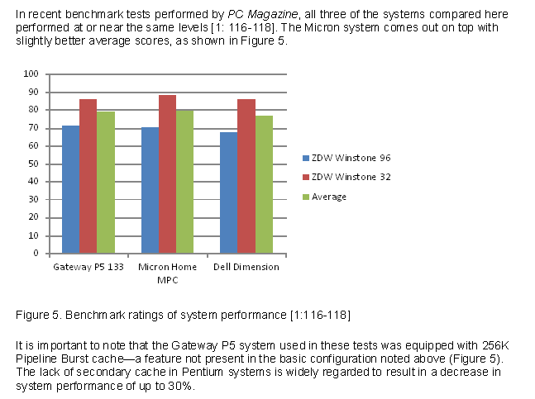
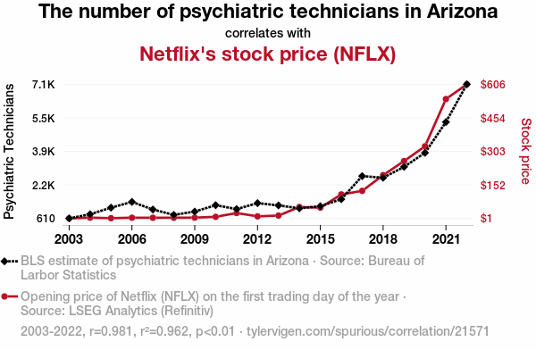
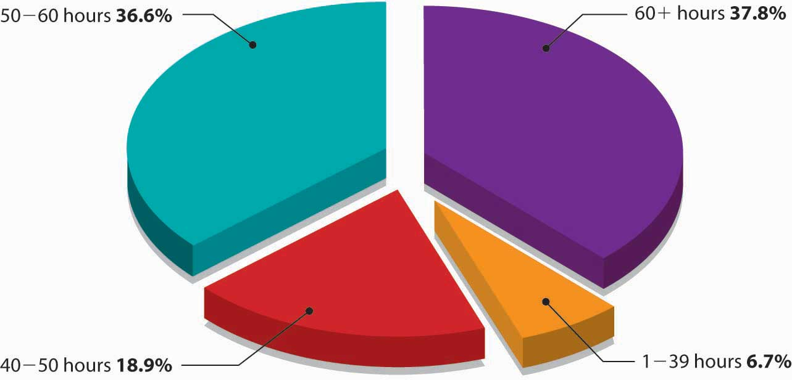
How to Create Chart in Word Document
Charts help you visualize the data and is a great way to reflect the information if it changes on a regular basis. You can find charts in Insert tap and add the chart into Word document.
Select Insert > Chart.
Select the chart type and then double-click the chart you want.
For help deciding which chart is best for your data.
When you insert a chart, buttons will appear next to its upper corner:
Use the Chart Elements button to show, hide, or format things like axis titles or data labels
Use the Chart Styles button to quickly change the colour or style of the chart
Use the Chart Filters button for more advanced options that shows or hides data in your chart.
When it is finished, save it and close it.
If you want, use the Layout Options button to arrange the chart and text in your document.
Charts help you visualizing financial data is a crucial skill for anyone who works with financial modeling, analysis, or reporting. Financial charts can help you to understand complex data, identify trends and patterns, compare different scenarios, and communicate your findings effectively. It also helps you to work out larger number of data and provide very simple layout of Report and Business statistics.

