Slide 1
CLAH4005: Defenders, Conquerors, Vanquished
Lecture 1: Why Greek History?

Slide 2
Some practicalities

Slide 3
When, where, how + Assessment
The module syllabus is on Moodle.
You should read this carefully as soon as possible.
You will find information about the assessment and deadlines there.

Slide 4
Remember
If you do not submit every assignment, you will automatically fail the module.
Attendance is compulsory.
The examination is a multiple-choice one. If you do not take diligent notes, you will be hard-pressed to pass it.

Slide 5
Studying Greek History
Problems and Solutions

Slide 6
Greece had a different culture than ours
Slavery
Not one country
but many separate
political entities
Women were
second class citizens

Slide 7
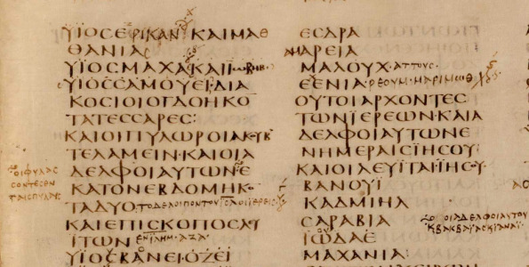
The Greeks spoke a different (and difficult) language
How much of our culture is tied in with our language?
How much of another culture can we understand without knowing its language?
How much of a language that is no longer fully alive can we truly understand?

Slide 8
There is a huge chronological gap between us and the Greeks
31 BCE to 2012 CE = 2043 years
800-31 BCE
=
Archaic, Classical and Hellenistic Greek history
2000 BCE
2000 CE

Slide 9
Solution!
Keep an open mind

Slide 10
Keep an Open Mind
Explore the Greek culture
Question all preconceptions about what the Greeks were like
There may be no definite answer or too many disparate answers.
Accept that there are questions we are not able to answer

Slide 11
Question your preconceptions
Which of the following do you agree with?
(1) All the Greeks loved philosophy and philosophers.
(2) The Spartans were always at war.
(3) The Greeks were civilised.
(4) The Greeks believed in the inherent worth of all men.
(5) The Greeks fought against the Persians for the freedom of Greece.

Slide 12
Too many gaps
The vast majority of literary material from antiquity is lost
We know of more than 3500 authors from antiquity. Less than 500 survive in any significant extent.
There were more than 1000 poleis in the classical Greek world. We can trace the details of the history of less than 10 for the whole of the classical period.
Example: Every Greek city had its own calendar. We can reconstruct the calendar of 4.

Slide 13
Use Everything
Even a tiny bit of information is better than no information at all
Learn to use different sources and evidence.
Use comparative material

Slide 14
Persist
Find out about the different sources and types of evidence
Research the author as much as what he says
Don’t avoid unfamiliar types of evidence
Ask someone who knows

Slide 15
Question the Sources
The sources are not an unquestionable authority
Trust them but question their viewpoint and their aims
Remember that everyone has an agenda

Slide 16
There is no Gospel Truth
Question the modern works
Always read more than one author/book/article
Always check the sources
Never trust blindly

Slide 17
Six Honest Serving-men
I KEEP six honest serving-men
(They taught me all I knew);
Their names are What and Why and When
And How and Where and Who.

Slide 18
Six Honest Serving-men for the historian I
What: What happened? EXACTLY!
Take good notes of all events. Make certain that you read the relevant ancient sources and take notes from them.

Slide 19
II
When: When something happened is very important. Think: how would we interpret history if we thought that WWI came after WWII?
Make a timeline with all events mentioned in class, in the books and articles that you read, as well as the ancient sources.

Slide 20
III
Where: Where something happened is important. How would we interpret WWII history if we thought that London was in France?
Make a map of your own with all the places that you come across in lectures and in your reading.

Slide 21
IV
Who: The protagonists of any action are important. How would we interpret WWII history if we thought the Hitler was English?
Make a clear list of the people that you come across in lectures and in your reading. Read about them (including authors) by using New Pauly.

Slide 22
Six Honest Serving-men for the historian III
How: How things happened is essential in understanding them.
Why: The why of history is the most important question of them all. We need answers – but remember to keep an open mind and check all the evidence.

Slide 23
The Spider-web of History
Linear thinking is not for the historian. Events and issues never simply progress from A to B.
They usually pass through C, D, and 25.
Think of the War in Iraq. Would there have been a war without the Iran vs. Iraq war in the 80s? Would there have been a war if in the first Iraq war, Saddam had been deposed?

Slide 24
Questions?

Slide 25
Follow-up
The follow-up reading is on Moodle!
Read all three articles
Answer the survey
Post in the forum, answering the given question.

