Slide 1
BMSW4001
Academic and Employability Skills (ACE)
Student name: Bia Furtado
Module leader: Sylvia Hoffman

Slide 2

Academic skills
Academic skills are a collection of behaviours learned by students through their studies.
Academic writing
Brainstorming
Data Analysis
Organization
Digital literacy
Time management

Slide 3
Employability skills
Employability skills are soft skills that enable you to collaborate well with people, apply knowledge to solve challenges and adapt to any work setting. They also incorporate the professional abilities that will help you succeed in the workplace.
Communication
Critical Thinking
Ethics
Computer skills
Flexibility
Efficiency
Time management

Slide 4

My future career
A pediatric nurse is someone who provides health and medical care for children from birth through their late teens, is a specialized nurse who usually completes advance training in the pediatric sector.

Slide 5
Skills required for the role
Critical Thinking and Observing skills
Sympathetic and Kind
Decision Maker
Team work
Good Organizer
Patience
Good mental and physical health
Intuitive, Good Judgement
Respect
Clear communication

Slide 6
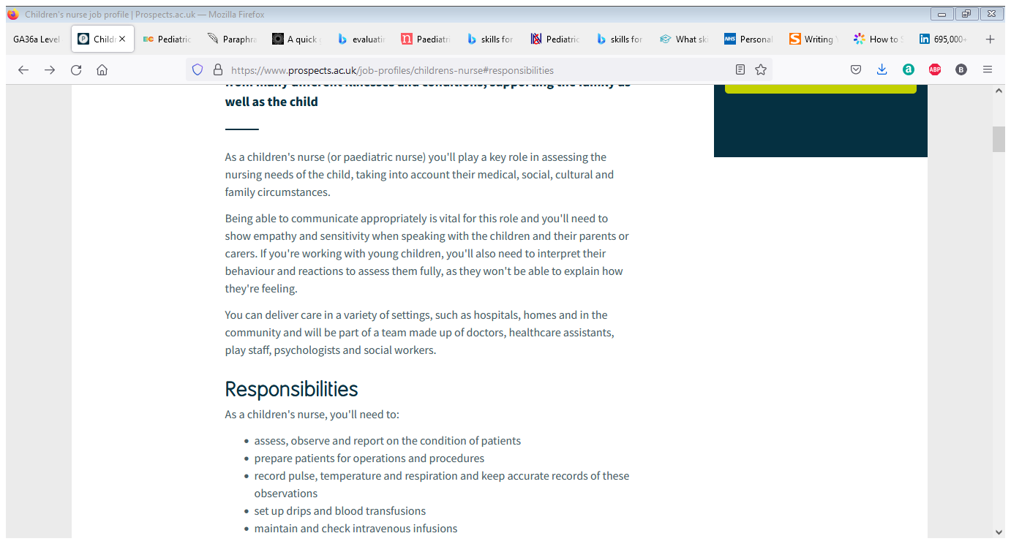
Evaluating my personal skills
Critical Thinking and Observing skills
Sympathetic and Kind
Decision Maker
Team work
Good Organizer
Patience
Good mental and physical health
Intuitive, Good Judgement
Respect
Clear Communication
Time management

Slide 7

Conclusion
To conclude my presentation, with this powerpoint I was able to define my strenghts and my transferable skills which will help me to suceed in my career as a paediatric nurse as well as my weaknessess and how I plan on improving them.

Slide 8

References/ Reading List
Prospects.ac.uk[online] Available at <https://www.prospects.ac.uk/job-profiles/childrens-nurse> [Accessed 7 December 2021]
Thebalancecareers.com[online] Available at <https://www.thebalancecareers.com/employability-skills-list-and-examples-4143571> [Accessed 8 December 2021]
Simplicable.com [online] Available at <https://simplicable.com/en/academic-skills> [Accessed 8 December 2021]
Healthcareers.nhs.uk [online] Available at <https://health careers.nhs.ac.uk/explore-roles/nursing/roles-nursing/childrens-nurse> [Accessed 8 December 2021]

