Slide 1
Finite State Machines

Slide 2
What is a Finite State Machine?
The clue is in the word finite
- in other words: limited, known and understood. When you build a finite state machine you define clearly all of the states that the machine can take and you think about the machine being in just one of those states at any given time.

Slide 3
What is a Finite State Machine?
A finite-state machine (FSM) or simply a state machine, is a mathematical model of computation used to design both computer programs and sequential logic circuits. It is conceived as an abstract machine that can be in one of a finite number of states.
The machine is in only one state at a time; the state it is in at any given time is called the current state (or state of interest). It can change from one state to another when initiated by a triggering event or condition; this is called a transition. A particular FSM is defined by a list of its states, and the triggering condition for each transition.
The behaviour of state machines can be observed in many devices in modern society which perform a predetermined sequence of actions depending on a sequence of events with which they are presented.
Simple examples are vending machines which dispense products when the proper combination of coins is deposited, lifts which drop passengers off at upper floors before going down, traffic lights which change sequence when cars are waiting, and combination locks which require the input of combination numbers in the proper order.

Slide 4
Types of Finite State Machines
There are two basic types of finite state machines:-
  Asynchronous;
  Synchronous.
The use of asynchronous circuits are more limited than synchronous circuits. These two types are defined as follows:-
  Asynchronous
    Asynchronous sequential circuits are basically combinational logic withy direct feedback and are cycled by transitions of each input and strictly use the propagation delay of the next state decoder for memory.
  Synchronous
    Synchronous circuits use hardware devices called flip flops for memory and are cycled by a special single input waveform commonly called the system clock.

Slide 5
Classification of Finite State Machines
There are three classes of machine worthy of note:-
  Class A or Mealy machine;
  Class B or Moore machine;
  Class C or Moore machine without an output decoder

Slide 6
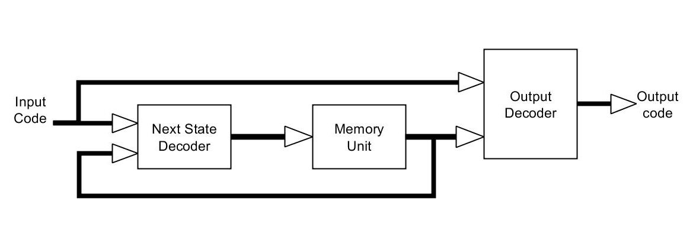
Class A machine
(Mealy Machine)
The output of the Mealy machine are a function of two sets of variables:-
the present input conditions;
the present state of the machine.

Slide 7
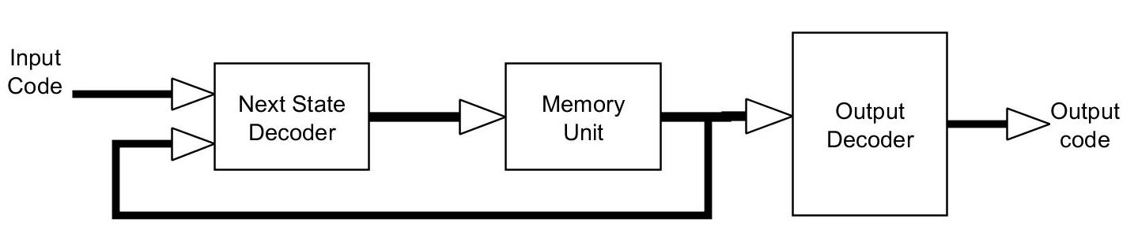
Class B machine
(Moore Machine)
The output of a Moore machine is strictly a function of the state of the machine

Slide 8
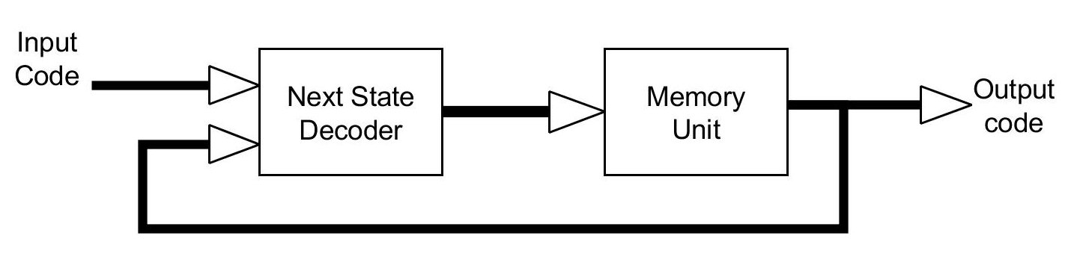
Class C machine
(Moore Machine)
The output of a class C Moore machine is again strictly a function of the state of the machine but without an output decoder.

Slide 9
Finite State Machines
Both the Mealy (Class A) and the Moore (Class B & C) are widely used. It is possible that some machines are derived from a mixture of both.
In these derived machines some outputs are conditional on both the inputs and the state of the machine (Class A), while others are dependant only on the state of the machine (Class B&C).

Slide 10
The State Diagram
The state diagram is to sequential design what a truth table is to combinatorial design.
A state diagram is defined by a series of circles connected by arrowhead lines. Each circle represents a state of the machine and each line is a graphical representation of state changes.

Slide 11
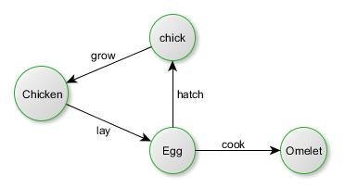
State Diagrams
Example 1, this is a simple state diagram representing the life cycle of a chicken

Slide 12
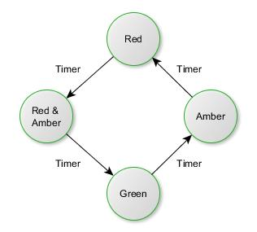
State Diagrams
Example 2 – Traffic lights basic state diagram

Slide 13
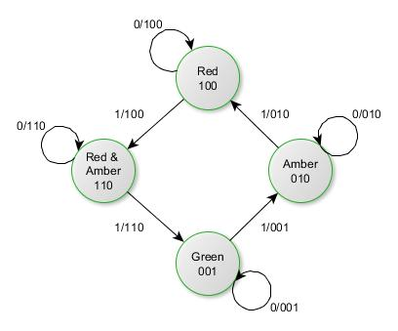
State Diagrams
Example 2 – Traffic lights basic state diagram
This diagram is the same as the previous one, except it now carries more information.
  Each state now shows its identifying state code.
  Loops are included to show a hold state while waiting for the timer signal T.
  Transitions are shown as their input terms.
Symbology format
T/RAG

Slide 14
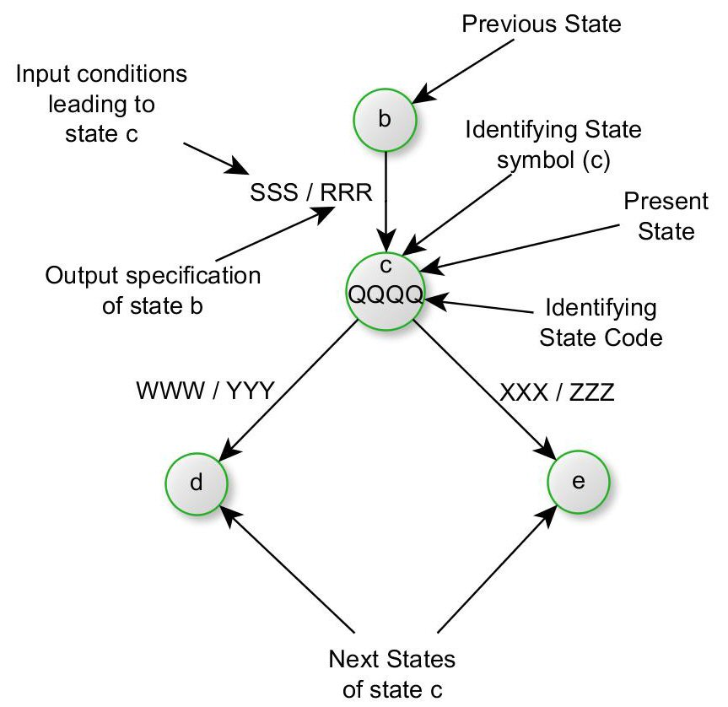
Finite State Machine - State Diagram example
An example of a state diagram is shown opposite and illustrates the present state (state of interest) and five important and required pieces of information related to each state of the machine.
  1) a state identifying symbol or code
  2) the previous state of the State of Interest
  3) the input specification leading to the State of Interest
  4) the output specification for the State of Interest
  5) the NEXT STATES and NEXT STATE branching condition for the State of Interest.

Slide 15
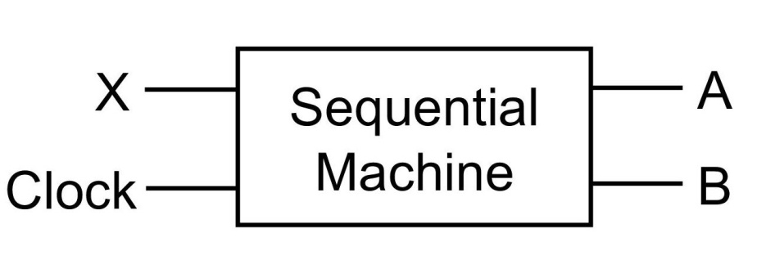
Example 1 - 2 bit counter
Consider the following example describing the sequential operation of a machine.
The machine has a single control input X and a clock, and two outputs on A and B.
When X=1
When X=0
no change
A and B change from 00
To 01
To 10
To 11

Slide 16
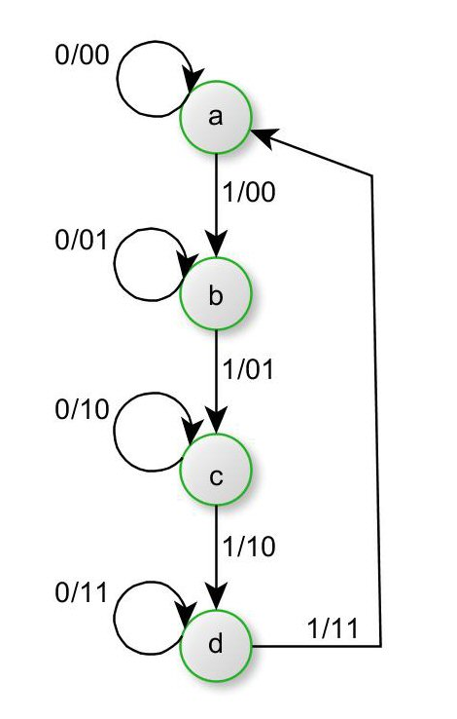
Example 1 - 2 bit counter
On consecutive rising edges of the clock the code on A and B changes from 00 to 01 to 10 to 11 and then repeats, IF X is asserted.
If at anytime X is de-asserted this machine is supposed to hold its present state.
Symbology format
X/AB
The loops illustrate a hold state.
The Clock is usually considered implied

Slide 17
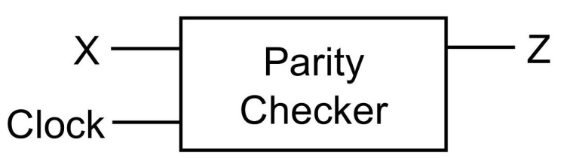
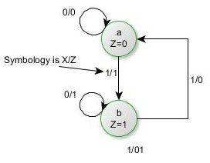

Example 2 – Parity checker
State Diagram
Z should equal ‘1’ if no of 1’s entered is odd.
(Odd Parity)
Implementation – J-K Flip Flop
Remember a J-K toggles on successive pulses if J and K inputs are held at logic ‘1’
Note: Clock is implied

Slide 18
Why do we use state diagrams?
The descriptive nature of the state diagram make it an invaluable aid in three major areas. These are:-
  i) the definition of sequential systems;
  ii) the analysis of sequential circuits;
  Iii) the design of sequential circuits.

Slide 19
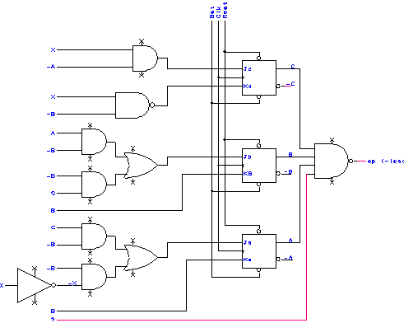
Analysis of sequential circuits
Step 1
Identify the functional blocks of the sequential machine- that is the NEXT STAGE DECODER, MEMORY ELEMENT and OUTPUT DECODER
Note: the circuit to the right is a class A machine)

Slide 20
Analysis of sequential circuits
Step 2
Write the boolean expression for each of the outputs of the Next Stage Decoder. This six bit code makes up the inputs for the JK flip flops. Once these are known they can be coupled with the JK flip flop characteristics to determine the True Next State
Ja = /B.C + /B./X
Ka= B
Jb = A./B + /B.C
Kb= B
Jc = /A.C
Kc = B
and the output
/load = /(A.B.C.X)

Slide 21
Analysis of sequential circuits
Step 3
Plot the map for each of the Next State variables. These maps serve as a useful tool for tabulating the Next State Code
AB
AB
AB
\ | 00 | 01 | 11 | 10
00 | 1 | 0 | 0 | 1
01 | 0 | 0 | 0 | 0
11 | 1 | 0 | 0 | 1
10 | 1 | 0 | 0 | 1
\ | 00 | 01 | 11 | 10
00 | 0 | 1 | 1 | 0
01 | 0 | 1 | 1 | 0
11 | 0 | 1 | 1 | 0
10 | 0 | 1 | 1 | 0
\ | 00 | 01 | 11 | 10
00 | 0 | 0 | 0 | 1
01 | 0 | 0 | 0 | 1
11 | 1 | 0 | 0 | 1
10 | 1 | 0 | 0 | 1
CX
CX
CX
Ja=/B./C + /B./X
Ka=B
Jb=A./B + /B.C

Slide 22
Analysis of sequential circuits
AB
AB
AB
AB
\ | 00 | 01 | 11 | 10
00 | 0 | 1 | 1 | 0
01 | 0 | 1 | 1 | 0
11 | 0 | 1 | 1 | 0
10 | 0 | 1 | 1 | 0
\ | 00 | 01 | 11 | 10
00 | 0 | 0 | 0 | 0
01 | 1 | 1 | 0 | 0
11 | 1 | 1 | 0 | 0
10 | 0 | 0 | 0 | 0
\ | 00 | 01 | 11 | 10
00 | 1 | 1 | 1 | 1
01 | 0 | 1 | 1 | 0
11 | 0 | 1 | 1 | 0
10 | 1 | 1 | 1 | 1
\ | 00 | 01 | 11 | 10
00 | 0 | 0 | 0 | 0
01 | 0 | 0 | 0 | 0
11 | 0 | 0 | 1 | 0
10 | 0 | 0 | 0 | 0
CX
CX
CX
CX
Kb=B
Jc=/A.X
Kc=B+/X
Load = A.B.C.D

Slide 23
Analysis of sequential circuits
Step 4
Using the entries in the maps, plot the values for the flip flop inputs (Ja,Ka,Jb,Kb,Jc,Kc) in a Present and Next State Table
 | Present State |  |  | Input | Next State Code |  |  |  |  |  | Oput | True Next State
 | A | B | C | X | Ja | Ka | Jb | Kb | Jc | Kc | Load | A | B | C
State0 | 0 | 0 | 0 | 0 | 1 | 0 | 0 | 0 | 0 | 1 | 0
 | 0 | 0 | 0 | 1 | 0 | 0 | 0 | 0 | 1 | 0 | 0
State 1 | 0 | 0 | 1 | 0 | 1 | 0 | 1 | 0 | 0 | 1 | 0
 | 0 | 0 | 1 | 1 | 1 | 0 | 1 | 0 | 1 | 0 | 0
State 2 | 0 | 1 | 0 | 0 | 0 | 1 | 0 | 1 | 0 | 1 | 0
 | 0 | 1 | 0 | 1 | 0 | 1 | 0 | 1 | 1 | 1 | 0
State 3 | 0 | 1 | 1 | 0 | 0 | 1 | 0 | 1 | 0 | 1 | 0
 | 0 | 1 | 1 | 1 | 0 | 1 | 0 | 1 | 1 | 1 | 0
State 4 | 1 | 0 | 0 | 0 | 1 | 0 | 1 | 0 | 0 | 1 | 0
 | 1 | 0 | 0 | 1 | 0 | 0 | 1 | 0 | 0 | 0 | 0
State 5 | 1 | 0 | 1 | 0 | 1 | 0 | 1 | 0 | 0 | 1 | 0
 | 1 | 0 | 1 | 1 | 1 | 0 | 1 | 0 | 0 | 0 | 0
State 6 | 1 | 1 | 0 | 0 | 0 | 1 | 0 | 1 | 0 | 1 | 0
 | 1 | 1 | 0 | 1 | 0 | 1 | 0 | 1 | 0 | 1 | 0
State 7 | 1 | 1 | 1 | 0 | 0 | 1 | 0 | 1 | 0 | 1 | 0
 | 1 | 1 | 1 | 1 | 0 | 1 | 0 | 1 | 0 | 1 | 1

Slide 24
Analysis of sequential circuits
Step 5
Using the entries for the Next State Code in the table and a flip flop Next state table for the Flip Flop, determine the True Next State for each flip flop one row at a time.
J | K | Action | Next State
0 | 0 | Do nothing | unchanged
0 | 1 | Reset | 0
0 | 1 | Set | 1
1 | 1 | Toggle | Change state 1=>0 0=>1
Next State Table for JK flip flop

Slide 25
Analysis of sequential circuits
 | Present State |  |  | Input | Next State Code |  |  |  |  |  | Oput | True Next State
 | A | B | C | X | Ja | Ka | Jb | Kb | Jc | Kc | Load | A | B | C
State0 | 0 | 0 | 0 | 0 | 1 | 0 | 0 | 0 | 0 | 1 | 0 | 1 | 0 | 0
 | 0 | 0 | 0 | 1 | 0 | 0 | 0 | 0 | 1 | 0 | 0 | 0 | 0 | 1
State 1 | 0 | 0 | 1 | 0 | 1 | 0 | 1 | 0 | 0 | 1 | 0 | 1 | 1 | 0
 | 0 | 0 | 1 | 1 | 1 | 0 | 1 | 0 | 1 | 0 | 0 | 1 | 1 | 1
State 2 | 0 | 1 | 0 | 0 | 0 | 1 | 0 | 1 | 0 | 1 | 0 | 0 | 0 | 0
 | 0 | 1 | 0 | 1 | 0 | 1 | 0 | 1 | 1 | 1 | 0 | 0 | 0 | 1
State 3 | 0 | 1 | 1 | 0 | 0 | 1 | 0 | 1 | 0 | 1 | 0 | 0 | 0 | 0
 | 0 | 1 | 1 | 1 | 0 | 1 | 0 | 1 | 1 | 1 | 0 | 0 | 0 | 0
State 4 | 1 | 0 | 0 | 0 | 1 | 0 | 1 | 0 | 0 | 1 | 0 | 1 | 1 | 0
 | 1 | 0 | 0 | 1 | 0 | 0 | 1 | 0 | 0 | 0 | 0 | 1 | 1 | 0
State 5 | 1 | 0 | 1 | 0 | 1 | 0 | 1 | 0 | 0 | 1 | 0 | 1 | 1 | 0
 | 1 | 0 | 1 | 1 | 1 | 0 | 1 | 0 | 0 | 0 | 0 | 1 | 1 | 1
State 6 | 1 | 1 | 0 | 0 | 0 | 1 | 0 | 1 | 0 | 1 | 0 | 0 | 0 | 0
 | 1 | 1 | 0 | 1 | 0 | 1 | 0 | 1 | 0 | 1 | 0 | 0 | 0 | 0
State 7 | 1 | 1 | 1 | 0 | 0 | 1 | 0 | 1 | 0 | 1 | 0 | 0 | 0 | 0
 | 1 | 1 | 1 | 1 | 0 | 1 | 0 | 1 | 0 | 1 | 1 | 0 | 0 | 0

Slide 26
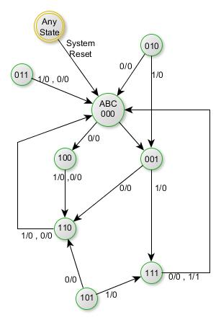
Analysis of sequential circuits
Symbology format
X/Load
Step 6
Using the Present State input, and the Next State data plotted in the Present and Next State Table, develop a state diagram to graphically illustrate the circuits state to state behaviour.

Slide 27
Analysis of sequential circuits
States 000, 001, 100, 110 and 111 are the sequential states 010, 011 and 101 are conditions which can never be reached unless noise or a erroneous power condition forces the circuit into these states.
However, these states are not hang states (ie. No input condition causes a transition to that state), because if the circuit happens to be forced to one of these states by some abnormal condition such as noise or power transients, it will not stay there longer for more than 1 clock cycle. This is a good feature to incorporate into a design because unwanted states are undesirable and unwanted states that hang the machine must be avoided.
Designs should be analysed to ensure hang states are not possible.

Slide 28
Analysis of sequential circuits
For further analysis the next state tables for the D, T and RS flip flops are shown
D - Flip flop
Input D | Action | Next state
0 | reset | 0
1 | set | 1
T (toggle) - Flip flop
Input D | Action | Next state
0 | Do Nothing | unchanged
1 | toggle | Change state
RS - Flip flop
Input S | Input R | Action | Next state
0 | 0 | Do Nothing | unchanged
0 | 1 | Reset | 0
1 | 0 | Set | 1
1 | 1 | AVOID | ?

Slide 29
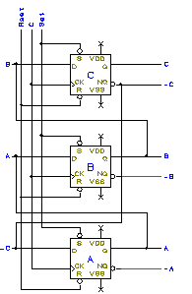
Analysis of sequential circuits
Worked Example 1
To analyse the circuit shown opposite.
Step 1
  Consider the circuit.
Step 2
  Generate equations
  Da=/C, Db=A, Dc=B

Slide 30
Analysis of sequential circuits
Step 3
  Next State Maps
AB
AB
AB
\ | 00 | 01 | 11 | 10
0 | 1 | 1 | 1 | 1
1 | 0 | 0 | 0 | 0
\ | 00 | 01 | 11 | 10
0 | 0 | 0 | 1 | 1
1 | 0 | 0 | 1 | 1
\ | 00 | 01 | 11 | 10
0 | 0 | 1 | 1 | 0
1 | 0 | 1 | 1 | 0
C
C
C
Da=/C
Db=A
Dc=B

Slide 31
Analysis of sequential circuits
Step 6
 | Present State |  |  | Input | Next State Code |  |  | Output | True Next State
 | A | B | C | - | Ja | Ka | Jb | - | A | B | C
State0 | 0 | 0 | 0 | - | 1 | 0 | 0 | - | 1 | 0 | 0
 | 0 | 0 | 1 | - | 0 | 0 | 0 | - | 0 | 0 | 0
State 1 | 0 | 1 | 0 | - | 1 | 0 | 1 | - | 1 | 0 | 1
 | 0 | 1 | 1 | - | 1 | 0 | 1 | - | 0 | 0 | 1
State 2 | 1 | 0 | 0 | - | 0 | 1 | 0 | - | 1 | 1 | 0
 | 1 | 0 | 1 | - | 0 | 1 | 0 | - | 0 | 1 | 0
State 3 | 1 | 1 | 0 | - | 0 | 1 | 0 | - | 1 | 1 | 1
 | 1 | 1 | 1 | x | 0 | 1 | 0 | - | 0 | 1 | 1

Slide 32
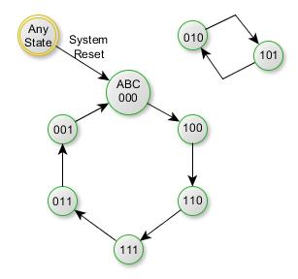
Analysis of sequential circuits
This circuit has two states (010 and 101) isolated from the main sequence.
This is typical for a twisted ring counter which is the circuit just analysed.
State changes take place
on clock rising edge

Slide 33
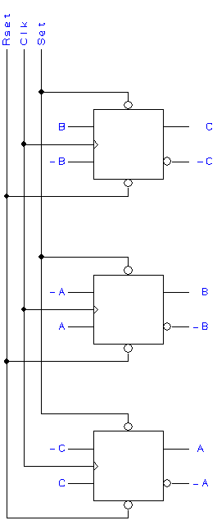
Analysis of sequential circuits
Worked Example 2
Analyse the twisted Ring counter, shown right.
Step 1
  Consider the circuit.
Step 2
  Generate equations
  Ja=/C Jb=/A Jc=B
  Ka=C Kb=A Kc=/B

Slide 34
Analysis of sequential circuits
Step 3
  Next State maps
AB
AB
AB
\ | 00 | 01 | 11 | 10
0 | 1 | 1 | 1 | 1
1 | 0 | 0 | 0 | 0
\ | 00 | 01 | 11 | 10
0 | 1 | 1 | 0 | 0
1 | 1 | 1 | 0 | 0
\ | 00 | 01 | 11 | 10
0 | 0 | 1 | 1 | 0
1 | 0 | 1 | 1 | 0
C
C
C
Ja=/C
Jb=/A
Jc=B
AB
AB
AB
\ | 00 | 01 | 11 | 10
0 | 0 | 0 | 0 | 0
1 | 1 | 1 | 1 | 1
\ | 00 | 01 | 11 | 10
0 | 0 | 0 | 1 | 1
1 | 0 | 0 | 1 | 1
\ | 00 | 01 | 11 | 10
0 | 1 | 0 | 0 | 1
1 | 1 | 0 | 0 | 1
C
C
C
Ka=C
Kb=A
Kc=/B

Slide 35
Analysis of sequential circuits
Step 4/5
Using the entries in the maps, plot the values for the flip flop inputs (Ja,Ka,Jb,Kb,Jc,Kc) in a Present and Next State Table
 | Present State |  |  | Input | Next State Code |  |  |  |  |  | Oput | True Next State
 | A | B | C | X | Ja | Ka | Jb | Kb | Jc | Kc | Load | A | B | C
State0 | 0 | 0 | 0 | - | 1 | 0 | 1 | 0 | 0 | 1 | - | 1 | 1 | 0
 | 0 | 0 | 1 | - | 0 | 1 | 1 | 0 | 0 | 1 | - | 0 | 1 | 0
State 1 | 0 | 1 | 0 | - | 1 | 0 | 1 | 0 | 1 | 0 | - | 1 | 1 | 1
 | 0 | 1 | 1 | - | 0 | 1 | 1 | 0 | 1 | 0 | - | 0 | 1 | 1
State 2 | 1 | 0 | 0 | - | 1 | 0 | 0 | 1 | 0 | 1 | - | 1 | 0 | 0
 | 1 | 0 | 1 | - | 0 | 1 | 0 | 1 | 0 | 1 | - | 0 | 0 | 0
State 3 | 1 | 1 | 0 | - | 1 | 0 | 0 | 1 | 1 | 0 | - | 1 | 0 | 1
 | 1 | 1 | 1 | - | 0 | 1 | 0 | 1 | 1 | 0 | - | 0 | 0 | 1

Slide 36
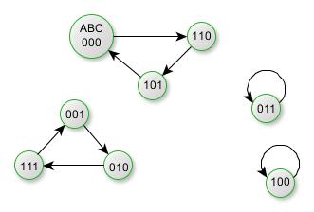
Analysis of sequential circuits
Step 6
State Diagram
As can be readily seen from the state diagram opposite this circuit has severe problems.
Two of the states are hang states as should the circuit ever go into these states due to noise or power transients there is no escape from them and then you have two separate ring
State changes take place
on clock rising edge

Slide 37
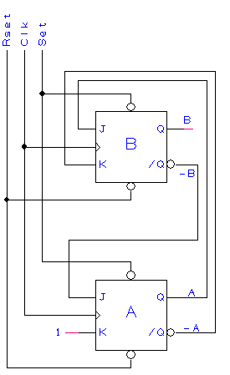
Analysis of sequential circuits
Carry out an analysis on the following circuits. Note any questionable operational properties and give state diagrams.
1) Opposite

Slide 38
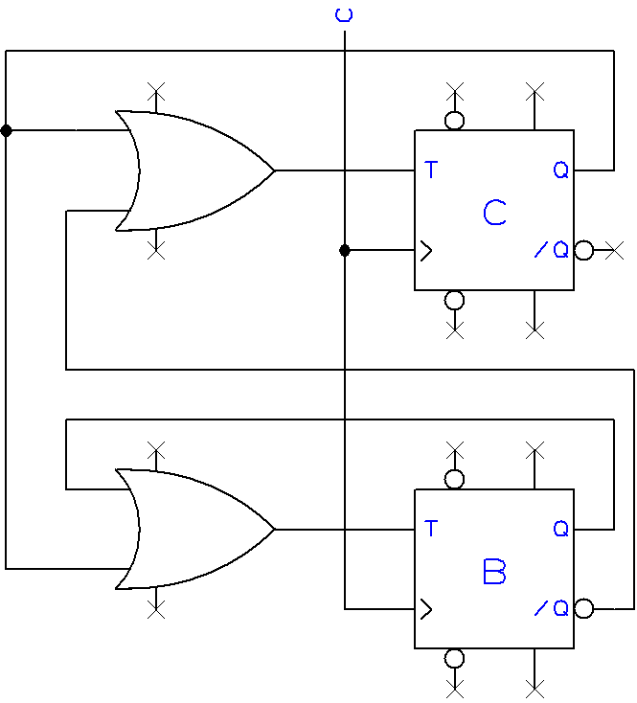
Analysis of sequential circuits
2) Opposite

Slide 39
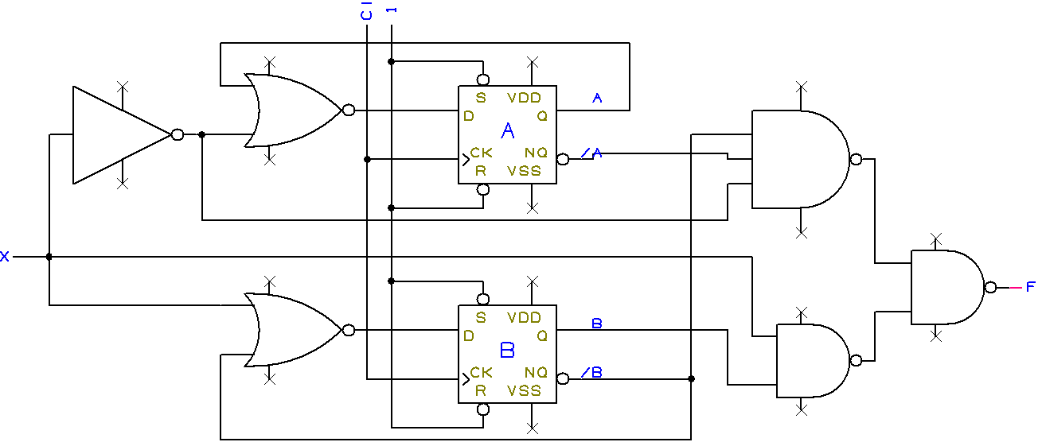
Analysis of sequential circuits
3) Below

Slide 40
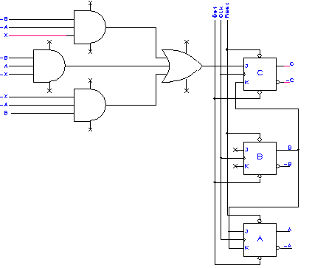
Analysis of sequential circuits
4) Opposite

Slide 41
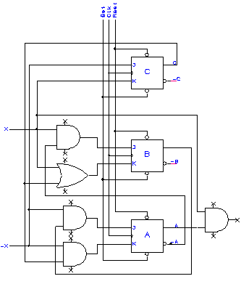
Analysis of sequential circuits
5) Opposite

