Slide 1
Reminder: MS-Teams Qs via chat
Open MS-Teams
Select: Chat (Left side menu)
Search: James Williams
Type a Message:
If you are struggling with an activity, you can message me via chat or request a 1-2-1 voice chat whenever needed.
You can also ask each other and help and support each other.

Slide 2
Log-in to MS-Teams
Log-in to Teams to:
  Ask Questions
  Request & receive feedback
  Collaborate with others
  Share good resources
  * Reminder: Bring Headphones with mic for 1-2-1 additional support

Slide 3

L4: Learning in the Digital Era
Assignment 1:
Task 2a - Team Activity

Slide 4



Introduction & Overview
Introduction
Tutor Show: Assign. 1, Task 2
Assign Teams
Activity: Teamwork
Assignment 1: Task 2 – Teamwork Activity
Tutorial Activity: Task 2 Team Activity

Slide 5
Assignment 1
Tutor Show:
Task 2 a)
Team Activity.
Available to download from the Assessment tile on Moodle.

Slide 6
Activity: Create Teams of 3/4 members
Get into Groups of 3/4 members
Create a ‘Team name’
Select a ‘Team Leader’
Team Leaders: Use MS-Teams to message tutor the name of each team member in your group.

Slide 7
Activity: Teamwork
In a small team (3/4 members), work together to produce a ‘mind-map’ that summarises:
key considerations of effective teamworking
Undertake your own research to complete this activity.
Approx.150-200 words per person.
How you, as a team, complete this activity, is up to the team.
Some tips on the next 2 slides:

Slide 8
Activity: Teamwork
In a small team (3-5 members), work together to produce a ‘mind-map’ that summarises ‘key considerations of effective teamwork’
Each team member could cover a different topic related to ‘effective teamworking’. See next slide for example topics.
Each Team-member could have a different node/branch on the Map
Your mind map should be clear & concise with approx.150 words per person.
Each team member should include 2 citations, and a reference list node in her/his branch of the Map.
It can be produced using a freely available Mind Mapping tool of your choice (e.g. Mindmeister.com, Coggle.it, GitMind.com, Ayoa.com) or an O365 App.
You can complete this activity in class. If needed, you can also collaborate online to finish this activity by next week (e.g. via MS Teams / Zoom).

Slide 9
Activity tips: Example topics
Some considerations for effective team-working, could include:
Team Leadership: e.g. Setting a Mission & objectives, Assigning roles and tasks.
Team Management : Organizing, resourcing and support.
Team Collaboration & relationships: Communication, emotions and empathy.
Effective communication: Tools & channels e.g. choosing the tools for effective team communication e.g. MS-O365 & MS-Teams, Google Workspace & Google Chat, Workvivo.com & Zoom, Slack.com, Discord, WhatsApp Grp…

Slide 10
Tip: MindMap & Digital collaboration
Tip: Mindmeister.com is an online collaborative mind-map tool.
Each team member can sign-up and log-in.
The Team leader can create the map and share it with other team members, so the team can collaborate on the Map together.
For ease of editing, you may want use MS-Word to write your 150-200 contribution first, include 2/3 citations and add it to the Map later when finished.
  Or if needed: email it to the Team leader to add to the map.

Slide 11
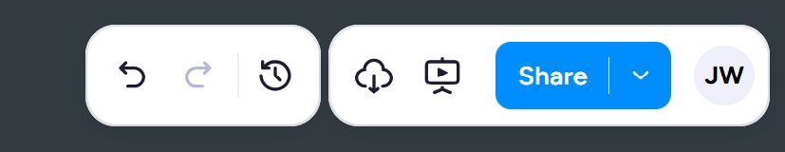
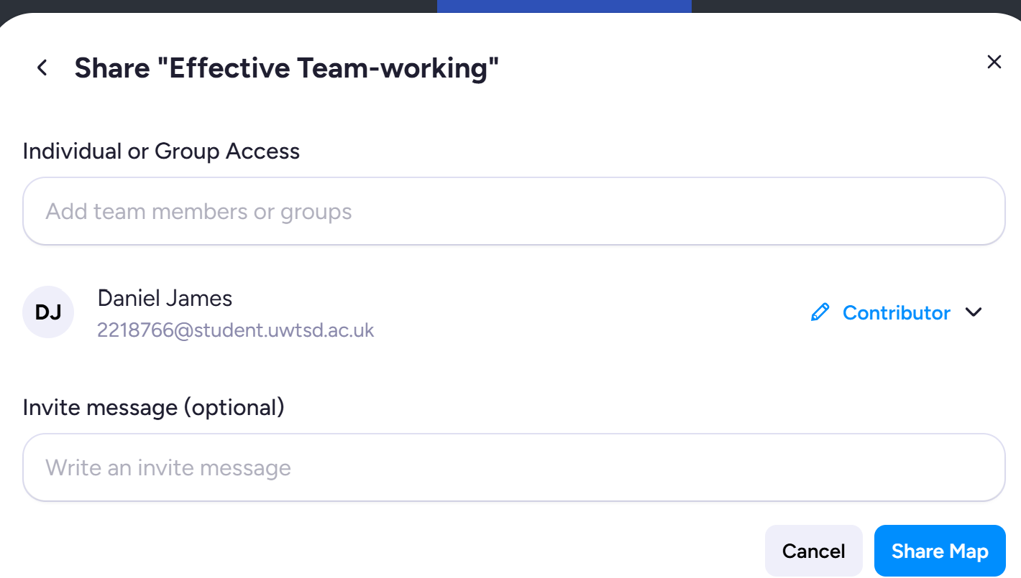
Tip: MindMap & Digital collaboration
The Team leader can share the map with team members, so the team can collaborate on the Map together:
Click ‘Share’ in MindMeister: Top right
Add the team members email address
And set the share permission right to ‘Contributor’:

Slide 12
Activity tip: Teamwork
It is up to you as a team to work out the best way to complete this activity.
Work together to solve any uncertainties and problems.
Example:
Get together in your Teams
Select a Team leader, a person will start the initial map, help to organize and support team members when needed to complete the activity.
Spend some time (e.g. 10mins) doing some initial research to identify key topics related to 'Key considerations of effective Team-working’ to allow each team member to have a topic to research and write about.
Then each team member can choose a topic for further research and writing, 150-200 words each.
Then after say approx. 20-30mins, come back together to create and add your work to the mind-map. Or Add it directly to the map after it is shared by the Team leader.
  Tip: Remember you can have a Mind-map branch per person.

Slide 13
Mind Map tools
There are many mind-map tools including many free ones. Some example tools include:
  Mindmeister.com
  Coggle.it
  GitMind.com
  Ayoa.com
  Free Mind Map Apps in Google docs
  Canva.com (see MindMap templates)
  Office365 Apps such as PowerPoint, OneNote and even Word can be used, although NOT recommended.

Slide 14
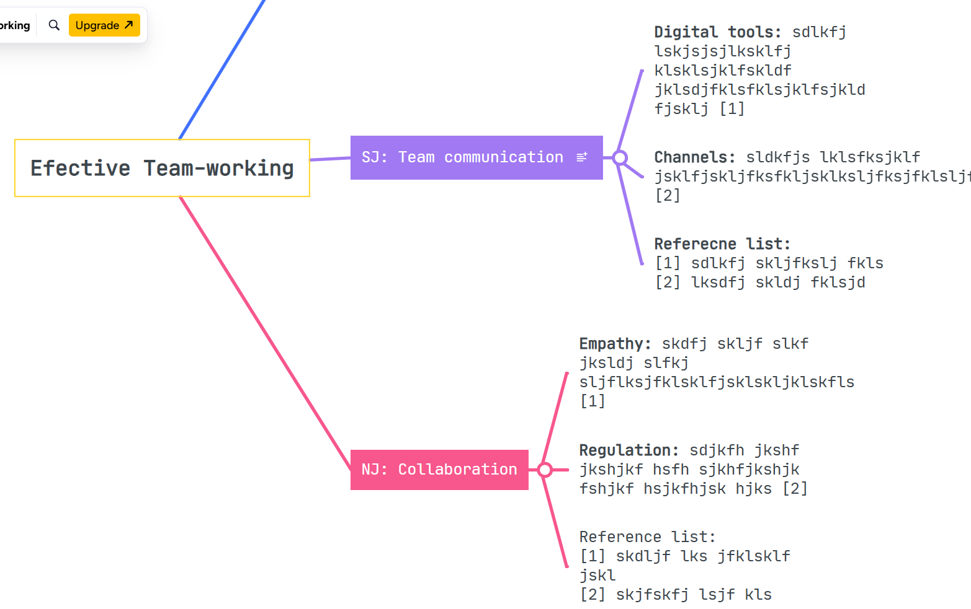
Tutor Show & demo: MindMeister.com
Show existing map & create map on mindmeister.com:

Slide 15
Mind-Map & Individual Poster
You will need to include an image of the mind-map and a brief description in your individual poster for Task 2b.
The brief description can simply state the team members you worked with and how you collaborated e.g. on-campus in-person f2f &/or online using collaborative tools (e.g. MS-Teams, Zoom, Discord, WhatsApp etc..)

Slide 16
Sharing & Publishing the map
Each team member will eventually need to add a screenshot of the Map in their poster and e-portfolio.
To Share the Map with each Team-member using Mindmeister, goto the top right [Share] icon and enter your team members email addresses.
You don’t need to publish the map to share with other team members for collaboration.
However, you can get a public url/link to include in your e-portfolio and word submission document. Not mandatory but recommended for the assessment, in case we need a better view of the map.
  E.g. In Mindmeister.com open the Map & goto:
  Share (Top right) and [Copy link]

Slide 17
Marking the map
This activity will be marked individually.
If a team member does not complete the activity, it will not affect other team members or the Team Leader.
It is up to each person to complete the activity and to collaborate with his/her team to get the job done.

Slide 18

Mind-map tutorials
If you are struggling and not sure how to create a mind-map, click the links below, or go to YouTube and search for:
  How to use MindMeister to create a Mind Map? or
  How to create an online mind map using a free cloud tool?
  You will find 5-minute tutorials that will help you to learn how to create an online mind-map with ease.

Slide 19
Activity: Collaborative Mind-map
In a small team (3/4 members), work together to produce a ‘Mind-map’ that summarises ‘key considerations of effective teamwork’.
Undertake research to complete this activity. Get together in your Teams and spend some time (e.g. 10/15mins) doing some initial research together to identify 'Key considerations' of Team-working.
Then each team member can choose a topic for further individual research and writing of 150-200 words (Approx. 20mins)
It is up to you as a team to work out the best way to complete this activity.
  Tip: Decide who is going to the Team leader, this person can help to organise and support the team to complete the activity.
  Example: Include some citations and a reference list node, per person. It’s ok for each team member to have a reference list node, in their section of the map.

Slide 20
Break time:
Start back: 12:20pm

Slide 21
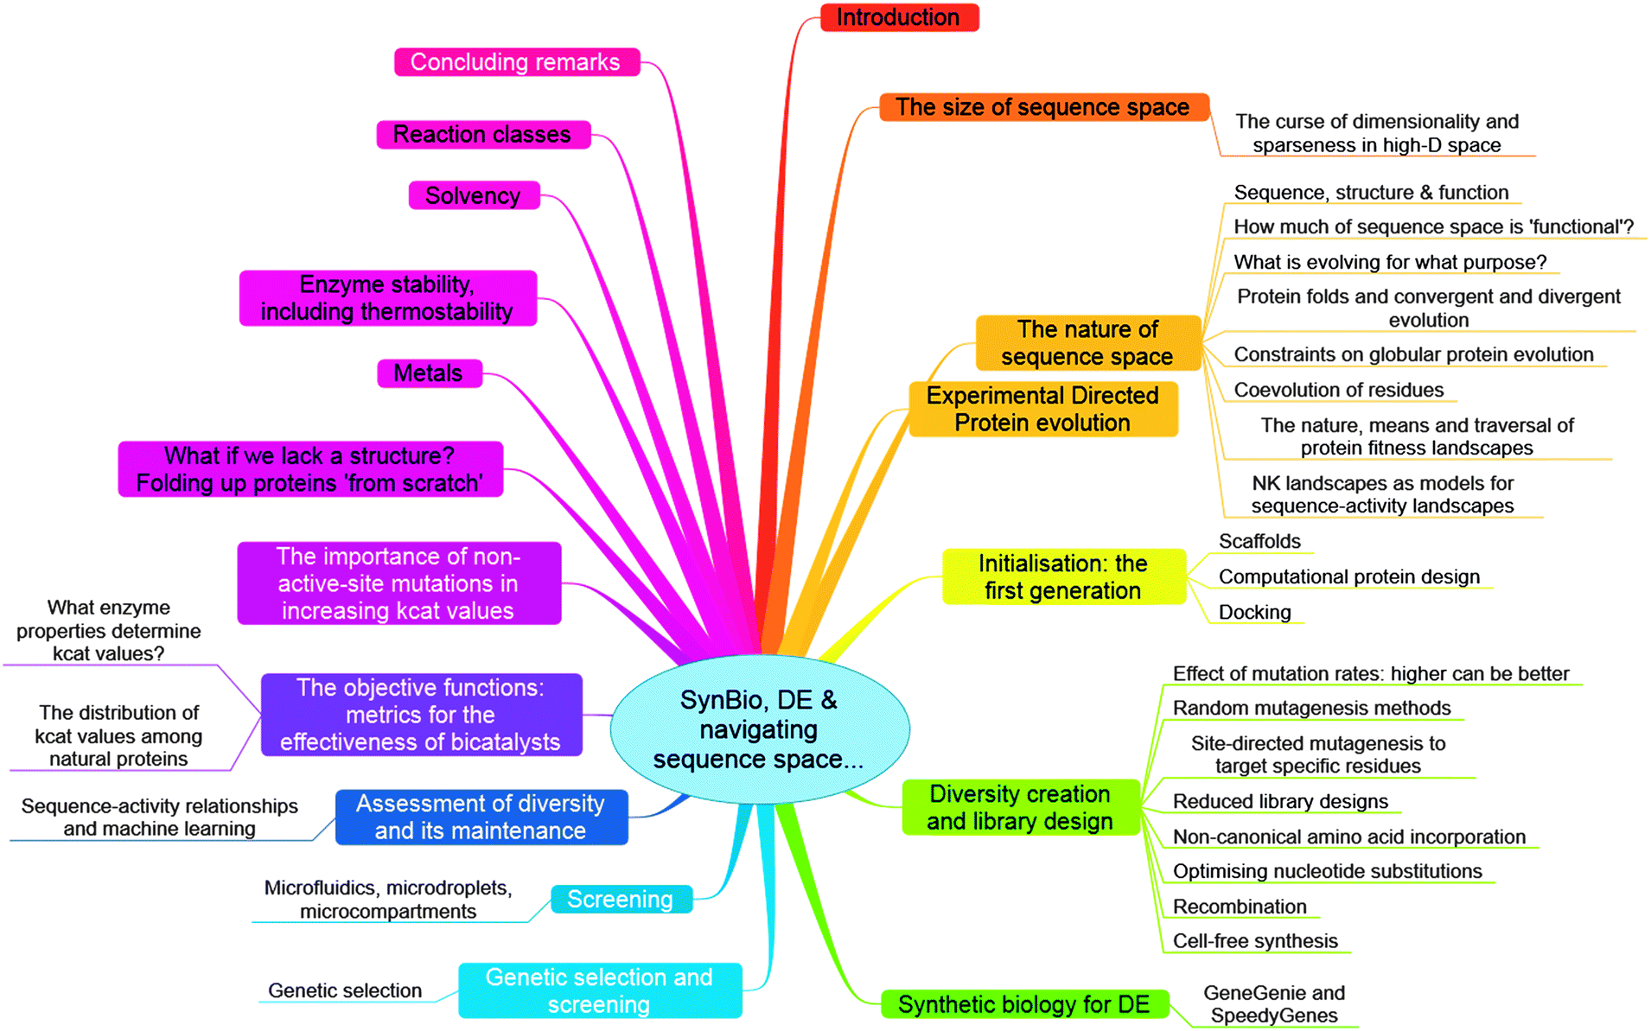
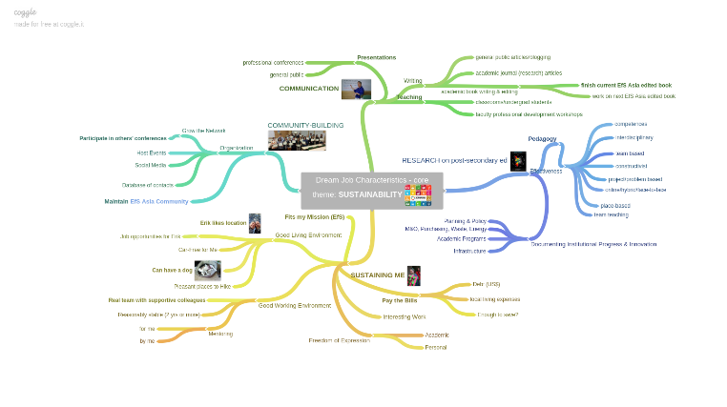
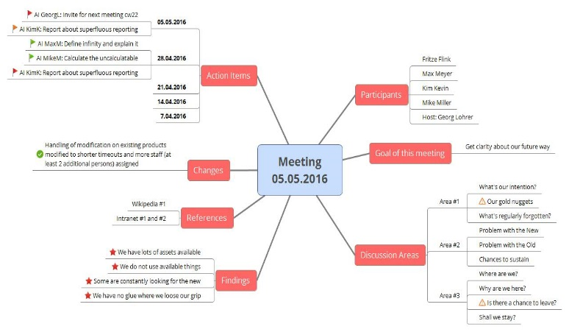
Assignment: Mind-map example
Tutor show: Example Mind-Map from a previous assignment.
This Photo by Unknown Author is licensed under CC BY
This Photo by Unknown Author is licensed under CC BY-NC-ND
This Photo by Unknown Author is licensed under CC BY-SA-NC

Slide 22
Activity: Collaborative Mind-map
In your team,
work together to produce a
‘Mind-map’ that summarises
‘key considerations of effective teamwork’.

Slide 23
Check-in
Qs?

Slide 24
Register
Register reminder.
Thanks to D.

Slide 25
The End.

Slide 26
Archive slides…

Slide 27
The Key to Success
THE KEY TO SUCCESS IN THIS MODULE IS TO MAKE WEEKLY PROGRESS.
Do not leave it until the end.

Slide 28

Show: Assignment example
Tutor note: Show 1/2 task answer examples from previous submissions.

Slide 29

Student Social Support:
* Exchange ideas and tips on how you're completing the assignment tasks.

