Slide 1

Week 3
What do I believe about knowledge, values and ethics?
Session 3
Epistemology: How can we know?

Slide 2
Today’s question
Ontology asks: What do I believe exists or is real?
Epistemology asks: How can I know about it?
What counts as knowledge?
How do I decide whether knowledge is convincing or trustworthy?

Slide 3
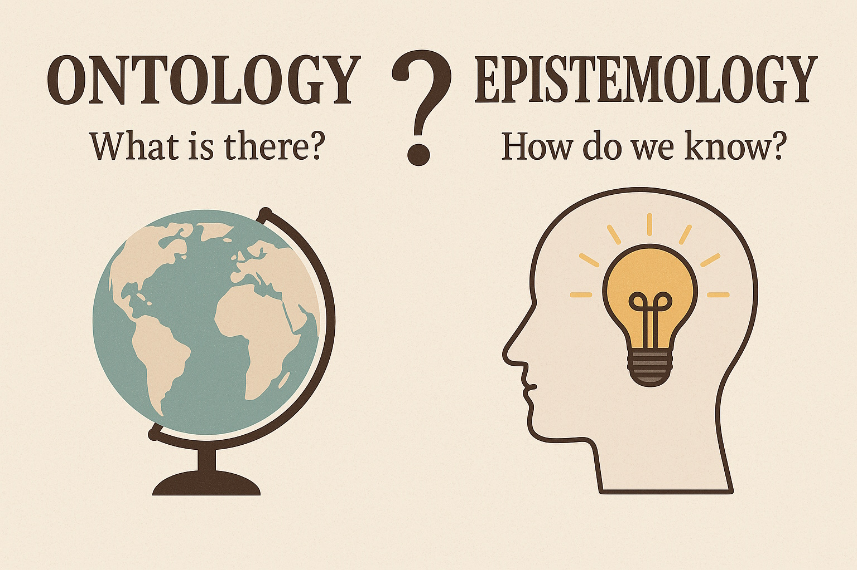
What is epistemology?
Epistemology is concerned with knowledge: what it is, how it is produced, and how claims to knowledge can be justified.
In research, it asks how you can gain knowledge about the thing you are studying.
Different researchers may use different ways of knowing because they hold different assumptions about knowledge.

Slide 4
Ontology → Epistemology → Research
These ideas are connected, but they are not the same thing.
ONTOLOGY — What do I believe exists or is real?
↓
EPISTEMOLOGY — How can I know about it?
↓
RESEARCH — How might I investigate it?

Slide 5

A simple creative example
Imagine you are researching the experience of visiting an immersive art gallery.
What would count as knowledge about that experience?
You might…
observe behaviour
ask visitors about their experiences
analyse exhibition materials (reviews/online discussions, artist statement, the artwork itself)
reflect on your own experience.
Would these different approaches produce the same knowledge?

Slide 6
Analyse visitor reviews → What can we learn from what other people have already said about the experience?
Analyse the installation → What can we learn by interpreting the thing that creates the experience?
Analyse the artist's statement → What can we learn about the artist's intended experience?
Each approach can produce a different kind of knowledge.

Slide 7
You observe a visitor standing completely still for five minutes.
You ask them afterwards what they experienced, and they say:
  “I felt like I was travelling through another world.”
You then read their online review, where they write:
  “Beautiful visuals, but the sound was overwhelming.”
And you experience the installation yourself and think:
  “The changing light made me feel disorientated.”
Which one is the truth?
They are all forms of knowledge, but they are different forms of knowledge.

Slide 8
Different ways of knowing
Knowledge can be developed through:
  observation
  measurement
  interviews and lived experience
  interpretation of images, texts or cultural material
  creative practice and making
The question is not simply ‘Which is best?’ but ‘Which is appropriate for what I want to know?’

Slide 9
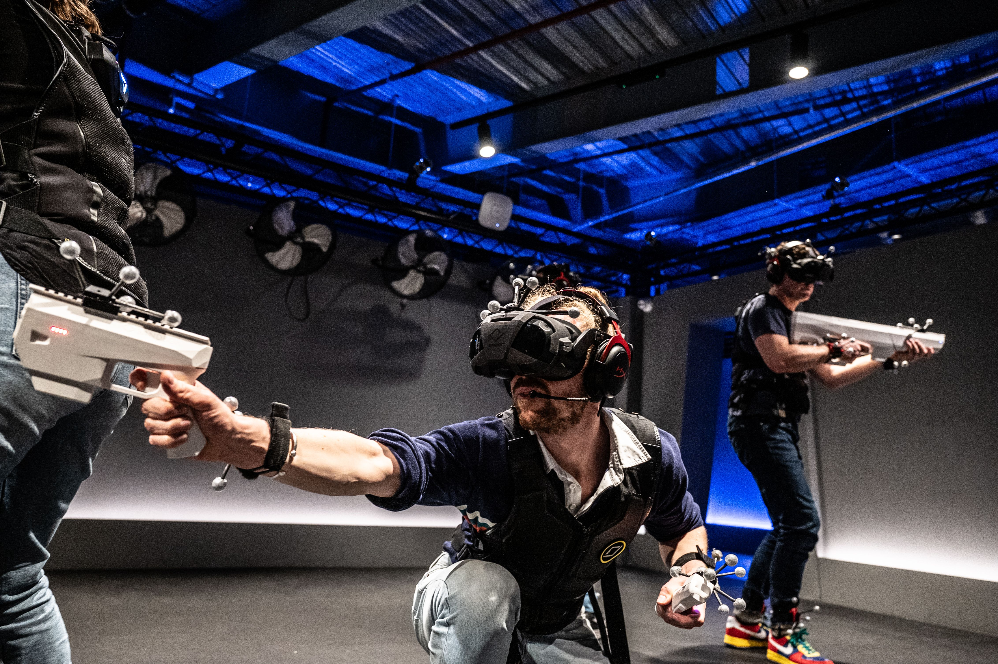
Activity: What would you use as evidence?
You want to understand how a VR gaming experience affects a player's sense of presence. What could you use as evidence?
A. Observe players behaviour while they play
B. Ask 10 players about their experience afterwards
C. Ask 50 player to rate their sense of presence on a questionnaire
D. Record physiological responses, such as heart rate
E. Analyse the game environment and how it is designed to create presence
F. Experience the game yourself and reflect on your own sense of presence
Discuss: What kind of knowledge would each approach give you? What would it tell you, and what would it not tell you?
Which is most appropriate and valuable to the study? (what would give you the most useful knowledge)

Slide 10
First thing, how are you defining ‘presence’?

Slide 11
There is no perfect method
Each approach gives you a particular kind of knowledge.
A questionnaire may show patterns across many people.
An interview may provide detailed personal experiences.
Observation may show what people do rather than what they say.
Your own reflection can provide insight, but it is also shaped by your position.

Slide 12
Knowledge is not always neutral
Who is producing the knowledge? And whose experience is being represented?
Who decides what counts as evidence?
What assumptions influence the interpretation?
What might be missing?
Is there a power dynamic?

Slide 13


Epistemology in creative practice
Creative practitioners often develop knowledge through doing, seeing, making, testing, reflecting and interpreting.
This does not automatically make every creative activity research.
For doctoral research, you need to systematically record and explain how your practice contributes to knowledge and how you can critically communicate what has been learned.

Slide 14
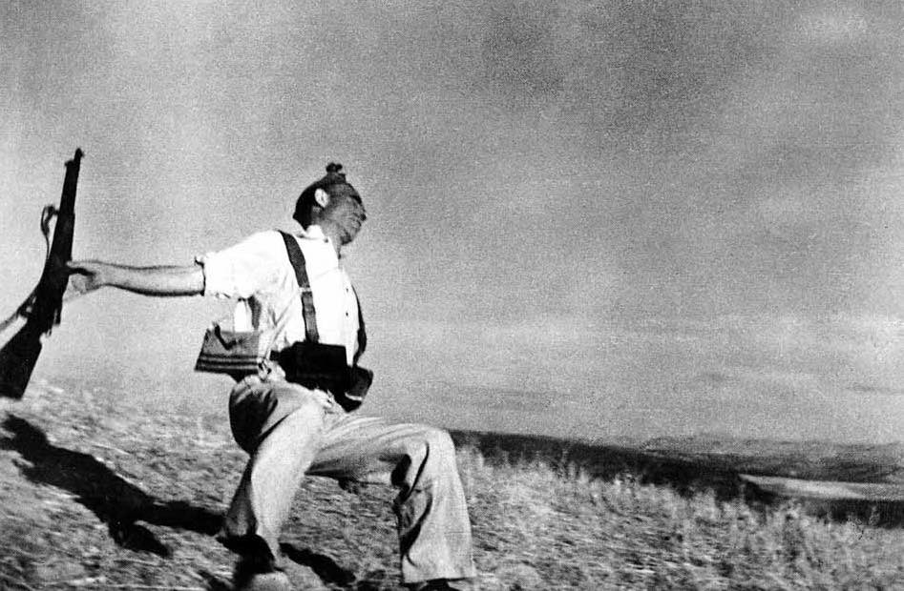
Example: Photography and memory
Practice:
I work with documentary photography/ photo-journalism.
Observation:
Photographs can influence how people remember an event.
Question:
How can photo-journalism influence the way people remember and understand events?
Ontology — What do I believe exists?
What is the thing I am actually investigating?
Is memory something that exists independently of the photograph?
Is memory of an event constructed or changed through our interactions with images?
Is the photograph itself part of the experience of remembering?
Is the research really about the relationship between photographs, memory and experience?
Epistemology: How could I develop knowledge about this?

Slide 15
How could we investigate it?
If you want to understand lived experiences, you might use interviews.
If you want to examine behaviour around photographs, you might observe.
If you want to explore how memory of an event is represented, you might analyse other visual material.
If you want to investigate your own creative process, practice-based or practice-led approaches might become relevant.

Slide 16
Activity: Return to your research
Write down your emerging research question.
What kind of knowledge do I need to answer this question?
Who or what could provide that knowledge?
What would count as convincing evidence?
Are there other ways of knowing that I have not considered?

Slide 17
Ontology and epistemology together
Ontology: What do I believe exists?
Epistemology: How do I believe I can know about it?
If I believe experience is personal and subjective, I may value people's accounts of experience.
If I believe reality can be measured objectively, I may place greater emphasis on measurement and observable evidence.

Slide 18
A useful question for your doctorate
Do not ask only:
“What method should I use?”
Ask first:
“What am I trying to know, and what would count as knowledge for this research?”
How do you know that something is ‘true’, meaningful or valuable?

Slide 19
What kinds of knowledge might your research recognise?
Experience
Observation
Measurement
Theory
Interpretation
Making
Testimony

Slide 20
Summary
In your Research Context, you introduce what you want to investigate.
In your Philosophical Position, you begin to explain what you believe about reality and knowledge.
Ontology helps establish what you think exists.
Epistemology helps establish how you think knowledge about it can be developed.

Slide 21
Exit activity Complete:
1. I think my research is trying to understand ______.
2. Useful knowledge about this could come from ______.
3. I would consider this knowledge convincing because ______.

Slide 22
Looking ahead
Ontology: What do I believe exists?
Epistemology: How can I know about it?
Next: Axiology — what do I value, and how might those values influence my research?

Slide 23
Read the paper ‘ŁukaszSułkowski Chapter Philosophical Foundatins Epistemology and Method taken from Epistemology and Methodology of Research in AI Age’ available on Moodle.
CAN BE FOUND ON MOODLE:
ADAD7014 > ‘Articles to Read’ > ’ProfDoc Students ONLY’ Folder

