Slide 1

Human Capital Management Practices in Starbucks
Module: Human Capital Management (LCMB7023)
Assessment: Group Presentation – Component 2
Group Members:
Tarikul Islam Tarek (2435183)
Sabbir Ahmed (2438312)
MD.Nuruzzaman (2438310)
Alima Niva (2431109)
Lecturer: Ejike Udeogu

Slide 2
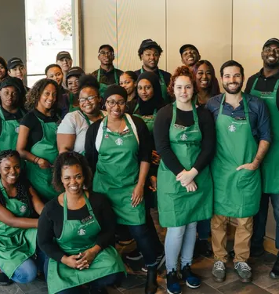
Diversity, Equity & Inclusion (DEI) at Starbucks

Slide 3
Overview of the Group Presentation
Each presenter covers a strategic HR area within Starbucks.
Topics: DEI | Performance Management | Training & Development |HR Technology and Digital Transformation
Objective: Show alignment between HR practice and business mission.
Underpinned by Soft HRM and employee-centric values.
HR Practices
Customer Experience
Business Growth
Engaged Partners

Slide 4

Understanding Diversity, Equity & Inclusion (DEI)
Belonging
Diversity
Equity
Inclusion
Diversity: The members of the different people and views are represented.
Equity: Equitable access to resources and opportunities.
Inclusion: Representation and belonging to all.
HRM Connections: Soft HRM values; Ulrich's "Employee Champion"; multicultural team effectiveness.
  Develops cultural awareness and ethical superiority within world HRM.

Slide 5

How Starbucks Embeds DEI
Global vision: “Culture of warmth and belonging for all.”
Supports talent retention and brand trust.
Inclusive Culture Pillars
Inclusive Hiring
Equitable Pay
Partner Networks
Training & Awareness
Leadership Accountability
1
2
3
4
5

Slide 6
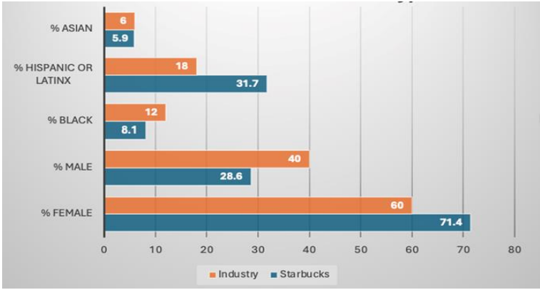

Inclusive Hiring and Representation
Partnerships with veteran, refugee, and disability networks.
Targets for representation in leadership (>45% women).
Community-based recruitment promotes local diversity.
Supports “fit with values,” not uniformity.
Figure: Diversity Analysis Comparison: Starbucks vs. Retail Industry (Minenko and Mujtaba, 2024)

Slide 7
Human Capital Management Practices in Starbucks
Driving Equity Across the Workforce
  Achieved 100% pay equity in US and UK.
  Transparent career-progression pathways.
  Equity audits to identify gaps globally.
  Links to ethical HRM and justice principles.

Slide 8
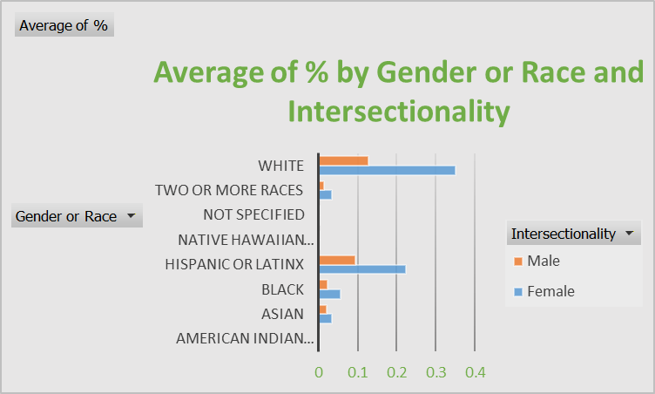
Inclusion Culture and Learning
Creating Belonging Through Learning
  Mandatory anti-bias & allyship training for partners.
  “Third Place Training” to strengthen inclusiveness.
  Peer support and Employee Resource Groups (ERGs).
  Reflects Kolb’s Experiential Learning Cycle – learn by doing and reflection.
Figure: Workforce at Starbucks by job level in the US (Starbucks, 2024)

Slide 9

Challenges & Recommendations
Current Challenges
Recommendations
Cultural differences in defining diversity.
Uneven implementation in licensed markets.
Sustaining engagement during growth.
Global DEI dashboard for metrics.
Cultural-intelligence training for managers.
Embed DEI KPIs in appraisals.
Local Inclusion Councils for contextual adaptation.

Slide 10
References
Armstrong, M. (2023) Armstrong’s Handbook of Human Resource Management Practice. 16th ed. London: Kogan Page.
Fuller, A. and Unwin, L. (2004) Workplace Learning in Context. London: Routledge.
Hofstede, G. (2001) Culture’s Consequences: Comparing Values, Behaviors, Institutions and Organizations Across Nations. 2nd ed. Thousand Oaks: Sage Publications.
Kolb, D.A. (1974) Experiential Learning: Experience as the Source of Learning and Development. Englewood Cliffs, NJ: Prentice Hall
Ulrich, D. (1997) Human Resource Champions: The Next Agenda for Adding Value and Delivering Results. Boston, MA: Harvard Business School Press.
Minenko, M. and Mujtaba, B.G. (2024) ‘Diversity Audit at Starbucks: Assessment of Workforce Demography, Inclusion Initiatives, and Corporate Culture,’ Business Ethics and Leadership, 8(3), pp. 173–183. doi: https://doi.org/10.61093/bel.8(3).173-183.2024. —
Starbucks (2024) Workforce Diversity at Starbucks. [online] Available at: https://about.starbucks.com/stories/2024/workforce-diversity-at-starbucks/
Starbucks Corporation (2024) Global Environmental and Social Impact Report 2024. [online] Available at: https://www.starbucks.com/responsibility.
Building an Inclusive Future for Partners Everywhere. [online] Available at: https://stories.starbucks.com

Slide 11
STARBUCKS: PERFORMANCE MANAGEMENT

Slide 12
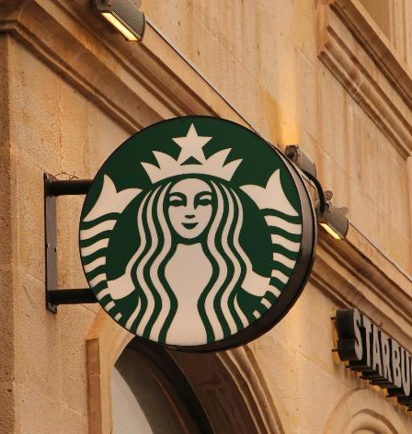
Presentation Overview
Definition & Role of Performance Management
Starbucks’ Performance Management Approach
Key Tools & Practices (Appraisal, Feedback, Development)
Managerial Involvement & Cultural Alignment
Challenges & Recommendations
Summary

Slide 13

Understanding Performance Management
Definition: Continuous process of reviewing, direction and refining of employee performance in order to meet strategic objectives.
  Exceeds yearly review - incorporates coaching, feedback, and recognition.
Role: To align personal objectives and the Starbucks mission to inspire and nurture the human spirit.
  The philosophy of Starbucks: performance through partnership: manager-partner collaboration.
  The performance management applied in the company is both the evaluation and development instrument.

Slide 14
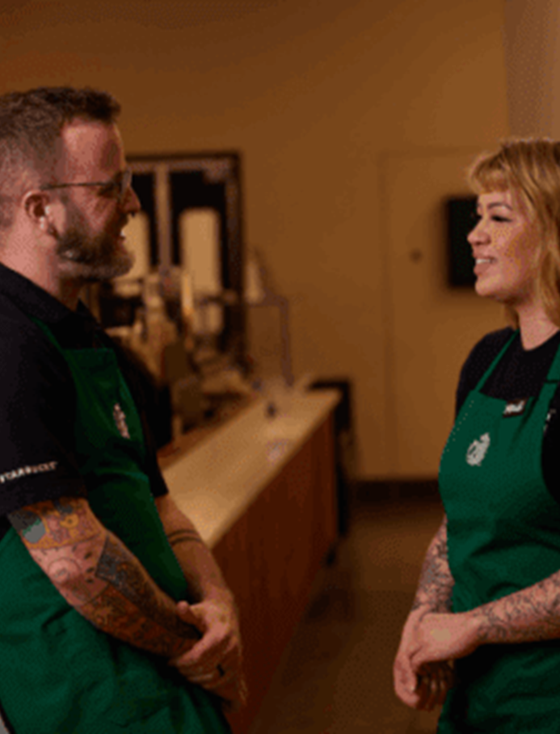
Starbucks’ Performance Management Approach
Continuous feedback model: Real-time coaching conversations rather than once-a-year appraisals.
Manager–Partner Dialogue: Regular “Check-In Conversations” focus on goals, personal development, and well-being.
Goal Setting: SMART goals set collaboratively between store manager and partners.
Performance Reviews: Semi-annual evaluations linked to leadership competencies — “Creating Inspired Moments” and “Delivering Results.”
Rewards Integration: Performance outcomes inform pay progression and recognition awards.
Goal Setting
Coaching
Check-In
Recognition
Development

Slide 15

Tools and Practices
Appraisal Process: Two-way meeting with manager, peer observation and feedback.
Technology Support: Chart of goals, training and accomplishments named Partner Hub.
Recognition Culture: Partner of the Quarter and Coffee Master are the names that Idaho State gives to recognition and connect it with performance and learning.
Training Integration: The lack of performance that is solved by offering specific coaching or reskilling (associated with Training and Development topic).
Ethical Foundations: Feedback focuses on respect, equitability, and development instead of punishment - which is in line with the inclusive culture of Starbucks.

Slide 16

Role of Line Managers & Organizational Culture
Line managers act as coaches, not controllers.
Expected to lead by Starbucks’ values — inclusion, empathy, accountability.
Regular feedback conversations foster engagement and trust.
HR provides training for managers to deliver fair evaluations and manage bias.
Aligns with Soft HRM approach — focusing on motivation, commitment, and employee voice rather than mere control.

Slide 17
Challenges & Recommendations
Current Challenges
Recommendations
Variation in feedback quality across regions and franchise stores.
Difficult balance between standardisation and local autonomy.
Cultural differences affect how feedback is received internationally.
Develop cultural intelligence training for managers to tailor feedback styles globally.
Strengthen consistency via digital performance analytics (track frequency and quality of Check-Ins).
Integrate career development pathways more clearly with performance data to motivate retention.
Reinforce Starbucks’ “expansive learning culture” (Fuller & Unwin, 2004) — link evaluation to learning opportunities.

Slide 18
Summary & References
Starbucks has a performance management system that is continuous, developmental and value-based and is based on feedback.
Close co-ordination of business objectives, partner development and culture.
Continued dilemma: how to remain global and at the same time be sensitive locally.
Best performance management in Starbucks represents soft HRM, as well as strategic combination of HR and operations.
References
Armstrong, M. (2023) Armstrong’s Handbook of Performance Management. Kogan Page.
Ulrich, D. (1997) Human Resource Champions. Harvard Business Press.
Fuller, J. & Unwin, L. (2004) Expansive Learning Environments. Routledge.
Starbucks Corporation (2025) Partner Hub & Culture Resources. Available at: https://careers.starbucks.com
Talent Management Institute (2024). Inside Starbucks: A Case Study on Talent Management. [online] www.tmi.org. Available at: https://www.tmi.org/blogs/inside-starbucks-a-case-study-on-talent-management.
HRE Executive (2024) What Starbucks is Doing to Elevate the Employee Experience Journey.

Slide 19
Training and Development at Starbucks

Slide 20
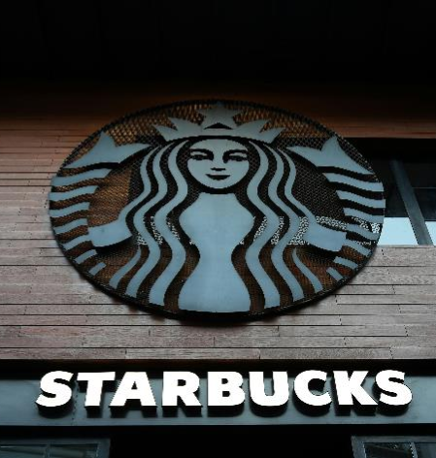
Presentation Overview
Definition & Role of Performance Management
Starbucks’ Performance Management Approach
Key Tools & Practices (Appraisal, Feedback, Development)
Managerial Involvement & Cultural Alignment
Challenges & Recommendations
References

Slide 21
Role of Training & Development at Starbucks
Training: systematic learning of job skills;
Development: long term employee development.
Starbucks refers to the workers as Partners, which encourages the culture of never-ending learning.
The Starbucks Experience is based on training- consistency in 35k+ stores.
Strategic objective: "Inspirational and caring the human spirit, one individual, one cup, one neighborhood at a time.
Training is consistent with customer-focused approach and empowerment of partners.

Slide 22
Training Implementation: Cycle & On-the-Job Learning
Training Cycle in Practice
On-the-Job Learning
Needs Analysis – identifies service & product-knowledge gaps.
Design – “Starbucks Experience Class”, role-play & digital modules.
Delivery – 70/20/10 model: 70% on-job, 20% coaching, 10% formal learning.
Evaluation – store-level observation, partner surveys, customer feedback.
Tell–Show–Do” coaching method by store mentors.
New baristas receive ~24 hours initial training + shadowing.
Reinforced by Starbucks Global Academy and “Coffee Master” certification.

Slide 23

Training Budget & Domains of Learning
Starbucks invests heavily: U.S. ≈ $1,000 per partner annually (estimate, TMI 2024).
Global programs include Barista Basics, Coffee Academy, and Leadership Pathways.
Bloom’s Domains (1956)
  Cognitive – product knowledge & recipes.
  Affective – customer empathy & brand values.
  Psychomotor – espresso skills & equipment use.
Balanced development builds technical & emotional intelligence critical to service.

Slide 24
Evaluating Training Outcomes
Kolb’s Experiential Learning (1974):
Starbucks measures success by how partners apply learning through real-world practice and reflection.
Partners experience real customer service tasks (Concrete Experience).Reflect with mentors on what went well or not (Reflective Observation).Identify better service responses (Abstract Conceptualization).
Test improvements in future shifts (Active Experimentation).
Workplace Learning Environment (Fuller & Unwin, 2004):
Starbucks fosters an expansive learning culture — coaching, peer support, and growth pathways.
Evaluation happens daily through observation, feedback, and customer metrics, not only formal tests.
Results observed:
High internal promotion rates and consistent service delivery.
Partners show confidence, teamwork, and problem-solving growth.

Slide 25
Critical Issues & Recommendations
Critical Issues:
Unequal access to training (Grugulis, 2007): variation across regions and franchise stores.
“Modern Myth” (Noon & Blyton, 1997): challenges the belief that training alone solves performance problems — Starbucks must combine training with supportive culture, fair pay, and career progression.
Workplace learning (Fuller & Unwin, 2004): Starbucks encourages expansive learning through peer mentoring and experiential reflection.
Recommendations:
Expand e-learning globally to reduce regional disparities.
Link training metrics to KPIs (customer NPS, turnover).
Introduce peer-mentorship cross-market.
Increase transparency of training investment by region.

Slide 26
References
Bloom, B.S. et al. (1956) Taxonomy of Educational Objectives. New York: McKay.
Fuller, J. & Unwin, L. (2004) ‘Expansive learning environments’, in Rainbird et al. Workplace Learning in Context. Routledge.
Grugulis, I. (2007) Skills, Training and Human Resource Development. Palgrave.Kolb, D. (1974) Experiential Learning. Prentice Hall.
Noon, M. & Blyton, P. (1997) The Realities of Work. Macmillan.
Starbucks Corporation (2025) Careers & Culture – Grow with Us. Available at: https://careers.starbucks.com
Panopto (2018). How Starbucks Does Training to Create an Unforgettable Experience. [online] Panopto Video Platform. Available at: https://www.panopto.com/blog/how-starbucks-does-training-to-create-an-unforgettable-customer-experience/.
Talent Management Institute (2024). Inside Starbucks: A Case Study on Talent Management. [online] www.tmi.org. Available at: https://www.tmi.org/blogs/inside-starbucks-a-case-study-on-talent-management.

Slide 27




Topic: Starbucks – HR Technology and Digital Transformation
University: University of Wales Trinity Saint David
Module: Human Capital Management (LCMB7023)
Assessment: Group Presentation – Component 2
Student:
ID: Lecturer: Ejike Udeogu Date: November 2025
Company Overview:
Founded: 1971 – Seattle, Washington, USA
Global presence: 90+ countries, 40,000+ outlets
Employees: ≈450,000 partners globally (Marr, 2018)
Annual revenue (2024): US $36 billion
Mission: “To inspire and nurture the human spirit – one person, one cup, and one neighborhood at a time.”

Slide 28


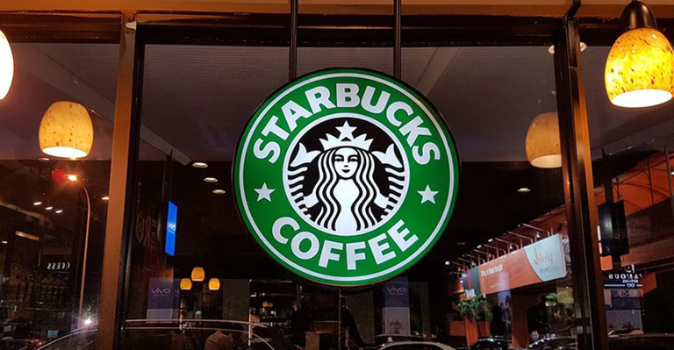
Evolution of Starbucks’ HR Transformation
Pre-digital Era: Fragmented HR databases and regional practices before 2015 (AdviserPlus, 2024).
Strategic HR Digitalization (2015): Initiated global cloud-based HR strategy.
Partnership with SAP SuccessFactors (2016): Integration of recruitment, learning, payroll (Littman, 2021).
Implementation Milestones:
2017 – Online recruitment and digital onboarding launched.
2018 – Full U.S. payroll digitalization achieved.
2019 – 60 % of global stores using cloud HR portals.
Operational Benefits:
30 % reduction in HR administrative costs by 2020 (Marr, 2018).
Average HR service-request time cut by 40 %.
Employee Access: HR self-service introduced across 80 + countries by 2023 (TMI, 2024).

Slide 29

Key HR Technologies Implemented
1. SAP SuccessFactors – Core HR modules for payroll, talent, and succession (Littman, 2021).
2. Workday Analytics – Real-time dashboards for workforce metrics (Marr, 2018).
3. AI-based Recruitment Bots – Automated screening; hiring time reduced by ≈40 % (DigitalDefynd, 2025).
4. MyPartnerHub App – Internal communication and engagement; > 350 000 daily users (Starner, 2015).
5. Starbucks Global Academy – Digital learning platform; 1.2 million+ course completions (TMI, 2024).
6. Mobile Scheduling Tools – Used in ≈ 85 % of U.S. stores (AdviserPlus, 2024).
7. Cloud Data Integration – Centralized reporting linking HR, finance, and operations (Marr, 2018).
8. Digital Recognition Systems – Peer-to-peer awards and gamified rewards (Littman, 2021).

Slide 30

Impact of Digital Transformation on HR Practices
Engagement: Partner engagement up 22 % (2018–2023) via digital feedback tools (Starner, 2015).
Retention: Voluntary turnover down from 65 % → 48 % in U.S. stores (Marr, 2018).
Internal Mobility: Promotions increased 25 % post career-path platform launch (TMI, 2024).
Diversity: 43 % women & 47 % BIPOC in corporate roles (2024) (Littman, 2021).
Data-Driven Leadership: 2,000 + managers use analytics dashboards daily (AdviserPlus, 2024).
Learning & Development: Over 12 million training hours delivered digitally (2022–2024).
Customer Link: Digitally engaged stores = +10 % higher sales productivity (Marr, 2018).
Sustainability Tie-in: E-learning incorporates ESG modules (TMI, 2024).

Slide 31



Challenges in HR Digital Transformation
1. Financial Cost: ≈ US $120 million global system investment (AdviserPlus, 2024).
2. Data Protection: Compliance with GDPR, CCPA & 80 + local laws (Littman, 2021).
3. Change Resistance: 20 % of managers reluctant to adopt digital tools (Starner, 2015).
4. Legacy Migration: Payroll errors during 2018 transition (Marr, 2018).
5. Skill Gaps: Digital literacy training ≈ US $5 million per year (TMI, 2024).
6. System Overlap: Tool duplication causing “tech fatigue” (DigitalDefynd, 2025).
7. Connectivity Issues: Inconsistent infrastructure in emerging markets.
8. Cultural Adaptation: Aligning tech use with local values and labour laws.

Slide 32


AI Forecasting: Predictive staffing and attrition models by 2025 (Marr, 2018).
Attrition Goal: Reduce turnover below 40 % by 2026 (DigitalDefynd, 2025).
Well-Being Platforms: 100 % global partner coverage by 2027 (TMI, 2024).
Sustainability Metrics: Link HR KPIs to ESG targets (AdviserPlus, 2024).
Diversity Analytics: 45 % women in leadership by 2030 (Littman, 2021).
Hybrid Work Tech: Collaboration tools for 20 000 remote employees (Starner, 2015).
AI Learning Coach: Adaptive training recommendations based on skills gaps (Marr, 2018).
Digital Ethics Framework: Governance model for AI and data use.
Future HR Technology Trends at Starbucks

Slide 33
References
AdviserPlus (2024) ‘Starbucks UK: Strategic HR transformation cuts absence costs’, AdviserPlus Case Study. Available at: https://adviserplus.com/our-story/our-clients/starbucks-uk-hr-transformation-cuts-absence-costs/ (Accessed: 1 Nov 2025).
DigitalDefynd (2025) ‘8 Ways Starbucks Is Using AI [Case Study]’, DigitalDefynd. Available at: https://digitaldefynd.com/IQ/starbucks-using-ai-case-study/ (Accessed: 1 Nov 2025).
Littman, J. (2021) ‘Starbucks will use analytics to track promotion decisions in diversity push’, Restaurant Dive, 5 Apr. Available at: https://www.restaurantdive.com/news/starbucks-will-use-analytics-to-track-promotion-decisions-in-diversity-push/597791/ (Accessed: 1 Nov 2025).
Marr, B. (2018) ‘Starbucks: Using big data, analytics and artificial intelligence to boost performance’, Forbes, 28 May. Available at: https://www.forbes.com/sites/bernardmarr/2018/05/28/starbucks-using-big-data-analytics-and-artificial-intelligence-to-boost-performance/ (Accessed: 1 Nov 2025).
Starner, T. (2015) ‘Starbucks brewing fresh approach to employee engagement’, HR Dive, 12 Aug. Available at: https://www.hrdive.com/news/starbucks-brewing-fresh-approach-to-employee-engagement/403850/ (Accessed: 1 Nov 2025).
Talent Management Institute (2024) ‘Inside Starbucks: A case study on talent management’, TMI Blog, 29 Mar. Available at: https://www.tmi.org/blogs/inside-starbucks-a-case-study-on-talent-management (Accessed: 1 Nov 2025).

Slide 34

Conclusion
HR functions collectively align with the company’s global strategy
Integrated HR operations, training, DEI, and technology foster innovation
Shared goal: skilled, inclusive, and digitally capable workforce
Strategic HR alignment enhances retention and competitiveness
Continuous adaptation builds organizational resilience

