Slide 1
Digital Portfolio and Audio Reflection
Student number 2438385
17 July 2026
DS3 Assessment
Module: New Digital Skills
LCLM4002 Digital Skills
Assessment
DS3 Digital Portfolio and Audio Reflection

Slide 2
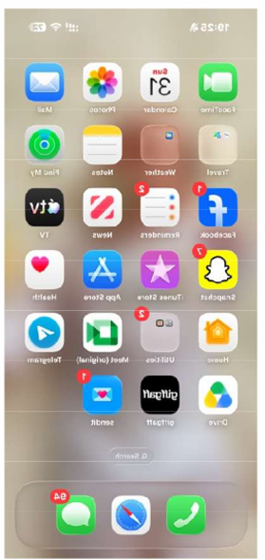
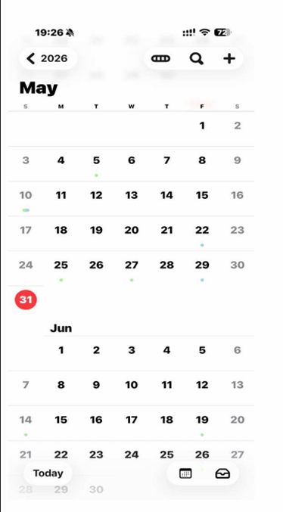
My Digital Portfolio
Portfolio Overview
My digital learning journey is shown in 4 artefacts.
I am putting my grades on DS1 and on DS2.
Every artefact is related to the practical application of digital skills.
Artefact 1
Phone Home Screen
Improved digital communication skills.
Daily tasks use of used mobile applications.
Artefact 2
Calendar App
Successfully scheduled assignments and appointments.
Potential time management and organisation improvements.
Developed better study planning (Grewal, 2025).
Notes:
This is my Digital Portfolio for the Digital Skills module. As part of my portfolio, I have four artefacts from DS1 and DS2, which will show the development of my digital skills during the module. My first two artefacts are my phone Home screen and Calendar App. These examples illustrate how I use digital tools to communicate, organise my studies and how I use them to manage my daily activities. Prior to undertaking this module, I had only used these applications for personal reasons. I now learn how they also contribute to my academic success by assisting me to manage deadlines, access Moodle and communicate with lecturers. This is a sign of the value of digital skills in education and the workplace, as commented on by Grewal (2025) that good digital skills enable people to work more efficiently and are a key factor in increasing productivity.

Slide 3
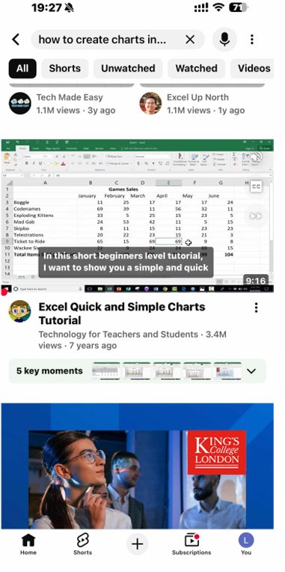
Business Digital Task
Artefact 3
Excel Sales Report
Arranged data on business sales on a weekly basis.
Used formulas correctly to make accurate calculations.
Improved spreadsheet skills.
Artefact 4
Excel Sales Chart
Used professional charts to present data.
Made comparisons between the business performance using visual means.
Enhance Data Analysis and Reporting (DataStudios, 2025).
Notes:
The next 2 artefacts are my Excel Sales Report and Sales Chart from DS2. This task was useful for gaining hands-on experience with Microsoft Excel, where I learned to structure the sales data, create formulas for calculating totals and formulate information using charts. I first found myself trouble with Excel due to my lack of experience in using formulas and analysing data. Once I went through the class and practised on regularly, I was really more confident. I am now able to organise data, analyse results and present information professionally. The skills are useful because all Microsoft 365 applications are used in companies all over the world, and digital competence is an important skill to have in the workplace (DataStudios, 2025).

Slide 4
My Learning Journey
Challenges
Some experience using Microsoft Excel.
Having trouble keeping up with school deadlines.
Limited knowledge of academic research.
Progress
Enhanced skills in the use of Microsoft Office.
Developed confidence using digital tools.
Developed an understanding of the responsible use of AI.
Current Skills
Create spreadsheets independently.
Present information professionally.
Look in trusted academic sources (Boogaard, 2019).
Natural
Trustworthy
Innovative
Sustainable
Notes:
During this module, I gained a lot of more digital skills. Initially I struggled with organizing the work, working on time and finding good academic sources. I was not confident with using Microsoft Excel as well. Breaking tasks into manageable ones was a strategy which helped me improve. This helped me to work in an organised manner and on time. Boogaard (2019) refers to this as microproductivity; doing a small amount of work at a time would help to increase the productivity and decrease the level of stress. I also learnt to use Artificial Intelligence in an ethical way instead of letting AI do everything for me.

Slide 5
Reflection and Future Development
Future Benefits
Better preparation of assignments at universities.
Improved business communication abilities.
Improved organisation of everyday activities.
Improving employability through the use of digital skills (Hedau, 2025).
Portfolio Reflection
Evidence of developing confidence in using digital devices.
Improved practical academic skills and work skills.
Notes:
Overall, I'm more confident in using digital technologies for academic, professional and personal purposes as a result of this module. I can now use Microsoft Word, Excel, PowerPoint, Moodle and other digital tools independently to accomplish a variety of tasks. These skills will enable me to deliver better assignments at University, communicate professionally, to analyse information and prepare business reports. They will also have better prospects for future work due to an increasing demand for digital skills among employers. Hedau (2025) states that LinkedIn is crucial in employability as there are millions of professionals, and most recruiters check LinkedIn profiles during the hiring process. It is a good example of how further development of my digital skills will help my career and my life-long learning.

Slide 6
References
Boogaard, K. (2019) What's microproductivity? The small habit that will lead you to big wins. Work Life by Atlassian. Available at: https://www.atlassian.com/blog/productivity/microproductivity-break-tasks-into-smaller-steps (Accessed: 16 July 2026).
DataStudios (2025) Microsoft 365 adoption in 2025: Businesses – how deep is its global reach? Available at: https://www.datastudios.org/post/microsoft-365-adoption-in-2025-businesses-how-deep-is-its-global-reach (Accessed: 16 July 2026).
Grewal, H.K. (2025) Lack of digital skills in workforce is hampering productivity. Facilitate Magazine. Available at: https://www.facilitatemagazine.com/content/news/2025/05/12/lack-digital-skills-workforce-hampering-productivity (Accessed: 16 July 2026).
Hedau, S. (2025) LinkedIn's Impact on Job Hunting: Facts & Figures (2025). LinkedIn. Available at: https://www.linkedin.com/pulse/linkedins-impact-job-hunting-facts-figures-2025-sagar-hedau-okdwf (Accessed: 16 July 2026).

