Slide 1
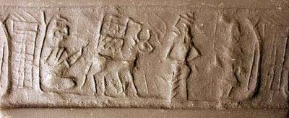
Sumerian cylinder seal, c. 3000 BC

Slide 2
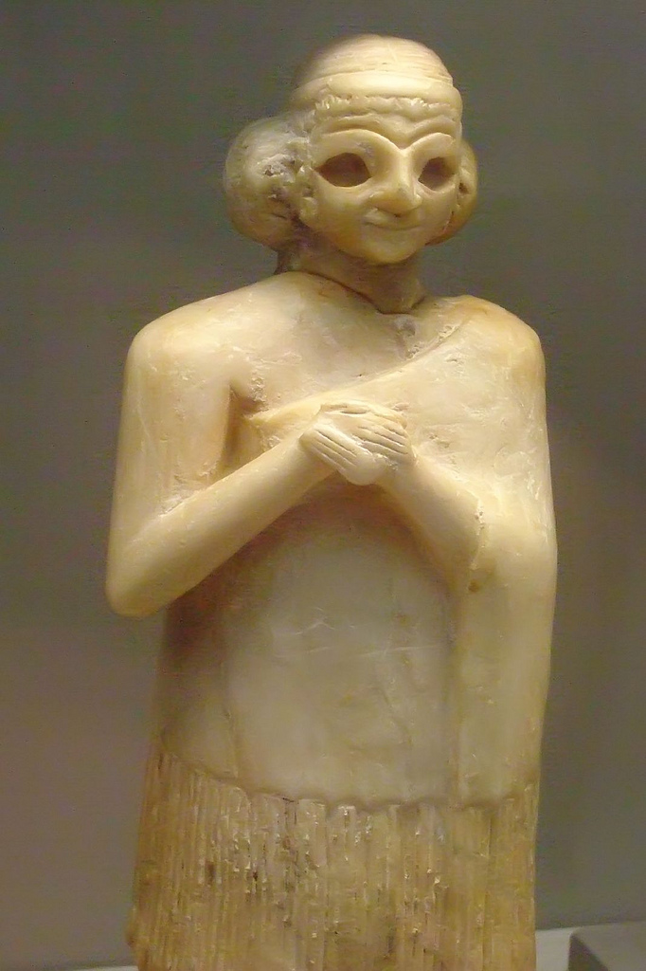
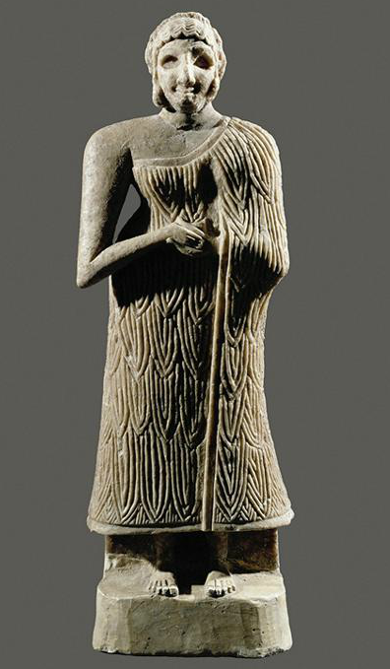
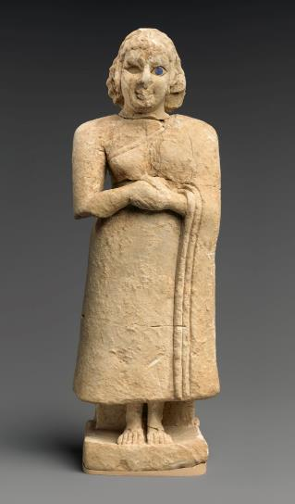
Nippur
Early Dynastic III figures c. 2600-2250

Slide 3
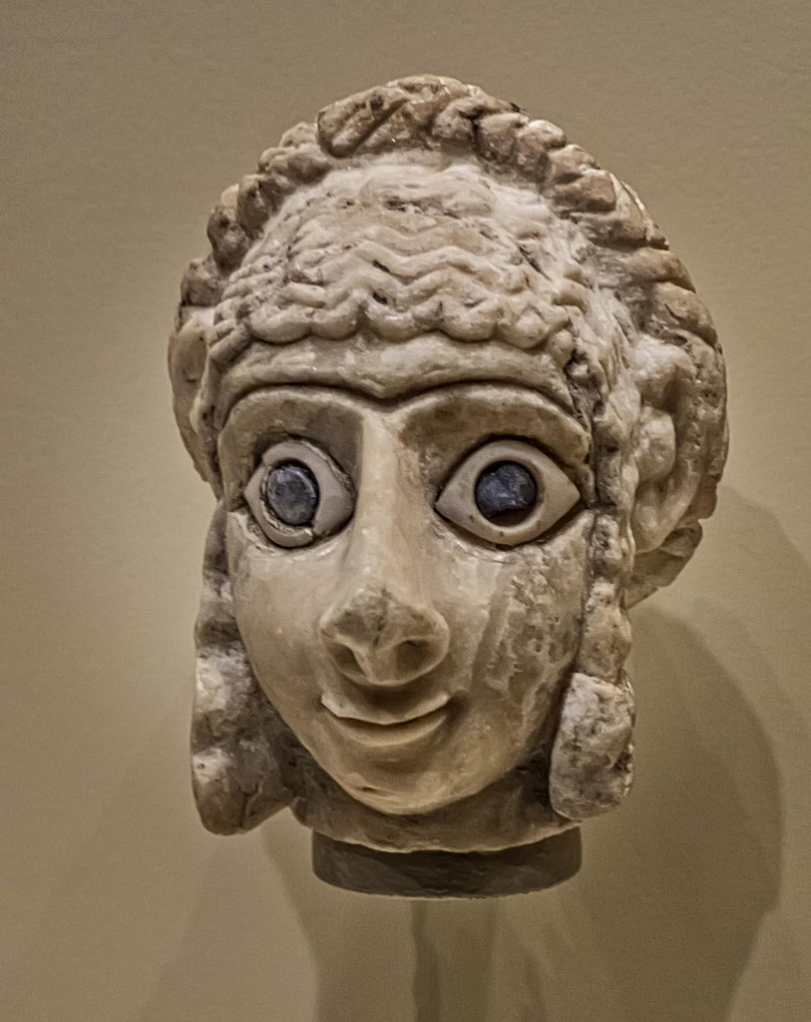
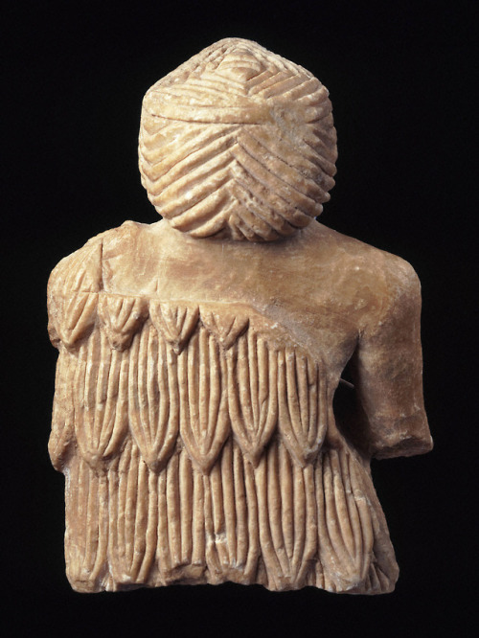
Khafajah
Early Dynastic III,

Slide 4
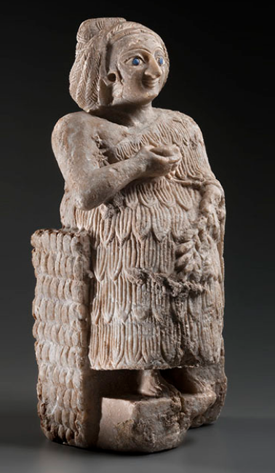
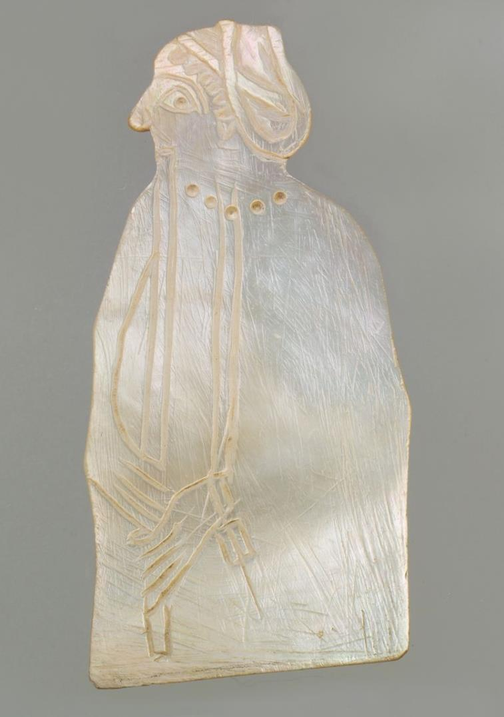
Early Dynastic III
Alabaster, Lapis, bitumen, shell
Early Dynastic shell inlay,
Nippur, 2600-2500

Slide 5
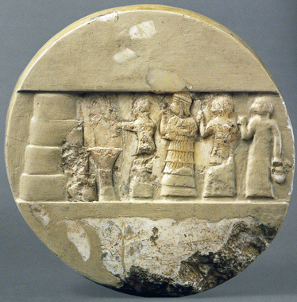
Disc of Enheduanna
c. 2300-2250 BC

Slide 6
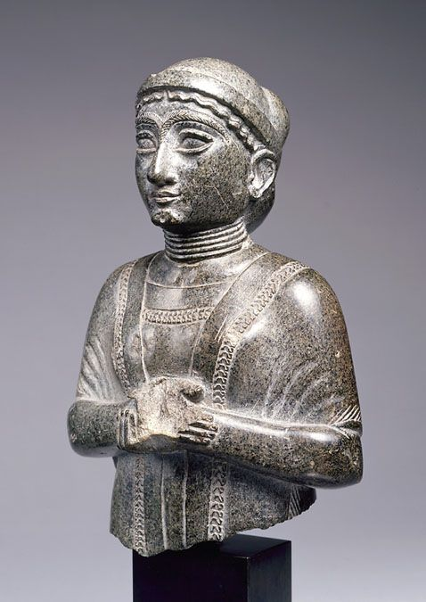
Portraiture?
Girsu 2150 BC

Slide 7
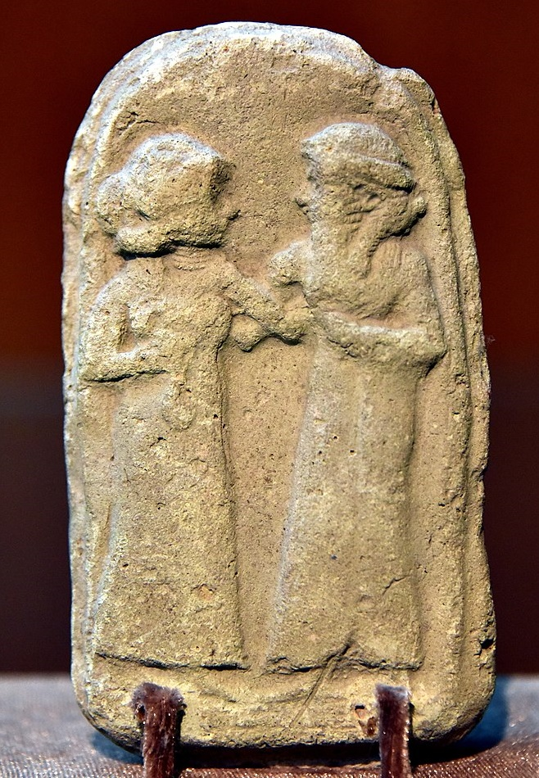
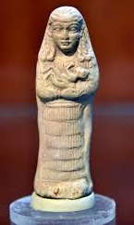
Old Babylonian plaque
Old Babylonian stone plaque

Slide 8
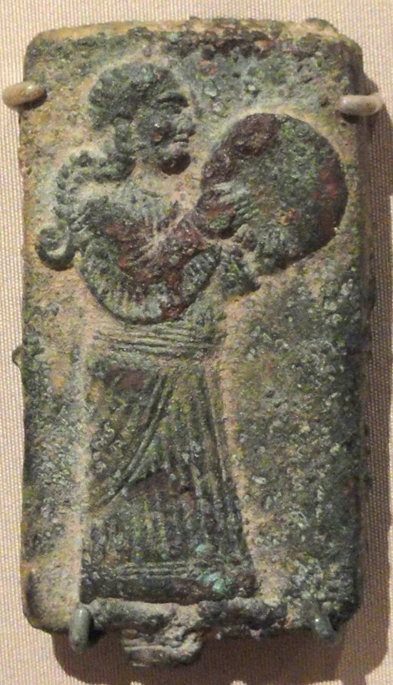
Neo-Assyrian woman drumming

