Slide 1

Developing relationships and workplace achievement
The meaning of employee motivation
This Photo by Unknown author is licensed under CC BY-SA-NC.
Dr Sujeewa Herath
Charlene Johnson 2131892
BMSW 5102
June 2023

Slide 2
Table of content
Introduction........................................................................................................................................................ Slide3
The meaning of employee Motivation...........................................................................................................…..Slide4
The meaning of employee Motivation................................................................................................................Slide5
Intrinsic & Extrinsic motivation ...........................................................................................................................Slide6
Intrinsic & Extrinsic motivation table...................................................................................................................Slide7
Herzberg motivation Theory.................................................................................................................................Slide8
Maslow motivation theory...................................................................................................................................Slide9
Conclusion...........................................................................................................................................................Slide11
References...........................................................................................................................................................Slide12&13
Motivation theories.............................................................................................................................................Slide10

Slide 3

Introduction
Motivation plays a critical role in the workplace and any organization; The purpose of this presentation is to provide a clear and better understanding of human resource management, the meaning of employee motivation, the key motivation theories. And a brief discussion of my own experience in motivating employees .

Slide 4
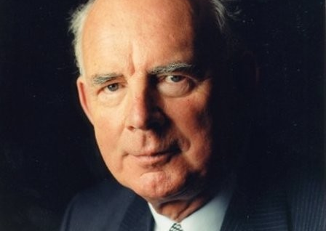
The meaning of employee motivation
Motivation is stimulating staff or individuals to perform in a certain manner, Motivation is concerned with the strength and direction of behavior and the factors that influence people to behave in certain ways (Armstrong, 2012,P182)

Slide 5

The meaning of employee motivation
"Motivation is an articulation of the forces which drive an individual to pursue a particular course of action.(Napolitano, 2018,P1.1)
Armstong describes motivation in a way that it's based on the strengths and behaviors of staff motivation whereas Napolitano identifies motivation as a combination of dynamic factors

Slide 6
Intrinsic & extrinsic motivation
Intrinsic motivation refers to behaviour that is driven by internal rewards. In other words, the motivation to engage in a behaviour arises from within the individual because it is naturally satisfying to you.(cherry, 2017,P1)
for example, if you work for a very large and popular company your intrinsic desire is to perform to the best of your ability and feel a sense of achievement or for Fullment
Extrinsic motivation drives by external rewards. All people might want to deserve rewards like fame, money, grades and etc. Competition is also a part of extrinsic motivation because it predicts that competitor’s wish is extrinsic as they compete with each other to achieve more money or fame or marketing recognition.(Filimonov,2017,P9)
for example, a star basketball player only wants to play for the attention the money and the fame playing as a team is not his focus. I will now continue with the advantages and disadvantages.

Slide 7
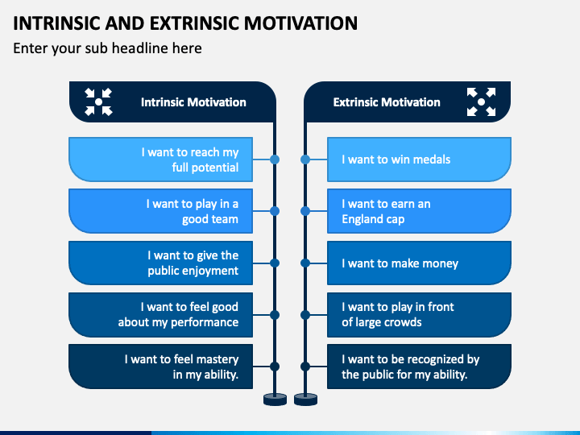
Intrinsic & Extrinsic Motivation

Slide 8
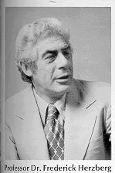
The key Motivation Theories
Herzberg study was restated and then changed to the two-factor theory of job satisfaction. The two factors that had an effect on job satisfaction were divided into two sets of categories.
The category was associated with ‘the need for growth or self-actualisation’ and became known as the motivation factors.
Motivation factors included achievement, recognition, the work itself, responsibility, advancement and the possibility for growth (Herzberg, 1966; Herzberg, 2003)
This is an insightful way to motivate staff which I have also experienced. Herzberg theories would be a great recommendation for any organization.

Slide 9
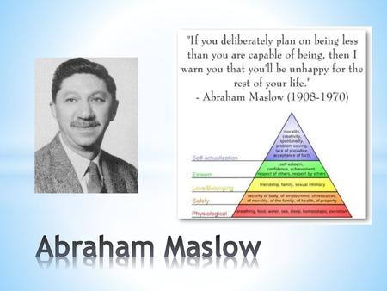
motivation
Motivation is concerned with the factors that influence people to behave in certain ways.
The man who is engaged in what are called the higher activities, thinking, inventing, creating, finds that these activities demand, as a prerequisite." (Maslow,1943,P216.) which is something that required as a condition for something else to happen or exit.

Slide 10
Motivation Theories
Taylor (1911) is based on rewards and punishments are directly related to their performance.
Hull (1951) Successful actions are repeated when a similar need arises.
Maslow (1954) people are motivated by their needs this in time transforms into goals.
Herzberg et al (1957) is based on the intrinsic to the work itself and extrinsic to the job, motivators or hygiene factors such as pay and working conditions.
Vroom (1964) and Porter and Lawler (1968) is more about effort that leads to rewards which must be achievable and worthwhile.​
Latham and Locke (1979) theory is based on feedback motivation is improved in a demanding but agreed goals setting.​
Adams (1965) people are motivated when treated fairly, all employees hard working, and efforts should have the reward value.

Slide 11

Conclusion
"The future belongs to those who believe in the beauty of their dreams." This famous motivation quotes is by Eleanor Roosevelt. All organizations, company's, employers and employees need motivation in order to continue, this is critical for any productivity to succeed, the developing of strategic strategies to better understand the working environment which encourages communication, feedback, rewards and individual performance.
This presentation has identified the intrinsic and extrinsic motivation and the key motivational theories by Abraham Maslow and Frederick Herzberg which I recommended as a great motivation theory, Micheal Armstrong book on motivation and Napolitano Gabriele book on motivation in the workplace, is also mentioned in this presentation.
It is essential to note that motivation is a regular and continuous form of action, motivating employee is the piler of every organization and must be adapted to employee's growth within a company.

Slide 12

References
https://idata.over-blog.com/0/48/55/67/dessins-pour-articles/frederick-herzberg.gif
Napolitano, G., 2018. Motivation in the Workplace: A Procter and Gamble Case Study. Babelcube Inc..
Cherry, K., 2016. What is intrinsic motivation. About. com Psychology retrieved from.
Filimonov, D., 2017. Extrinsic motivation and incentives.
Napolitano, G. (2018) Motivation In The Workplace: A Procter and Gamble Case Study, https://scholar.google.com/scholar?start=10&q=books+on+motivation+in+the+workplace&hl=en&as_sdt=0,5. Babelcube Inc. 25th of May 2018. Available at: https://scholar.google.com/scholar?start=10&q=books+on+motivation+in+the+workplace&hl=en&as_sdt=0,5 (Accessed: 27 June 2023).
https://m.media-amazon.com/images/I/519NfYttWiL.jpg

Slide 13

References
Armstrong, M. (2009) Armstrong’s Handbook of Human Resource Management Practice. 12 edition. London etc.: Kogan Page.
Stoyanov, S 2017, An Analysis of Abraham H. Maslow's a Theory of Human Motivation, Macat International Limited, Milton. Available from: ProQuest Ebook Central. [23 June 2023].
Available at: https://uk.linkedin.com/in/michael-armstrong-4613a668 (Accessed: 24 June 2023).
Maslow, A.H. (no date) ‘A dynamic theory of human motivation.’, Understanding human motivation., pp. 26–47. doi:10.1037/11305-004.
https://slideplayer.com/86/14128427/big_thumb.jpg
cherry, kendra (2017) ‘Intrinsic motivation’, Changing Employee Behavior [Preprint]. doi:10.1057/9781137449566.0007.
https://www.google.com/url?sa=i&url=https%3A%2F%2Fwww.sketchbubble.com%2Fen%2Fpresentation-intrinsic-and-extrinsic-motivation.html&psig=AOvVaw0ldlgOAQPsqt6EHXCQggJ2&ust=1687800326580000&source=images&cd=vfe&ved=0CBAQjRxqFwoTCOjuiLL43v8CFQAAAAAdAAAAABAx

