Slide 1
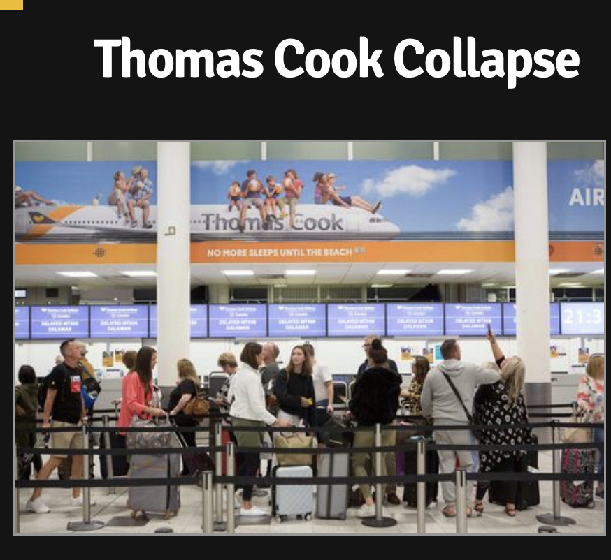
International Travel Operations

Slide 2
THOMAS COOK
FOUNDED 1841 UK TRAIN TOURS
1951 EUROPEAN TOURS - GRAND TOUR, TRAINS & GREAT EXHIBITIONS
FOUNDER OF PACKAGE HOLIDAYS & TOUR OPERATORS
NATIONALISED DURING WAR
PRIVATISED 1970’S
BRAND IDENTITY
DON’T JUST BOOK IT THOMAS COOK IT!
AIRTOURS
2012 OLYMPICS
SUBSIDIARIES - UK, EUROPE & WORLD WIDE
Airtours, Airline, Condor, Hotels and Resorts
Sept 2019 Liquidation

Slide 3
THOMAS COOK
2007 THOMAS COOK
Merger Thomas Cook & My Travel Merged WITH 52% OF SHARES OWNED BY ARCANDOR
2008 Bought Hotels4U
2009 ARCANDOR BANCUPTCY
2010 CLOSED GOING PLACES & MERGE WITH COOPERATIVE CREATING UK’S LARGEST TRAVEL NETWORK
2013 SOLD NEILSON FOR £9.5M
2014 SOLD NETFLIGHTS FOR £45M
2016 COOPERATIVE GROUP OPTED TO QUIT JOINT VENTURE & REBRANDED IN 2017-2018

Slide 4
THOMAS COOK GROUP
21K STAFF WORLDWIDE
9K STAFF IN UK
TOUR OPERATIONS
THOMAS COOK UK, GERMANY, FRANCE, NETHERLANDS, BELGIUM, CHINA,
AIRTOURS - UK
NECKERMAN REISEN - AUSTRIA & SWITZERLAND
SCANDANVIAN & EASTERN EUROPEAN TOUR OPERATORS
RUSSIA

Slide 5
ISSUES
2006 CHILDREN’S DEATHS IN CORFU - CARBON MONOXIDE POISONING
TOUR OPERATOR THOMAS COOK
2010 - 11 DEFENDANTS FACED MANSLAUGHTER CHARGES INCLUDING 2 THOMAS COOK EMPLOYEES WHO WERE ACQUITED
2015 UK ENQUIRY - UNLAWFUL KILLING
BREACHED DUTY OF CARE
PUBLICITY - MAIL ON SUNDAY - TC RECEIVED £3M FROM HOTEL
TC THEN MADE £1.5 DONATION TO UNICEF NOT CONSULTING WITH CHILDREN’S FAMILY
“FIRMS HANDLING OF THE CASE HAS BEEN A LESSON IN HOW NOT TO MANAGE A CRISIS” Independent Newspaper (2010)

Slide 6
THOMAS COOK - 2019
THE BEGINNING OF THE END
STRATEGIC REVIEW ANNOUNCED
APRIL - RESTRUCTURING TO REDUCE £1.6B DEBT
MAY - ANNOUNCE £300M EMERGENCY BANK FUNDING, FOLLOWED BY £1.5B LOSSES IN 1ST HALF OF FINANCIAL YEAR
JUNE - TALKS WITH CHINA’S FOSUN RE SELLING TOUR OPERATOR
AUGUST - ANNOUNCEMENT FORSUN TO PAY £450M FOR 75% OF TC TOUR OPERATIONS & 23% OF AIRLINE
SEPTEMBER 2019 - RUMOURS
LAST MINUTE NEGOTIATIONS - SECURED £900M IN DEBT FOR EQUITY FUNDING INCLUDING £450 FROM FORSUN
UK GOVT TO FUND £200M WITH SUPPORT FROM TURKISH GOVT & SPANISH HOTELIERS GROUP BUT UK GOVT REFUSED
22ND SEPT UK AIRPORTS INPOUNDED TC AIRCARFT ON ARRIVAL DUE TO DEFAULT IN PAYMENT OF AIRPORT CHARGES
CAA ANNOUNCED LIQUIDATION 2AM & CEASE OF OPERATIONS
600K UK TOURISTS OVERSEAS
CAA - OPERATION MATTERHORN TO REPATRIATE 150K UK TOURISTS
BIGGEST PEACETIME UK REPATRIATION
40 AIRCRAFTS FROM COMPETITORS & TC

Slide 7
2019 ECONOMIC & MANAGEMENT ISSUES
BREXIT
MEDIA
MISMANAGEMENT - FINANCIAL & OUTDATED PRODUCTS
BONUSES
GOVERNMENT POSITION
CONTRACTS WITH HOTELS & AIRPORTS
IMPACT ON THE UK IMAGE
END OF PACKAGE HOLIDAYS?
DEMISE OF TRAVEL AGENTS

Slide 8
NEILSON
FOUNDED 1976 AS SEPARATE COMPANIES BROUGHT TOGETHER IN 1999 BY THOMAS COOK TO RUN THEIR SKI, SAILING & BEACH HOLIDAYS
NEILSON CONTRIBUTED £1B TO GROUP
2013 THOMAS COOK RATIONALISATION RESULTED IN NEILSON BEING SOLD TO RISK CAPITAL A PRIVATE EQUITY GROUP FOR £9.5M
THOMAS COOK DECISION WAS SO THEY COULD FOCUS ON KEY BRANDS - STRATEGY FOR PROFITABLE GROWTH - MASS TOURISM
NEILSON 5 YEARS GROWTH - NEW BEACH CLUBS, NEW DESTINATIONS, MOUNTAIN COLLECTIONS, IMPROVED HOSPITALITY, RECORD GUEST SCORES YEAR AFTER YEAR
2018 NEILSON SOLD TO LDC (IGLU.COM AWAY RESORTS, BLUE BAY TRAVEL & FOREST HOLIDAYS)
ANNUAL REVENUES OF £80M - HIGHLY PROFITABLE & PRIMED FOR GROWTH
NEW VISION & GROWTH BASED ON THE INCREASED DEMAND FOR ACTIVITY & WELLNESS HOLIDAYS & PREMIUM MARKET - NICHE TOURISM
INCREASE REGIONAL AIRPORTS, EXPANSION TO GLOBAL MARKETS. 80K GUESTS, 65 YACHTS

Slide 9
THE TRAVEL INDUSTRY IMPACTS
PACKAGE TRAVEL DIRECTIVE - ATOL, CAA, IATA & ABTA
TUI - MONOPOLY (MERGED WITH FIRST CHOICE IN 2007)
TOUR OPERATORS, TRAVEL AGENTS, HOTELS, RESORTS & AIRLINES AMALGAMATING
MASS V NICHE TOURISM
PRICE INCREASES
NEW TRENDS - ONLINE, INDEPENDENT TRAVEL, LO COST AIRLINES, AIRB&B
UK IMAGE & BREXIT

Slide 10
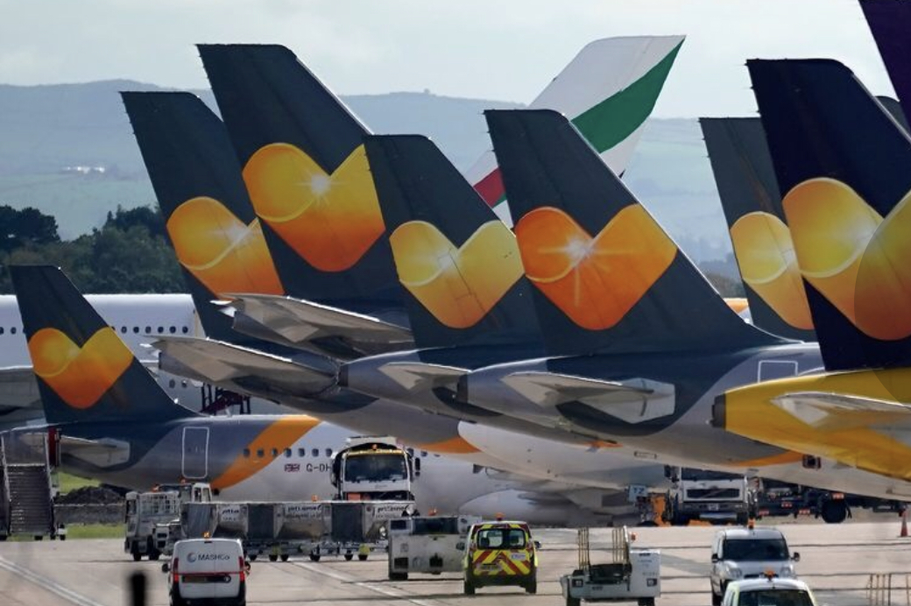
FUTURE??

