Slide 1
CLOUD COMPUTING TECHNOLOGIES – ACCC5000
Week 3: Session 1: Cloud Service Models & SaaS

Slide 2
Learning Outcomes
By the end of this session, students will be able to:
Understand Cloud Service Models
Understand Software-as-a-Service
Understand various business services provided by SaaS providers
Understand various characteristics of SaaS
Understand Suitability of SaaS
Understand Pros and Cons of SaaS

Slide 3
Cloud Service Models
Cloud companies provides computing resources, development platforms, and applications as a service to the end users
The information technology (IT) industries started subscribing the cloud services instead of buying the products
Cloud computing is a model that enables the end users to access the shared pool of computing resources without the need to buy or own it
The essential characteristics of the Cloud include on-demand self-service, broad network access, resource pooling, rapid elasticity, and measured service

Slide 4
Cloud Service Models
The National Institute of Standards and Technology (NIST) defines three basic service models, namely:
1. Software-as-a-Service (SaaS)
2. Platform-as-a-Service (PaaS)
3. Infrastructure-as-a-Service (IaaS)
SaaS: SaaS is a software program positioned as a shared cloud service and made available as a “product” or generic utility represents the typical profile of a SaaS offering
PaaS: PaaS delivery model represents a pre-defined “ready-to-use” environment typically comprised of already deployed and configured IT resources
IaaS: The IaaS delivery model represents a self-contained IT environment comprised infrastructure-centric IT resources that can be access and managed via Cloud service-based interfaces and tools

Slide 5
Cloud Service Models
Figure: Basic Cloud service models

Slide 6
Software-as-a-Service (SaaS)
The ability given to the end users to access an application over the Internet that is hosted and managed by the service provider
SaaS is delivered as an on-demand service over the Internet, there is no need to install the software to the end user’s devices
software & its associated data are hosted centrally and accessed using a client through a browser
software is provided as a web-based, on-demand, pay-as-go(some cases free!) service

Slide 7
Software-as-a-Service (SaaS)
  SaaS is a software program positioned as a shared cloud service and made available as a “product” or generic utility that represents the typical profile of SaaS offering
  SaaS services can be accessed or disconnected at any time based on the end user’s needs
  SaaS delivery model is typically used to make a reusable cloud service widely available to a range of cloud consumers

Slide 8
Differences between Traditional Software and SaaS
Traditional
SaaS
One-time fee
Use on your computer
Free trial not available
Installments required
Some updates are automatic
New version is a new purchase
Mobile synchronization requires additional software (costlier)
Subscription fee
Use on your computer
Free trial often available
Installment not required
All updates are automatic
New version may be new subscription
Mobile synchronization may require additional software often free or affordable

Slide 9
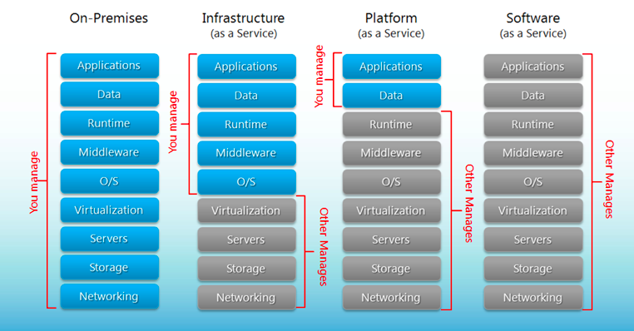
Differences between Traditional Software and SaaS

Slide 10
Differences between IaaS, PaaS & SaaS
Figure: Differences between IaaS, PaaS and SaaS service models

Slide 11
Business Services of SaaS
The important benefits of using SaaS applications are less vulnerable to attack, has longer life cycle, consumes less power, and is less expensive
A typical SaaS provider may provide following services
1. Social networks
2. Document management
3. Business Services and
4. Email services

Slide 12
Business Services of SaaS
Figure: Service provided by SaaS providers

Slide 13
Business Services of SaaS
Business Services:
Most of the SaaS providers started providing a variety of business services that attract start-up companies
The business SaaS services include ERP, CRM, billing, sales, and human resources
2. Social Networks:
Social networking sites are extensively used by the general public, many social networking service providers adopted SaaS for their sustainability
The number of users of the social networking sites is increasing exponentially, Cloud computing is the perfect match for handling the variable load

Slide 14
Business Services of SaaS
3. Document Management:
Most of the enterprises extensively use electronic documents therefore, most of the SaaS providers started providing services that are used to create, manage, and track electronic documents
4. Mail Services:
Email services are currently used by many people and the future growth in e-mail usage is unpredictable
To handle the unpredictable number of users and the load on e-mail services, most of the email providers started offering their services as SaaS services

Slide 15
Characteristics of SaaS
SaaS services are different and give more benefits to end users than the traditional software
The following are the essential characteristics of SaaS services that make it unique from traditional software:
One to Many: SaaS services are delivered as a one-to-many model, where a single instance of the application can be shared by multiple tenants or customers
Web Access: SaaS services provide web access to the software. It allows the end user to access the application from any location if the device is connected to the Internet

Slide 16
Characteristics of SaaS
3. Centralized Management:
SaaS services are hosted and managed from the central location; hence, management of the SaaS application becomes easier
The SaaS providers will perform the automatic updates that ensures that each tenant is accessing the most recent version of the application without any user-side updates
4. Multidevice Support:
SaaS services can be accessed from any end user devices such as desktops, laptops, tablets, smartphones, and thin clients

Slide 17
Characteristics of SaaS
5. Better Scalability:
Most of the SaaS services leverage PaaS and IaaS for its development and deployment
SaaS ensures a better scalability than the traditional software
The dynamic scaling of underlying Cloud resources makes SaaS applications work efficiently even with varying loads
6. High Availability:
SaaS services ensure the 99.99% availability of user data as proper backup and recovery mechanisms are implemented at the back end
7. Application Programming Interface (API):
- SaaS services have the capability of integrating with other software or services through standard APIs

Slide 18
Suitability of SaaS
SaaS is popular among individuals and start-up companies because of the benefits it provides
Most of the traditional software users are looking for SaaS versions of the software as SaaS has several advantages over traditional applications
SaaS applications are the best option for the following:
On-demand software
Software for start-up companies
Software compatible with multiple devices
Software with varying loads

Slide 19
Suitability of SaaS - Exceptions
- The SaaS deliver model is not the best option for the applications mentioned (in the previous slides) in the following:
Real-time applications:
SaaS applications depend on Internet connectivity, so it may not work better with low Internet speed
2. Applications with confidential data:
Data are always stored with third-party service providers, therefore, there is no surety that our data will be safe
3. Better on-premise application:
Some of the on-premise applications might fulfill all the requirements of the organization. In such situations, migrating to the SaaS model may not be the best option

Slide 20
Pros and Cons of SaaS
Pros | Cons
No Client-side installation | Security
Cost savings | Connectivity requirements
Less maintenance | Loss of control
Ease of access
Dynamic scaling
Disaster recovery
Multitenancy

Slide 21
Any Questions?

