Slide 1
Changemaker, Creativity and Value Creation
Title: CPM and PERT

Slide 2
Lesson Objectives
explain a critical path method (CPM) chart.
explain the concept of slack.
explain and create a PERT chart.
explain the differences between a CPM chart and a PERT chart.

Slide 3
Critical Path Method (CPM) Charts Task dependencies are very important and, as mentioned in the previous lesson, they affect schedules and planning techniques.
Critical Path Method (CPM) charts are an example of such a task planning method. A CPM chart is a visual way to organize task dependencies.

Slide 4
Creating CPM chart
The steps involved in making a CPM chart are:
Make a list of tasks needed to finish the project and then create a Work Breakdown Structure (WBS) for those tasks
2. Add time estimates to each task.
3. Organize the tasks by grouping dependencies horizontally together.
For example, a task that is finish start dependent on another should be grouped next to the task it is dependent on. Arrows can then be used depending on which task dependency is at work to depict the dependency.
4. From these task groupings, paths can be created. A path is a sequence followed using arrows that you can take from one task to another (with dependencies shown as appropriate).

Slide 5
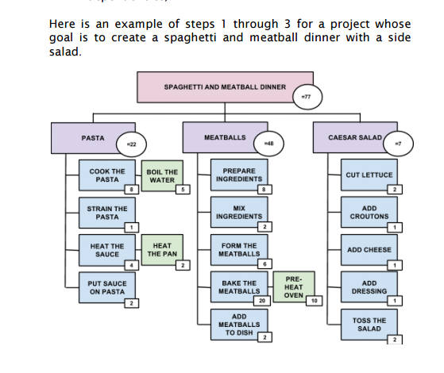

Slide 6
Paths that go from the beginning to the end of the chart are called beginning-to-end paths. Tasks on different beginning to-end paths can be completed independently and, therefore, at the same time.
If two or more beginning-to-end paths meet, this is a coordination point for task dependencies—it means that the two or more tasks must be finished before the task they point to can begin. In other words, the tasks must be coordinated.
A CPM chart can have as many beginning-to-end paths and coordination points as needed to finish the project.
The example below shows a number of beginning-to-end paths generated from the Work Breakdown Structure (WBS) from steps 1 through 3 of the spaghetti and meatball dinner project. These paths illustrate the groupings under “Pasta” and “Meatballs” in the WBS.

Slide 7
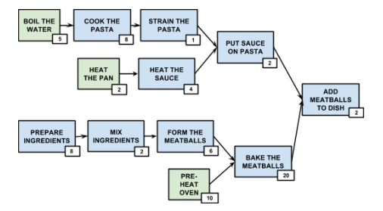

Slide 8
There are four paths in this example. Following the arrows, these four paths are from:
• “Boil the Water” through to “Add Meatballs to Dish”
• “Heat the Pan” through to “Add Meatballs to Dish”
• “Prepare Ingredients” through to “Add Meatballs to Dish”
• “Pre-heat Oven” through to “Add Meatballs to Dish”
There are also three coordination points:
• when “Strain the Pasta” and “Heat the Sauce” coordinate before “Put Sauce on Pasta”
• when “Form the Meatballs” and “Pre-heat Oven” coordinate before “Bake the Meatballs”
• when “Put Sauce on Pasta” and “Bake the Meatballs” coordinate before “Add Meatballs to Dish”

Slide 9
If an overall time estimate is desired, it can be calculated by adding together the longest beginning-to-end path in a CPM chart.
This is because all other beginning-to-end paths can happen at the same time.
In the example above, “Pre-heat Oven” can occur at the same time as the path “Prepare Ingredients” à “Mix Ingredients” à “Form the Meatballs.”
A beginning-to-end path can also illustrate tasks that occur in parallel.
Parallel tasks can occur in any order, as long as they are finished before the final task.
Drawing on the “Caesar Salad” grouping from the WBS example above, it is possible to illustrate parallel tasks.

Slide 10
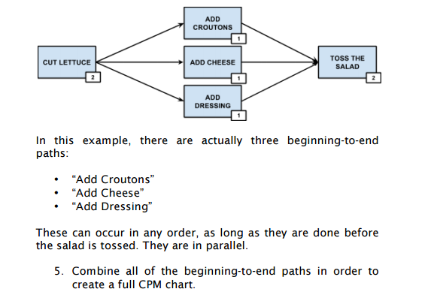

Slide 11
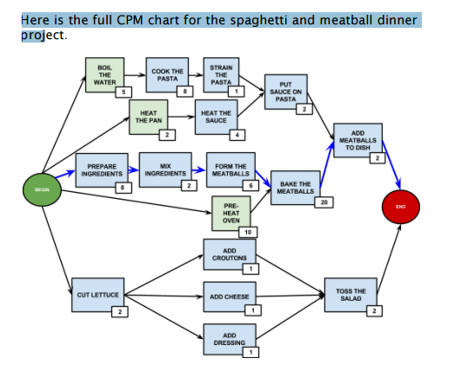

Slide 12
Critical Paths CPM charts, once completed, are a useful tool for generating a schedule for the project and determining minimum time estimates. The major way this is done is through the use of critical paths.
A critical path is the longest duration path of tasks between logical points. In other words, a critical path is the beginning to-end path with the greatest time estimate. It represents the minimum amount of time needed to complete a project, assuming there are enough resources that other beginning-to end paths can be done at the same.
The critical path in the example CPM chart above has been highlighted in blue. In addition to providing the longest time estimate for the project, critical paths also provide information for longest and shortest time estimates for project tasks. Critical paths highlight the tasks that are critical for the project.
These are the tasks along the longest duration path, which represent the minimum time for those tasks. But critical paths also highlight which tasks have slack—the ones on a different end path from the critical path. Because other beginning-to-end paths from the critical path have smaller time estimates, tasks on those paths can be delayed, as long as the total estimate of the path never exceeds the critical path. This potential extra time for tasks is what gives the estimate slack.

Slide 13
Critical tasks in the critical path should be the first to be scheduled from a CPM chart, because tasks in other paths can be given extra time to finish (within the critical path time limit), without adding to the overall project. Slack is useful to projects, as it provides a degree of flexibility to certain tasks, without necessarily affecting the target completion date.

Slide 14
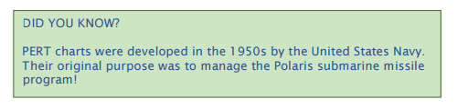
Program Evaluation and Review Technique (PERT) Chart
Another task planning tool affected by task dependencies is the Program Evaluation and Review Technique (PERT) chart. Similar to CPM charts, PERT charts are visual representations of a project.

Slide 15
PERT charts use nodes and edges in their network or graphical depictions. Nodes, usually illustrated as circles, represent milestones. Milestones are not time based, so in a PERT chart, nodes tend to represent some kind of event such as the production of a work product or some other event occurring. In contrast, nodes in CPM charts represent tasks. Edges, illustrated as lines that connect nodes, represent tasks.

Slide 16
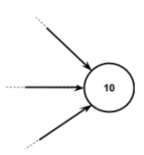
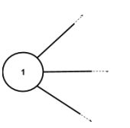
In a PERT chart, after lines are drawn, they are further denoted with tasks and time estimates. The lines are also given arrows, to illustrate task dependencies and the order tasks must be completed in. A sequence of dependent tasks is therefore represented in a path that follows the direction of the arrows. If multiple independent paths come out of a node (that is, if multiple lines come out of a node), it means that those tasks can be completed at the same time, assuming time and resources are available. They are in parallel.

Slide 17
Alternately, if multiple paths lead towards a node (if multiple arrows point to a node), it means that these paths must synchronize. In other words, those paths must be completed around the same time, before the next path leading out of the node can start. In general, PERT charts make dependencies easier to see.

Slide 18
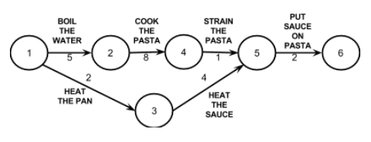
Example of a PERT Chart
This example draws on the project discussed from the Critical Path Method Charts (CPM Charts) with the hypothetical project whose goal is to create a spaghetti and meatball dinner with a side salad. The paths for making pasta would look as follows in a PERT chart:

Slide 19
Edges, or the arrows, have been labelled with task and time.
Task dependency is clear through the order of the arrows. Nodes, or milestones, have been labelled with numbers. Labelling nodes this way is effective, as numbers are a simple system, but it also allows for nodes to be easily referenced. Each node occurs after at least one event is completed.
Note in this section that there are two independent paths: 1 ->3 -> 5 can be worked on during the path 1-> 2 ->4 -> 5.

Slide 20
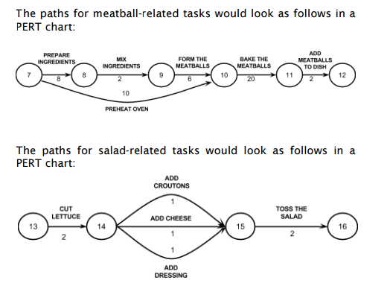

Slide 21
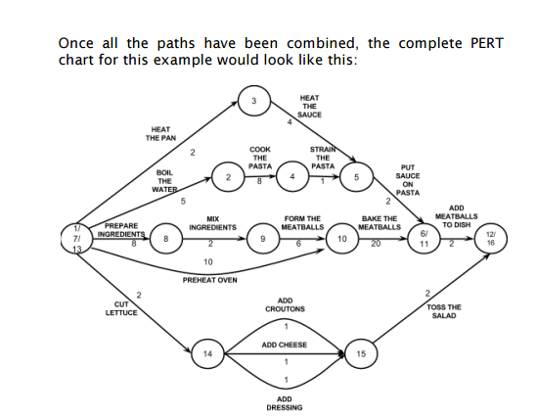

Slide 22
Critical Paths
Critical paths are very important in PERT charts.
As in CPM charts, the critical path is the path with the longest task time estimates. The critical path actually represents the fastest amount of time the project can be finished it, as all the tasks in the critical path must be finished, but it is assumed that shorter paths can be done within that same time.
The critical path is therefore the minimum amount of time a project can take, assuming there are enough resources that other paths can be completed at the same time. Let us examine a the previous example to illustrate this.

Slide 23
The critical path from preparing ingredients through to adding meatballs to the dish (1->2->6->8->1->12) takes a total of 38 minutes. This is the longest task time estimates, as other paths take shorter to finish.
1->5->9->11->12 takes 10 minutes, 1->4->7->9->11->12 takes 18 minutes, 1->8->11->12 takes 32 minutes, and
1->3->10->12 takes 5 minutes.
Even though the critical path takes the longest, all of those steps must be finished, so the overall project will take at minimum 38 minutes to finish.
Also as in CPM charts, paths other than the critical path have slack, as they have some room for estimates to change (as long as the path still takes less time than the critical path), without affecting the overall project estimate.

Slide 24
Again, drawing from the above example, the paths
1->5->9->11->12, 1->4->7->9->11->12, 1->8->11->12, and 1->3->10->12, which are all shorter than the critical path, can take some extra time to finish, if necessary, as long as they do not take more time than a total of 38 minutes for the path (or the overall project estimate will change). This flexibility in timing means they have slack.
Any task on the critical path that is extended in terms of time will result in an increase to the minimum time for the project, because there is no slack on the critical path. In the above example, the critical path of 1->2->6->8->1->12 takes 38 minutes, so the minimum time the project will take is 38 minutes.

Slide 25
However, if the original estimate of 6 minutes to finish task 6->8 is extended to 10 minutes, then the critical path estimate will also change, from 38 minutes to 42 minutes.
The minimum time for the project has changed to a total of 42 minutes, as the critical path has no slack.
In a PERT chart, critical paths must be horizontal.
In the example above for the project of making a spaghetti and meatball dish with a side salad, the critical path has been outlined in blue to be easily identified. As critical paths are always horizontal in PERT charts, they are always easily identified, even if information such as time estimates may not be available.
All other paths in the chart must be drawn either above or below the critical path.

Slide 26
PERT or CPM?
In what circumstances is it better to use a CPM chart or a PERT chart?
Both can be used to demonstrate project dependencies and to generate time estimates. In other words, both work well for task planning.
In some cases, either chart can be used with success, and it is then a matter of preference for the development team and the project manager. In circumstances where the project may be more task focused, however, the CPM chart is favourable. In CPM charts, additional information can be added to tasks, such as costs. In circumstances where the project may be more event or milestone based, in contrast, the PERT chart is favourable. PERT charts show what tasks need to be completed prior to an event or milestone.

