Slide 1


MA in Psychotherapeutic Practice Research and Writing Workshops
Notes:
So,here we are, starting on this research journey.
One way of looking at t his is that this is your final module, the final stage of your MA qualification – the Dissertation Module and this is where you will conduct your research in order to gather data and the relevant information to write your dissertation

Slide 2

MA in Psychotherapeutic Practice Research and Writing Workshops
Notes:
Within this PP we are considering, as you begin your research journey … what is this all about?
The world of research is exciting and complex and the importance of research is clearly evidenced all around us in our every day lives.
It was research which first alerted society to the links between smoking and ill health and the importance of research is more evident today than ever, as research was at the very heart of the fight against COVID 19 … it was research which led us to understand how COVID 19 was spreading through the population, and research which led to the development of the COVID 19 tests, vaccinations and antidotes which helped us get back to normal life after the pandemic. Research also informs us of the impact which counselling has on our clients, their health and their wellbeing.
Moving on to another aspect of research, you will note that the heading on your Moodle page directs us to the concept of ‘Standing on the Shoulders of Giants’ which is what you will do when you find out what has already been written about your subject and then expand on this knowledge. Another concept of research is contained on this slide … through research, we never stop learning.

Slide 3




Supervision … Use effectively
Notes:
You will see from the draft programme of work the topic areas we will be considering and how these will help you greatly on your research journey.
Also make sure that you make full use of ,,, Moodle / Library and remember that the only question which is stupid, is the one that is not asked.
Most importantly, make full use of supervision and we will also be looking at how you might do this within our workshops..

Slide 4

The importance of ethics …
We will address how to apply for ethical approval and the inevitability of ethics within research
Notes:
We’ll also address the main concepts and principles of ethic … and address how ethical principles work in theory and practice as you work through your own research.
Remember …. That no research is every ethically neutral.

Slide 5
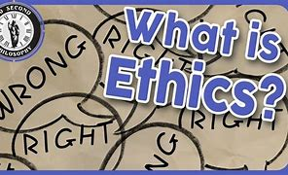
The importance of ethics …
There is always more to learn on the subject of ethics … .. …

Slide 6

The importance of ethics [Cont’d]
Ethics in action

Slide 7

Data collection and analysisanalysis

Slide 8
Looking back and bouncing forward
Your dissertation, is the ‘writing up’ of the exploration of your topic - the result of your in-depth research
Looking back at what you have done and bouncing forward – the value of your research findings

Slide 9
A Recap: Looking back and bouncing forward
An Introduction,
A literature review,
A justification of the data selected for analysis and research methodology, analysis of the data and, finally,
Conclusions and recommendations.

Slide 10
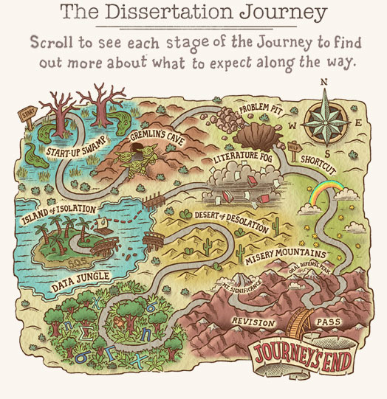
The Research Journey

Slide 11
Discussion and questions:

