Slide 1

MA RESEARCH AND DISSERTATION WRITING
STARTING TO WRITE YOUR METHODS CHAPTER

Slide 2
Chapters of a Dissertation
Chapter 1 – Introduction
Chapter 2 – Literature Review
Chapter 3 – Methodology
Chapter 4 – Findings
Chapter 5 – Implications

Slide 3
The aim of this lesson is to:
Get you started on writing you ‘Methodology and methods’ chapter

Slide 4
The Methods Chapter
The methodology section is usually Chapter 3 of a dissertation and should contain information on how to replicate the study

Slide 5
Chapter Three
The Method chapter of a dissertation therefore describes the steps that you undertook to address your research questions.

Slide 6

Chapter Three: S0 … the purpose of this chapter is to inform the reader about the mechanics of your research

Slide 7
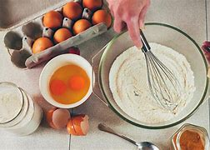
Methodology ….

Slide 8
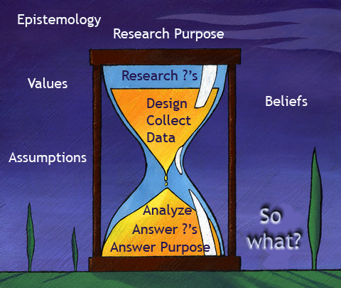
Hourglass Model of Research

Slide 9
You will have learned about these concepts in your Advanced Research lessons, but to recap:
Ontological issues
Epistemological issues
Axiological issues
Methodological issues

Slide 10
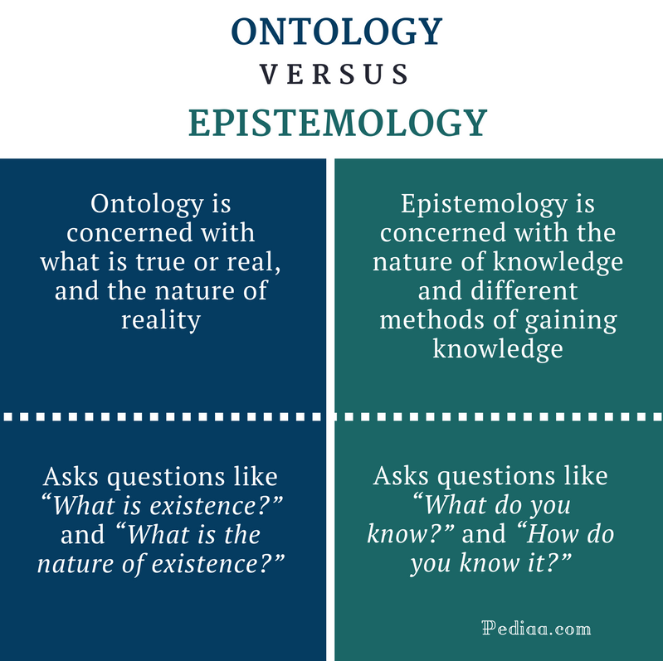

Slide 11
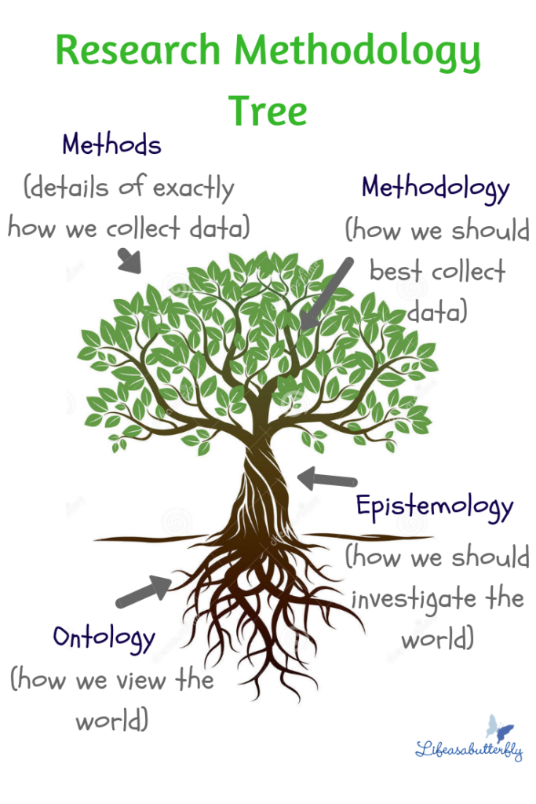

Slide 12
Chapter Three
Begin the chapter or section with a brief introduction

Slide 13
Chapter 3: Methodology
Briefly re-introduce research purpose and questions
Offer a rationale for selecting and aligning the framework of your research

Slide 14
Chapter 3: Methodology (Cont’d)
Research Design

Slide 15

Chapter 3: Methodology (Cont’d)
  Influences on data analysis
  Data management with examples
  Data analysis with examples
  The decisions you made, and why

Slide 16
Chapter 3: Methodology (Cont’d)
Trustworthiness and Rigour
Steps taken to achieve and maintain trustworthiness

Slide 17
Chapter 3: Methodology (Cont’d)
Data Collection Procedures

Slide 18

Chapter 3: Methodology
Ethics

Slide 19
Chapter 3: Methodology
Summarize the research design and prepare the reader for the next chapter.

Slide 20
Chapter 3: Methodology
Have you assured the reader that the research design is justified and appropriate for the desired outcomes?

Slide 21
The aim of this lesson was to:
Get you started on writing your ‘Methodology and methods’ chapter
Have we achieved this?

