Slide 1
Name: Avram Bujor, Alessandra Ion
Student ID:2433529,2433531
Date: 12/11/2025

Slide 2
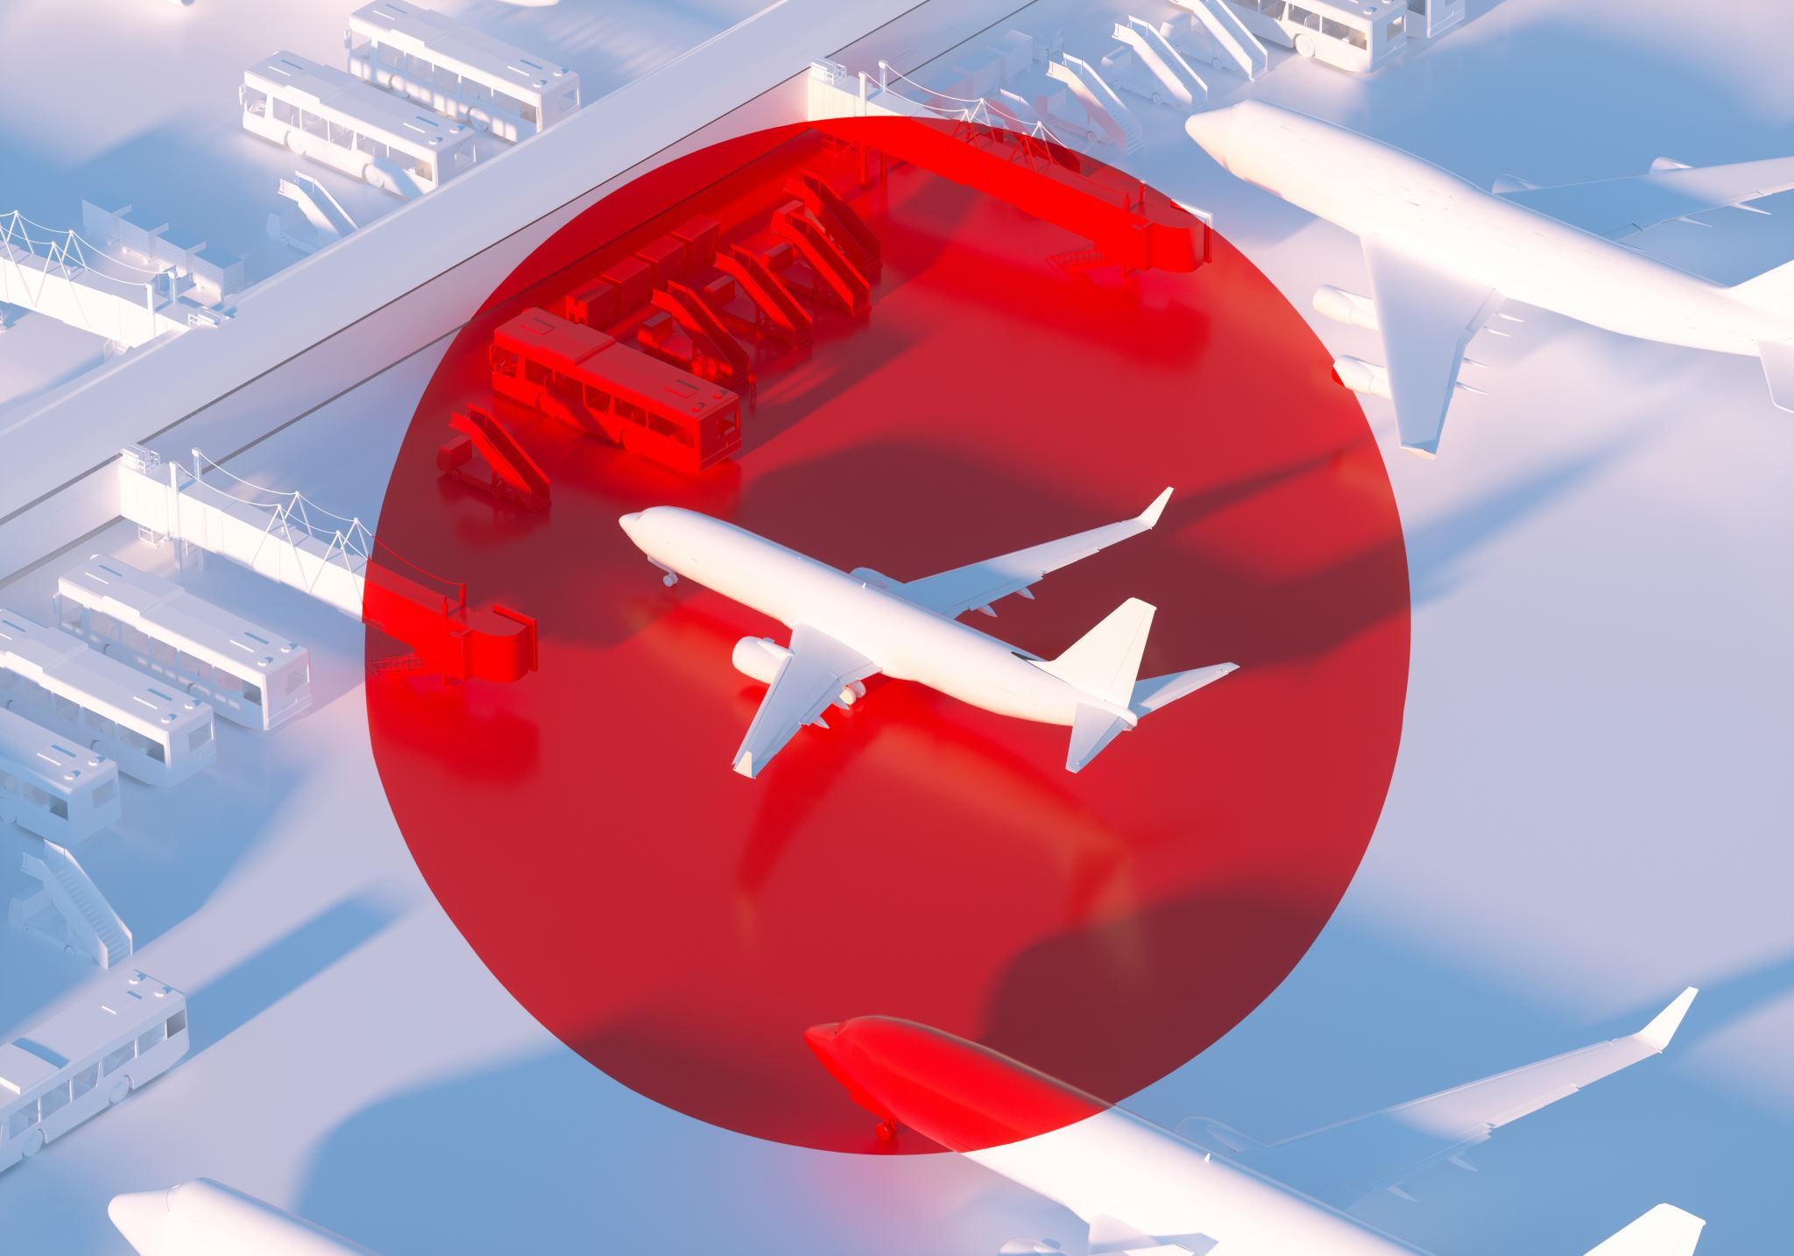
Flight Food LTD

Slide 3
What am going to talk about?
Hi, in this presentation I will be talk and air line ready mean and the company I will be discussing about is gate group a company that provides over 700 millions meals a year please sit back and enjoy.

Slide 4
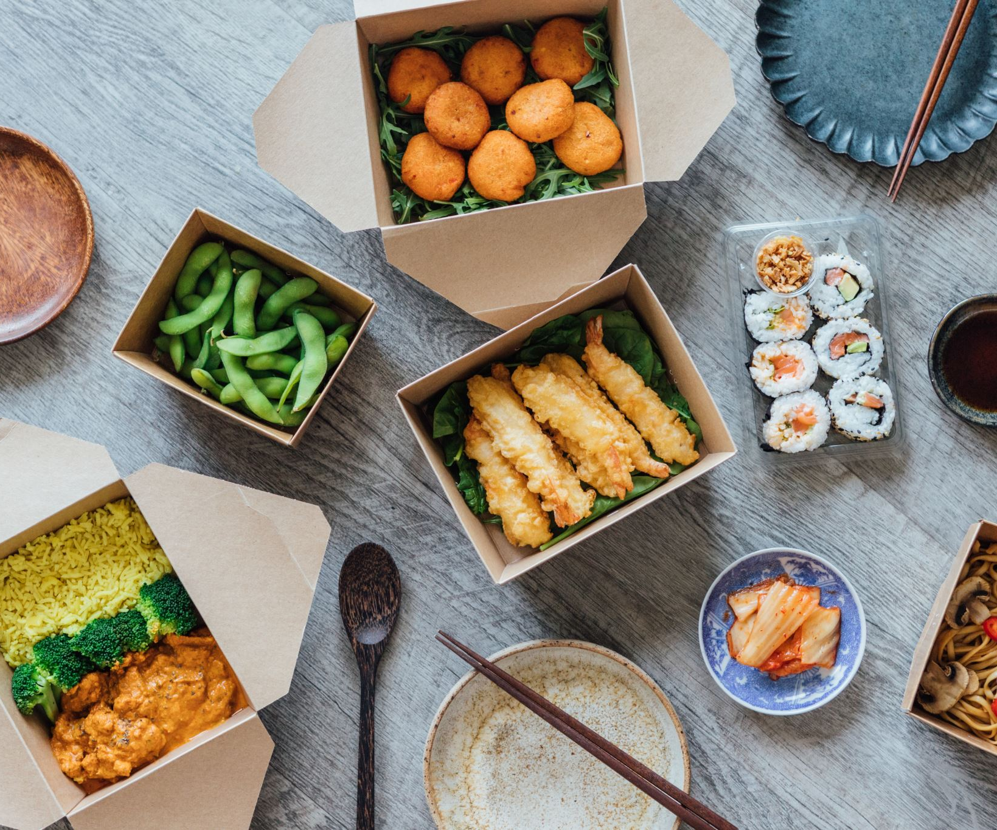
WHO PROVIDE THE READY MEAL FOR AIRLINES
The ready meal are made and prepared by a company called the gate group.
Gate group is a swiss based company that provides in flight catering.
They state that they serve more than 700 millions passenger every year across 200 global location

Slide 5
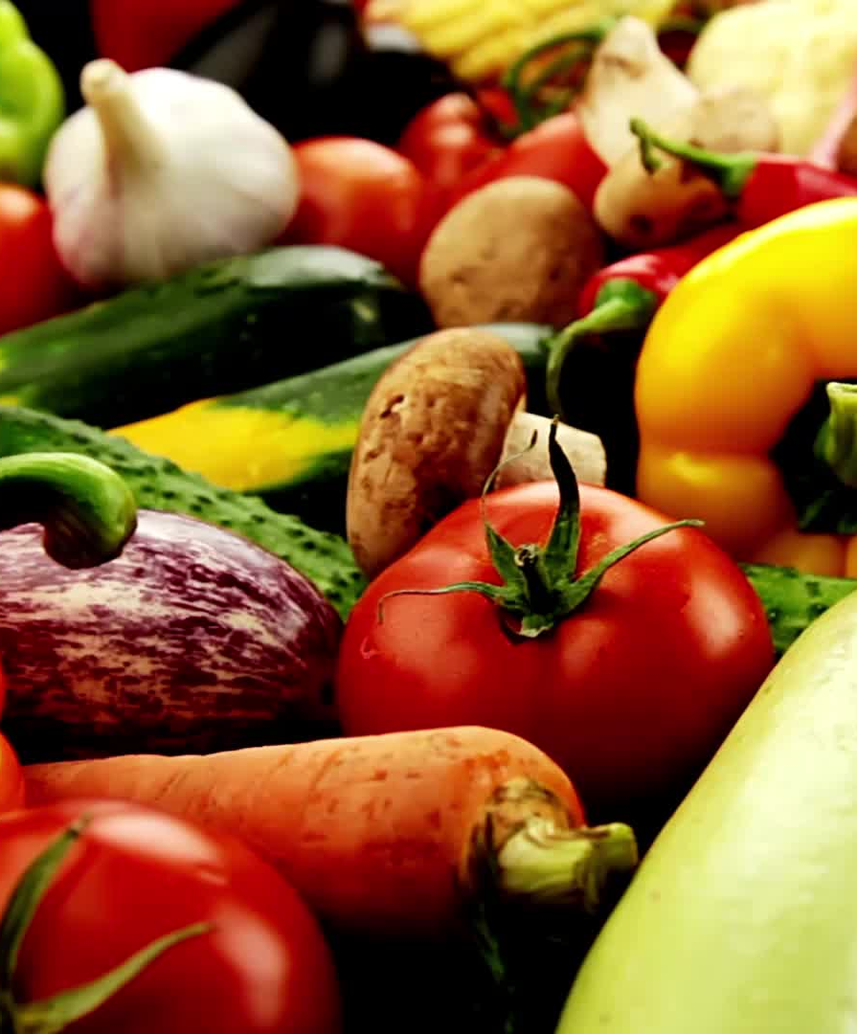
What problems is gate group facing
They have had previous they have had issues with roaches in the oven
One of the main problem is reheating the food as food loses taste and may go bland
Passengers are request fresher food and it cost the company three time more that they normal food
They have massive volume of waste per day from millions from the food they make .

Slide 6
What have they done?
They have installed a new temperature controlled for food to stay fresher
Gate group has adopted a formalised food safety
They committed to 100% cage free eggs
They launched a revamped gateopex globel operations framework to bring consistency in quality

Slide 7
In conclusion.
Gate group has learned from its past food related and operational challenges and is now modernizing its systems to deliver safer more consistent and higher quality airline meals. While problems like cost pressure and global consistency remain, the company is moving in a clearly stronger and more suitable direction

