Slide 1

Strategies for Effective communication in a Business Setting
Esther Akpanmkpuk -2108030
Sarah N’guessan - 2127140
Andrew Tolise -2129059
Marie Mudijike -2126589
Nimra Malik -2123954
MODULE – BMSW4002
TUTOR – Daminabo Pokubo

Slide 2
Table of Contents
Brief Overview.
Introduction
Types of communication (Non-verbal & Verbal)
What is effective communication?
Model of communication.
What are the barriers of communication in project management.
What is channel of communication.
Conclusion.
References.

Slide 3
Amazon a global e-commerce giant, founded by Jeff Bezos in 1995 has tasked Tom Jackson to take charge of an ambitious project, aimed to foster fast and reliable delivery services across Europe. However, conflict and disagreement have surfaced within the team due to differences and lack of an effective channel of communication.
In this presentation, we shall examine the strategies to use in improving communication within the project team members to further help Tom establish the most appropriate communication strategy for his team, and how he can overcome barriers that may come his way.
BRIEF OVERVIEW

Slide 4
Introduction
“Communication is defined as the exchange of information between two or more parties.”
Communication
When team members can communicate, they can collaborate; good communication is essential for improving teamwork and teambuilding. Employees who understand each other's communication styles can collaborate more effectively and reduce the risk of misunderstandings or conflict.
There are a variety of ways to improve communication in teams. The slides will examine the models and channels that can be used by Tom to improve communication.
We will also share our recommendations on what we think is the best model of communication for this project.
Theories of communications
Models of communication
Channels of communication

Slide 5
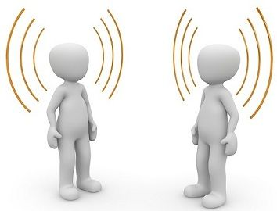
VERBAL & NON-VERBAL COMMUNICATION
Oral
VERBAL
Written
Facial expressions
Gestures
By Surbhi S 2018
Verbal communication is a form of communication in which you use words to interchange the information with other people either in the form of speech or writing. Surbhi S 2018
NON VERBAL
Eye contact
Nonverbal communication does not use words for communicating
Body movement and posture

Slide 6
What is effective communication?
(CLIMB 2019) Describes effective communication as “knowing how to listen attentively. It’s the ability to offer empathy, open-mindedness, and helpful feedback based on what you hear.”
It is however very easy for information to be ineffective. This happens when messages may be received but not understood, therefore leaving the recipient confused and the message not acted upon. This is an example of poor communication and is noted as a communication barrier.

Slide 7
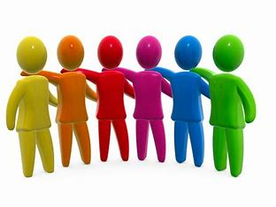
Example of effective communication
“Having a job that is majorly based on excellent customer service and customer satisfaction, means I most integrate effective communication on a daily basis. With everyone, from my colleagues to my clients. My personal strategy is simple!”
Esther
I start by speaking clearly with an even tone (Not too relaxed not too firm)
Maintaining eye contact in order to keep the focus of whom I speak with
A relaxed and direct body language that emphasises my interest in the conversation
And lastly, a smile. The most effective non verbal communication there is!

Slide 8
.
THE BENEFITS OF EFFECTIVE COMMUNICATION
“By making sure all parties are heard, in order to find a solution that is ideal for everyone involved”
“Actively listening and embracing different points of views”
BUILDS TRUST
BETTER RELATIONSHIPS
PREVENTS & RESOLVES PROBLEMS
IMPROVED PRODUCTIVITY & ENGAGEMENT
“Listening carefully and offering quality feedback to his team will make them feel heard and understood. This in turn nurtures respect”
“Tom’s team will be more likely to be interested in their work and grasp their roles and responsibilities, through clear expectations and objectives”

Slide 9
How does this benefit amazon
Effective communication in the workplace is an integral part of an efficient and successful business. The main benefit to Amazon is increased productivity, which in turn generates higher profit for the company.
This is possible through team motivation and well-communicated and shared goals. Indeed editorial (2021) acknowledges this as "it ensures everyone understands their jobs and obligations, helps establish strong client and employee connections, and keeps people motivated and productive."

Slide 10
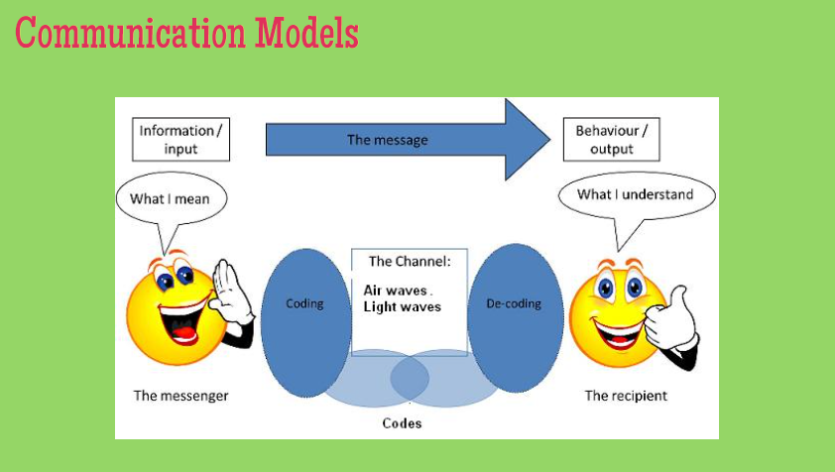

Slide 11
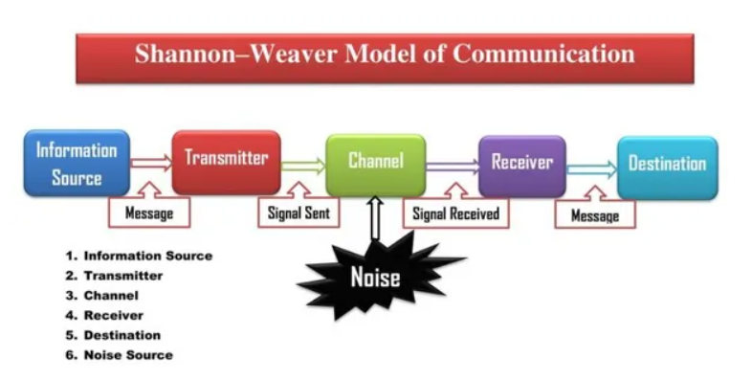
Shannon-Weaver model of communication
Components
  Source of information: Generates messages
  Transmitter: Creates signals from the message through encoding process
  Channel: The medium over which signals are transmitted.
  Receiver: “Decodes" (reconstructs) the message received from the signal
  Destination: The place the message is delivered
  Noise: This component, is a dysfunctional factor. It is the disruption to the message's path through the medium that could cause the signal received to deviate from the signal sent.

Slide 12
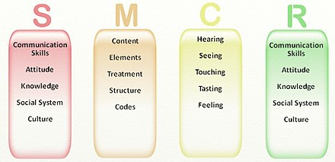
Berlo’s model of communication
Postulates the Sender-Message-Channel-Receiver (SMCR) model of communication.
The factors that affect communication are described at every stage
The model emphasizes encoding and decoding
The 4 components that affect communication are sender, message, channels and receiver.
As indicated, each component is influenced by several factors
Muyanga and Phiri, 2020

Slide 13
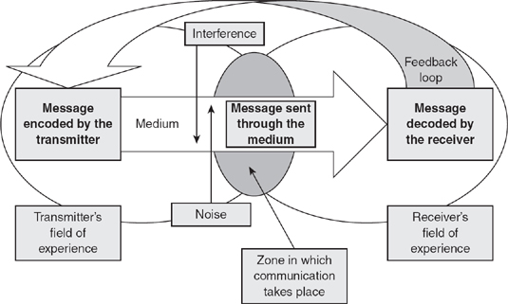
Schramm’s interactive model
The model puts more emphasis on encoding and decoding of the message
The model envisions communication as a 2-way circular communication between the source and receiver
The model expands more on Shannon-Weaver communication model.
Rubtcova and Pavenkov, 2021

Slide 14

Tom should use the Schramm’s Interactive and Berlo’s SMCR model for the Amazon Project
Berlo’s model: The factors that affect communication are described at every stage
Suitable for Tom’s project due to different time zone, culture, social system and attitude
Schramm’s model covers the feedback loops missing from Berlo’s
Schramm’s model envisions communication as a 2-way circular communication between the source and receiver.
Shannon – Weaver and Berlo’s model both a one - way communication model
Vdovin, 2022.

Slide 15
What are the barriers of communication in project management?
Communication barriers can be defined as the aspect or condition that interfere with effective exchange of ideas or thoughts.
(Bechnk, 2019) This tells us about different types of barriers in communication such as:
Emotional barriers
Language barriers
Physical barriers
Hybrid work barriers
Technological barriers
Organization structure
Lack of trust
Information overload
Cultural differences
Psychological

Slide 16
How communication Barriers Affect Amazon in Project Management
Physical Barriers
The geographic distance between the sender for example Tom and the receiver (employees) which can consume a lot of time as in location due to time zone as well as country which can be a big factor when sending/ receiving information.
Language Barriers
Different language barriers due to the different culture of individuals and understanding which can affect the workflow and communication of person to person within a working environment as the work area is diverse in different places London, Paris and Berlin.
Organisation Barriers
The conflict of disagreement also the commitment of employees within the area they work which can affect the interaction between CEO and rest of the team (staff) hence affecting the business consistency in the work area.
Psychology Barriers
This can affect metal health censures which can be affected by late payment increasing stress as well as anger of staff having lack of work for due lack or reduction of payment therefore having a negative a fact in the environment of business resulting in a decreasing in working staff and higher turn over.

Slide 17
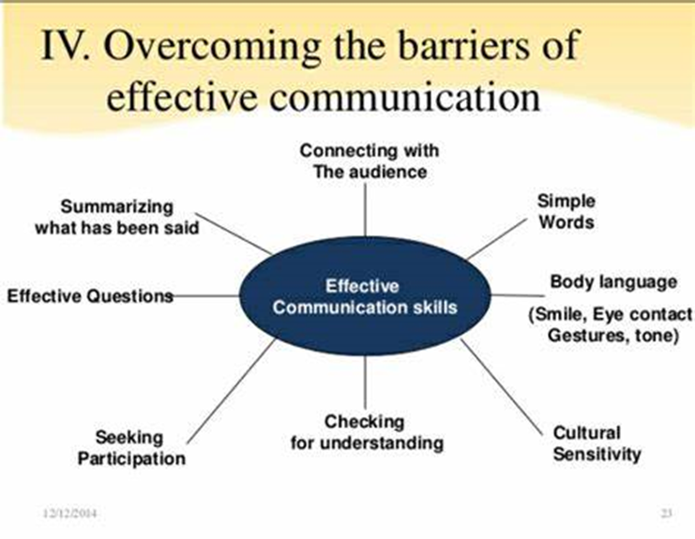
How Amazon can solve the communication barriers
The success of an organisation are the ones who implement communication affectively (Mehdi,2019).
Siddique 2018

Slide 18
What is channel of communication:
It is the flow of information with the other people within the organization.

Slide 19
IMPORTANCE OF CHANNEL RICHNESS
Richer
Lendle – Daft model of information richness
Video Conferencing
Radio
hierarchy (daft and Lengel, 1986) Television
Letters
Emails
Posters
Weaker

Slide 20

Channels to be used by tom to improve communication
Using social networking within the staff.
Using a device for staff whilst working(Philips, 2020)
Omni-channel marketing (Akter,Hossain and Strong,2021)
Connecting internally by using electronic mail.

Slide 21
Conclusion
To conclude we were able to expand on our research after carefully reading the case study, we found out that it is crucial to know how to
Communicate effectively
As it builds trust and ultimately prevents & resolves problems.
We were also able to review different models of communication
In addition, in depth discussed the barriers of communication, which in this very case we saw that one of the key barriers was:
Physical barriers
Language barriers
Therefore, to summarise, the channels of communication that we recommend are emails and scheduled video call meetings because we are aware of the various locations mentioned, which are China, Birmingham, and Brazil, which all have different time zones and these channels of communication will make it more convenient for them to communicate. (Podium, 2022)
A significant number can be on a video call from anywhere in the world, allowing information to flow quickly to anyone who needs it.

Slide 22
References
Kubota, M., 2019. What is “Communication”? ―Beyond the Shannon & Weaver’s Model―. International Journal, 13(1), pp.54-65.
Muyanga, C.C. and Phiri, J., 2020. Assessment of Effective Communication in International Schools in Developing Countries Based on the Berlo’s SMCR Model. Open Journal of Business and Management, 9(1), pp.448-459
Rubtcova, M. and Pavenkov, O., 2021, August. Lasswell and Osgood-Schramm models of mass communication. In the 3rd World Conference on Social Sciences on the (pp. 3-5).
Vdovin, A., 2022. How to Improve Communication Between Managers and Employees | DeskAlerts Available at: https://www.alert-software.com/blog/how-to-improve-communication-between-managers-and-employees (accessed 11.11.22).
Common sense media. (2020, june 2). Retrieved from Common sense: https://www.commonsensemedia.org/articles/what-is-communication
Coursera. (2022, November 4). Coursera. Retrieved from Strategies in Communication:: https://www.coursera.org/articles/strategies-in-communication
COMMUNICATION: DEFINITION, TYPES OF COMMUNICATION AND BARRIERS OF COMMUNICATION’ (2019) Вестник университета, (10), pp. 261–266.
Khosrow-Pour, D.B.A. (2019) Breaking down Language and Cultural Barriers Through Contemporary Global Marketing Strategies. Hershey: IGI Global.
CLIMB 2019. The 7 Benefits of Effective Communication in Personal and Professional Settings http://climb.pcc.edu/blog/the-7-benefits-of-effective-communication-in-personal-and-professional-settings
Indeed Editorial. What Is Effective Communication? https://www.indeed.com/career-advice/career-development/effective-communication#:~:text=Effective%20communication%20is%20important%20because%20it%20offers%20the,employee%20engagement%20among%20team%20members.%20...%20More%20items

Slide 23
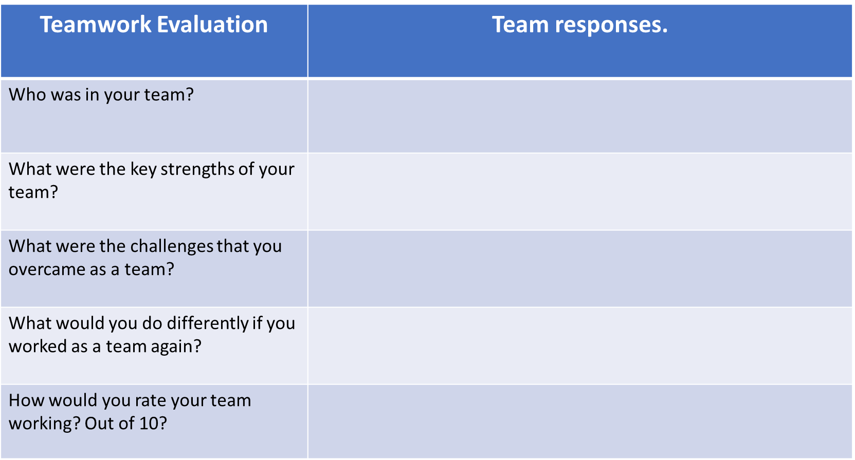
Andrew Tolise – 2129056
Sarah N’guessan – 2127140
Esther Akpanmkpuk – 2108030
Marie Mudijike – 2126589
Nimra Malik - 2123954
Decision making: We were able to communicate swiftly as a group to decide the best way of contact. Good decision making of roles and questions each team member would have.
Team members displayed knowledge and understanding of their questions
Being able to all agree on the best structure of the presentation
Having sufficient information for each question without overdoing the text
Deciding on the two different slides that were produced
Overcoming the pressure
Communicate our differences and acknowledge everyone’s views. Making sure team members stick with agreements made by the team. Timely acknowledgment and involvement of team members in all steps of the process.
7

