Slide 1
Problem Solving and Decision Making
Student name Alexandru Dragomir
Student ID 2107400
Lecturer name DR Chijioke D Uba

Slide 2

Introduction
The purpose of the study is to evaluate the staff absenteeism in the workplace.
Mid Cheshire Hospitals NHS Foundation Trust has faced the problem of staff absenteeism (Mcht, 2022).
It refers to the habitual non presence of employees in their job.
Notes:
The purpose of the study is to evaluate the staff absenteeism in the workplace. Mid Cheshire Hospitals NHS Foundation Trust has faced the problem of staff absenteeism (Shrm, 2022). In workplaces, staff absenteeism is a huge problem for organizations. It refers to the habitual non presence of employees in their job.

Slide 3
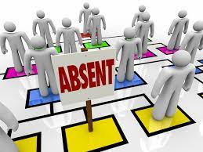
The nature and the impact of the complex problem on employees and their organizations
In the workplace absenteeism affects the individual's productivity.
Excessive absenteeism develops the chances of dropping from the work to the employees.
The positive impact is that individuals can rest and they can reduce their stress from their mind (Shrm, 2022).
Notes:
In the workplace absenteeism affects the individual's productivity. However, excessive absenteeism develops the chances of dropping from the work to the employees that leads to the long term consequences for employees such as higher incidences of unemployment, lower average income and many more things.

Slide 4
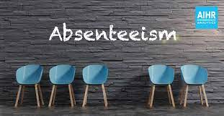
PESTLE analysis of the macro-environmental factors in Mid Cheshire Hospitals NHS Foundation Trust-
Political factors
The government has several rules that motivate their employees in their workplace and reduce absenteeism.
In the year of 2017, the UK government has topped in terms of political stability (Tarro, et al. 2020).
Brexit is one of several political factors that keep NHS workers away. Brexit has challenged Mid Cheshire Hospitals NHS Foundation Trust. Brexit uncertainty affects UK organizations, including the hospital.
Economic factors
In the year of 2019, the GDP rate of the country is almost 2.744 trillion in US dollars.
It puts the country's economy in 6th position globally.
The unemployment or the absenteeism rate in the UK's economy is approximately 3.8% (Pestleanalysis, 2022).
In the organization the tax rate is almost 19%.
MCHT's economic factor is improving national Quality, Productivity, Innovation, and Prevention while saving £20bn.
Notes:
Political factors
In the organization there are several factors that determine the stability of government like effectiveness of government policies, low corruption, control and rules of the laws (Mcht, 2022). In the UK, the government has several rules that motivate their employees in their workplace and reduce absenteeism.
Economic factors
In the year of 2019, the GDP rate of the country is almost 2.744 trillion in US dollars that puts the country's economy in 6th position globally. In the organization the tax rate is almost 19%. In the UK, the inflation is almost 1.94% (Pestleanalysis, 2022). The unemployment or the absenteeism rate in the UK's economy is approximately 3.8%.

Slide 5
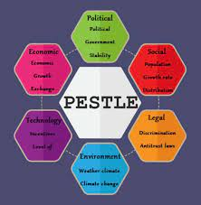
PESTLE analysis of the macro-environmental factors in Mid Cheshire Hospitals NHS Foundation Trust-
Social factors
The health care organizations have progressed in recent years in providing quality service to their patients (Attendanceworks, 2022).
It prefers the British health care system for complicated, serious diseases or injuries.
The social factors of MCHT refer to the Demographic changes that increase the changes adopted by the hospital for the ageing population and the middle-class expectations.
Technological skills
The country has the world's leading development and research institutes.
The economy provides several great opportunities for organizations.
Technology helps doctors treat patients well. Technology makes disease detection easy. The company needs workplace improvements. Healthcare services improved patient care.
Notes:
Social factors
In the UK, people spend a huge amount of money on their health insurance. The health care organizations have progressed in recent years in providing quality service to their patients as well as it prefers the British health care system for complicated, serious diseases or injuries (Taibi, et al. 2021).
Technological skills
The country has the world's leading development and research institutes and it always strives to break the barriers in every field. However the economy provides several great opportunities for organizations. The development and invention contributes to the economy of the country.

Slide 6
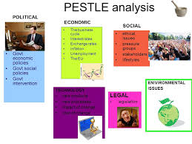
PESTLE analysis of the macro-environmental factors in Mid Cheshire Hospitals NHS Foundation Trust
Legal factors
The organization operates their business to follow their employees act.
Policies help the organization to develop their management system in business.
Employment, copyright, discrimination, health and safety, and consumer laws are involved. These policies help organisations improve management.
Environmental factors
The organization has faced some serious environmental issues.
Organizations have taken some steps and they spread some information about services, eco-friendly products, less plastic waste and recycling (Taibi, et al. 2021).
Notes:
Legal factors
In the UK, the organization operates their business to follow their employees act (Attendanceworks, 2022). In this factor organizations have to protect their rights such as sick pay, paternity or maternity leave, holiday pay, minimum wage and more things.
Environmental factors
The organization has faced some serious environmental issues (Neuprofessionals, 2022). However, private corporations, government as well as other organizations have taken some steps and they spread some information about services, eco-friendly products, less plastic waste and recycling.

Slide 7
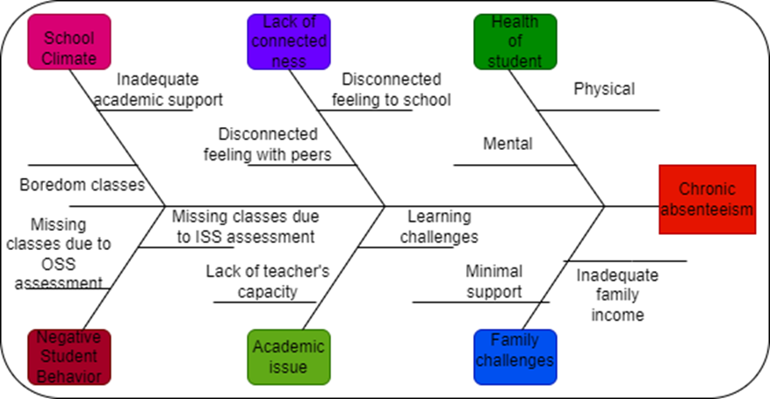
Cause-and-effect analysis of the complex problem
One reason for staff absences at the hospital is employee dissatisfaction. Almost wherever you go, you can see signs that workers are discontent with their jobs and pay. Employees may leave a company because they are dissatisfied with their duties or the income they get. Most workers are dissatisfied because they are not given sufficient recognition or compensation for the amount of effort and time they put into their employment.
As a result, employees at MCHT often express dissatisfaction with both their workload and their allotted vacation time. Because they are not compensated enough for their hard labour, employees routinely miss work (Iliffe and Manthorpe, 2019). The staff have stopped showing up to work on a regular basis and have instead begun looking for jobs elsewhere, which might be problematic for the company. This company is having trouble since it has to squander time and money training new personnel after having to start from scratch again.
Reason No. 2: Staff absence is often brought on by illness. It's impossible to avoid becoming ill, so the hospital staff has no choice but to take time off. When workers regularly miss work, it is called absenteeism. Mental health issues, bereavement, caregiving, stress and burnout, harassment and bullying, sickness, and many more all contribute to absence. Absenteeism causes a rise in labour costs and a decline in productivity, among other negative outcomes (Heazell et al., 2021). Workers have experienced the difficulty of being away from their jobs.
The staff's output has suffered as a direct result of all the absence. Since they are unable to fully absorb all the information presented during their training because of the lack of available staff. When employees miss their training, they miss out on crucial information and their performance suffers as a result. Those working at the hospital are on a waiting list due to the patient shortage, so they'll have to pull together to get a lot done. There is a noticeable paucity of treatment and care services at the hospital due to the lack of workers.
Notes:
In the workplace Absenteeism is a term while the employees could not provide any legitimate reason for missing their work. Depression is the leading cause of absenteeism in the workplace. Besides this there are several causes such as a challenging curriculum, negative self image, lack of interest in work and more things (Neuprofessionals, 2022). Effects are higher incidences of unemployment, lower average income and more things.

Slide 8
Decision | Plus | Minus | Interesting
Increase salary | The worker will be pleased to receive just compensation for their efforts. | It's time for a new budget plan for the organization. | Absenteeism will be reduced and regular attendance improved in the workplace.
Promote health and wellbeing | Employees will respect the company because they know how valuable they are to its success. | NHS management must spare more time for strategic planning. | Workers will make every effort to keep up with their normal work schedules in the face of a mild illness.
Motivation through reword | Workers will always be willing to stand by their employer in times of need. | The company's leader should spend more time encouraging and rewarding staff members. | As a result, workers won't be so preoccupied with making ends meet, and they'll be more apt to give their full attention and effort to each assignment at hand.

Slide 9
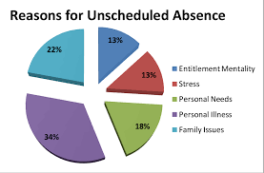
An evaluation of alternative solutions to absenteeism
Rewards for good attendance.
Providing feedback (Tarro, et al. 2020).
Reducing workplace stress.
Notes:
In the workplace there are several solutions to absenteeism such as reducing workplace stress, rewards for good attendance, providing feedback and several alternative things that reduce absenteeism from the workplace.

Slide 10
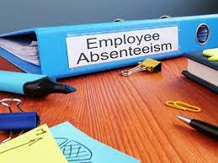
An aim of choosing the most appropriate solution among these alternatives
Management policies and programs.
Decision making (Neuprofessionals, 2022).
Return to work support.
Notes:
The organizations choose the alternative solution to reduce the absenteeism in their workplace because it is the trend by tracking the absence to improve the absence management policies and programs (Tarro, et al. 2020).

Slide 11
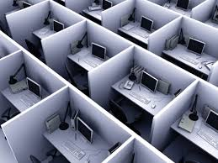
Conclusion
Absenteeism in the workplace affects badly (Forbes, 2022).
The absence from the work that is considered customary and reasonable due to occasional illness, personal time and vacation.
It affects individual productivity.
Notes:
The above study has shown that the absenteeism in the workplace affects badly. Sometimes it refers to the absence from the work that is considered customary and reasonable due to occasional illness, personal time and vacation. There are several reasons for absenteeism among employees in the workplace.

Slide 12
References
Mcht, (2022). Mid Cheshire Hospitals NHS Foundation Trust. Available in- https://www.mcht.nhs.uk/ ( accessed on 27th february 2022)
Shrm, (2022). Managing Employee Attendance. Available in- https://www.shrm.org/resourcesandtools/tools-and-samples/toolkits/pages/managingemployeeattendance.aspx( accessed on 18th february 2022)
Attendanceworks, (2022). The Problem. Available in- https://www.attendanceworks.org/chronic-absence/the-problem/( accessed on 15th february 2022)
Forbes, (2022). The Causes And Costs Of Absenteeism In The Workplace. Available in- https://www.forbes.com/sites/investopedia/2013/07/10/the-causes-and-costs-of-absenteeism-in-the-workplace/( accessed on 22th february 2022)
Neuprofessionals, (2022). Mid Cheshire Hospitals NHS Foundation Trust (MCHFT). Available in- https://neuprofessionals.com/our-current-and-historic-trusts/mid-cheshire/ ( accessed on 25th february 2021)
Pestleanalysis, (2022). PESTLE Analysis of the NHS. Available in- https://pestleanalysis.com/nhs-pestle-analysis/ ( accessed on 23th february 2022)
Taibi, Y., Metzler, Y.A., Bellingrath, S. and Müller, A., 2021. A systematic overview on the risk effects of psychosocial work characteristics on musculoskeletal disorders, absenteeism, and workplace accidents. Applied ergonomics, 95, p.103434.
Tarro, L., Llauradó, E., Ulldemolins, G., Hermoso, P. and Solà, R., 2020. Effectiveness of workplace interventions for improving absenteeism, productivity, and work ability of employees: a systematic review and meta-analysis of randomized controlled trials. International journal of environmental research and public health, 17(6), p.1901.

Slide 13


