Slide 1

Topic: A Systems-Based Analysis of Quality Failures:
Root Causes and Policy Challenges in the Khyati Hospital
Case under PM-JAY
A Systems-Based Analysis in Khyati
Student Name: Mahendra Jesingbhai Vadhel
Module code and title: LCHS7006 (Quality Assurance and Service Improvements)
Student ID: 2430466
Lecturer Name: Dr Fahad Khan

Slide 2

Introduction
The Khyati hospital was formally debarred and removed from the Pradhan Mantri Jan Arogya Yojana (PM JAY) scheme in November 2024.
Two deaths happened on 11 November 2024
(Source: Timesofindia, 2024)

Slide 3

Background of the case study
PM-JAY refers to Pradhan Mantri Jan Arogya Yojana as an essential part of the Ayushman Bharat Initiative proposed by the Indian Government (Healthvoice, 2025).
The core purpose is to offer quality healthcare services to people with low income in India.
(Source: Healthvoice, 2025)

Slide 4
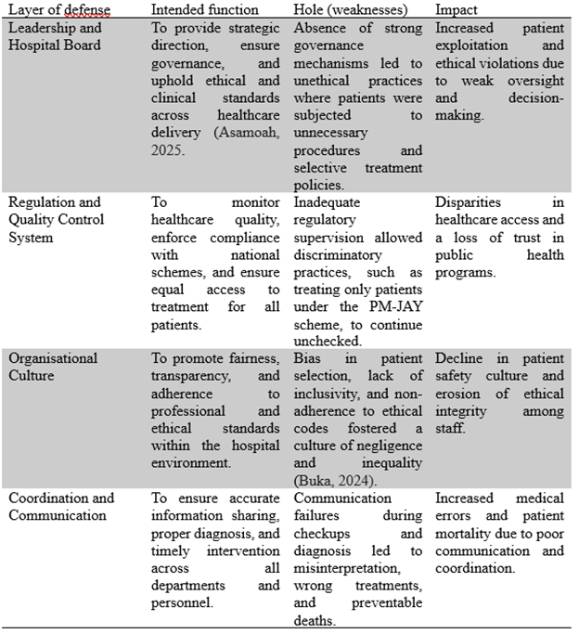
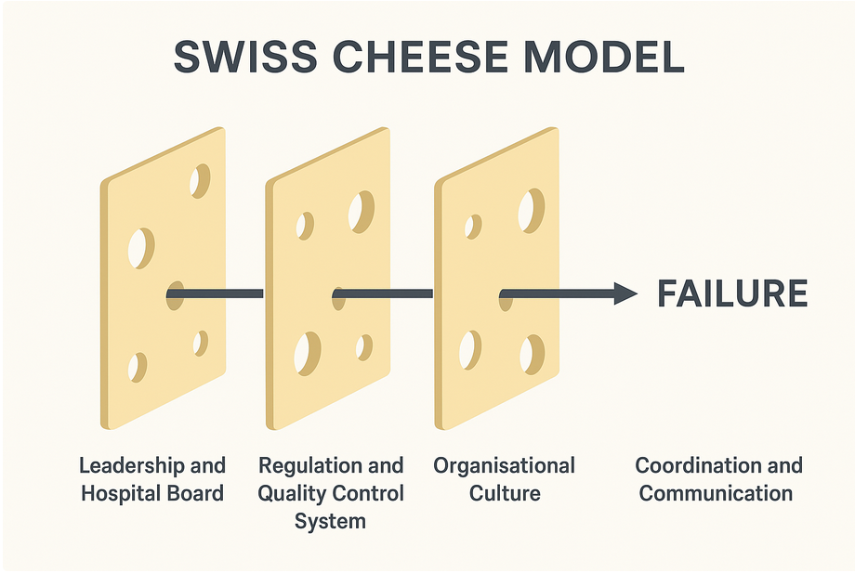
The root causes by using the systems-based safety model
(Swiss Cheese Model)
(Source: Self-developed)

Slide 5
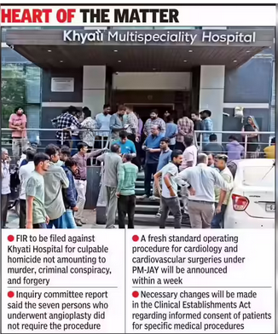
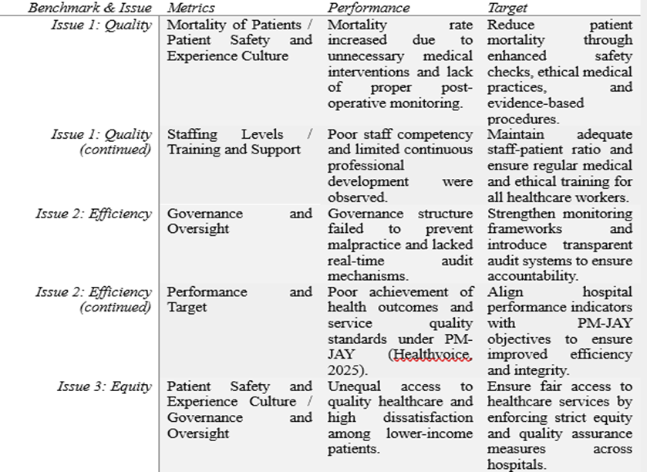
Analysis of benchmarks
Eventually, the Khyati Hospital case, in association with the PM-JAY, reportedly has quality failures.
(Source: Times of India, 2024)

Slide 6

Outlining how the report (component 2) will be structure
Introduction / Background Analysis
Understanding of Theoretical Perspectives
Application of Conceptual Framework
Methods or Approaches Used
Root Cause Analysis
Governance and Policy Analysis
Impact Assessment on Efficiency, Quality, and Equity
Recommendations Driven by the Findings
Conclusion
(Source: Google, 2025)

Slide 7
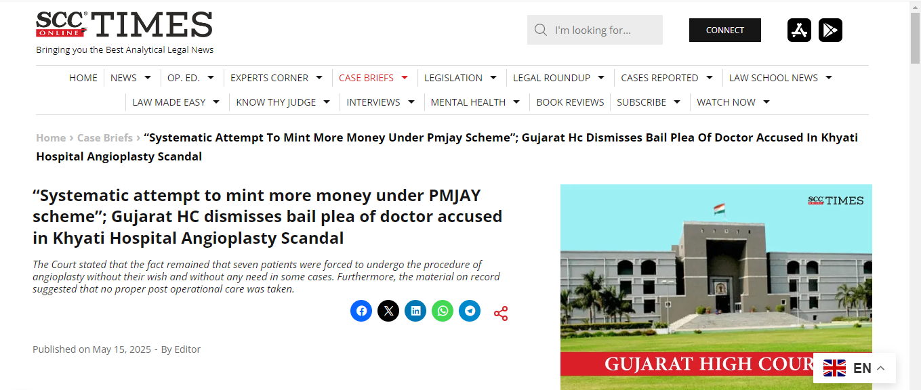
Conclusion
Theories or Models, including the Fishbone Diagram, the Systems Theory, and the Donabedian Model, will be further elaborated in the report.
The Fishbone Diagram basically categorizes the primary causes with the help of different dimensions.
These dimensions include fuel, process, environment, equipment, and policy.
The Donabedian model comprises three foundational pillars such as structure, outcomes, and process (Tossaint-Schoenmakers et al., 2021).
(Source: Scconline, 2025)

Slide 8
References
Deccanherald, 2024. 5-gujarat-hospitals-de-panelled-from-pmjay-due-to-irregularities-2-doctors-also-face-action. https://www.deccanherald.com/india/gujarat/5-gujarat-hospitals-de-panelled-from-pmjay-due-to-irregularities-2-doctors-also-face-action-3310288
Healthvoice, 2025. What-the-khyati-hospital-pmjay-scandal-reveals-about-our-hospitals-invisible-risk. https://healthvoice.in/what-the-khyati-hospital-pmjay-scandal-reveals-about-our-hospitals-invisible-risk
Indianexpress, 2025. Pmjay-racket-case-gujarat-court-denies-bail-to-khyati-hospital-ceo-cardiologist. https://indianexpress.com/article/cities/ahmedabad/pmjay-racket-case-gujarat-court-denies-bail-to-khyati-hospital-ceo-cardiologist-9899942/
Medicaldialogues, 2024. hospital-diagnostics/pmjay-fraud-khyati-hospital-misused-emergency-tags-for-rapid-medical-approval. https://medicaldialogues.in/news/health/hospital-diagnostics/pmjay-fraud-khyati-hospital-misused-emergency-tags-for-rapid-medical-approvals-140013
Med.unc, 2025. A-Model-for-Measuring-Quality-Care-NHS-Improvement. https://www.med.unc.edu/ihqi/wp-content/uploads/sites/463/2021/01/A-Model-for-Measuring-Quality-Care-NHS-Improvement-brief.pdf
Scconline, 2025. Gujarat-hc-dismisses-bail-plea-accused-doctor-khyati-hospital-angioplasty-scandal. https://www.scconline.com/blog/post/2025/05/15/gujarat-hc-dismisses-bail-plea-accused-doctor-khyati-hospital-angioplasty-scandal/
Shabani, T., Jerie, S. and Shabani, T., 2024. A comprehensive review of the Swiss cheese model in risk management. Safety in extreme environments, 6(1), pp.43-57.https://link.springer.com/article/10.1007/s42797-023-00091-7
Tagaram, S.D. and Chen, C., 2024. Quality Tools and Techniques (Fishbone Diagram, Pareto Chart, Process Map). In StatPearls [Internet]. StatPearls Publishing.https://www.ncbi.nlm.nih.gov/books/NBK607994/
Timesofindia, 2024. Controversy-erupts-at-khyati-hospital-allegations-of-targeting-pm-jay-cardholders-in-fatal-angioplasties. https://timesofindia.indiatimes.com/city/ahmedabad/controversy-erupts-at-khyati-hospital-allegations-of-targeting-pm-jay-cardholders-in-fatal-angioplasties/articleshow/115369210.cms

Slide 9
References
Tossaint-Schoenmakers, R., Versluis, A., Chavannes, N., Talboom-Kamp, E. and Kasteleyn, M., 2021. The challenge of integrating eHealth into health care: systematic literature review of the Donabedian model of structure, process, and outcome. Journal of medical Internet research, 23(5), p.e27180.https://www.jmir.org/2021/5/e27180/
Images:
https://asq.org/quality-resources/fishbone?srsltid=AfmBOoo9WCJHwAITB4lyczmO4svLI7Ptcdi6CN5sANGLwXRTSbXgda7h
https://www.safechoicesafety.com/how-a-piece-of-cheese-can-save-a-life/
https://www.google.com/url?sa=i&url=https%3A%2F%2Fwww.finline.in%2Freport-format%2Fall-sample-project-reports%2F0&psig=AOvVaw0R25M8ZXi4yzjckC6yzSuN&ust=1760866966701000&source=images&cd=vfe&opi=89978449&ved=0CBkQjhxqFwoTCMCu5ee6rZADFQAAAAAdAAAAABAE
https://timesofindia.indiatimes.com/city/ahmedabad/khyati-hospital-debarred-from-pm-jay-for-malpractice/articleshow/115267234.cms

Slide 10
THANK YOU

