Slide 1
Module: Psychology in Health and Social Care
Module code: LCHS4010
Assignment-1 Presentation
Submitted By: Daniela Apetrei
Student ID: 2016760

Slide 2
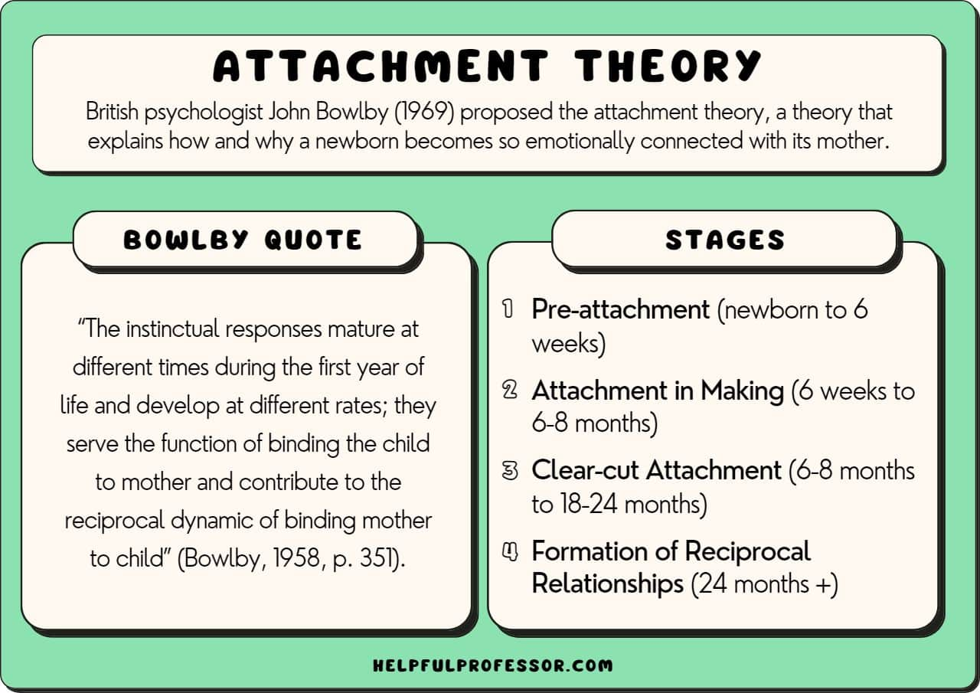
Introduction and Scenario Background
This presentation examines a true story of a young carer, Jenny, who is 16 years old and has been caring long term of her mother after the demise of her father in a critical period of adolescence.
It uses the Attachment Theory of Bowlby, (1969) to explore how protracted caregiving, loss, and role reversal can influence the psychological growth of Jenny and her emotional wellbeing throughout the lifespan.
The discussion takes into account both biological factors, including emotional control and stress management, and environmental ones, including family-related demands and deprivation of parental support.
Lastly, the presentation will suggest a theory-grounded community support plan that will encourage emotional security, decreasing burden of care, and positive development of adolescents in health and social care practice.
Notes:
This presentation uses a lifespan developmental approach to the case of Jenny, a 16-year-old young carer. Over the last five years, Jenny has had a lot of care giving expenses towards her mother as a result of losing her father. Her mother also has mobility problems, memory and low mood which need physical and emotional attention. Consequently Jenny has been subjected to long-term care giving requirements at a critical stage of development.
This presentation seeks to discuss the possible impact of the events on Jenny and her psychological growth and wellbeing as well as suggest a community support plan based on one lifespan theory. The attachment theory of Bowlby, (1969) has been chosen due to the long-term effect of care giving relationships in early years and their continuous attachment on development, which is the key figure in the case of Jenny. The presentation will describe the main ideas of attachment theory, use them in the lived experience of Jenny, take into account biological and environmental factors, and critically assess the utility and shortcomings of the theory as an instrument to be used in health and social care.

Slide 3
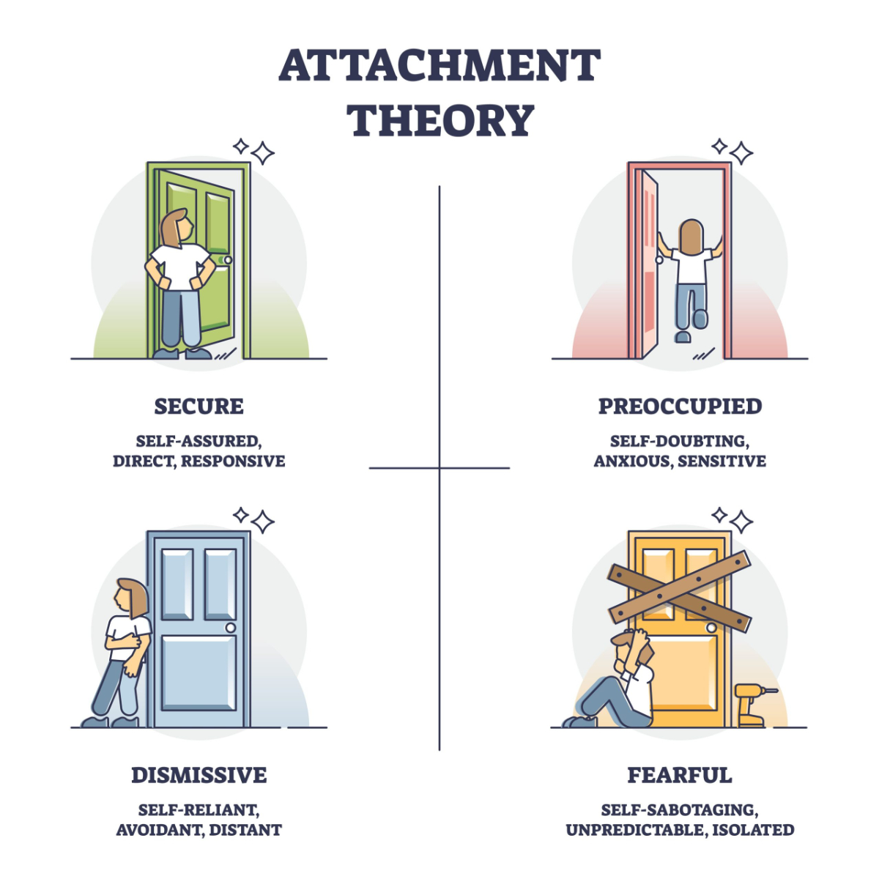
Introduction to Attachment Theory
Attachment theory is a theory by Bowlby, (1969), which describes the fact that human beings have a biological need to establish emotional connections with caregivers to survive and manage emotions.
Attachment can be described as a consistent affective connection that offers a secure foundation of exploration and growth and influences internal working models of self and relationships throughout the lifespan (Fletcher and Gallichan, 2016).
Attachment is promoted by biological behaviours like proximity seeking and distress responses and established by caregiver sensitivity and emotional availability (Bowlby, 1969).
Ainsworth et al., (1987) distinguished secure, avoidant, ambivalent, and disorganised attachment styles, which are characterized by various emotional and relational results.
The attachment theory is consistent with a lifespan approach: patterns of early emotional regulation and relationships are carried into adolescence and adulthood (Holmes, 2014).
Notes:
Attachment theory is the theory that was proposed by Bowlby, (1969) and suggests that humans have a biological tendency to form intimate emotional ties with the caretakers as a survival mechanism and as a method to regulate their emotions. Bowlby referred to attachment as special and stable emotional bond between an infant and a caregiver that gives an individual a safe ground to explore and grow (Bowlby, 1969). The theory notes that the early attachment relationships determine the internal working model of an individual that affects self, other and relationships expectations throughout the lifespan (Fletcher and Gallichan, 2016).
Attachment is perceived as an inherent behavioural mechanism, whereby, biological processes like seeking proximity and distress responses in the absence of attachment persons, support attachment. The quality of attachment is however of great importance and in this case, the sensitivity and responsiveness of the care giver as well as the emotional availability are important. The study by Ainsworth et al., (1987) established secure, avoidant, ambivalent, and disorganised patterns of attachment, each one of which is related to various emotional and relational consequences.
Notably, the attachment theory concurs with the lifespan perspective that was highlighted in this module because it acknowledges that childhood emotional regulation, self-esteem, and interpersonal functioning persist into adolescence and adulthood (Holmes, 2014).

Slide 4
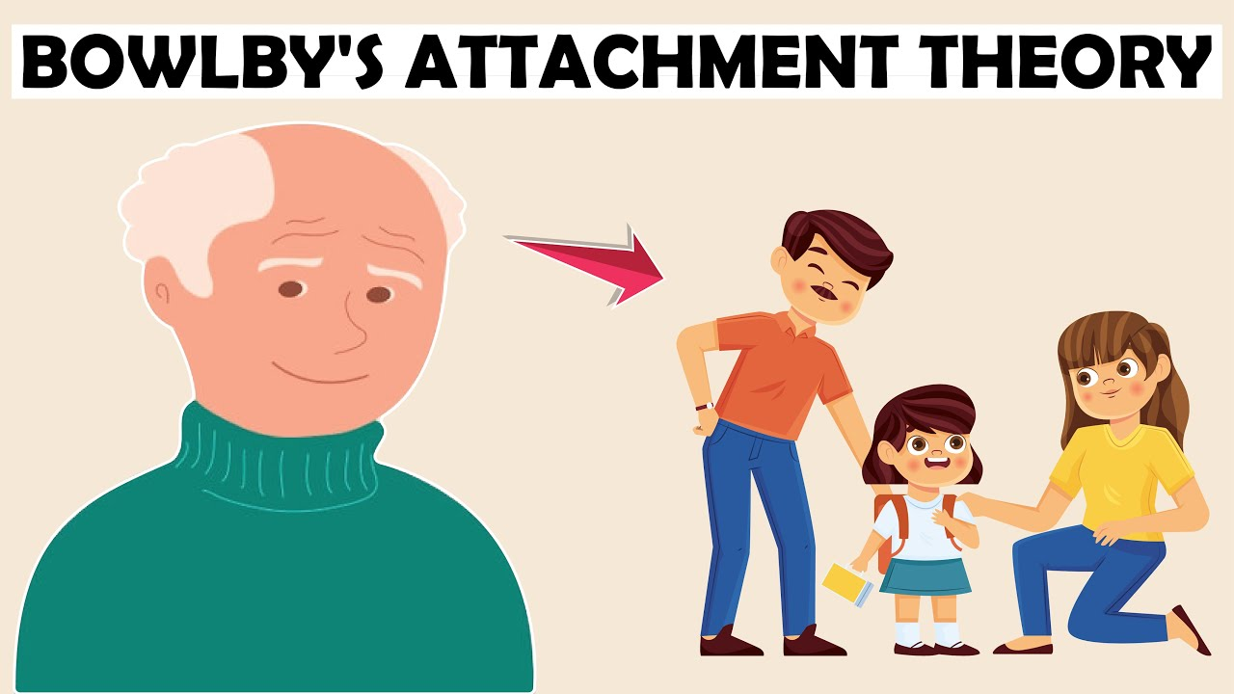
Applying the Attachment Theory to the Experiences of Jenny
Loss of the primary attachment figure in the form of bereavement after the death of her father interferes with the internal working models and emotional security of Jenny (Barnett-Jones, 2023).
In adolescence, an effective base of caregivers helps identity and autonomy; role reversal negatively impacted Jenny to gain reassurance (Baltes and Silverberg, 2019).
According to attachment theory, caregiver inconsistency and emotional unavailability help develop insecure patterns, such as emotional suppression, hyper-responsibility, and fear of abandonment in adolescents (Meins, 2016).
Perpetual caregiving can promote self-sacrifice, which raises the chances of emotional burnout, anxiety, and challenges in establishing balanced relationships in the process of development (Orenstein and Lewis, 2022).
These pressures increase the vulnerability of adolescents to inadequate emotional control.
Notes:
The loss of her father and the emotional and physical hardships of the mother that followed the death of the father might have severely disrupted Jenny early childhood attachments (Barnett-Jones, 2023). In an attachment viewpoint, this is the loss of a primary attachment figure as well as a shift in the accessibility of the other caregiver. These experiences may put the working model of a young individual under pressure.
Making a transition to adolescence, human beings are usually dependent on caregivers as a safe point as they seek identity, autonomy, and peer interactions (Baltes and Silverberg, 2019). Nevertheless, Jenny played the reversal role of a child and a caregiver that might have restricted her power to find emotional support and reassurance. According to the attachment theory, the inconsistency or emotional unavailability of care-giving may lead to the formation of insecure attachment patterns in adolescents, such as the emotional suppression, hyper-responsibility, or fear of abandonment (Meins, 2016).
Jenny might have also been taught to put the needs of others and her needs aside which endangers her with emotional fatigue, anxiety, and inability to build balanced relationships (Orenstein and Lewis, 2022). These results correlate with the findings of studies that have associated insecure attachment with mental illness, lack of emotional control, and vulnerability in adolescence.

Slide 5
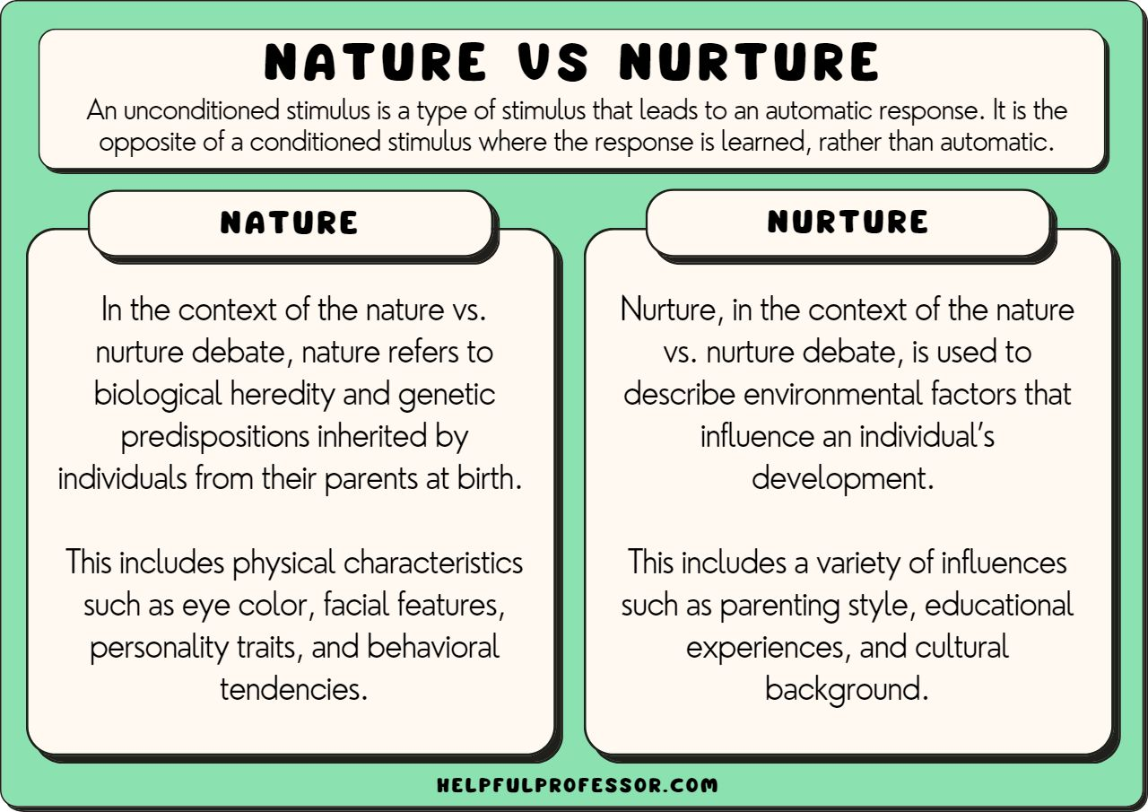
Nature and Nurture Influences
Attachment theory is a synthesis of biological and environmental factors that describe how stress and loss and uncertainty trigger the attachment system, and sensitize the emotion of adolescence (Boyd and Bee, 2019).
The adolescence period is associated with the reorganisation of the nervous system and heightened emotional responsiveness, which means that Jenny might be prone to the chronic caregiving burden and anxiety (Boyd and Bee, 2019).
Factors like bereavement, diminished maternal care, continuing household responsibilities and lack of age-related social experiences, among others, place an environmental strain on recovery and coping resources (Baltes and Silverberg, 2019; Orenstein and Lewis, 2022).
Sensitivity hypothesis says that consistent caregiver responsiveness is required in the secure attachment need and maternal memory issues and low mood can diminish that.
Notes:
Attachment theory combines both biological and environmental factors of development. The stress, loss and uncertainty would have triggered Jenny biologically to follow the attachment system, making her more sensitive to emotions at the adolescent stage, which is already linked to neurological changes and emotional responsiveness (Boyd and Bee, 2019).
The emotional development of Jenny is likely to have been influenced by the long-lasting aspect of care giving, bereavement, less parental support and less access to age-related proper social experiences, all of which are influenced by environmental factors (Baltes and Silverberg, 2019; Orenstein and Lewis, 2022). The sensitivity hypothesis holds that secure attachment requires active presentation of emotional responsiveness over time. The emotional availability of Jenny might have been decreased by her mother and her cognitive functioning, which, in their turn, reinforced Jenny in self-regulating and oppressing her distress.
Such a biochemical vulnerability and environmental stressor interaction points to the significance of a lifespan-aware practice of health and social care (Baltes, 1987).

Slide 6

Theory-Based Support Plan of Jenny
The main goal of the intervention is to achieve emotional security, role strain mitigation, and offer alternative secure relationships via attachment-informed support. The presence of a reliable base that will allow safe expression of emotions can be achieved by assigning a regular key worker or mentor (Bowlby, 1953).
The family-based support services are also supposed to reduce the caregiving burden on Jenny by offering practical support to her mother, which will enable role reorganisation and engage her in age-related developmental activities (Boyd and Bee, 2019).
The subject of grief, loss, and responsibility can be resolved through therapeutic interventions, including counselling or groups of young carers to foster trust and emotional expression (Meins, 2016; Holmes, 2014).
The flexible and emotionally constant school-based support has to be offered by the informed teaching staff.
Notes:
The first aim of the intervention is to reestablish emotional security, minimize role strain, and offer Jenny other secure relationships using the attachment theory. One important approach would be to assign a regular key worker or mentor to offer stable emotional support which is equivalent to the secure base role outlined in the attachment theory (Bowlby, 1953). The relationship would enable Jenny to share emotions without fear of overbearing on others.
Secondly, the family-oriented care group should be presented so that Jenny could be relieved of her caring burden. Physical support to her mother, including home care services and administration, would be useful to re-organize the roles of the family and Jenny could resume age-specific developmental activities (Boyd and Bee, 2019).
Thirdly, emotional processes of grief, loss, and responsibility may be attended to through the help of therapeutic interventions, including counselling or group support of young carers (Kentor and Koplow, 2020). Attachment-informed therapy lays emphasis on the development of trust, emotional expression, and reflective functioning which are especially applicable in adolescents who have caregiving burdens (Meins, 2016; Holmes, 2014).
Lastly, the school support must be organized so that teachers would be informed of the situation of Jenny, and be able to allow her flexibility and emotional support, which would support consistency in her social world.

Slide 7

Attachment Theory Critique
Attachment theory can be useful as it can be used to explain how emotional development and wellbeing impact under prolonged caregiving stress and emotional unavailability and, therefore, practitioners can comprehend the emotional needs of Jenny and structure relationships-oriented therapy instead of being strictly practical (Meins, 2016).
Nevertheless, this theory has its weaknesses because it dwells heavily on early relations and become excessively deterministic by suggesting that early insecurity is necessarily followed by future psychological problems.
Studies indicate that the nature of attachment patterns is flexible, and positive relationships during adolescence can alter previous experiences of insecurity and lead to resilience and better emotional performance (Baltes, 1987; Jones et al., 2018).
Hence, attachment theory needs to be utilized dynamically.
Notes:
The attachment theory can be extremely helpful in this regard since it describes how the emotional development and wellbeing may be influenced by prolonged caregiving stress and emotional unavailability (Meins, 2016). It gives a definite pattern of understanding the emotional requirement of Jenny and directs interventions based on relations and not strictly practical interventions.
Nevertheless, the theory is limited as well. Attachment theory puts a lot of emphasis on early relationships and is prone to over-determinism in that early insecurity must result in later problems. Studies by Baltes, (1987): Jones et al., (2018) show that attachments patterns are flexible and may be altered through introduction of supportive relationships in adolescence stage. The theory has also been criticized due to cultural biasness since norms of caregiving and roles of family differ with culture and socioeconomic status.
Thus, although the theory of attachment has some useful information, it must be applied with flexibility and an awareness of the resilience and social context, as well as systems support systems (Fletcher and Gallichan, 2016).

Slide 8

Conclusion
The attachment theory provides a powerful lifespan theory that can be used to explain the psychological effects that the long-term caregiving has on the development of Jenny.
The loss, role reversal, and emotional responsibility may have caused a loss of security in the adolescence stage.
Evidence-based interventions based on attachment will enhance emotional wellbeing and practical support.
The case demonstrates that the issues of relational security, environmental support, and early intervention are crucial to the development of healthy adolescents.
Notes:
Finally, the attachment theory by Bowlby offers a sound lifespan approach to understanding the psychological effects of caregiving issues on an individual who is young such as Jenny. The feeling of loss, role reversal and emotional responsibility experienced by her might have upset her sense of security and emotional control at a very crucial developmental phase. Through evidence-based intervention activity using attachment as a guiding factor, a health and social care specialist will be able to help Jenny improve her wellbeing, as well as to support her emotionally and practically. The significance of relational security, environmental support as well as an early intervention in healthy adolescent development is evident in this case.

Slide 9
References
Ainsworth, M., Blehar, M., Waters, E. and Wall, S. (1978) Patterns of attachment: A psychological study of the strange situation. Hillsdale: Erlbaum.
Baltes, M.M. and Silverberg, S.B., 2019. The dynamics between dependency and autonomy: Illustrations across the life span. In Life-span development and behavior (pp. 41-90). Routledge.
Baltes, P.B. (1987) ‘Theoretical propositions of life-span developmental psychology’, Developmental Psychology, 23(5), pp. 611–626.
Barnett-Jones, B. (2023) ‘Our first few years as a child can determine the rest of our lives’, The Guardian, 3 April.
Bowlby, J. (1953) Child care and the growth of love. London: Penguin.
Bowlby, J. (1969) Attachment and loss: Vol. 1. Attachment. London: Hogarth Press
Boyd, D. and Bee, H. (2019) Lifespan development. 8th edn. Harlow: Pearson.
Fletcher, H.K. and Gallichan, D.J., 2016. An overview of attachment theory: Bowlby and beyond. Attachment in intellectual and developmental disability: A clinician's guide to practice and research, pp.8-32.
Jones, J.D., Fraley, R.C., Ehrlich, K.B., Stern, J.A., Lejuez, C.W., Shaver, P.R. and Cassidy, J., 2018. Stability of attachment style in adolescence: An empirical test of alternative developmental processes. Child development, 89(3), pp.871-880.
Holmes, J., 2014. John Bowlby and attachment theory. Routledge.
Meins, E. (2016) ‘Attachment and mental health’, Current Opinion in Psychology, 7, pp. 20–25.
Orenstein, G. and Lewis, L. (2022) Development through the lifespan. London: Sage.
Kentor, R.A. and Kaplow, J.B., 2020. Supporting children and adolescents following parental bereavement: guidance for health-care professionals. The Lancet Child & Adolescent Health, 4(12), pp.889-898.

