Slide 1
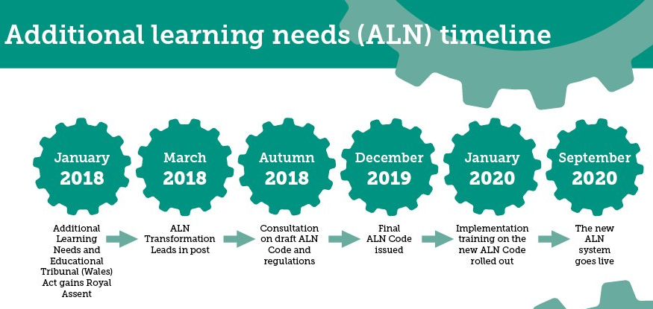
Student name- Menna Johns Student number- 1803428 Module code- ECEY6001
Introduction/ School Development
Whilst discussing the new legislation, Senedd Research (2019) outlines the importance of the development and how it will benefit children and young people. In September 2020, the 2018 Act will be replacing the Special Educational Needs (SEN) framework and will be reforming the system to focus on ALN.
The Welsh Government (2018) discuss the ALN transformation programme which has been developed to become a united system in order to support children and young people from 0 to 25 years old who have an ALN. The system will now ensure that all learners needs are supported and are able to achieve their full potential. The new programme also support the UNCRC and are positioning the learners needs, opinions and wishes at the forefront of decisions. The publication highlights the importance of early interventions and identifying signs and symptoms of ALN in order to have an effective strategy in place. However, schools must ensure that appropriate training is given to their staff to develop their understanding and knowledge in order to support the children with ALN. The Welsh Government (2018) discuss the new approach and highlight that there will be steps taken to up- skill teaching staff in order to assist children further. Training packages will be offered to schools and settings to professionally develop all staff.
The Additional Learning Needs Tribunal Wales Bill Update
The Welsh government (2018) has stated that change must happen in order to support and protect children who are in need of further assistance due to their ALN. The law for education for children with additional needs is out of date by 30 years. The Additional Learning Needs Tribunal Wales Bill was officially updated in 2015 and has been updated accordingly since. The new law allows children with ALN to get an IDP which will specify what needs must be supported to allow them to learn. The IDP will be created with the support of the school, child, parents and a health care representative. The Additional Learning Needs (ALN) Transformation Programme (2018) explain the effects that the new government enforcements will have on schools in order to support the children in their care who have ALN. Educators must work closely with health care professionals and other organisations by placing the child at the core of decisions. Schools must also work to ensure children are being fully supported and that their ALN has minimal distraction to their education.
Change was needed to-
Provide appropriate guidance to schools to identify and support children’s specific needs
Identify needs early
Support children’s needs and rights
Include the children with ALN
IDPs to replace SEN and IEPs
The Additional Learning Needs and Education Tribunal Wales Act (2018) outlines how Individual Development Plans (IDPs) are to replace statements of Special Educational Needs (SEN) and Individual Education Plans (IEPs) for children who are being supported through school action. The Welsh Government Act (2018) states that schools must do more to recognise if a child in their care has ALN. They must ensure that an ALN coordinator is assigned to replace previous SEN coordinators. In order to support the child and their parents, schools should ensure that opportunities are given to discuss concerns, strategies and action plans at an early stage.
The school must:
Identify whether a child has Additional Learning Needs (ALN)
Put an IDP in place
Refer decisions to local authority such as health services and social services if the support needed is beyond the school’s ability
Funding
The Council for Disabled Children (2013) outlined that there is specific school funding for children with ALN. The budget was based on how many children in the school has ALN and the government recommend that schools should use the national budget to pay for up to £6,000 worth of special educational support to meet the needs of the children. Since then, the Government (2018) outlined that children with ALN would gain a further £350 million funding to provide appropriate care and support. Mainstream schools would benefit by gaining the correct training, equipment and staffing to assist the children.
However, since this publication, Nazia Parveen (2019) headlined that funding for children with ALN has dropped by 17%. NASUWT (no date) state that although the demand for ALN coordinators has increased, specialist teaching and support staffing positions have been drastically cut. This has led to increased teacher responsibilities, however, it is thought that teachers do not receive the appropriate guidance, support or training that is needed to effectively assist children with ALN. Schools have responsibilities for providing an effective and beneficial education to children with ALN. The Children with Additional Learning Needs document (2018) states that educators must adapt to the diverse and complex needs of children and to take a holistic approach to support their requirements.
This can be done by-
Formally assessing children
Organise appropriate staffing and funding
Encourage children to participate in everyday activities
Having a positive relationship with the parents
Conclusion
The new legislation reform (2018) was overdue and needed to ensure the right care and provision was provided for children with ALN. Erw (2018) states that all children must receive an appropriate education which caters for their needs. Schools must ensure that they offer suitable training for their staff to support the children in their care.
Snap Cymru (2018)

