Slide 1
Waste, Rubbish, dirt

Slide 2
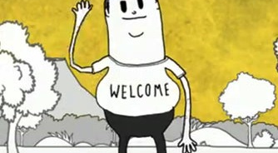
Steve Cutt’s ‘Man’ – things being used

Slide 3
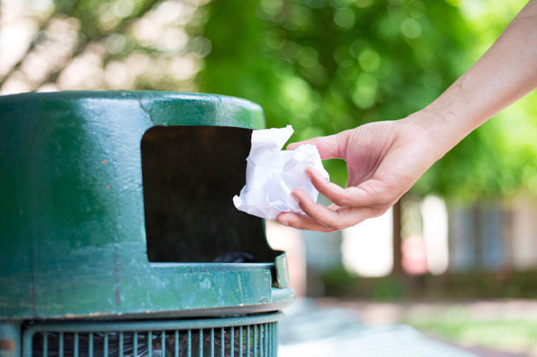
Overview: waste production
Being alive produces ‘waste’
Waste can be described as unwanted items
Unwanted items are expected to be discarded in socially acceptable zones

Slide 4
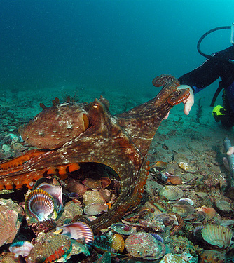
Modern humans and other animals organise their waste
Middens are designated areas (pits) for waste.
  Waste includes: bones, shells, phyto-matter, excrement
Midden is middle English meaning ‘mess’. It is still used today in Scotland and by archaeologists
Other animals create middens (squirrels)
Octopus midden – indicative of size of the animal

Slide 5
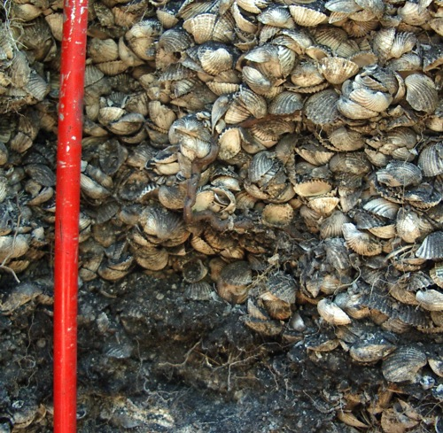
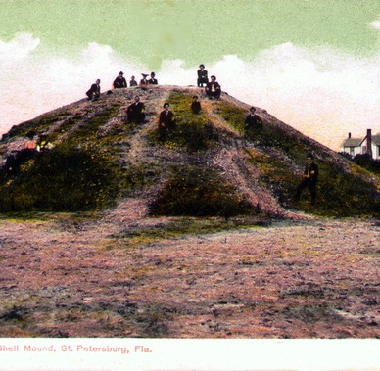
Prehistoric shell middens indicating size of the mounds
Albatros Bay, Australia
St. Petersburg, Florida

Slide 6
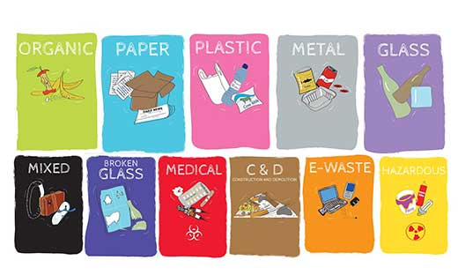
Garbology
‘The study of human refuse and trash is a field of research known as garbology, which involves collecting, sorting and categorising tonnes upon tonnes of waste. The fundamental dogma of garbology is that what people have owned and thrown away speaks more eloquently, informatively and credibly about the lives they lived than perhaps they themselves could do’ (Rathje & Murphy 1992:54).

Slide 7
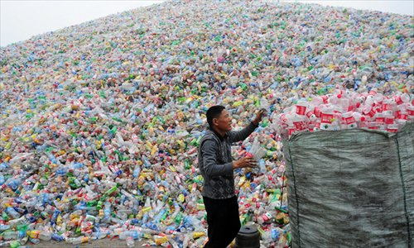
Rathje and Murphy explain what can be read from consumer waste
‘You can tell what kind of wine they drink. All their letters come in and out, and who they buy through - Saks or Sears and Roebuck - and how they maintain their household. It’s better’n being a psychiatrist. I can tell you anything you want to know’ (1992:55).

Slide 8
Rubbish theory (1979)
Thompson’s Rubbish Theory shows how an object’s value rises and falls depending on context. Things become ‘rubbish’ when they lose value…
Thompson claims that things are either DURABLE or TRANSIENT – which determines their value
‘Objects in the transient category decrease in value over time and have finite life-spans. Objects in the durable category increase in value over time and have infinite life-spans’
(Thompson 1979: 7).
Transient: fruit
Durable: gold ring
Points to consider: Do his ideas work today? Is longevity always important or valuable?

Slide 9
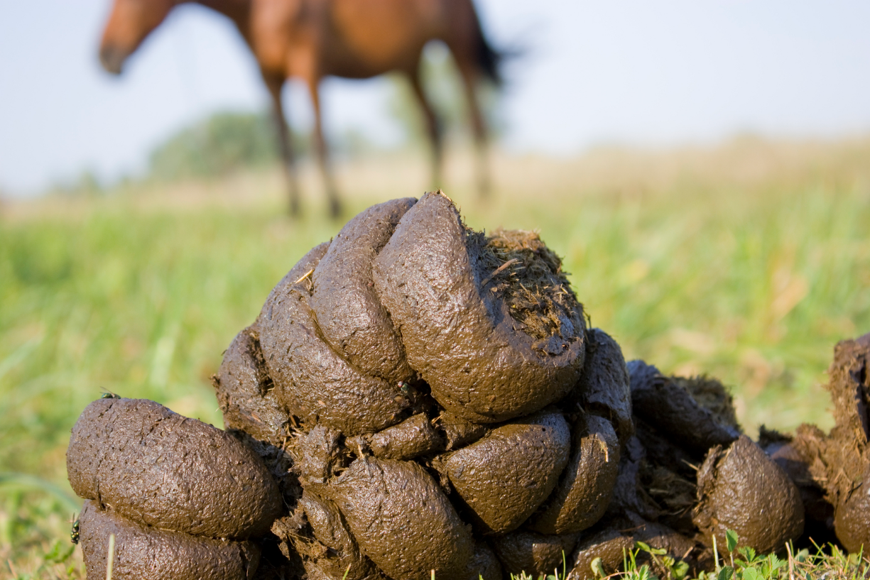
value
According to Thompson (1979), looking at the things in people’s lives reveals the item’s value.
The decline of an object is determined through the cultural value system.
Discarded objects reveal items with ‘zero-value’ (Thompson 1979: 9).
Activity: can you name an item that is differently valued because of culture or context?

Slide 10
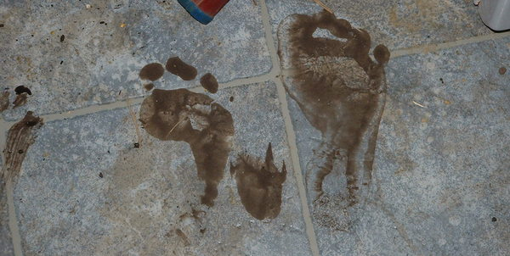
Mary Douglas
What is the problem with waste? Why do humans separate themselves from it?
Waste is considered DIRTY.
What does ‘dirt’ mean?

Slide 11
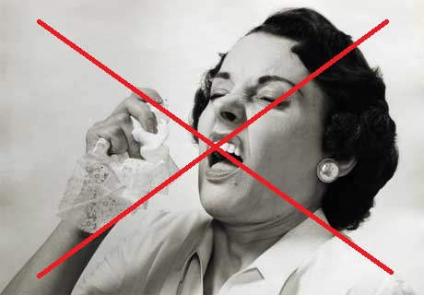
Dirt is ‘matter out of place’ (Douglas, 1966)
Dirt is a socially constructed idea.
  Dirt does not intrinsically exist
What is dirty in one place is not in another
Something is considered to be dirty when its place challenges or contests social notions of order
We tidy to bring back order

Slide 12
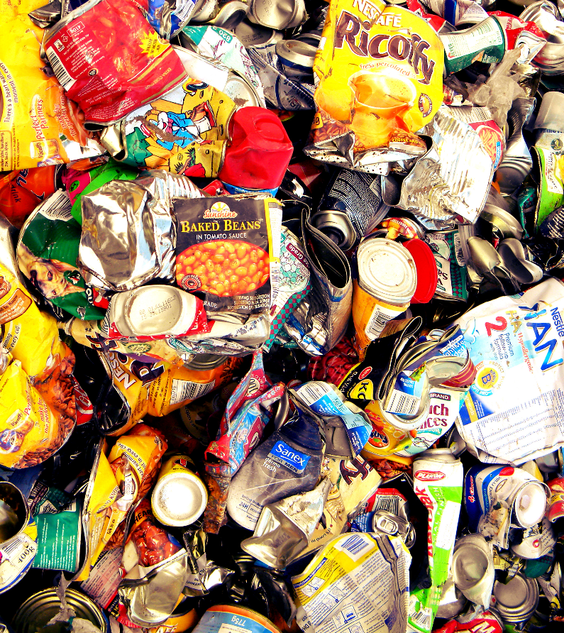
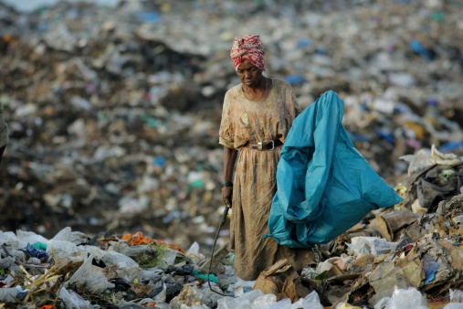
Rubbish is now a modern, global problem
Plastic is the star of this show

Slide 13
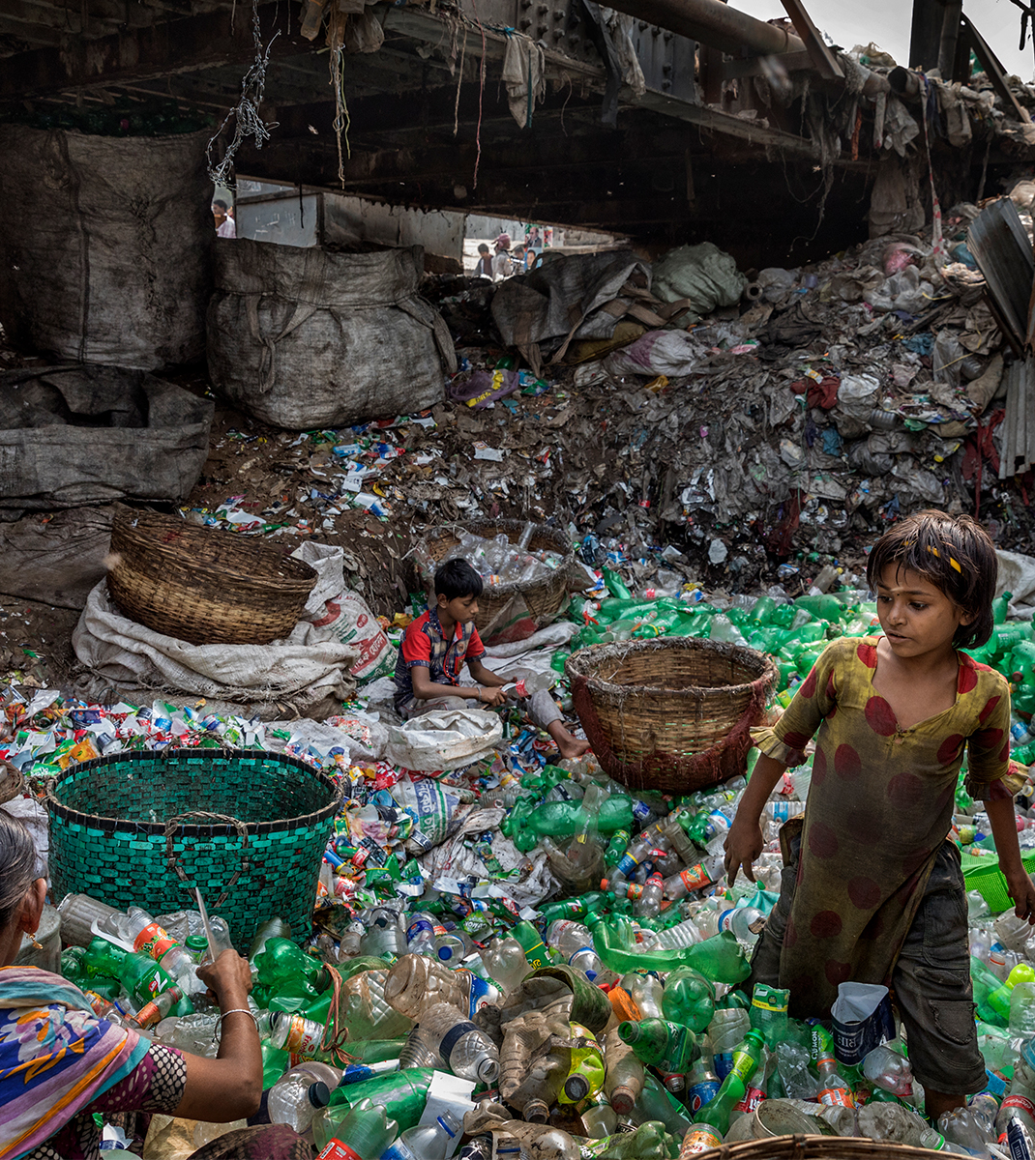
Plastic troubles rubbish theory
Plastic endures and resists, but is plentiful.
Does plastic disrupt the ordinary transience of rubbish and challenge what rubbish once was? Or is it mounding up as shell middens do?

Slide 14
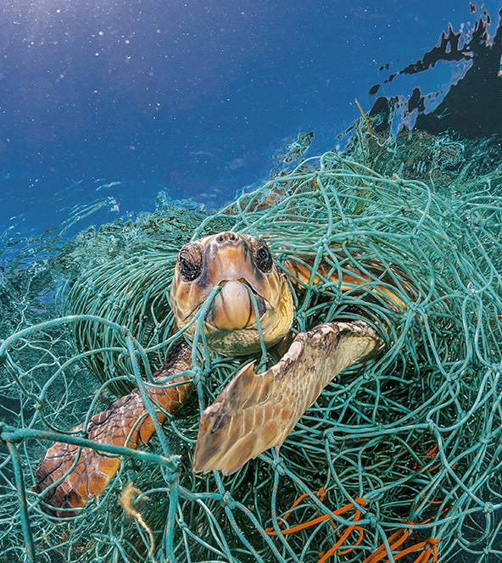
Hawkins 2017 Plastic, disposability and the art of not caring
Plastic is a marker of modernity and anthropogenic impact
‘We are thoroughly mixed up with plastic literally and metaphorically’ (p 15)
Asks ‘why has this durable material become synonymous with disposability and single use?’

Slide 15
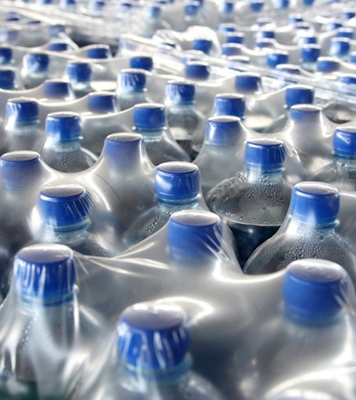
Plastic is rubbish from its inception
Plastic is made to be rubbish – think packaging
Single use plastic
  Retail plastic: punnets etc
  Immediate consumption: cups, straws
But its odd durability makes it an odd candidate for this disposability jobs.

Slide 16
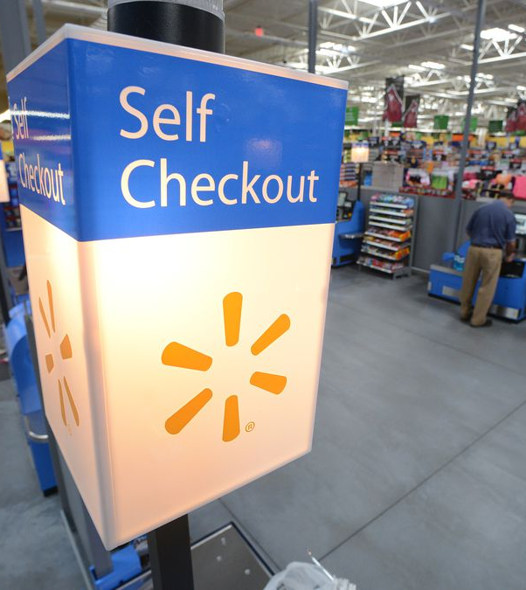
Plastic’s materiality has done 2 things:
It helped enhance the idea and practice of SELF SERVICE
Which encouraged single use items into the market

Slide 17
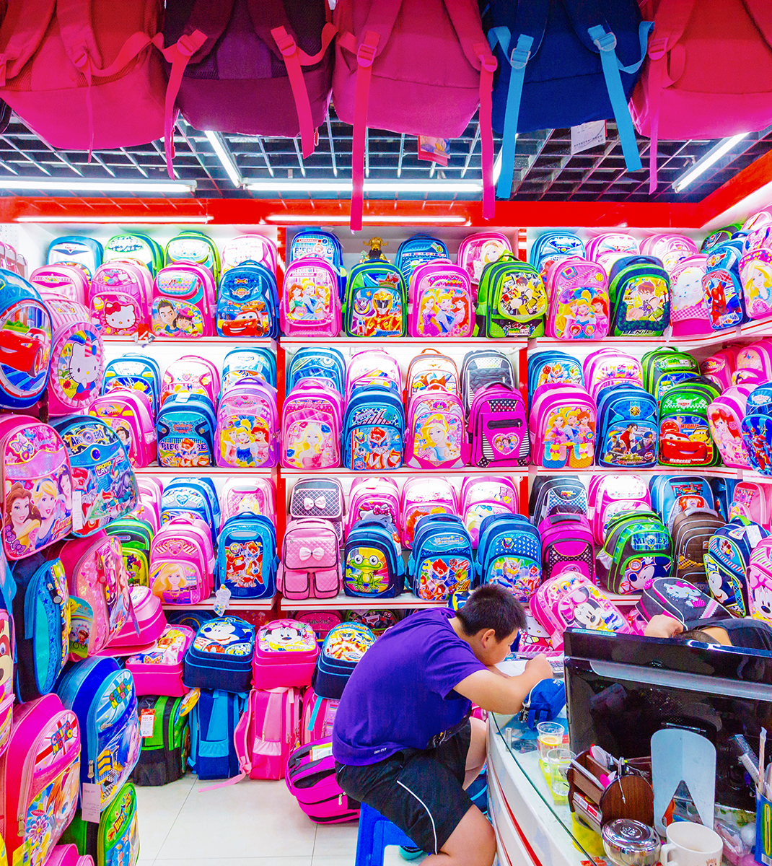
Plastic is political
Hawking (2017) thinks plastic is governing our lives. It is utterly linked to us and people are struggling to rid their lives of it.
Plastic is an actant (Latour 1993) that has made consumers ethically thoughtless.

Slide 18
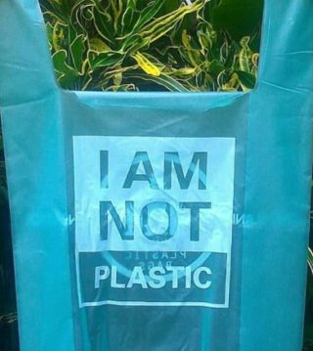
The future…?
Hawkins (2017) calls for a novel approach that is not human centred because, she claims, plastic is not ‘passive’.
She proposes a morethanhuman ethics that recognises materiality over consumption uses.

Slide 19
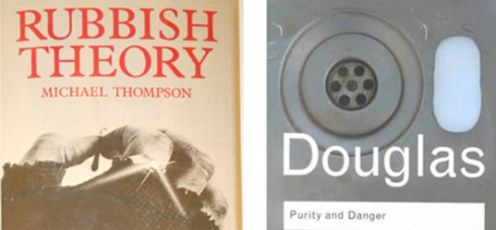
References
Douglas, M 1966 (2002) Purity and Danger: an analysis of concepts of pollution and taboo Routledge: London
Hawkins, G 2017, ‘Ethical blindness: plastics, disposability and the art of not caring’, in V Kinnunen & A Valtonen (eds), Living ethics in a more-than-human world, University of Lapland, Finland, pp. 15–28.
Rathje, W. J., and Murphy, C 1992 Rubbish: the archaeology of garbage University of Arizona Press: Arizona
Thompson, M 1979 Rubbish Theory: the creation and destruction of value Oxford University Press: Oxford

