Slide 1

Life course approach to Health and Wellbing

Slide 2
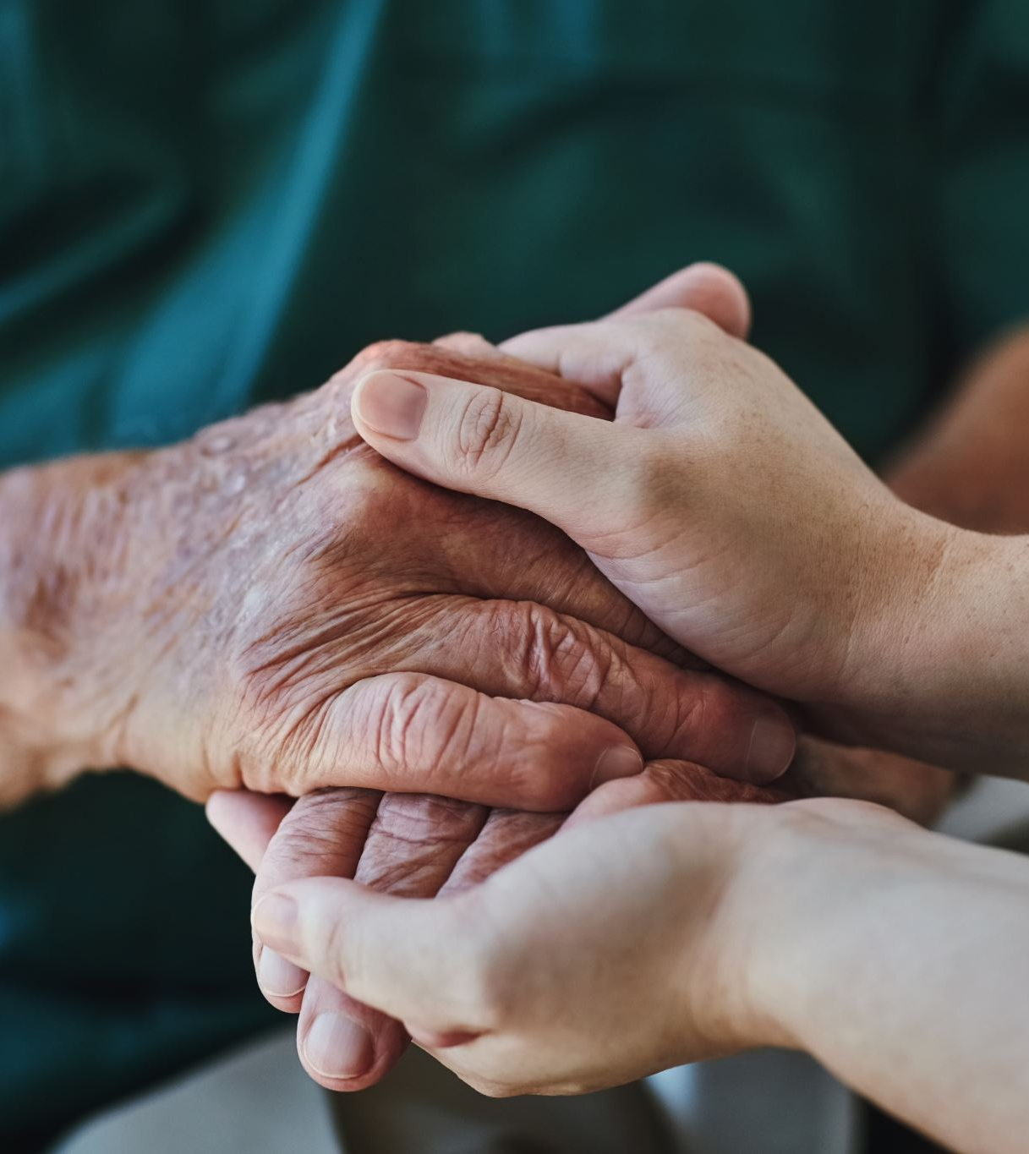
Definition
The life course approach to health and wellbeing starts from preconception and pregnancy, through to infancy and early years, childhood and adolescence, working age and adults and old age.
FROM CRADLE TO GRAVE!!
This approach aims to secure access to health for people of all ages and addressing peoples needs and safeguarding the human right to health throughout their life time.
Mental Health, Well being, Social, behavioural, economic and environmental are all factors that fit into the categories protective factors and risk factors.

Slide 3
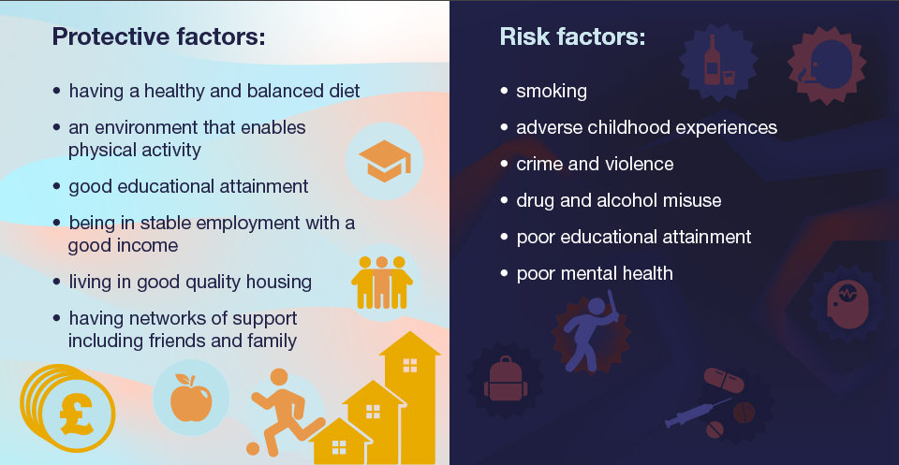
www.gov.uk(2025)

Slide 4
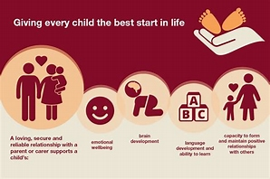
Interventions

Slide 5
A framework developed by Public Health Care Wales (PHW)
Recognises fundamental components to move the health and care system In a positive direction toward a prevention-based approach.
This Framework brings gether well-established approaches and is intended to work on inequalities, population health management, healthcare public health, and health care pathways. The prevention-based approach helps to identify:
What needs to be done to achieve a common goal
Opportunities
Who to collaborate with to create a positive impact
www.gov.uk (2025)

Slide 6
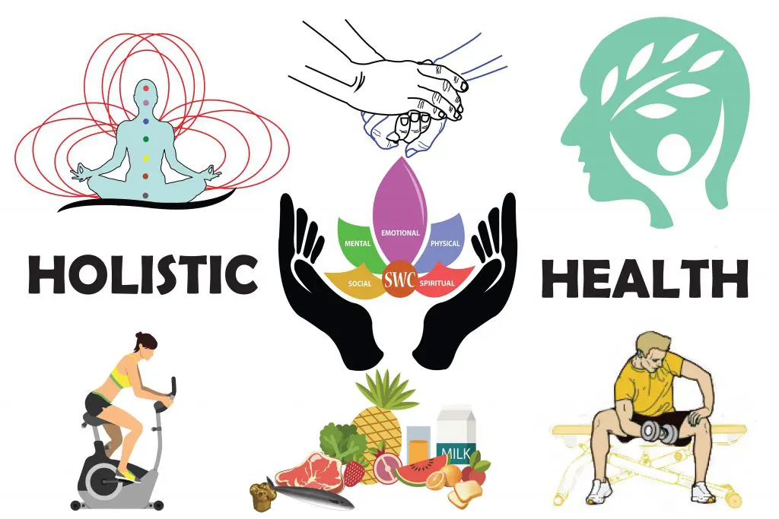

Slide 7

HOLISTIC LIFESTYLE
Holistic means Whole and relates to what makes us whole.
There is not really a part of life that can not be improved living a holistic life.
Holistic relates to the Body (physical), the Mind (mental and emotional) and the Soul (spiritual).
Holistic action creates productive and healthy ageing.
Lifestyle is they way you choose to live your life. This includes routine, such as eating and exercising regularly.
When you live holistically you are acknowledging all three areas, Body, Mind and Soul.
If Healthy habits such as eating healthy, exercise, hobbies and values are instilled in your lifestyle, the results from theses actions will be recognised and in turn you will see the benefits.
www.holisticlifestyleguide .com (2025)

Slide 8

Physical
Better Sleep, Lower chance of disease/chronic illness, weight loss
Mental
Less stress/anxiety, clear thinking/decision making, Higher quality relationships
Spiritual
Deeper connection with your self, nature the universe and increased life satisfaction
www.holisticlifestyleguide.com (2025)

Slide 9
What Problems can a holistic Lifestyle Solve?
Lack of motivation
Stress/Anxiety
Poor Digestion
Poor Sleep
Suicidal thoughts
Brain fog
Dependence on medicine for chronic illness
Holistic lifestyle choices are what feels natural to you, there is no one size fits all. It about bringing calm, clarity and wellbeing into your daily life.
www.becoming youwithjulie.com (2025)

Slide 10
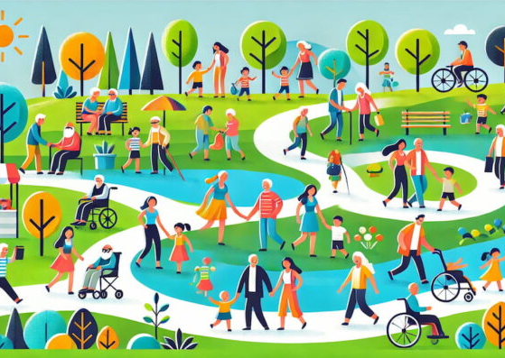
WELLBEING
Wellbeing is associated with physical. Mental and emotion al health.
Wellbeing changes as we progress through the stages of life. Childhood, adolescence, adulthood and old age.
Understanding the unique challenges and needs at every stage experienced, we will better support ourselves and allows us to build resilience and enjoy life to its fullest no matter what age.
Build health day by day every day, It is NEVER to late.
www.thehealthcarebusinessclub.com (20

Slide 11
REFERENCES
Mkettingtonbooks.com. (2025). The 10 Principles of Personal Longevity. Available at: https://mkettingtonbooks.com/10p-freedom.html?msclkid=5a6e73d2c0421717eda0140fb5b4bf0e2025 (Accessed 12 Mar. 2025).
GOV.UK. (n.d.). Health matters: Prevention - a life course approach. Available at: https://www.gov.uk/government/publications/health-matters-life-course-approach-to-prevention/health-matters-prevention-a-life-course-approach#prioritising-prevention-of-ill-health 2025
HBC Editors (2024). What Is Well-being at Every Life Stage? Healthcare Business Club. Available at: https://healthcarebusinessclub.com/articles/consumer/what-is-well-being-at-every-life-stage/.2021
holisticlifestyleguide.com. (n.d.). Holistic Lifestyle Guide Link Page. Available at: https://holisticlifestyleguide.com/.2025
James, P. (2025). PPN - Health matters: Prevention - a life course approach. Ppn.nhs.uk. Available at: https://ppn.nhs.uk/north-west/resources/news/item/health-matters-prevention-a-life-course-approach (Accessed: 13 March 2025)
Living, M.E. (2022). Mother Earth Living - Healthy Life, Natural Beauty. Mother Earth Living - Healthy Life, Natural Beauty. Available at: https://www.motherearthliving.com/ (Accessed: 13 March 2025)

Slide 12
Wagner, C., Cristian Carmeli, Jackisch, J., Kivimäki, M., Bernadette, Stéphane Cullati and Arnaud Chiolero (2024). Life course epidemiology and public health. The Lancet. Public health, 9(4), pp.e261–e269. doi:https://doi.org/10.1016/s2468-2667(24)00018-5.
Local action on health inequalities Reducing social isolation across the lifecourse. (n.d.). Available at: https://assets.publishing.service.gov.uk/media/5a80aa52e5274a2e87dbb209/3a_Social_isolation-Full-revised.pdf. 2015
Gouveia, L. (2024). Common Health Concerns in Different Life Stages - Saint James Health. [online] Saint James Health. Available at: https://saintjameshealth.com/common-health-concerns-in-different-life-stages/ 2025
AptamilTM Early Life Nutrition & Pregnancy Advice - Join Aptaclub. (2019). Pregnancy Diet & Nutrition | Aptaclub. Available at: https://www.aptaclub.co.uk/pregnancy/diet-and-nutrition.html.
Kuruvilla, S., Sadana, R., Montesinos, E.V., Beard, J., Vasdeki, J.F., Araujo de Carvalho, I., Thomas, R.B., Drisse, M.-N.B., Daelmans, B., Goodman, T., Koller, T., Officer, A., Vogel, J., Valentine, N., Wootton, E., Banerjee, A., Magar, V., Neira, M., Bele, J.M.O. and Worning, A.M. (2017). A life-course approach to health: synergy with sustainable development goals. Bulletin of the World Health Organization, 96(1), pp.42–50. doi:https://doi.org/10.2471/blt.17.198358

Slide 13
The, L. (2024). Becoming You With Julie. Becoming You With Julie. Available at: https://becomingyouwithjulie.com/lifestyle/creating-a-holistic-lifestyle-the-beginners-guide (Accessed: 13 March 2025)
Wellhub. (2025). Wellhub | Speak with an Employee Wellbeing Specialist. Available at: https://wellhub.com/en-uk/lp/hands-up-pm/ 2025
Howland, G. (2018). My Top 10 Essentials for a Natural, Manageable Pregnancy. Mama Natural. Available at: https://www.mamanatural.com/top-10-pregnancy-essentials/ 2025
AptamilTM Early Life Nutrition & Pregnancy Advice - Join Aptaclub. (2019). Pregnancy Diet & Nutrition | Aptaclub. Available at: https://www.aptaclub.co.uk/pregnancy/diet-and-nutrition.html.

