Slide 1

Llwybr Datblygu’r Gymraeg
Welsh Language Development Pathway
Tachwedd 16eg 2021
Grŵp Ch – Mari Powell
Darlith 33 (Lecture 3)

Slide 2

Nod Ac Amcanion
Aims and Objectives
Nod Ac Amcanion
Aims and Objectives
Fframwaith
Cymwyseddau
Iaith
Welsh Language
Competency
Framework
Y Portffolio
The Portfolio
Adolygu
Revision
Pwy? Sut? Ble?
Who? How? Where?
Treigladau
Mutations

Slide 3

Fframwaith Cymwyseddau Iaith
Welsh Language Competency Framework

Slide 4
Beth ydy’r Fframwaith Cymwyseddau Iaith i Ymarferwyr Addysg?
What is the Welsh Language Competency Framework for Education Practioners?
It is a national framework to measure Welsh language competency of all student teachers in Wales.
In the future, the aim is to use the Framework to measure Welsh language competency of the whole education sector.
The Framework measures your Listening, Speaking, Reading and Writing skills in Welsh. It also measures your skill as a language teacher, e.g. how you develop the language skills of pupils in your class.
The Framework is a tool to help you plan further professional development opportunities when you enter the teaching profession.
You will need to submit a portfolio of evidence of your ability to use the Welsh language in the classroom.

Slide 5
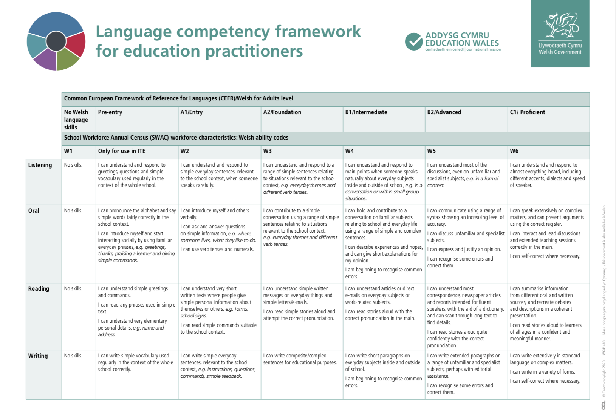
Welsh Government Version

Slide 6
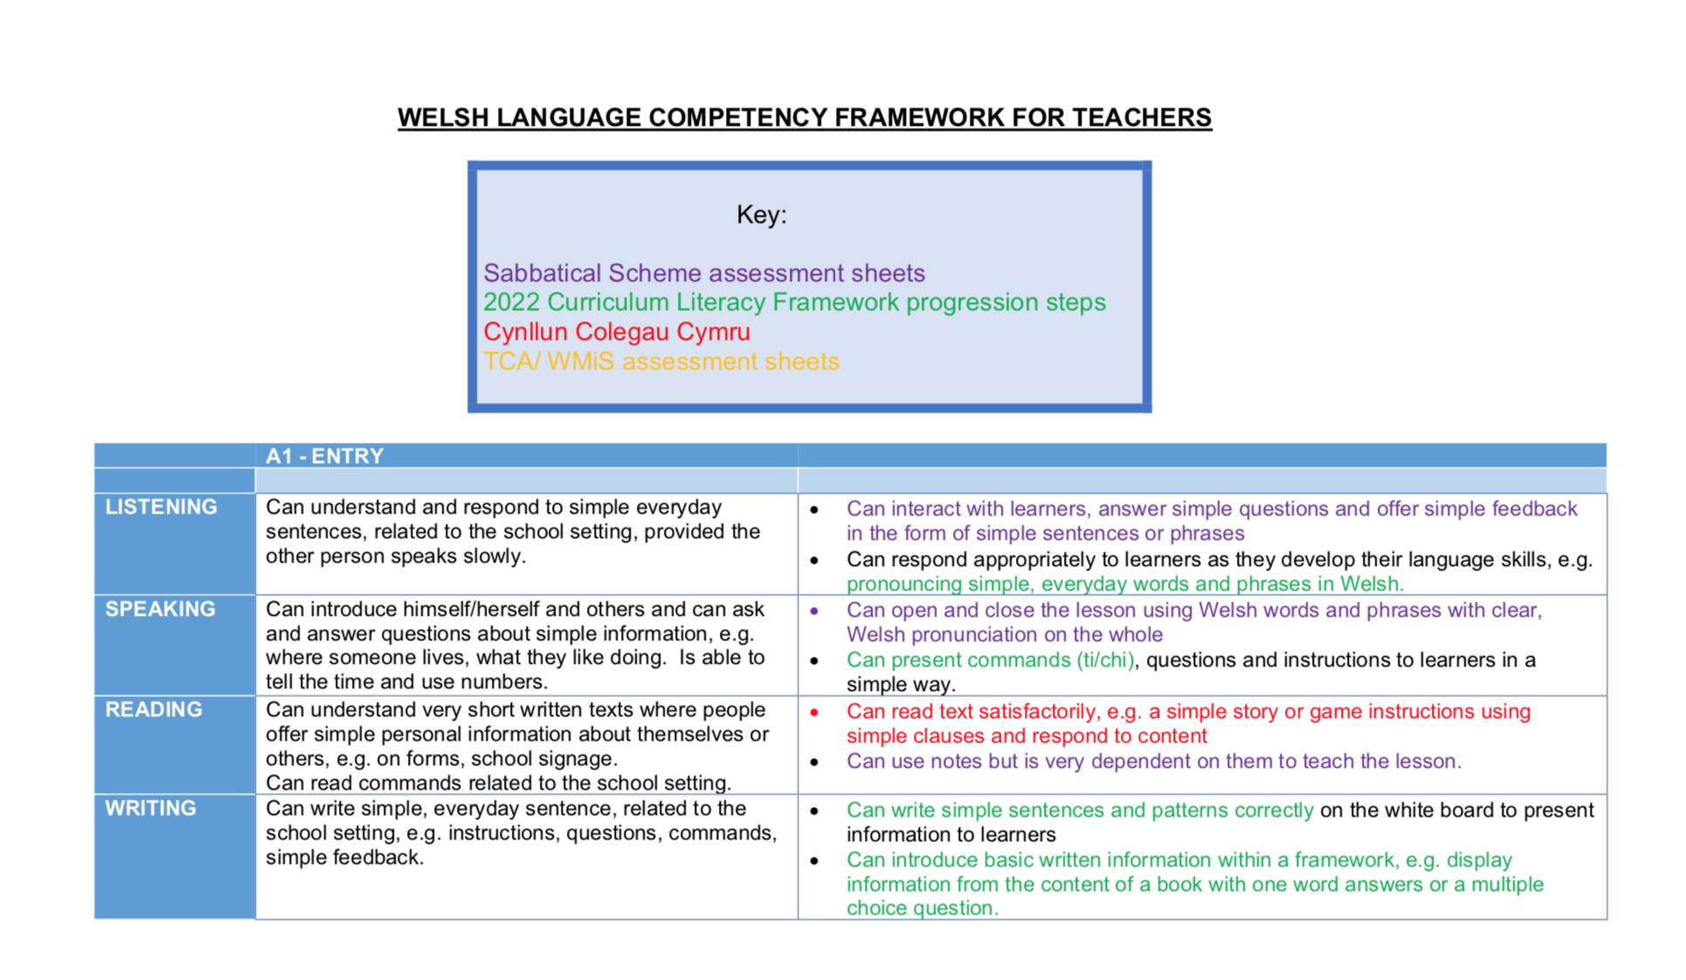
Original Version (by Rhagoriaith)

Slide 7
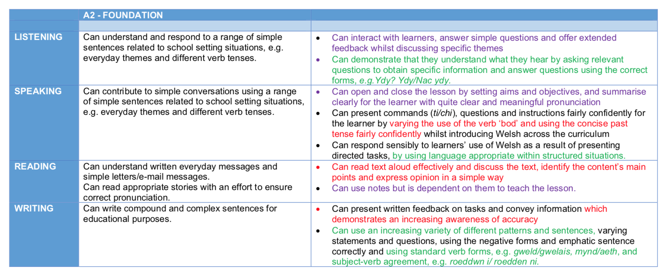
Original Version (by Rhagoriaith)

Slide 8
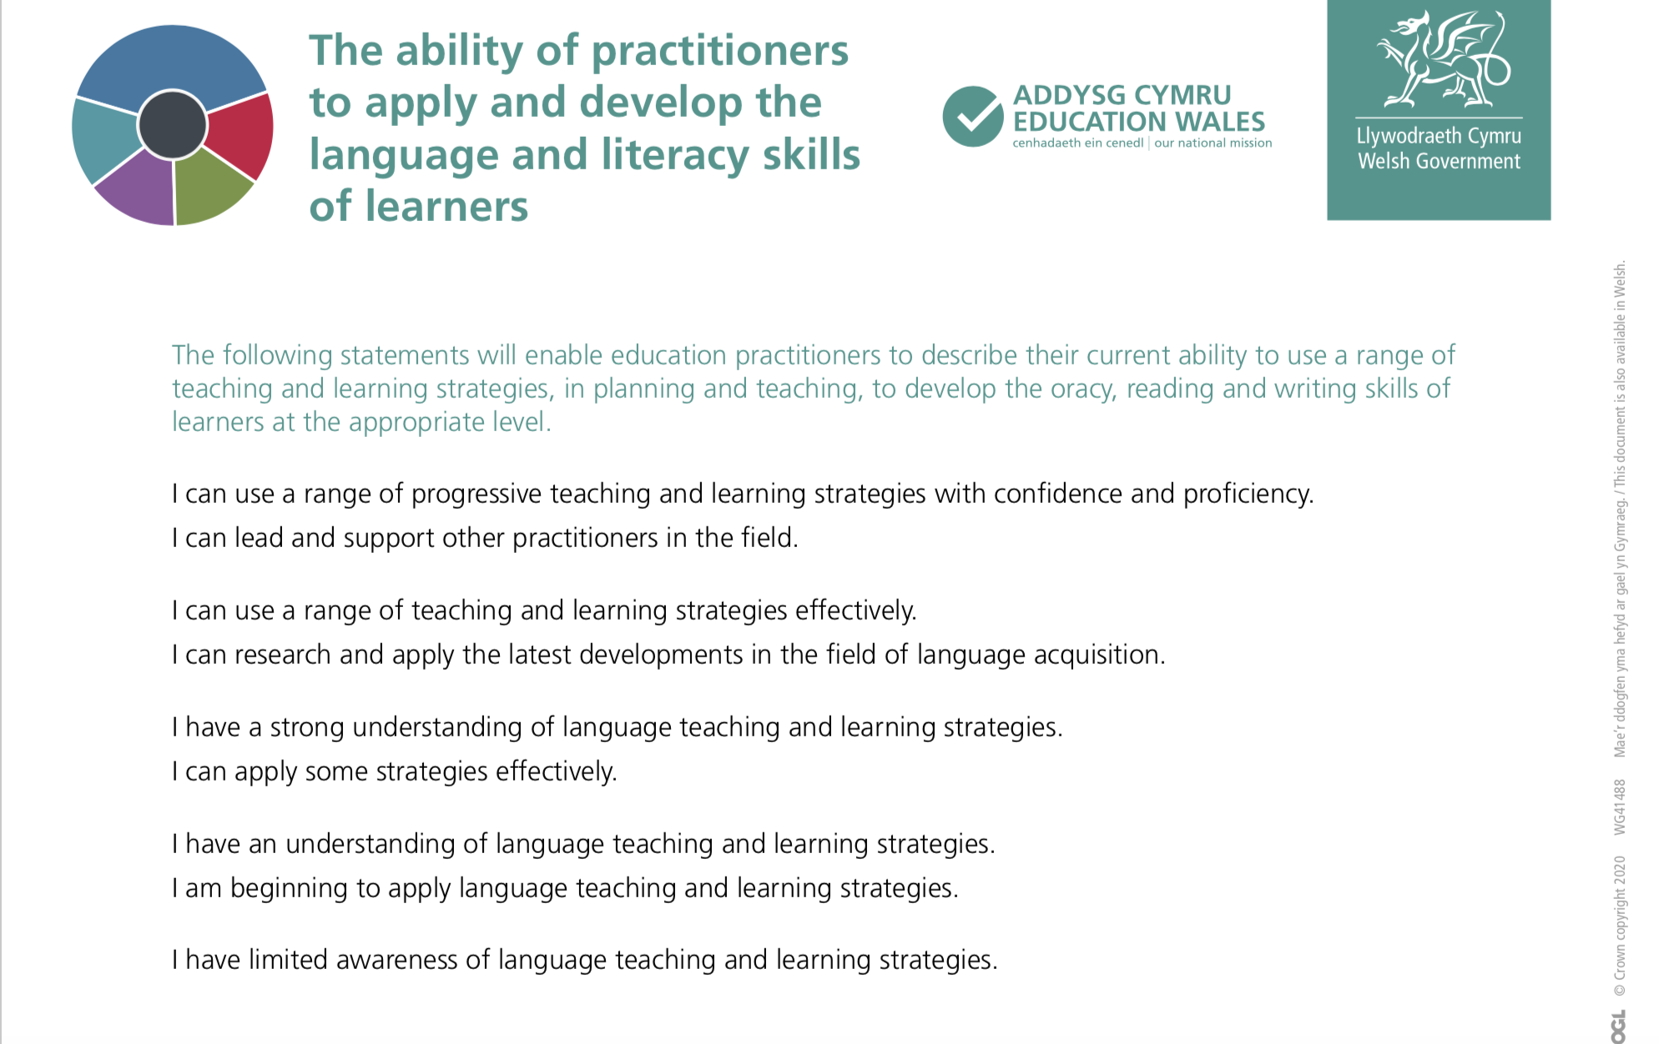
Welsh Government Version

Slide 9
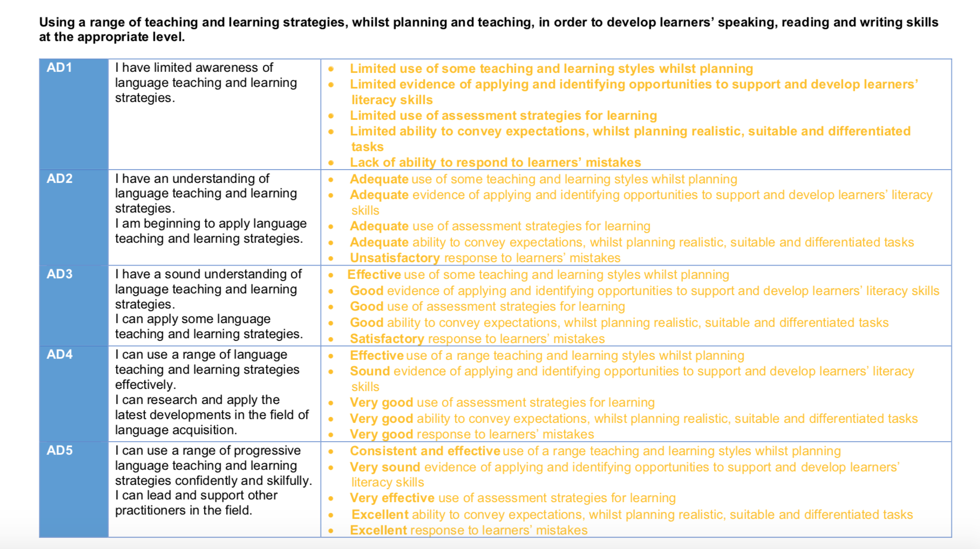
Original Version (by Rhagoriaith)

Slide 10
Beth sydd angen i chi wneud?
What do you need to do?
Cadwch dystiolaeth o sut rydych
chi’n datblygu pob un o’r sgiliau
iaith canlynol:
    1. Llafar
    2. Gwrando
    3. Darllen
    4. Ysgrifennu
Keep evidence of how you develop
each of the following language
skills:
1. Speaking
2. Listening
3. Reading
4. Writing

Slide 11
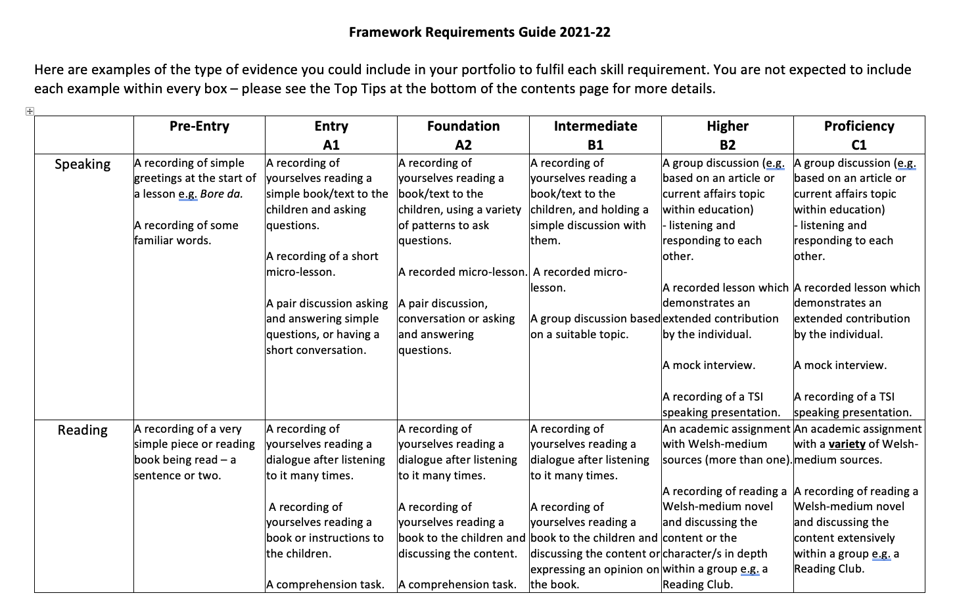
Y Portffolio: Canllaw i’r mathau o dystiolaeth i’w cynnwys
The Portfolio: Guidelines on the types of evidence to be included
Introduction and Guidelines available on Moodle.

Slide 12
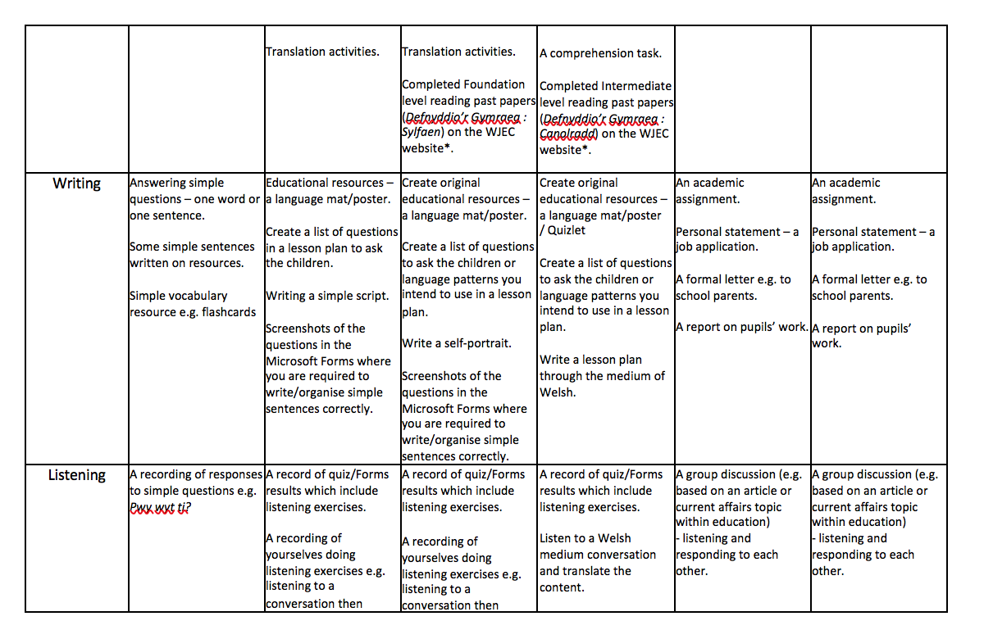
Y Portffolio: Canllaw i’r mathau o dystiolaeth i’w cynnwys
The Portfolio: Guidelines on the types of evidence to be included

Slide 13
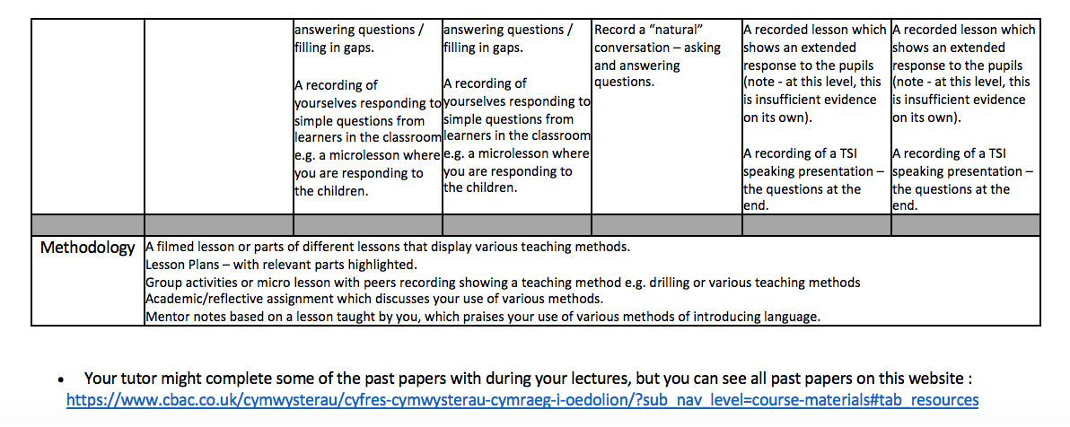
Y Portffolio: Canllaw i’r mathau o dystiolaeth i’w cynnwys
The Portfolio: Guidelines on the types of evidence to be included
How are you developing the pupils’ language skills?
Are you using a variety of teaching and learning strategies?
You should receive support from your school mentor with regards to planning your lessons and developing the pupils’ language and literacy skills.

Slide 14
Pwysig!
Important!
You cannot fail / pass the Framework / Portfolio. This is not an exam, a test or an assignment.
Every student who graduates with a QTS is expected to have the Framework levels on their PLP at the beginning of their teaching career.
Collecting evidence should not be a lot of extra work. This is something that should happen on a regular basis. Create a folder on the “One Drive” to keep your evidence.

Slide 15
Eich Portffolio Cymraeg
Your Welsh Portfolio
Eich Portffolio Cymraeg
Your Welsh Portfolio
Mae’n bosib byddwch chi ar lefelau
gwahanol ar gyfer sgiliau gwahanol,
e.e.
Siarad: A2
Darllen: A1
Ysgrifennu: A1
Gwrando: A2
It is possible for you to be on different
levels for different skills,
e.g.
Speaking: A2
Reading : A1
Writing : A1
Listening: A2

Slide 16

Eich lefel(au)…
Your level(s)…

Slide 17
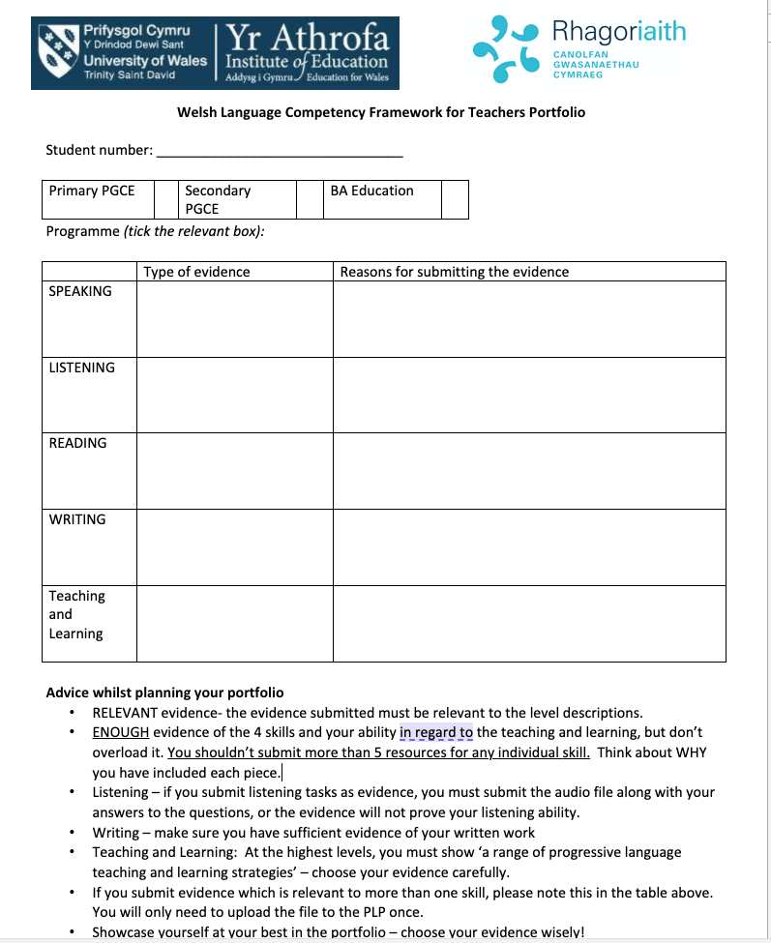
Y Portffolio
The Portfolio
Bydd rhaid i chi uwchlwytho tystiolaeth dan 6 adran wahanol yn y PDP:
You will be required to upload evidence to your PDP under 6 different sections:
Cyflwyniad | Introduction
Llafar | Oral
Darllen | Reading
Gwrando | Listening
Ysgrifennu | Writing
Methodoleg Dysgu ac Addysgu | Teaching and Learning Methodology
Justify why you have included each piece.
What does each piece evidence show in relation to the level descriptors?
Label each piece of evidence as they will appear in your portfolio, e.g. sound file ‘Lesson Yr 1: Y Tywydd’

Slide 18

Cyngor Doeth!
Top Tips!
Your portfolio is your showcase so choose your best bits!
Mae’n haws chwynnu na chasglu o’r newydd.
It’s easier to sort a full desktop file than to collect evidence from new before the deadline.
Perthnasol
Relevant evidence
Digon ond dim gormod!
Enough evidence but try not to overload.
Film of micro lesson – this could evidence more than one skill, e.g. speaking, listening and reading
Only upload once: make clear in the introduction where you have uploaded the micro lesson.
Choose evidence carefully:
Is it relevant?
Is it appropriate?
What does it show?
Why is it there?

Slide 19

Sut gallaf helpu fy hun?
How can I help myself?
Notes:
Duolingo – app to help you learn Welsh with 5 minutes daily activities
Say Something in Welsh – aim is to get you speaking Welsh
Ap Geiriaduron – Welsh dictionary to help you with translations

Slide 20
Mae gwefan Peniarth yn cynnwys llawer o adnoddau defnyddiol i annog y Gymraeg yn ddyddiol yn y dosbarth.
There are a number of useful resources on the Peniarth website which will help you use the Welsh language daily in the classroom.
Cliciwch ar bob llun i ddysgu mwy am yr adnodd.
Click on each picture to learn more about the resource.
Mae eitemau iaith fel berfau, treigladau, arddodiaid ac ymadroddion iaith bob dydd wedi'u cynnwys, ac wedi grwpio fesul lliw i ddod o hyd i’r atebion yn hawdd.
Language elements such as verbs, mutations, prepositions and everyday phrases are all included, and are grouped by colour so that answers are easily found.
Mae’r cardiau yma’n cynnwys ymadroddion a chwestiynau addas i'w defnyddio o ddydd i ddydd ar draws y cwricwlwm.
These cards contain phrases and questions suitable to be used on a daily basis across the curriculum.

Slide 21
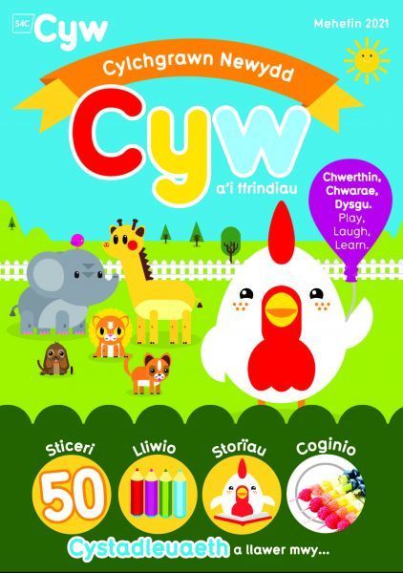


Sut gallaf helpu fy hun?
How can I help myself?
Darllenwch!
Gwyliwch y teledu!
Gwrandewch ar y radio!

Slide 22

Oes unrhyw gwestiynau?
Any questions?

Slide 23
Adolygu
Revision

Slide 24
Yr Wyddor | a | b | c | ch | d
dd | e | f | ff | g | ng
h | i | j | l | ll | m
n | o | p | ph | r | rh
s | t | th | u | w | y

Slide 25


Dysgu’r Wyddor Gymraeg
Learning the Welsh Alphabet
https://youtu.be/h-zu72YpXKY
https://youtu.be/J0f5wT9dCpY
https://youtu.be/_xlgp8PfRqw
https://www.youtube.com/watch?v=EFSmzXCY1m4

Slide 26

Sut mae dweud…?
How do you say…?
ll
i
ch
b
dd
e
u
y
f
w
ng

Slide 27

Llafariaid: Deiseiniaid
Vowels: Two-letter sounds
ai, ae, au (eye)
aw (cow)
eu, ei, ey (say)
oe, oi, ou (boy)
ow (own)
wy

Slide 28
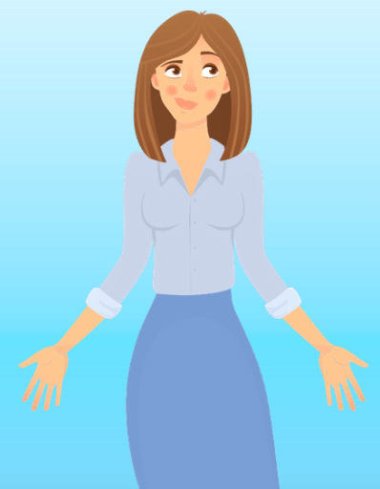
Sut mae dweud…?
How do you say…?
gwaith
cadair
ai
gwair
llygaid

Slide 29
Sut mae dweud…?
How do you say…?
llaeth
pennaeth
ae
chwaer
gwasanaeth

Slide 30
Sut mae dweud…?
How do you say…?
aur
haul
au
golau
llyfrau

Slide 31
Sut mae dweud…?
How do you say…?
awr
llawr
aw
caws
bawd

Slide 32
Sut mae dweud…?
How do you say…?
eich
teithio
ei
neidio
eiliad

Slide 33
Sut mae dweud…?
How do you say…?
dweud
gwneud
eu
goleudy
Eurwen

Slide 34
Sut mae dweud…?
How do you say…?
cloi
rhoi
oi
troi
lloi

Slide 35
Sut mae dweud…?
How do you say…?
oer
oed
oe
coed
coeden

Slide 36
Sut mae dweud…?
How do you say…?
cyffrous
ou
clou

Slide 37
Sut mae dweud…?
How do you say…?
clown
brown
ow
rhowch
trowch

Slide 38
Sut mae dweud…?
How do you say…?
hwyl
llwy
wy
llwynog
bwyta

Slide 39

Pwyslais
Emphasis
Yn y Gymraeg mae’r pwyslais, fel arfer, ar y sillaf olaf ond un.
In Welsh, the emphasis is almost always on the last but one syllable.
NIa
fi
YSgol
DOSbarth
BETHan
ysgrifENNu
PAPur

Slide 40

Ti / Chi
You
ti = informal, singular, someone you know well
(a friend, relative or learner)
chi = plural (when addressing a class or group of learners)
neu (or)
chi = formal, someone of authority, someone you
don’t know well (parent, Head, or visitor to school)
Cofiwch! Remember!
Yn Gymraeg, there are 3 ways of saying ‘you’

Slide 41
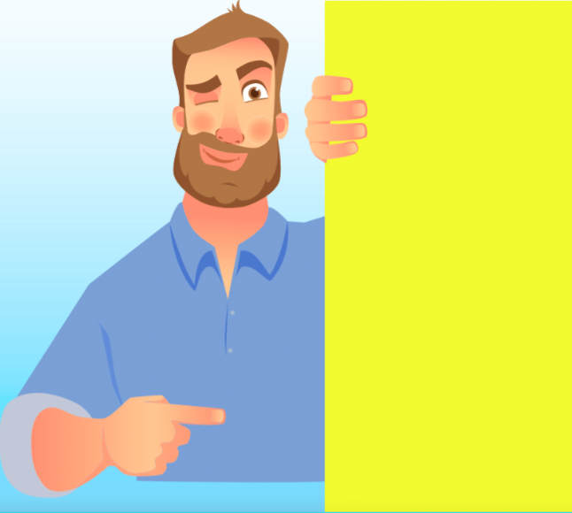
Y Treiglad Meddal
The Soft Mutation
p > b
t > d
c > g
b > f
d > dd
g > -
m > f
ll > l
rh > r
Mae treiglad meddal ar ôl cyfarchiad.
(soft mutation after a greeting)
Helo, blant!
Bore da, bawb!
Mae ansoddeiriau’n treiglo’n feddal ar ôl ‘yn’.
(adjectives mutate softly after ‘yn’)
Dw i’n fendigedig.
Dw i’n _weddol.

Slide 42
Croesawu’r Dysgwyr
Welcoming Learners

Slide 43

Sgyrsiau syml
Simple conversations
Pa eiriau sydd ar goll? Llenwch y bylchau cyn clicio ar yr atebion.
Oeddech chi’n gywir?
Which words are missing? Fill in the gaps before clicking to see the answers. Were you correct?
Athro: | Bore da, ________. (children)
Plant: | Bore da, Syr.
Athro: | Sut _______ chi heddiw?
Plant: | Da _______, diolch.
Athro: | Bore da, blant.
Plant: | Bore da, Syr.
Athro: | Sut rydych chi heddiw?
Plant: | Da iawn, diolch.
Cliciwch am yr ateb!
Athrawes: | Bore da, __________. (boys)
Plant: | Bore da, Miss.
Athrawes: | Sut rydych chi ______? (today)
Plant: | Bendigedig, diolch.
Athrawes: | Bore da, fechgyn.
Plant: | Bore da, Miss.
Athrawes: | Sut rydych chi heddiw?
Plant: | Bendigedig, diolch.
Cliciwch am yr ateb!
Nawr eich tro chi! Ysgrifennwch sgwrs syml.
Now your turn!
Write a simple conversation.
Athrawes: | ____________ da, ferched.
Plant: | Prynhawn da, Miss.
Athrawes: | Sut rydych chi heddiw?
Plant: | Gwych, _________.
Athrawes: | Prynhawn da, ferched.
Plant: | Prynhawn da, Miss.
Athrawes: | Sut rydych chi heddiw?
Plant: | Gwych, diolch.
Cliciwch am yr ateb!

Slide 44
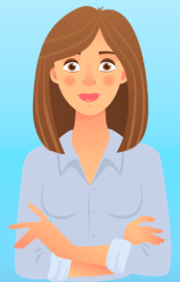
Athro: | Bore da, blant.
Plant: | Bore da, Syr.
Athro: | Sut rydych chi heddiw?
Plant: | Da iawn, diolch.
Athrawes: | Bore da, fechgyn.
Plant: | Bore da, Miss.
Athrawes: | Sut rydych chi heddiw?
Plant: | Bendigedig, diolch.
Ymarferwch gyda phartner.
Practice with a partner.
Athrawes: | Prynhawn da, ferched.
Plant: | Prynhawn da, Miss.
Athrawes: | Sut rydych chi heddiw?
Plant: | Gwych, diolch.

Slide 45
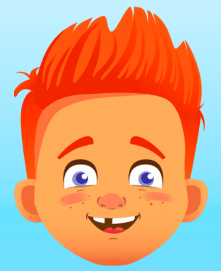
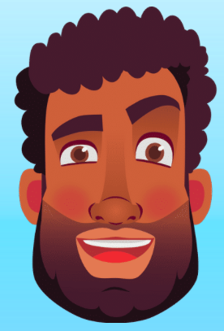
Pwy wyt ti?
Pwy ydych chi?
Who are you?
Beth ydy dy enw di?
Beth ydy’ch enw chi?
What is your name?
Tom dw i.
Tom ydw i.
Mr Davies dw i.
Mr Davies ydw i.
Dosbarth Derbyn ydyn ni.

Slide 46
Ble rwyt ti’n byw?
Ble rydych chi’n byw?
Where do you live?
Y Treiglad Trwynol
The Nasal Mutation
p > mh
t > nh
c > ngh
b > m
d > n
g > ng
Rydw i’n byw…
Pontardawe >
Tonypandy >
Caerdydd >
Blaendulais >
Dinbych >
Glanaman >
ym Mhontardawe
yn Nhonypandy
yng Nghaerdydd
ym Mlaendulais
yn Ninbych
yng Nglanaman
Cofiwch!
Mae treiglad trwynol ar ôl ‘yn’.
(nasal mutation after ‘yn’)

Slide 47
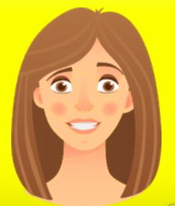
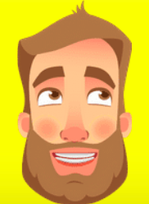
Gwaith pâr
Pair work
Partner A
Partner B
Rhydaman
Gorseinon
Crymych
Port Talbot
Bedwas
Cydweli
Merthyr Tudful
Pontardawe
Tregaron
Caerffili
Caerfyrddin
Aberystwyth
Tyddewi
Dinbych
Powys
Bangor
Glanaman
Llanelli
Pontypridd
Caerdydd
Partner A:
Dwedwch enw lle, e.e. “Caerfyrddin”.
Partner B:
Dwedwch, “Rydw i’n byw yn / ym / yng …”, e.e. “Rydw i’n byw yng Nghaerfyddin.”
Yna, newidiwch rôl.

Slide 48

Ysgrifennwch dair brawddeg:
eich enw chi
sut rydych chi’n teimlo
ble rydych chi’n byw
Write 3 sentences about yourself:
your name
how you are feeling
where you live
Eich tro chi!
You turn!

Slide 49


Good morning, everyone!
Where do you live? (plural)
Who are you?
I am very good, thanks.
I am tired.
SPIN
Well done, everyone!
I am great!
I live in Carmarthen.
I am Mrs Jones.
How are you today?
Good afternoon, girls!
Where do you live?
tekhnologic
Notes:
12 Segments

Slide 50

Da iawn chi!
Hwyl fawr!

