Slide 1
Types of Court Government
What makes Civilisation?

Slide 2
Frankfort 1944, 3, 12. = Llewellyn-Jones 2013, 19
“The ancient Near East considered kingship the very basis of civilization. Only savages could live without a king. Security, peace, and justice could not prevail without a ruler to champion them. Whatever was significant was embedded in the life of the cosmos, and it was precisely the king’s function to maintain the harmony of that integration. . . . For the truth about their king affected their lives in every (even the most personal) aspect, since through the king the harmony between human existence and the supernatural order was maintained.”

Slide 3
Monarchy
Constitutional Monarchy
Absolutist Monarchy
Monarchy Limited by a constitution (written or unwritten)
Does not set policy or choose leaders
‘reigns but doesn’t rule’
(e.g. Britain)
Theoretically unrestricted political power
Can have subordinate political entities, but serve at whim of monarch.
(e.g. Louis XIV ; ‘l’état c’est moi’)

Slide 4
Hereditary monarchy
'How do hereditary monarchies of the patrimonial type reproduce themselves from one ruler to the next, often over a period of centuries? (Spawforth 2007, 5 after Elias 1983)

Slide 5
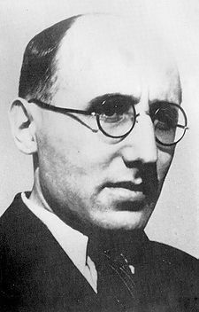
Norbert Elias and the study of courts
Born in Breslau in Prussia (1897)
Fought for German Army in WWI
Joined German Zionist movement (PhD in Philosophy 1922)
Joins Mannheim at Frankfurt in his sociological institute (to work on his habilitation Der höfische Mensch completed in 1933)
1933 flees to Paris
1935 to the UK (1939 LSE -> 1941 Cambridge -> 1954 Leicester in Sociology retired in 1962)
1969: Die höfische Gesellschaft. Untersuchungen zur Soziologie des Königtums und der höfischen Aristokratie (based on the 1933 habilitation). Neuwied/Berlin: Luchterhand. (Published in English translation by Edmund Jephcott as The Court Society, Oxford: Blackwell, 1983).

Slide 6
Elias Thesis (based on the court of Louix xiv)
The royal court served as a rational power game
Nobles could be virtual prisoners – unable to escape court without paying serious penalty
The people around the court were in fact people
The social pressures of the court shaped the people and the processes

Slide 7
Elite
Monarch
Court

Slide 8
Revisionist views of Elias
Overstated views on the absolutist nature of the court of Louix XIV
Underplays the role of mutual negotiation
Less exciting now – ‘trappings’ and ‘substance’ of monarchy
Use of sociological concepts (e.g. conspicuous consumption and status) (now the normal approach)

Slide 9
Ancient court societies
Assyria
Babylonia
Egypt
Homeric Greece
Macedon
Successor Kingdoms
Early Rome
Imperial Rome
China
India

Slide 10
Levantine Courts
Neo-Assyrian Court
Egyptian Court
Neo-Elamite Court
Achaemenid Court
Courts in Asia Minor Anatolia
Macedonian Court
Alexander’s +
Seleukid/Ptolemaic Courts
Chinese Court
Sasanian Court
Roman and Byzantine Courts

Slide 11
Types of Sources
Literary
Epigraphic
Papyrological
Iconographic
Numismatic
Material remains

Slide 12
Example of Literary sources
When the army assembled at Apamea and a mutiny broke out among the soldiers on account of some arrears of pay that were owing to them, observing that the king was very nervous and alarmed at such a movement taking place at so critical a time, Hermeias engaged to discharge the whole sum due, if the king would consent that Epigenes should take no part in the campaign; as he said there would be no chance otherwise of anything being properly managed in the army in view of the bitterness of the quarrel between them. The king was displeased at this request, and would fain have refused, being anxious for Epigenes to accompany him on the campaign owing to his military capacity, but beset as he was and preoccupied through Hermeias' nefarious machinations by court etiquette and by a host of guards and attendants, he was not his own master, so that he gave way and acceded to the request. When Epigenes retired, as he was bidden, into civil life, the members of the council were intimidated by this consequence of Hermeias' jealousy, but the troops upon their demands being met experienced a revulsion of feeling and grew well disposed to the man who had procured payment of their pay.
Polybius 5.50

Slide 13
Epigraphic
Whereas in the beginning King Antiochos, son of King
Seleukos, having succeeded to the kingdom and conducting a
noble and honorable policy, sought to restore the cities
throughout the Seleukis, which were beset by difficult
circumstances because of those rebelling against the state, to
peace and their former prosperity, and (sought), by punishing
as was right those who attacked the state, to recover
his ancestral rule; for which reason, both pursuing a laudable
and just ambition and having not only his Friends and
the forces as his supporters in contending for the state, but
(having) also the divine as his well-disposed helper, he restored
the cities to peace and the kingdom to its previous
Condition;
…
with good fortune, be it decreed by the council and the
people that the priestess, the hieronomoi and the prytaneis
pray to Athena of Ilion together with the envoys that the
arrival of the king and his sister the queen, the Friends, and
the forces should have been for the best, and that all other
good things should come about for the king and the queen,
and that the state and their kingdom should last, increasing
as they themselves desire.
OGIS 219 = I.Ilion 32

Slide 14
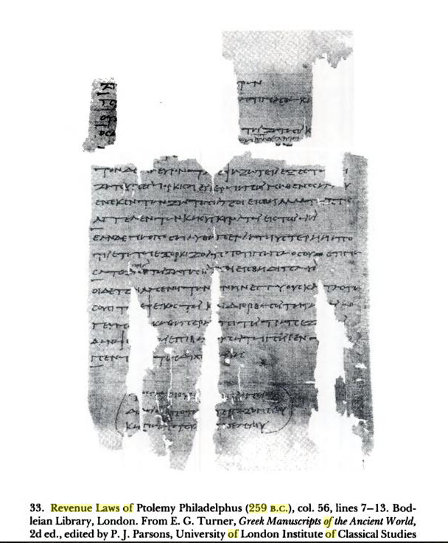

Slide 15
PEnt 26 = Select Papyri, 2.268
(Loeb)
To King Ptolemaeus greeting from Ctesicles. I am being wronged by Dionysius and my daughter Nicē. For though I had nurtured her, being my own daughter, and educated her and brought her up to womanhood, when I was stricken with bodily infirmity and my eyesight enfeebled she would not furnish me with any of the necessaries of life. And when I wished to obtain justice from her in Alexandria, she begged my pardon and in year 18 she gave me in the temple of Arsinoe Actia a written oath by the king that she would pay me twenty drachmae every month by means of her own bodily labour ; if she failed to do so or transgressed any of the terms of her bond, she was to forfeit to me 500 drachmae on pain of incurring the consequences of the oath. Now, however, corrupted by Dionysius, who is a comedian, she is not keeping any of her engagements to me, in contempt of my old age and my present infirmity. I beg you therefore, O king, not to suffer me to be wronged by my daughter and Dionysius the comedian who has corrupted her, but to order Diophanes the strategus to summon them and hear our case ; and if my words are true, let Diophanes deal with her corrupter as seems good to him and compel my daughter Nicē to yield me my rights. . . . For by this means I shall no longer be wronged, but having sought your protection, O king, I shall obtain justice. {Docketed} We have delegated . . . {Endorsed} Year 1, Gorpiaeus 30 Tubi 13. Ctesicles against Dionysius and Nicē his daughter concerning a written oath.

Slide 16
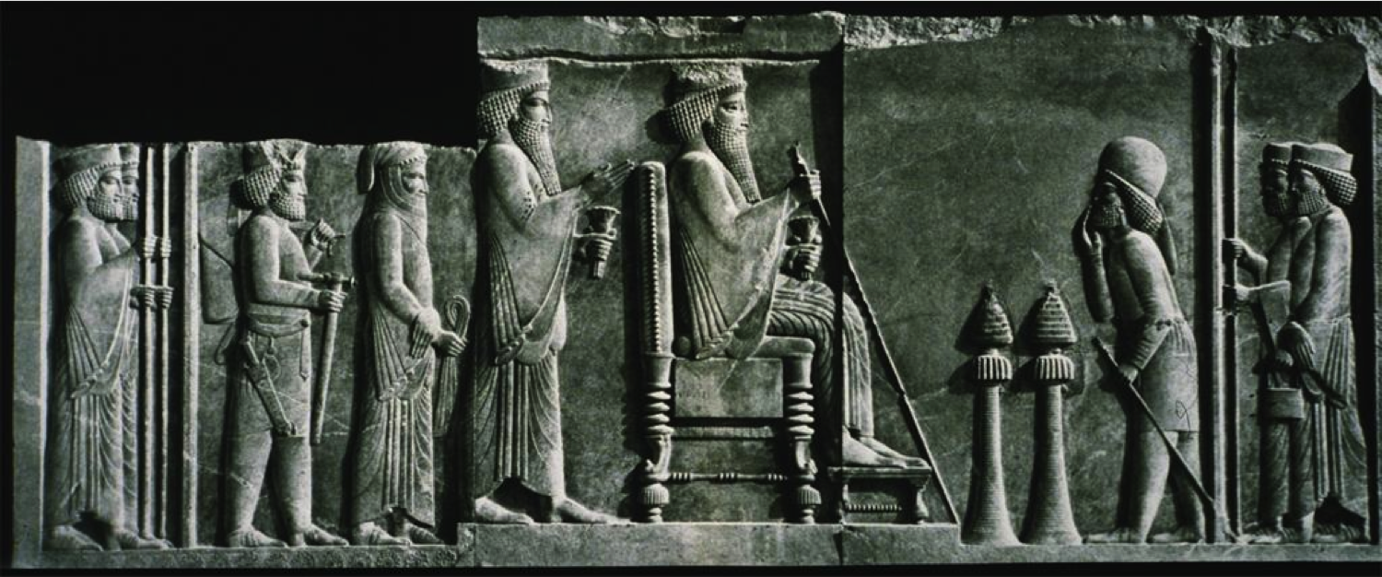
Persepolis palace relief

Slide 17
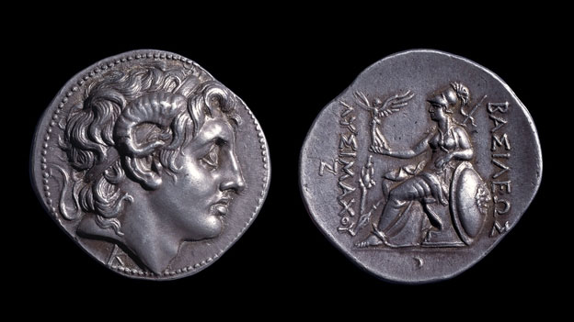
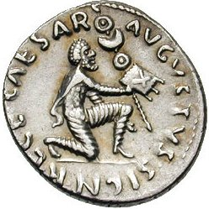

Slide 18
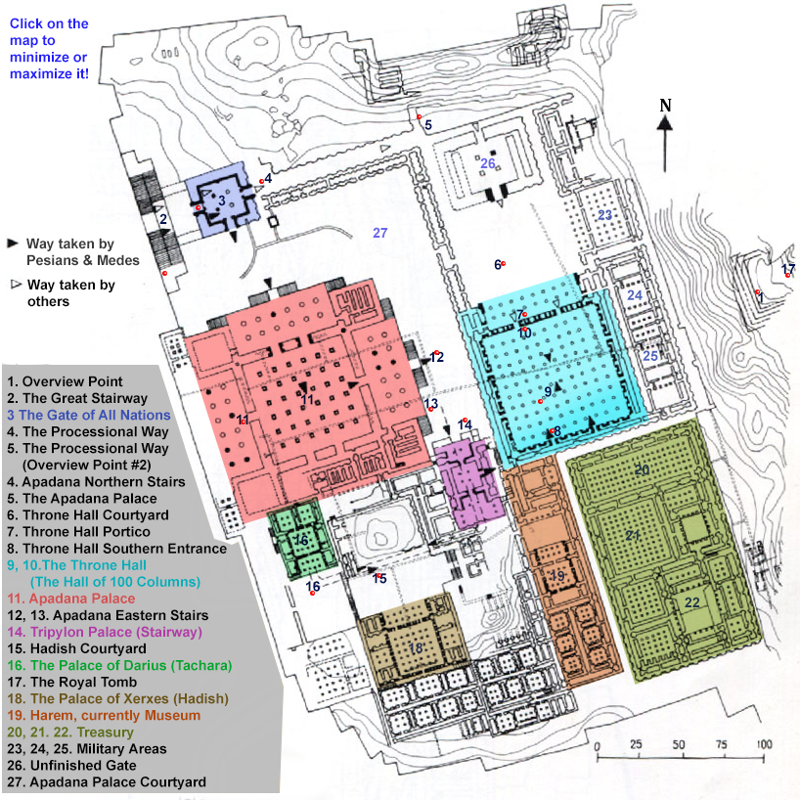

Slide 19
People at court

Slide 20
philia
Philia = ritualised friendship
xenia = ‘guest-friendship’

Slide 21
Philia
‘a mutually intimate, loyal and loving bond between two or a few persons that is understood not derive primarily from membership in a group normally marked by native solidarity, such as family, tribe, or other such ties. Friendship is thus what anthropologists call an achieved rather than an ascribed relationship, the latter being based on status whereas the former is in principle independent of a prior formal connection such as kingship.’ - Konstan 1997: 1.
Are there differences between ‘friends of the king’ and normal ‘friendship’
obligations of service v. obligations of friendship

Slide 22
Members of the court
Royal philoi
  Often come from beyond the empire – (according to Herman linked to philia and xenia networks)
    prōtoi philoi (first friends)
    timōmenoi philoi (honoured friends)
    prōtoi kai prōtimōmenoi philoi (first and highly honoured friends)
suntrophoi – people raised with the king
Kolakes (flatterers)
Parasitoi (parasites)
Tropheus (master of the pages)
Archiatros (Chief physician)
archigrammateus (chief secretary)

Slide 23
Binding members of the court
Philia and xenia relationships
Ritualised gift exchange
Fictive kinship: titles such as sungeneis or adelphoi (relatives or brothers)
‘philia at the royal courts had two functions. First, it was instrumental in creating unity by stressing that the philoi immediately surrounding the king belonged to the same status group and were ideally each other’s peers. Second, it created a sense of accord which in turn facilitated collective action.’ – Strootman 2014: 149

Slide 24
Herman, G 1997: 208
Many of the courtiers…were recruited through the instrumentality of xenia, an ancient form of fictive kinship… The Hellenistic rulers… availed themselves of pre-existing xenia networks to draw new allies into their orbit. These networks account not only for the preponderance of Greeks among the newly recruited Hellenistic court members, but also for the increasing similarities between the three courts. The Hellenistic court societies, then, did not operate in vacuo. Instead, they were part of a wider, interactive, international society of ritualized friends.

Slide 25
Sunedrion = royal council
King and his most powerful philoi
(e.g. for Alexander it included the hetairoi)
In theory, membership by the choice of the king
Present a united decision making front
Problem and importance of parrhēsia (freedom of speech)

Slide 26
Interacting at court
Banquets and symposia
Hunting
Royal weddings

Slide 27
Ath. 539e-f = Phylarchos FGrh 81 F 41
And Phylarchus, in the twenty-third book of his History [ Fr_41]… was far less than the daily sums squandered by Alexander; for he had a tent capable of containing a hundred couches, and fifty golden pillars supported it. And over it were spread golden canopies wrought with the most superb and costly embroidery, to shade all the upper part of it. And first of all, five hundred Persian Melophori stood all round the inside of it, clad in robes of purple and apple-green; and besides them there were bowmen to the number of a thousand, some clad in garments of a fiery red, and others in purple; and many of them had blue cloaks. And in front of them stood five hundred Macedonian Argyraspides; and in the middle of the tent was placed a golden chair, on which Alexander used to sit and transact business, his body-guards standing all around. And on the outside, and round the tent, was a troop of elephants regularly equipped, and a thousand Macedonians, in Macedonian uniform; and then ten thousand Persians: and the number of those who wore purple amounted to five hundred, to whom Alexander gave this clothing for them to wear. And though he had such a numerous retinue of friends and servants, still no one dared to approach Alexander of his own accord; so great was his dignity and the veneration with which they regarded him. And at that time Alexander wrote letters to the cities in Ionia, and to the Chians first of all, to send him a quantity of purple; [540] for he wished all his companions to wear purple robes.

Slide 28
Receiving ambassadors
Waiting (lots of waiting)
Entertainment and feasting
Acceptance of a gift by the king implied granting of (part of) the accompanying request

