Slide 1

I Acknowledge the use of ChatGPT (https://chatgpt.com/) on 22 October 2023 to further my ideas and how I’m going to present my presentation.
1. Give me ideas on how I can tackle my presentation
2. Give example
I confirm that I have not presented any AI generated text as my own work. I confirm I have copies of my drafts, notes, and other resources I used before, and after the use of
AI tools which I may be asked to provide in evidence.

Slide 2
Developing Restaurant Management
Name: Mark Jeffrey Pascual
Student number: 2229176
Module: Developing Restaurant Management BMGM5004
Lecturer: Antoinette Milne

Slide 3


Restaurant management often emerges as a secondary aspect for many owner-managers who initially enter the food service industry to fulfil a lifelong dream of owning their own business or being their own boss (Scalon, 1993).
A key responsibility of a restaurant manager is to cultivate a positive and productive work environment. Effective leadership is crucial in this regard, as it involves setting high standards for customer service, fostering an inclusive and positive work culture, and promoting teamwork and communication among employees (Bruce, 2023).
According to Cooper (2004) the management style of restaurant managers has needed to evolve as their workforce has become increasingly dispersed. A management style encompasses the methods and approaches used to achieve the goals of a project, team, or company (Miranda, 2024).
Effective management is not just about motivating employees to improve performance, but also about treating them with respect and ensuring their happiness. Ultimately, there is no single correct management style, as it varies based on individual perspectives (LSBF Staff, 2018).
Introduction to Restaurant
Management
Stock image
Notes:
By addressing these responsibilities and challenges, restaurant managers can create a thriving and successful operation.

Slide 4
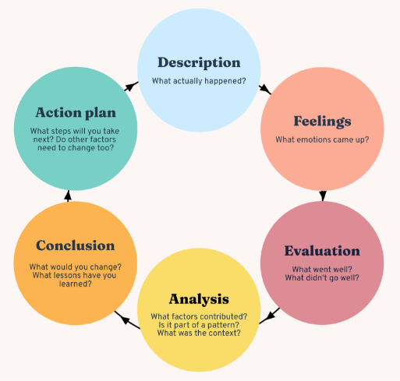
Gibb’s Reflective Model
On this presentation I will be using Gibbs’ reflective model. It emphasises the importance of reflecting on experiences to gain insights, learn from mistakes, and improve future actions (McLeod and Saul, 2024: Bitesize Learning, n.d: The University of Edinburgh, 2020)

Slide 5

All organisations consider communication is vital for survival, as a business cannot exist without it. They engage in a wide range of communication activities, with a primary focus on ensuring effectiveness (Fielding, 2006).
In my experience, understanding the hierarchy in a restaurant is crucial (Fine dining lovers, 2017). It clarifies who is responsible and accountable for its operation. Restaurant managers oversee the overall day-to-day running of the establishment, while the kitchen manager, typically the executive chef or head chef, is responsible for managing the kitchen.
Element 1: Abilities to liase and communicate with team members throughout the whole operation, showing initiative.
Stock image

Slide 6
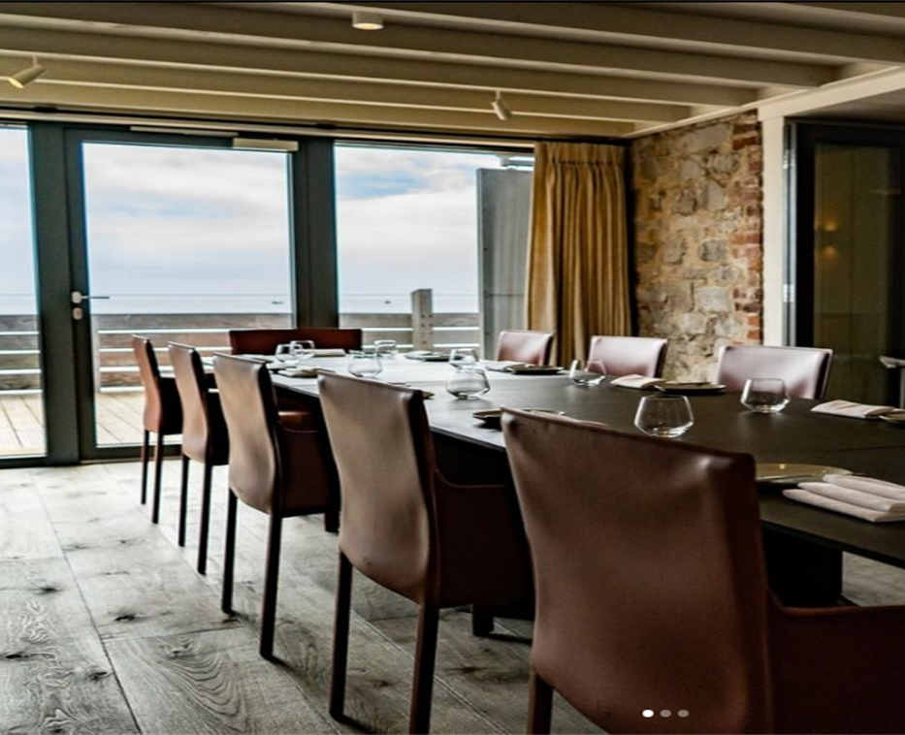


During my placement at Beach House, the Chef de Partie (CDP) showed me how to make the canapés, but I wasn't satisfied with the results. Despite my concerns, he encouraged me to continue. When I sent the canapés to the pass during dinner service, the Head Chef expressed his dissatisfaction. I understand that working in a Michelin-star restaurant requires a high level of attention to detail. Therefore, whenever I feel something isn’t up to standard and the CDP disagrees, I take it to the Head Chef to ensure it is correct. Although it can be uncomfortable at times, I believe it’s the right course of action.
This hierarchy becomes even more evident when we consider the communication patterns of the scene (Diedrich, 2011). It serves as a clear communication pathway, indicating where to report concerns and who is responsible for taking action.

Slide 7

Time stress, spatial separation, and uncertainty, along with varying levels of task interdependency, can significantly reshape teamwork dynamics, leading to more complex decision-making processes beyond traditional tasks. (Cohen and Thompson,2001)
In my time at Beach House, the pressure of running own station, responsibility, taking initiative and decision making is a skills that will develop over time.
Element 2: Take initiative in resolving a potential
challenge that could have adversely affected the operation.

Slide 8

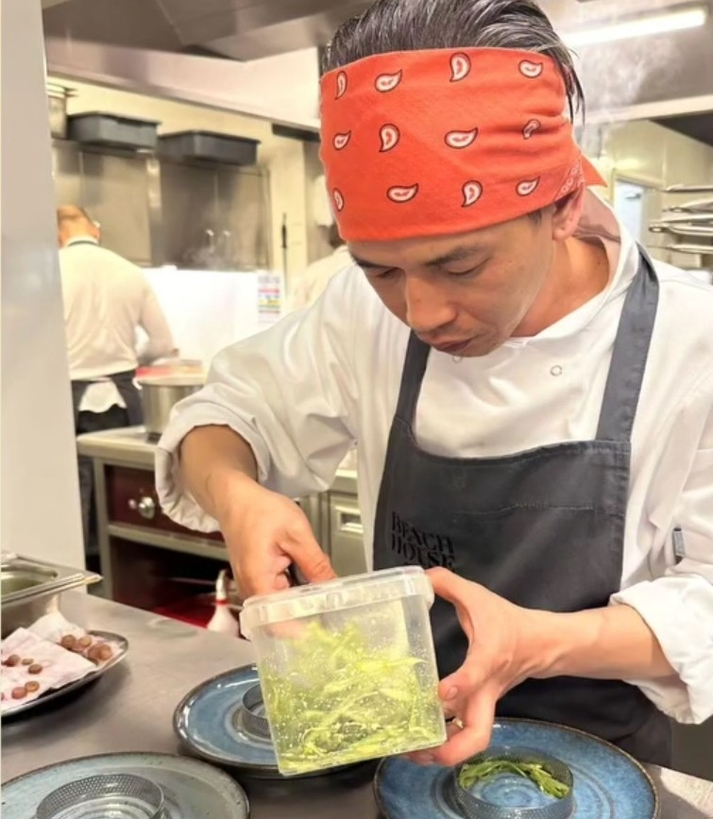
I had the opportunity to run a specific station, and there was a request for a vegetarian option that I didn’t know how to prepare. I took the initiative to ask one of the Chef de Parties (CDPs) for guidance, however they were too busy to help me, so I attempted to figure it out on my own. Unfortunately, my choice of flavour combinations didn’t turn out well, and the Chef asked me to redo it, which resulted to delays in service. In the future, I need to ensure I have the correct information before proceeding, and I will proactively ask about any dietary requirements for the service ahead of time. This experience left me feeling unsettled, and I want to avoid going through it again.
According to Ford, et.al (1989) time pressure is just one of several contextual factors that affect the cognitive strategies involved in decision-making. Other factors include the significance and complexity of the decision, as well as the degree of accountability decision-makers have for the outcomes (Payne, et. al, 1993).

Slide 9

Element 3: Utilising Restaurant
Management Systems Effectively:
Stock ordering Systems
According to Francis (2023), managing kitchen inventory is essential for running a successful restaurant. A well-organised inventory not only helps prevent waste but also ensures that the kitchen is consistently stocked with the necessary ingredients. Effective inventory management helps control costs by avoiding overstocking or understocking supplies. Additionally, it maintains consistency in the quality of dishes, as chefs can readily access the required ingredients without delay or confusion (Deveshwar & Dhwal, 2013).
Every Saturday, I prepare a list of what I need for the following week. I make sure to closely monitor our stock levels to reduce waste by making my orders as accurate as possible. I aim to order just enough for the week, and if supplies run low, I place additional orders midweek.
One time, I ran out of stock due to an inaccurate order, so I had to rush to the shops to find the items I needed, or sometimes the chefs had to go foraging. This caused delays in our preparation. Now, I make sure to double-check my orders to avoid such issues.

Slide 10

Briefing before Service
In any team-oriented organisation, effective communication is crucial for successful performance. Each communication method serves a specific purpose and format, with careful attention and focus given to every customer (Maier, 2012).
During my placement at Beach House, we had a briefing before every service to ensure everything was in order, including details about the guests, special dietary requirements, and any special occasions. This helped ensure the restaurant ran smoothly.
These briefings are an excellent way to facilitate clear communication. I plan to adopt this approach in my future endeavours, as it promotes effective communication and ensures smooth operations.
Shutterstock.com

Slide 11
Conclusion
I gained valuable insights into restaurant management, particularly the importance of communication, hierarchy, and decision-making under pressure. Daily service briefings were key to ensuring smooth operations and effective teamwork, while attention to detail and proactive problem-solving. Running my own station taught me the significance of responsibility, taking initiative, and managing tasks efficiently. Learning to navigate the hierarchy, consult with senior chefs, and adapt quickly under time constraints highlighted the need for strong leadership and communication skills—critical aspects that I aim to apply in future management roles.

Slide 12
References:
Bite Size Learning, (n.d). The Gibbs’ Reflective Cycle stages. Available at: https://www.bitesizelearning.co.uk/resources/gibbs-reflective-cycle-explained-diagram-examples. (Access: 23 October 2024)
Bruce, B. (2023). The Importance of Strong Leadership in Restaurant Manager. Available at: https://www.linkedin.com/pulse/importance-strong-leadership-restaurant-manager-brian-bruce (Access: 22 October 2024)
Cohen, M.S. and Thompson, B.B., (2001). Training teams to take initiative: Critical thinking in novel situations. Advances in human performance and cognitive engineering research, 1, pp.251-292.
Cooper, C.L. ed., (2004). Leadership and management in the 21st century: Business challenges of the future. OUP Oxford.
Diedrich, M.I., (2011). Kitchen Hierarchies. Beyond Uncle Tom’s Cabin: Essays on the Writing of Harriet Beecher Stowe, pp.109-24.
Fielding, M. (2006). Effective communication in organisations. Juta and Company Ltd.
Fine Dining Lovers (2017). Kitchen Hierarchy Explained. Available at: https://www.finedininglovers.com/article/kitchen-hierarchy-explained. (Access:22 October 2024)
Ford, J. K., Schmitt, N., Scheitman, S. L., Hults, B. M., & Doherty, M. L. (1989). Processing tracing methods: Contributions, problems and neglected research questions. Organizational Behavior and Human Decision Processes, 43(1), 75– 117. Available at: https://doi.org/10.1016/0749-5978(89)90059-9 (Access: 23 October 2024)
Francis (2023). How to Manage Kitchen Restaurant Kitchen Inventory: The Secrets Revealed. Available at: https://restaurantmanagement.co.uk/manage-kitchen-inventory/ (Access: 23 October 2024)
Francis (2024). Restaurant Kitchen Management: Be The Best In Your Field. Available at: https://restaurantmanagement.co.uk/restaurant-kitchen-management-a-guide-to-being-the-best-in-your-field/#Conclusion ( Access: 22 October 2024)
LSBF Staff (2018). The Golden Rules of Effective Management. Available at: https://www.lsbf.org.uk/blog/opinion-features/the-golden-rules-of-effective-management. (Access: 23 October 2024)
Maier, T, (2012). Hospitality Leadership Lessons in French Gastronomy The Story of guy and Franck Savoy. Author House.

Slide 13
References:
Miranda, D. (2024). 10 Management Style of Effective Leaders. Available at: https://www.forbes.com/advisor/business/management-styles/ . (Access: 22 October 2024)
Mc Leod, S. (2024). Gibbs Reflective Cycle. Available at: https://www.simplypsychology.org/gibbs-reflective-cycle.html. (Access 23 October 2024)
Payne, J.W., (1993). The adaptive decision maker. Cambridge University Press.
Scanlon, N. (1993). Restaurant Management. John Wiley & Sons.
The University of Edinburgh, (n.d). Gibbs’ Reflective Cycle. Available at: https://www.ed.ac.uk/reflection/reflectors-toolkit/reflecting-on-experience/gibbs-reflective-cycle. (Access: 23 October 2024)

