Slide 1
Overloading, Access Modification and Inheritance

Slide 2
Refresh
What is the variable naming convention should be used ?
camelCase
What is a class ?
A template from which objects may be instantiated
What is a constructor ?
The first “pseudo-function” that is called when an object is created
What are the functions in a class called ?
Methods
What is the difference between a class and a struct ?
Structs have public access by default, classes are private by default

Slide 3
Access
Private – accessible internally by the other members of the class
Public – accessible by members of the class and by external entities
Protected – accessible by the class itself and any derived classes

Slide 4
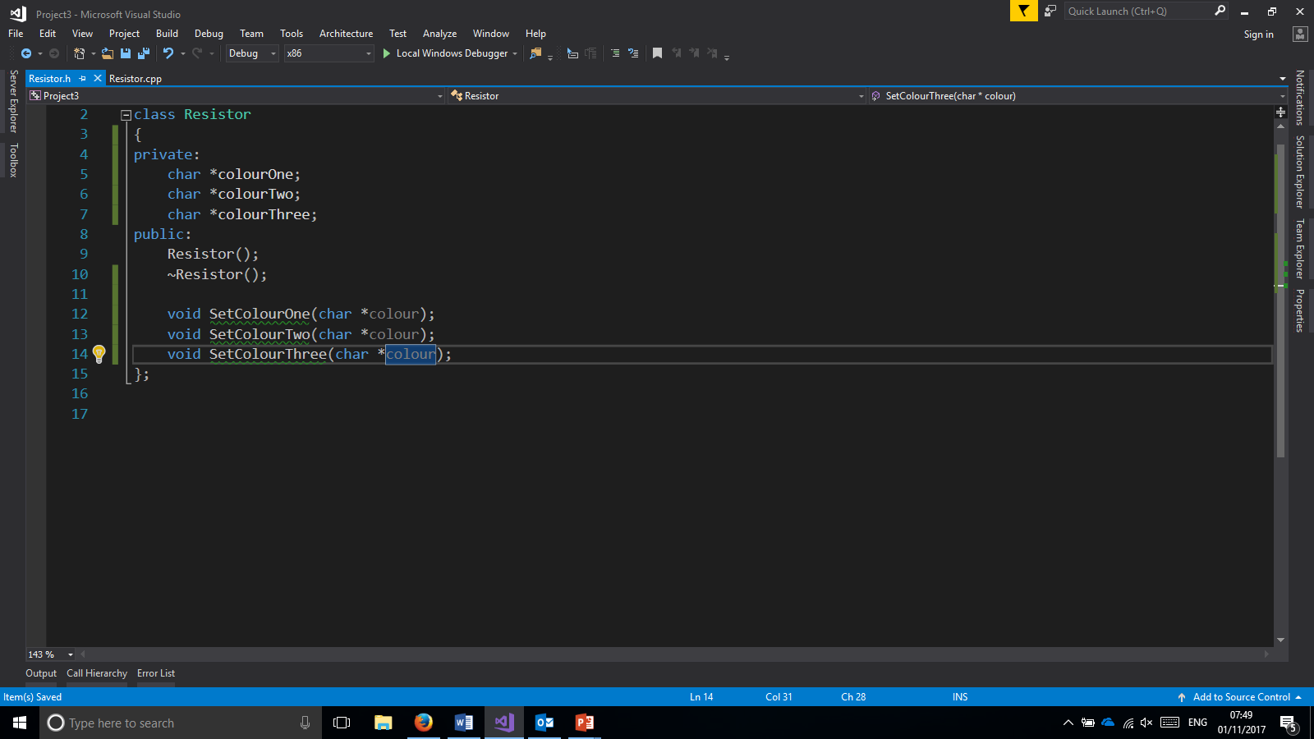
Privately Accessible
Used in tutorial
Privately accessible by the class
Each object has a its own version of these values which only it can access

Slide 5
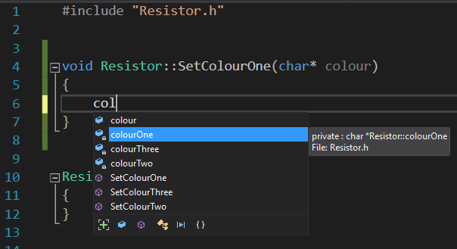
Internal Usage

Slide 6

Publicly Accessible
Previous tutorial
Accessible internally an externally
Includes constructor and destructor.

Slide 7
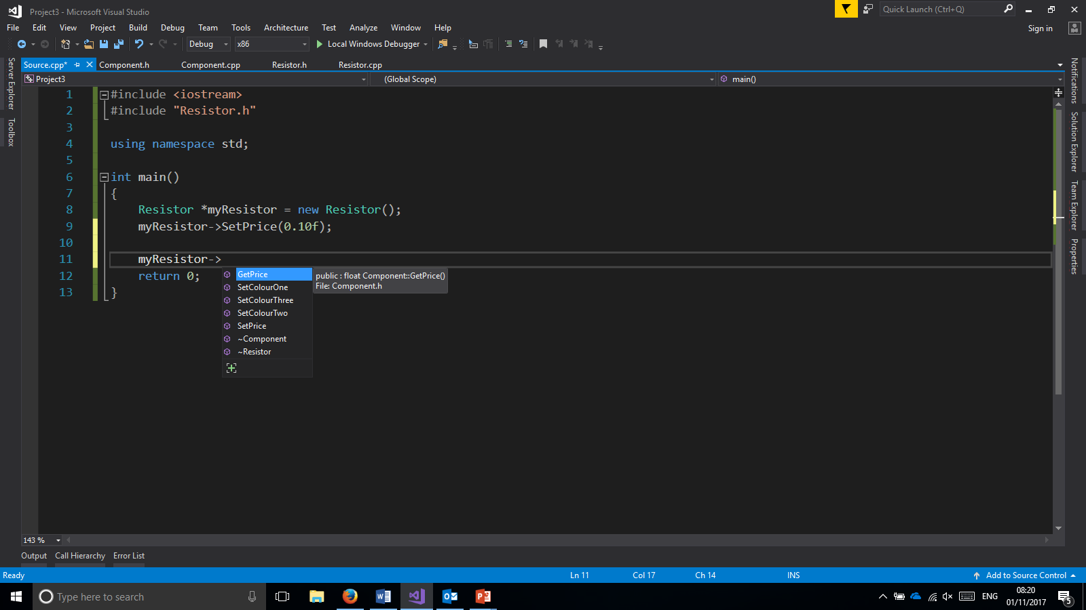
External Usage

Slide 8
Usage and Reasoning – ATMManagement.c
What attributes are needed ?
  Account_no, balance
What methods are needed ?
  RetrieveAccountInformation()
  CheckPin()
  DecrementBalance()
What should be made private ?
  Account_no, balance
What should be made public ?

Slide 9
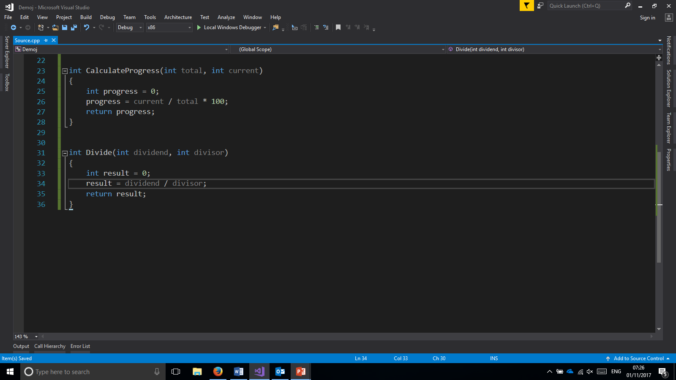
Functions
Subroutine within a program
Have a return type
Have a reference name
May have parameters (arguments)

Slide 10
Overloading
Catering for multiple typed parameter possibilities
Adding further flexibility to a function
Different inputs can require different operations

Slide 11
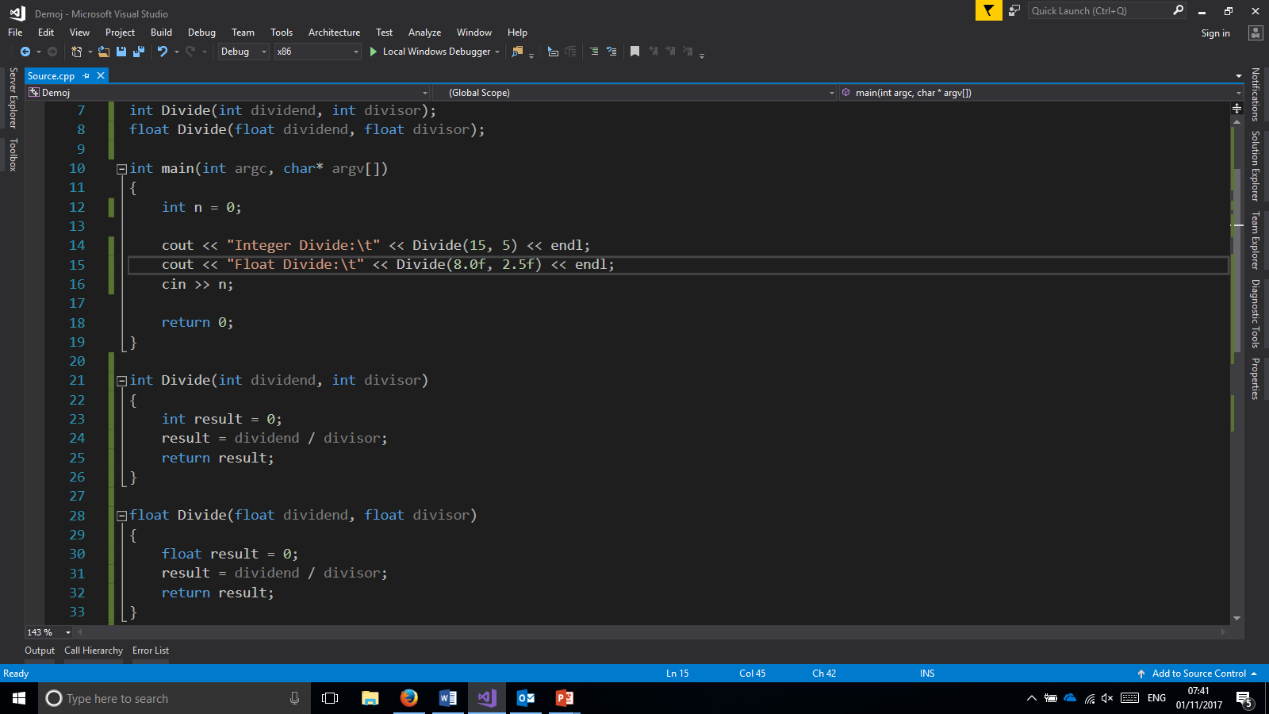
Function Overloading in Practice

Slide 12
Inheritance
Generalised class – parent class
Specialised subclasses – child classes
Used to add depth of information and for encapsulation

Slide 13
Inheritance
superclass
Subclasses

Slide 14
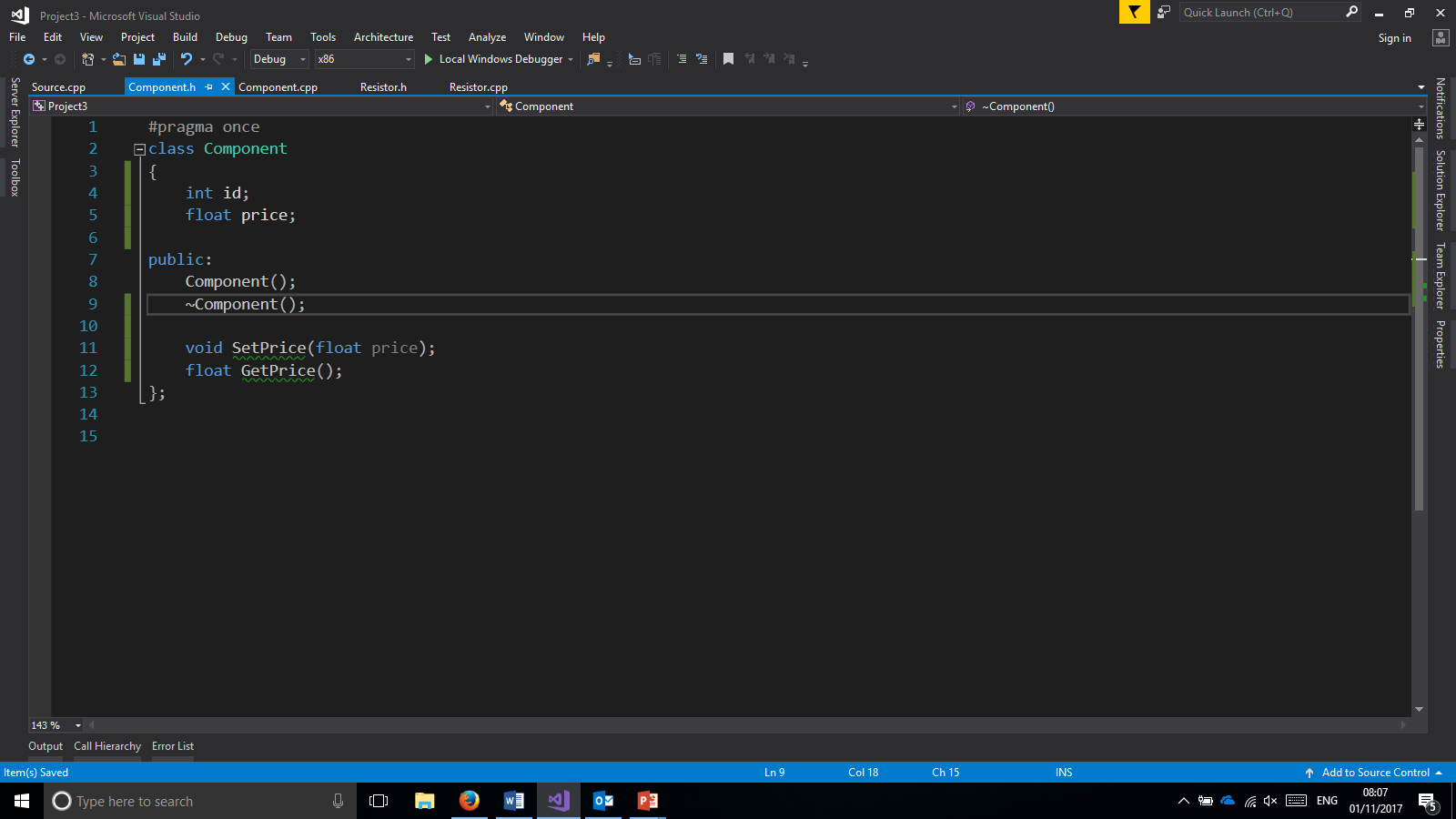
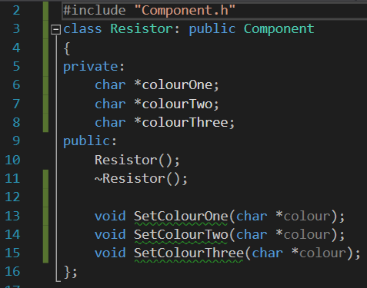
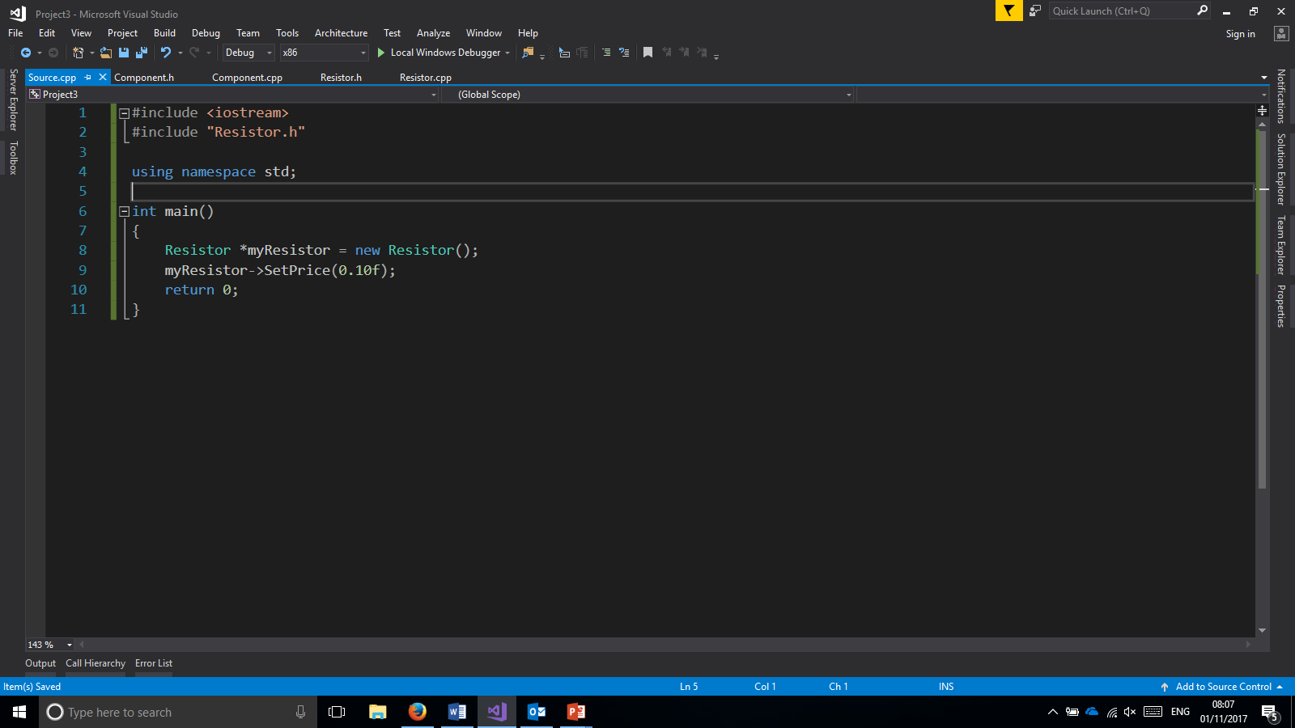
In Practice

Slide 15
In Practice Diagram
Superclass: Component
Subclass : Resistor

Slide 16
Further Notes
Inherited classes may be super classes to their own children
Those children may access all functionality and attributes to it’s root generalised class
Key principle in the use of polymorphism

Slide 17
Examples Where this could be used ?

