Slide 1
Performance Indicators in
Energy Management
By
Andrew Thorn

Slide 2
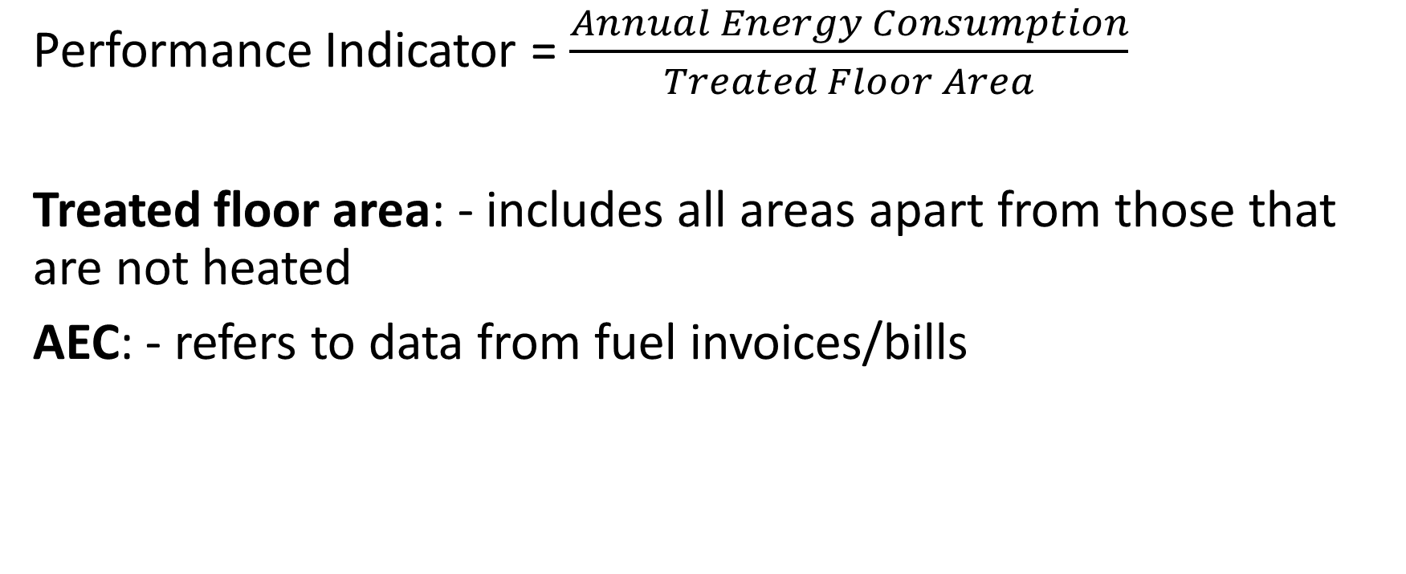
Performance Indicator
Performance Indicator = $\frac{Annual Energy Consumption}{Treated Floor Area}$
Treated floor area: - includes all areas apart from those that are not heated
AEC: - refers to data from fuel invoices/bills

Slide 3
Performance Indicators
Use fuel accounts to arrive at a performance indicator
Differences arise due to geographical location and also: -
Building size and shape
Level of engineering services
Occupancy pattern
Level of energy required for manufacturing processes

Slide 4
Standard Performance Indicators
Building type | Occupancy | PI for stated classification (GJ/m²)
 |  | Good | Satisfactory | Fair
Office Factories Warehouses Schools Shops Hotels | S/S 5 day week S/S 5/6 day week S/S 5/6 day week S/S 5 day week S/S 6 day week C 7 day week | <0.7 <0.8 <0.7 <0.7 <0.7 <1.3 | 0.7 – 0.8 0.8 – 1.0 0.7 – 0.8 0.7 – 0.8 0.7 – 0.8 1.3 – 1.5 | 0.8 – 1.0 1.0 – 1.2 0.8 – 0.9 0.8 – 1.0 0.8 – 1.0 1.5 – 1.8

Slide 5
Classification of Levels of Acceptance
Good: - Low energy consumption; indicative of careful control and good energy management procedures
Satisfactory: - Energy usage consistent with sensible operating procedures
Fair: - Barely average performance, for typical situations significant savings should be achieveable

Slide 6
Classification of Levels of Acceptance
Poor: - Energy usage is high: - for typical situations indicative of significant heat losses in winter and/or poor control of energy use
Very poor: - Energy usage is excessive- immediate action should be taken to investigate and remedy

Slide 7
Correction Factors for SPI
Item | Specification | Correction factor
Occupancy Period Engineering Services Location Size | Single shift, 7-day Week Double shift, 5- day Week Double shift, 7- day Week Continuous Air Conditioning Mechanical Ventilation Electrical Heating Scotland/Exposed Sites South-West England Rest of UK Floor area <5000m² Floor area >5000m² Floor area very large buildings | 1.2 1.3 1.4 1.4 1.4 1.3 0.8 1.1 0.9 1.0 1.0 0.95 0.9

Slide 8
Correction Factor for Energy Used
Energy consumption for process and manufacturing is assumed to consist of more than 20% of the energy consumption for building services in the preparation of the SPIs
If it exceeds this proportion an adjustment should be made to the PI for the building before a comparison is made

Slide 9
Example
A factory located near Manchester has a treated floor area of 900m² and works a six day week, single shift and has the following annual energy consumption
Space heating AEC = 800 GJ
Process and Manufacturing AEC = 350 GJ
Determine the performance indicator for the factory and compare it with the equivalent SPI

Slide 10
Solution
The proportion of energy associated with process and manufacturing is
(350/800) x 100 = 43.75% which is above the minimum of 20%
Space heating + process x 20/80
= 800 + 350 x 20/80
AEC = 888 GJ
PI for factory = AEC / Floor area
PI = 888/900 = 0.987 GJ/m²

Slide 11
Correction Factor for Air Conditioning
The factors for air conditioning and mechanical ventilation should only be applied where the floor area served by the plant is at least 60% of the total floor area
These factors should be reduced pro rata when the floor area served is less than 60%

Slide 12
Example
Determine the correction factor which must be applied to the SPI for a plant in which the floor area served by the air conditioning plant is 35%. The plant is located in Scotland and SDD is 2496

Slide 13
Notes
SPI’s quoted are based upon SDD of 2000
If the SDD in the heating season differ by more than ± 10% of the product of 2000 x location correction factor

Slide 14
Solution (1)
Revised correction factor
= Annual SDD/2000
From Table 2 correction factor for location of building is 1.1
Product of location factor and 2000 degree days is 1.1 x 2000
= 2,200
Percentage difference between this product and the annual SDD for the area is
((2496 – 2200) /2200) x 100 = 13.45

Slide 15
Solution (2)
13.45% exceeds the 10% limit
The correction factor for this location of the building will be:
Correction factor = 2496 / 2000
= 1.25

Slide 16
Correction Factor for Electric Space Heating
Example
A four-storey office block having a treated floor area of 500m per floor is located in the Plymouth area. The ground floor is air conditioned and upper floors are heated by gas fired boiler serving radiators. The occupancy pattern is single shift 7 days a week
Determine the Standard Consumption Targets for the building

Slide 17
Solution (1)
Corrction factor for the occupancy pattern is 1.2
Correction factor for the proportion of air conditioning, which is
((500 / (500 x 4)) x 100 = 25%
= (25/60) x 1.4 + (35/60) x 1.0
= 1.17
Annual SDD for Plymouth area is 1840
This is below the SDD figure of 2000 used in producing SPI
Correction factor for location is 0.9

Slide 18
Solution (2)
Product of 2000 x 0.9 is 1800
The variation is ((1840 – 1800) / 1800) x 100 = 2.2% which is below the 10% limit. Thus correction factor for location of 0.9 is used
Correction factor for building size is 1.0
Overall correction = 1.2 x 1.17 x 0.9 x 1.0 = 1.264

Slide 19
Example
A factory operating a double shift five-day week with a treated floor area of 50m x 20m and located near Birmingham has the following energy consumptions annually:
Oil fired space heating
Electric heating
Process and manufacturing
Determine the performance index for the factory and compare with the standard consumption targets

Slide 20
Solution (1)
Total energy consumption = 900 + 400 + 600 = 1900 GJ
Proportion attributed to process = (600/1900) x 100 = 32%
The energy required for process is outside the 20% limit for use with SPIs
Total energy consumption with a maximum of 20% process will be:
Space heating + process = Minimum + Maximum
1300 + 1300 x 20/8 = 1300 + 325
= 1625 GJ

Slide 21
Solution (2)
The PI for the factory will be
Annual energy consumption / floor area
= 1625/(50 x 20) = 1,625 GJ/m²
Following corrections for occupancy, engineering services and location

Slide 22
Solution (3)
Correction for occupancy pattern is 1.3
Space heating by electricity represents (400/1300) x 100 = 31% of the energy consumption for space heating
Correction for all electric space heating of 0.8 needs adjustment thus:
Correction for engineering services
= 0.31 x 0.8 + 0.69 x 1.0 = 0.94

Slide 23
Solution (4)
SDD for Birmingham is 2357 and correction for location is 1.0
The variation will be ((2357-2000)/2000) x 100 = 17.85%
This is greater than the 10% limit
The revised correction is 2357/2000 = 1.18
Correction for floor area is 1.0
Overall correction for factory is
= 1.3 x 0.94 x 1.18 x 1.0 = 1.44

Slide 24
Solution (5)
SPI | Good | Satisfactory | Fair | Poor
Factories Overall Correction SCT | 0.8 1.44 1.15 – 1.44 | 0.8 – 1.0 1.44 1.15 – 1.44 | 1.0 – 1.2 1.44 1.44 – 1.73 | 1.2 – 1.5 1.44 1.73 – 2.16
The PI for the factory was calculated as 1.625 GJ/m² This lies within the fair classification of STCs (1.44 – 1.73 which states barely average performance

Slide 25
Example
A general office in the Thames Valley works on a single shift, 5 days a week. It is serviced with a space heating system and a tempered air mechanical ventilation system
Determine the performance indicator for the building and compare it with the standard consumption target

Slide 26
Example (Data)
Annual consumption of gas 1050 GJ, annual consumption of electricity 97,300 kWh, treated floor area 1200m
There is no correction factor for location, occupancy or floor area
However, there is a correction for mechanical ventilation is 1.3

Slide 27
Solution (1)
Annual gas consumption + Annual electricity consumption
1050 + 97,300 (convert to GJ)
1050 + 350
Total energy consumption = 1,400 GJ
Performance Indicator for the building
= Annual energy consumption/ treated floor area
PI = 1400 / 1200 = 1.167 GJ/m²

Slide 28
Solution (2)
Building type | Good | Satisfactory | Fair | Poor
Office SPI Overall Correction Office SCT | <0.7 1.3 <0.91 | 0.7 – 0.8 1.3 0.91 – 1.04 | 0.8 – 1.0 1.3 1.04 – 1.3 | 1.0 – 1.2 1.3 1.3 – 1.56
A value of 1.167 compared with PI with standard consumption targets shows the building as having a fair performance

Slide 29
Solution (3)
Fuel | Carbon dioxide conversion factor (Kg CO₂ /kWh energy)
Gas Oil Coal Electricity | 0.20 0.29 0.32 0.70
Annual gas consumption in kWh
= 1050 x 278
= 291,900 kWh

Slide 30
Solution (4)
Carbon dioxide emission from burning gas
= 291,900 x 0.2 = 58,380 Kg
Carbon dioxide emission from generating electricity
= 93,700 x 0.7 = 68,110 Kg
Total annual emissions = 126,490 Kg or 126.5 tonnes
Annual emission = 126,490/1200 = 105.4 Kg/m

Slide 31
Normalised Performance Indicators
Take into account several factors that contribute to additional fuel usage

Slide 32
Steps in Calculating Normalised
Performance Indicators
Convert energy units to kWh
Find the energy used for space heating
Modify the space heating energy to account for weather
Modify the space heating energy to account for exposure
Add non-heating energy use
Hours of use factor
Convert the floor area into units of square metres
Calculated the Normalised Performance Indicator (NPI)

Slide 33
Find the Energy Used for Space Heating
Where central plant provides both space heating and domestic hot water then you will need to calculate the energy used for space heating from total fuel used by this plant
In the absence of a better estimate, a useful guide is to take 75% of the total fuel used by the combined space heating and hot water plant

Slide 34
Modify the Space Heating Energy to Account for Weather
In order that a reasonable comparison can be made with data from different years a correction factor is applied
This correction factor is derived from Degree Days information
Degree days indicate both the amount of time and the temperature below this base temperature, taken to be 15.5°C

Slide 35
Modify the Space Heating Energy to Account for Weather
As an example if, for one week the average outside air temperature was 12.5°C this would represent a severity of (15.5 – 12.5) x 7 = 21 degree days
In order to calculate the weather correction factor, the total degree days for a “standard year” are divided by the degree days for the year in which the energy data is to be considered

Slide 36
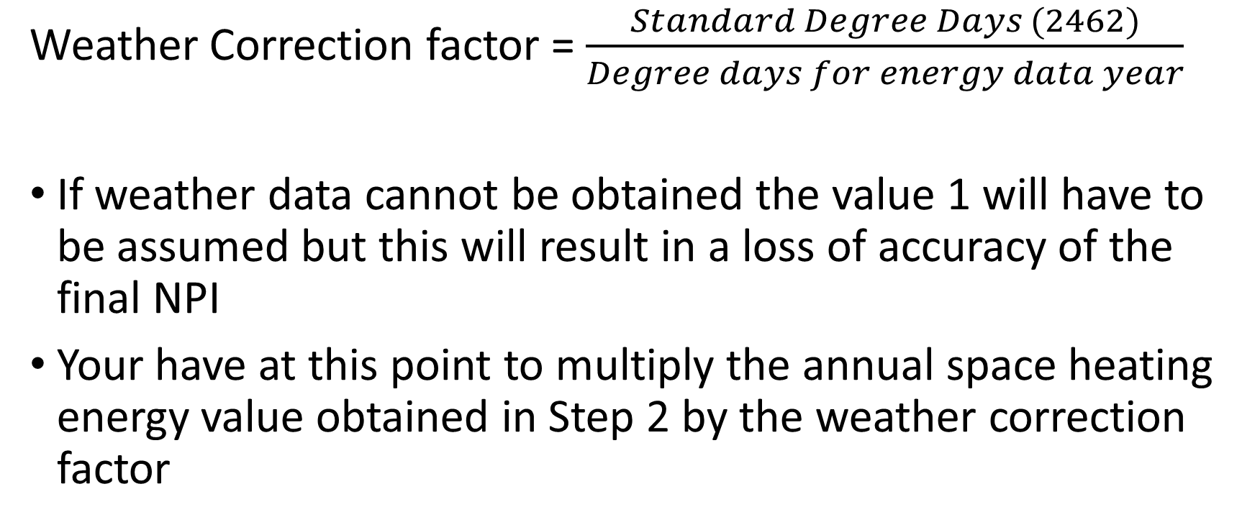
Modify the Space Heating Energy to Account for Weather
Weather Correction factor = $\frac{Standard Degree Days (2462)}{Degree days for energy data year}$
If weather data cannot be obtained the value 1 will have to be assumed but this will result in a loss of accuracy of the final NPI
Your have at this point to multiply the annual space heating energy value obtained in Step 2 by the weather correction factor

Slide 37
Modify the Space Heating Energy to Account for Exposure
Exposure Factors
Sheltered. The building is in a built-up area with other buildings of similar height or greater surrounding it. This would apply to most city centre locations | 1.1
Normal. The building is on level ground is urban and rural surroundings. It would be normal to have some trees or adjacent building | 1.0
Exposed. Coastal and hilly sites with little or no adjacent Screening | 0.9

Slide 38
Add Non-Heating Energy Use
All other energy use in the building should now be added to the corrected space heating energy obtained previously
It is not necessary to normalise non-space heating data, since it is not significantly dependent on weather or exposure
Remember to add all energy used, including separately metered supplies for areas that may have been added to the original building but which were included in your area assessment

Slide 39
Hours of Use Factor
Not all educational buildings are used for the same length of time in a year, and variations in hours of use will occur between different buildings on the same campus
A correction can be made to annual energy consumption to allow for this
Choose the appropriate “standard hours” of use factor for you building type and divide this figure by the actual number of hours of use for your own buildings

Slide 40
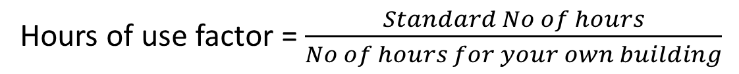
Hours of Use Factor
Type of building | Hours of Use
College of Further Education Universities – Non residential (teaching and Admin) - Residential - Overall | 3,200 3,500 6,000 4,250
Hours of use factor = $\frac{Standard No of hours}{No of hours for your own building}$

Slide 41
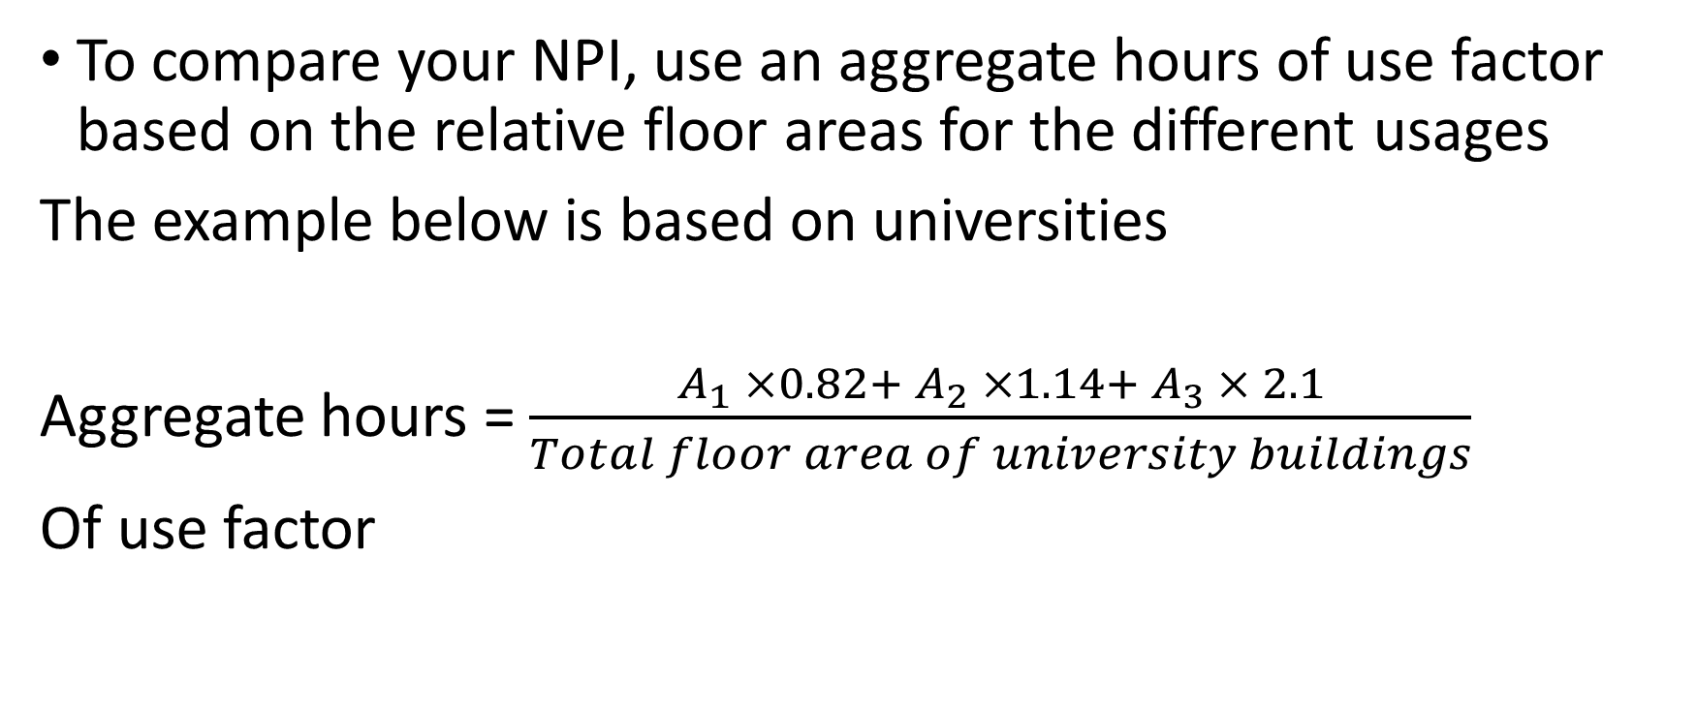
Hours of Use Factor
To compare your NPI, use an aggregate hours of use factor based on the relative floor areas for the different usages
The example below is based on universities
Aggregate hours = $\frac{A_{1} ×0.82+ A_{2} ×1.14+ A_{3} × 2.1}{Total floor area of university buildings}$
Of use factor

Slide 42
Hours of Use Factor
A₁ = Teaching laboratory and Admin areas (m²)
A₂ = Residential building area (m²)
A₃ = Continuously heated area (m²)
Based on average breakdown of 73% teaching, 25% residential and 2% continuously heated
If the hours of use factor is greater than 1.33 or less than 0.67 the NPI calculation should be applied with caution as your site may not be comparable with the data available

Slide 43
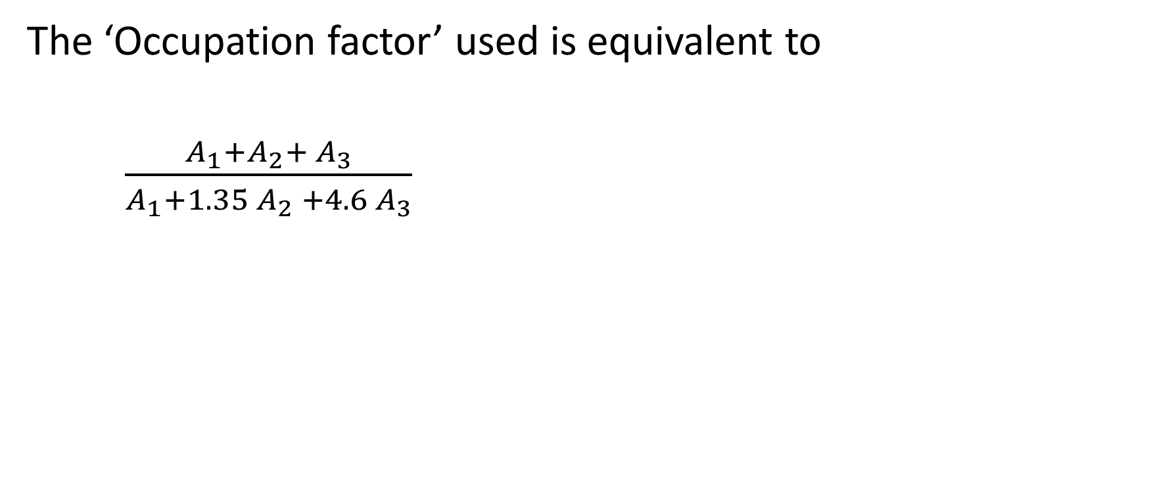
Hours of Use Factor
The ‘Occupation factor’ used is equivalent to
$\frac{A_{1}+A_{2}+ A_{3}}{A_{1}+1.35 A_{2} +4.6 A_{3}}$

Slide 44
Calculate the Normalised Performance Indicator (NPI)

