Slide 1
The Scarman Report concluded that the 1981 riots were the consequence of “complex political, social and economic factors” that produced “a disposition towards violent protest” in Britain’s inner cities. Explain the rationale behind Scarman’s conclusion, and assess the role of a) racial discrimination and b) police strategies in fostering the riots.
BA Conflict & War
AHHI6013: Civil Disobedience and State Control
Jordan Edwards 1502326

Slide 2
Introduction
Question Approach
Geography
Historiography
Source Material Comparison
Main Arguments
Analysis Outcome
Conclusion
Bibliography

Slide 3
Question Approach
Introduction to Argument
Overview of Scarman Report
Relevant Historiography
Political Factors
Social Factors
Economic Factors
Assessment of Racial Discrimination
Investigation into Police strategies and subsequent culpability
Conclusion

Slide 4
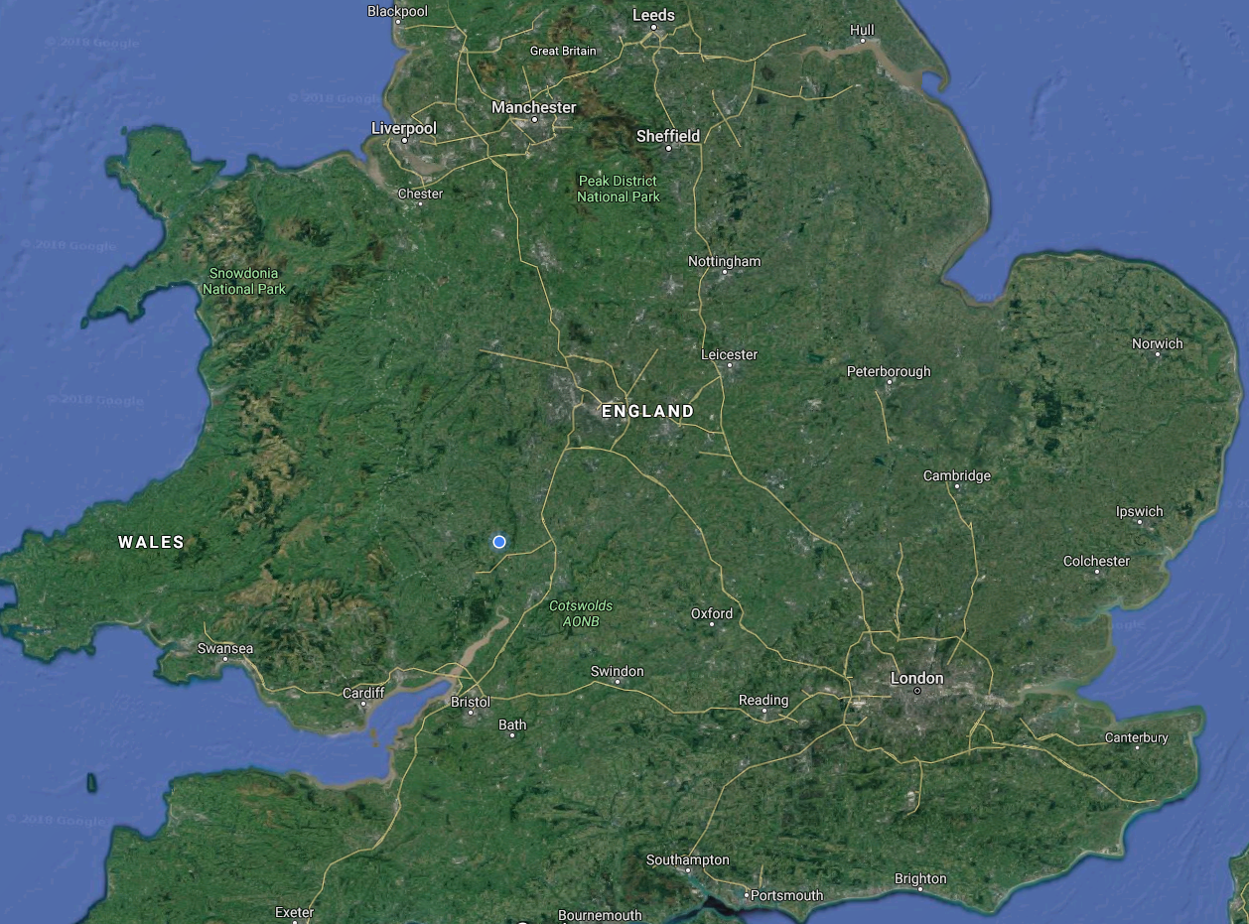
Geography
London – Brixton Riots
Birmingham – Handsworth Riots
Leeds – Chapeltown Riots
Liverpool – Toxteth Riots
Manchester – Moss Side Riots

Slide 5
Historiography
‘Complex political, social and economic factors’
‘A disposition towards violent protest’
Racial disadvantage – ‘endemic, ineradicable disease threatening the very survival of our society’
Benyon, John. Scarman and After: Essays Reflecting on Lord Scarman’s Report, the Riots and their Aftermath (Oxford: Pergamon, 1984).
‘Police and Community’
‘The Inner City’
‘50 buildings had been burnt down and countless shops looted, 258 police needed hospital treatment and 160 people had been arrested’
Frost, Diane and Richard Philips eds. Liverpool ‘81: Remembering the Riots (Liverpool: Liverpool University, 2011).

Slide 6
Main Arguments
Operation Swamp 81 set the conditions for violent unrest.
High unemployment was as a result of ‘positive discrimination’ towards Brixton’s African – Caribbean communities.’
Institutional failure to address unemployment increased crime rates.
Unrest was further exacerbated by poor housing and a lack of amenities.
Role of Vagrancy Act 1984, informally referred to as ‘sus’ law, in enabling Police racial profiling.
Alienation of Black and minority communities from wider society resulted in significantly narrowed opportunities.
'Kettle, Martin and Lucy Hodges. Uprising!: Police, the People and the Riots in Britain’s Cities (London: Macmillan, 1982), pp.52

Slide 7
Source Material Comparison
The Daily Mirror - ‘One of the great social documents of our time’
The Guardian - ‘Failed to grasp various crucial nettles’
The Daily Telegraph – ‘Vague liberal sentiments are all very well, but not likely to be effective when things turn nasty’
The Times – ‘it could not, and it has not, come up with instructions either for politicians or for the general public on how to prevent riots’
The Daily Mail – ‘This report is more what one might have expected from a representative of the National Council for Civil Liberties’
The Sunday Times – ‘masterly … lucid and compelling’
The Observer – ‘rational, optimistic and compelling’
Benyon, John. Scarman and After: Essays Reflecting on Lord Scarman’s Report, the Riots and their Aftermath (Oxford: Pergamon, 1984), pp. 8-10

Slide 8
Conclusion
A coherent and structured approach will be utilised in answering the essay question.
An awareness of the 1981 riots significant scale is crucial in understanding the effect on society.
Generally, scholarship is in support of Lord Scarman’s findings.
The presence of Racial discrimination was undeniable.
Both Government and the Police hold significant culpability in the lead up to and their reaction in the face of unrest.
Ultimately the 1981 riots accelerated social change.

Slide 9
Bibliography
Benyon, John. Scarman and After: Essays Reflecting on Lord Scarman’s Report, the Riots and their Aftermath (Oxford: Pergamon, 1984).
Crick, Michael. Militant (London: Faber 1984).
Evans, Eric J. Thatcher and Thatcherism (London: Routledge, 1997).
Frost, Diane and Peter North. Militant Liverpool: A City on the Edge. (Liverpool: Liverpool University, 2013).
Frost, Diane and Richard Philips eds. Liverpool ‘81: Remembering the Riots (Liverpool: Liverpool University, 2011).
Gamble, Andrew. The Free Economy and the Strong State : The Politics of Thatcherism (Basingstoke: Macmillan Education 1988)
Gilmour, Ian. Dancing with Dogma: Britain under Thatcherism (London: Simon & Schuster, 1992).
Hall, Stuart. ‘Thatcherism: A New Stage?’ Marxism Today, February 1980.
Kavanagh, Dennis and Anthony Seldon. The Thatcher Effect (Oxford: Clarendon, 1989).
Kettle, Martin and Lucy Hodges. Uprising!: Police, the People and the Riots in Britain’s Cities (London: Macmillan, 1982).
Riddell, Peter. The Thatcher Decade: How Britain has Changed during the 1980s (Oxford : Basil Blackwell 1989)
Scarman, Leslie George. The Brixton Disorders 10–12 April 1981: Report of an Inquiry (London: HMSO, 1981).
Scraton, Phil. ‘The Legacy of Hillsborough: Liberating Truth, Challenging Power,’ Race & Class, Vol.55, No. 2, 2013, pp.1–27.
Taafe, Peter and Tony Muhlearn. Liverpool: A City That Dared to Fight (London: Fortress Books, 1988).
Tafari, Levi. Liverpool Experience: Collected Poems (Neustadt, Germany: Michael Schwinn, 1989).
Zephaniah, Benjamin. Inna Liverpool (Stirling: AK Press, 1992).

