Slide 1

Leadership

Slide 2

Leadership Model
Dynamic Leadership Model
Sets aside conventional approaches
Embrace the changes in the business environment
Stresses upon constant innovation and invention (Waldman and O'Reilly, 2019).
A clear vision while continuously adjusting to circumstances
Notes:
The dynamic leadership model suggests that the constantly changing business environment all over the world requires a leader to take a dynamic approach to leadership and management. This model suggests that a leader must set aside the conventional approaches to leadership as these static approaches do not relate to the changing business environment. This model requires leaders to give more stress on continued invention and innovation in the various organizational practices. This will help the organization to effectively tackle challenges arose due the changing business environment. Moreover, under this model, the leader keeps a clear vision of the organizational objectives. However, the path of the organization to achieve these objectives adjusts according to the changing circumstances.

Slide 3
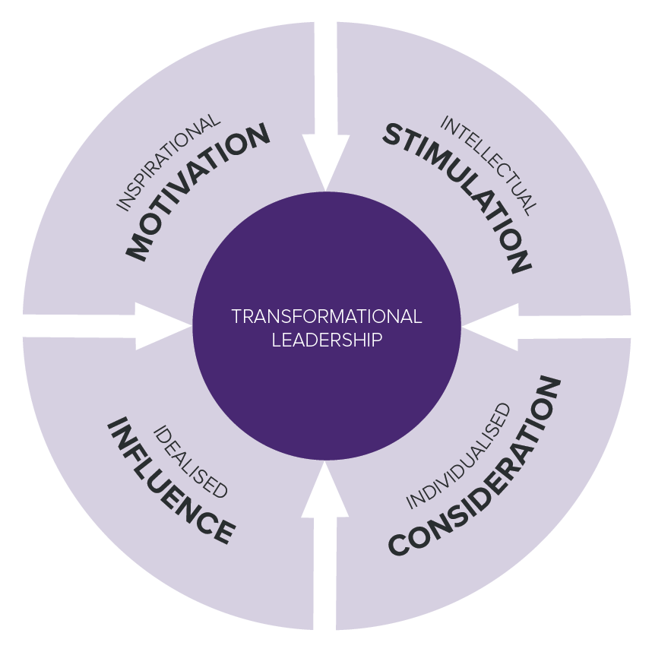
Leadership Theorie
Transformational Theory
Inspirational Motivation
Intellectual Stimulation
Idealized Influence
Individualized Consideration
(Ghasabeh, Soosay and Reaiche, 2015)
Notes:
The four main aspects of the transformational leadership theory are inspirational motivation, intellectual stimulation, idealized influence, and individualized consideration. Inspirational motivation requires a leader to be charismatic, who can motivate, assure, and arouse excitement among the employees. Further, the factor of intellectual stimulation requires a leader to give freedom to encourage innovation, creativity, and problem-solving attitude among the employees. This helps in stirring the employees’ imagination, which helps in quick problem identification, finding of the solution, and committed implementation of the same by the employees. Moreover, idealized influence requires a leader to lead by example, and a leader must himself live by the principles. This makes the leader a role model for the employees. Lastly the factor of Individualised consideration requires a leader to show genuine concerns for the feelings and needs of employees. This helps in creating a relationship of trust between the leader and the employees.

Slide 4

Application of the Model and Theory by Jeff Bezos
Adopted “Two-Pizza Teams” to increase the effectiveness of organizational meetings.
One-click shopping, single-threaded leaders, and working backward are some other examples (Tayeb, 2021)
Sets an example for other employees.
High expectations enhance the efficiency of employees (McGinn, 2013).
Notes:
The implementation of the dynamic leadership model can be seen in Jeff Bezos’s innovative strategies like Two Pizza Teams. It suggests that he does not fear in siding away the conventional leadership and management strategies. This new strategy helped him to increase the effectiveness of organizational meetings. Some other innovative practices started by him are single-threaded leaders, working backward, one-click shopping, etc. Moreover, the example of the transformational leadership theory is evident from the fact that Jeff Bezos often comes up with big ideas and turns them into reality. He keeps focus on the long-term goals of the organization. Further, he also keeps extremely high expectations from his employers, which helps talented, motivated, and ambitious people to stretch and achieve those goals. Through his innovative ideas, high standards, and learning attitude, he sets an example for his employees to strive for perfection and higher goals.

Slide 5
References
Ghasabeh, M.S., Soosay, C. and Reaiche, C., 2015. The emerging role of transformational leadership. The Journal of Developing Areas, 49(6), pp.459-467.
Waldman, D. and O'Reilly, C., 2019. Leadership for organizations. 1st ed. California: Sage.
McGinn, D., 2013. How Jeff Bezos Makes Decisions. [online] Harvard Business Review. Available at: <https://hbr.org/2013/10/how-jeff-bezos-makes-decisions> [Accessed 11 July 2022].
Tayeb, Z., 2021. Jeff Bezos made decisions at Amazon based on 5 key principles, according to a former board member. [online] Business Insider. Available at: <https://www.businessinsider.in/tech/news/jeff-bezos-decision-making-at-amazon-came-down-to-5-key-principles-according-to-a-former-board-member/articleshow/87684194.cms> [Accessed 11 July 2022].

