Slide 1
SBPD8001
Preparing for doctoral research
03 Research Design

Slide 2
Topics
Research design and objective
Major research designs
  Experimental research
  Survey research
  Case study research
  Comparative research
  Observational research
  Action research

Slide 3
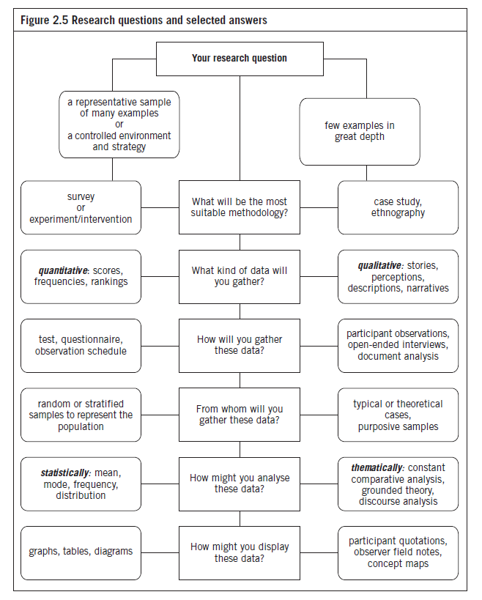

Slide 4
Research Design
Research design is the master plan specifying the methods and procedures for collecting and analyzing the required information
It determines how the participants are selected, how variables are manipulated, data are collected and analysed, and how confounding variables are controlled so that the overall research problem can be addressed

Slide 5
Research Design and Objective
Research Objectives
Common Research Design
Descriptive: To describe and measure any phenomena at a point in time
Exploratory: To gain background information, to define terms, to clarify problems and develop hypotheses, to establish research priorities, to develop questions to be answered
Explanatory: To determine the accuracy of a theory
Causal: To determine causality, test hypotheses, to make “if-then” statements, to answer questions
Survey; case study
Survey; case study
Experiment; survey; case study
Experiment

Slide 6
Choosing a Research Design
Best addresses the problem
Ethics
Cost in time and money
Validity

Slide 7
Experimental Research
Experimental research examines the cause-and-effect relationships between variables.
The method involves manipulating one variable to determine if changes in one variable cause changes in another variable.
The influence of all potential confounding variables are eliminated. This is to ensure that the results obtained are a direct result of the effects of the intervention.
The method relies on controlled methods, random assignment and the manipulation of variables to test a relationship.
Quasi-experimental research involves selecting groups, upon which a variable is tested, without any random pre-selection processes.

Slide 8
Experimental Research
Field experiments are done in a natural setting, whereas laboratory experiments are undertaken in a simulated setting.
Proves the direct cause-and effect relationship between two variable.
Advantages: can establish cause and effect relationships; adjustability/flexibility
Disadvantages: lack of “reality”; unrepresentative samples

Slide 9
Hawthorne Studies
A series of experiments were conducted in 1930’s at the Western Electric in Hawthorne, Illinois.
One of the experiments aimed to examine the effects of lighting on productivity
Result: Productivity increased regardless of lighting level
Conclusion: Increased productivity was due to workers’ receiving attention and the presence of a social system in the workplace
Hawthorne effect: A kind of reactivity that occurs when subjects demonstrate the expected effect of the treatment not because of its actual influence, but because they try to behave the way they think the researcher is looking for.

Slide 10
Survey Research
Survey research studies samples drawn from populations and from these samples it infers the characteristics of the defined population or universe.
Sample surveys attempt to determine the incidence, distribution, and interrelations among sociological and psychological variables, and in so doing, usually focus on people, the vital facts of people, and their beliefs, opinions, and attitudes.

Slide 11
Survey Research
Advantages
Disadvantages
Less expensive
Collected and processed quickly
Uniformity in questioning and response sets
Objective epistemological position (neutral or unbiased position)
Wider geographical distribution
Closed response sets restricts choice
In-depth data not collected
Passive activity
May generate expectations among the participants
Intrusive form of data collection
Lack of reciprocity

Slide 12
Types of Surveys
Surveys can be undertaken through oral or written questioning.
  Oral questioning is known as interviewing
  Written questioning is accomplished through questionnaires
Four types of surveys
  Mail surveys
  Telephone surveys
  Self-completion surveys
  Interviewer-completed questionnaires

Slide 13
Mail Surveys
Mail surveys use questionnaire to collect data.
The questionnaires are mailed to respondents, who then fill in the answers and return the questionnaires to the researcher.

Slide 14
Advantages of Mail Surveys
The cheapest method
Can target dispersed geographical areas
Are completed at the respondents’ convenience
Can offer anonymity when codes are not used; if codes are used, confidentiality assurances would have to be offered
Remove interviewer bias
Can achieve response rates from well-educated respondents or when there is high interest in the research topic.

Slide 15
Disadvantages of Mail Surveys
Mailing lists are difficult to obtain
Lack of face-to-face contact
Not always fully completed and returned
Return of surveys can take some time
To increase response rates, reminder cards are used, which adds to the cost and increase the time.
Respondents are unable to seek clarification
The researcher is unable to make observation notes
The researcher has no way of knowing the literacy level of respondents
The length of questionnaires restricts the use of visual aids
Open-ended questions do not achieve lengthy written responses

Slide 16
Telephone Surveys
Structured interviews using closed questions, with an interviewer recording the respondents’ answers
Contact with respondents is made using telephone technology

Slide 17
Advantages of Telephone Surveys
Enable personal contact to be made with respondents and sample may be drawn from a range of geographical regions for a lesser cost than face-to face interviews
It is faster than mail or intercept surveys
The interviewer is in charge of the question order
Probes can be used to elicit further information
Can ensure that only one respondent answers the questions.

Slide 18
Disadvantages of Telephone Surveys
It can be more expensive than mail surveys.
There are limited interview times pertaining to the best times for making and gaining responses.
It cannot use visual aids
Open-ended questions are limited
The interviewer can not control the interview.

Slide 19
Self-completion Surveys
It is completed by the respondent.
The self-completion surveys may be distributed to possible respondents or left in a prominent position for completion.

Slide 20
Self-completion Surveys
Advantages
Disadvantages
The participant can complete the questionnaire at their own pace
If left with the respondents, the questionnaire can be completed at a time convenient to the respondents
The researcher can never be sure that the targeted person has responded to the questionnaire, unless the researcher has personally handed the questionnaire to the respondent and waited for its completion
The respondents can not seek clarification
The respondents may not understand the language
Lower response rate

Slide 21
Interviewer-completed Surveys
A face to face interview
It engages the respondent in answering questions posed orally by the interviews
The respondents does not have to write anything down, which is completed by the interviewer.

Slide 22
Interviewer-completed Surveys - Advantages
There is no need to write anything down, so it is less intrusive than a mail or self-completion survey
Show cards and visual images can be used
Face-to face interaction can contribute to increased participation
It achieves a higher response rate than mail or telephone surveys
Clarification may be sought by the respondent
Probes may be used by the interviewer to extend responses.
Both open-ended and closed questions may be asked
No follow-up collection

Slide 23
Interviewer-completed Surveys - Disadvantages
The costs for training, supervising, and transporting are very high
The presence of an interviewer can introduce interviewer bias based on the interviewer’s appearance, mannerisms, tone of voice or language used
Respondents may query anonymity or confidentiality claims
Respondents may not find the interception by the interviewer convenient

Slide 24
Online Surveys
Advantages
Disadvantages
Respondents enter the data directly
The cost of conduct is minimal
Faster than mail, telephone or intercept surveys
Real-time responses
Lack of sampling frames
Not knowing who completed the surveys
Many paid survey panels are not reliable
Difficulties in gaining access to some e-lists

Slide 25
Case Study Research
Case study is an in-depth analysis of a single case or a small number of cases
A large number of aspects of a single case (individual, organization or team) was investigated in depth over a long period within the case’s own context.
It involves collecting in depth, descriptive data which is then interpreted, analysed and evaluated.
The method is particularly appropriate when little in known about a topic
Multiple sources of data
Triangulation (the use of two or more methods of data collection or sources of data in the study of some aspect of human behaviour)

Slide 26
Case Study Research
According to Robert Yin (1994), a case study is an empirical inquiry that investigates a contemporary phenomenon within its real-life context
“The case study method allows investigators to retain the holistic and meaningful characteristics of real-life events – such as individual life cycles, small group behaviour, organizational and managerial processes, neighbourhood change, school performance, international relations, and the maturation of industries”. (Yin, 2009)

Slide 27
Case Study Research
Type of case study | Description
Exploratory (Yin, 1994) | The study ‘explores’ single or multiple cases of the tourism phenomenon to discover uniqueness or characteristics, since no pre-existing data exist in the public arena. The ‘what’ is determined.
Descriptive (Yin, 1994) | The study collects evidence to enable the researcher to describe either a single case or multiple cases. The ‘who’, ‘what’ and ‘where’ are determined
Explanatory (Yin, 1994) | The study seeks to determine ‘how and why’ the single case or multiple cases operate as they do.

Slide 28
Case study research
Advantages
disadvantages
In-depth data is collected on a single case or multiple cases
Evidence is grounded in the social setting being studied
Study members can check the data for accuracy
Member checking may remove researcher bias
Methodological triangulation is used
The case study focus is emergent.
The research process is subjective as opposed to objective.
Evidence may be denied for reproduction based on the use of member checking.
Data collection, analysis and findings may contain bias.
Findings are not able to be generalized to other cases.

Slide 29
Single- versus Multiple-case Design
Single-case
Multiple-case
Context
Context
Context
Holistic
(single
unit
analysis
Case
Case
Case
Context
Context
Case
Case
Context
Context
Context
Embedded
(multiple
unit
analysis
Embedded unit of analysis 1
Embedded unit of analysis 1
Embedded unit of analysis 1
Embedded unit of analysis 2
Embedded unit of analysis 2
Embedded unit of analysis 2

Slide 30
Single- versus Multiple-case Design
Rationales for single case study
Rationales for multiple case study
The case selected is a/an
critical case
extreme/unique case
typical/representative case
revelatory case (phenomenon previously inaccessible)
longitudinal case
Provides intra- and inter-case comparisons
Predicts similar results (literal replication); cases are designed to corroborate each other
Predicts contrasting results (theoretical replication); cases are designed to cover different theoretical conditions and different results are expected.

Slide 31
Comparative Research
Comparative research methods identify, analyse and explain similarities and differences between cases, contexts and time periods.
It may be associated with other types of research designs. E.g., comparative experimental studies, comparative case studies, comparative observational studies.

Slide 32
Observational Research
Research involving observation of behaviour and recording of those observation in an objective manner.
What do we observe?
  Identify behavioural categories and behaviour to be recorded
How do we record the observation?
  Media: Video Recording, Tape Recording, paper-and-pencil
  Duration, frequencies, etc.
What sampling strategies do we use?
  Event Sampling?
  Individual Sampling?

Slide 33
Participant Observation
The researcher can play the following roles:
Complete observer: the researcher is uninvolved and detached, and merely, passively records behaviour at a distance (e.g., a researcher standing in the street, making observations of tourists)
Observer as participant: the researcher’s observer role is known but he does not participate (e.g. a researcher accompanies a tour group, observing and questioning tour members’ behaviour as they proceed).
Participant as observer: the researcher becomes a member of the group being studied and tells the members that they are being studied (e.g. a researcher joins a tour group, observing and enjoying the trip).
Complete participant: the researcher let people see them only as a participant, not as a researcher (e.g., a researcher acts as a mystery customer).

Slide 34
Advantages of Participant Observation
Examines interactions and behaviors in real-world settings
Enables researchers to become aware of how the participants construct and describe their world
Provides first-hand information
Provides information when other data collection methods are less effective
  routes taken around museum exhibits
  length of time spent at interpretive signs in a national park

Slide 35
Continued…
May highlight behaviors/events that the participants may not wish to discuss
Time-efficient
Is not associated with complicated data collection methods
Cost-effective, as several methods are simultaneously used
Enables a wide range of data to be collected, as the researcher is in the study setting for an extended time period.

Slide 36
Disadvantages of Participant Observation
Does not work well with large groups, as the observer can only be in one location or one setting at one time
Does not have a temporal comparability, as it is focused on the present; past or future settings are unable to be observed
Is not appropriate for opinions and attitudes unless coupled with interviewing, as the researcher cannot observe attitudes and opinions
May not gather complete information sets, as some events may be taboo for observation
May be associated with observer bias, selective observations and interpretations

Slide 37
Continued…
Has no controls for researcher bias
Does not provide quantifiable generalizations on results
May result in misinterpretation of interactions or phenomena if analyses are not revalidated by the participants
May cause changes in behaviors due to the participant observer’s presence
May result in difficulty in comparability if several observers are in the field
Replication is impossible, because once the act has occurred, it is over
Is associated with subjective interpretations by observers

Slide 38
Action Research
Action research aims at an understanding of a complex situation rather than prescribing a universal social law.
Unlike academic researchers who remain “neutral”, action researchers attempt to intervene the problem setting. Their goal is to foster improvement via a defined research framework.
Action research assists in organizational change. It empowers stakeholders (e.g., employees, residents, etc.) to contribute to the research and decision making process.
It involves planning, implementing, monitoring and reflecting.

Slide 39
Action Research - Example
Abstract: “Ecologically sound tourism planning and policy require an empowering community participation. The participatory action research model helps a community gain understanding of its social reality, learn how to learn, initiate dialog, and discover new possibilities for addressing its situation.”
Guevara, J., & Roberto, Q. (1996). Learning through Participatory Action Research for Community Ecotourism Planning, Convergence, 29(3), 24-40.

Slide 40
Advantages and Disadvantages
Advantages:
It is participatory in nature (e.g., residents representatives are encouraged to undertake research projects that address the needs of the community
Process and outcomes are owned by the participants
It aims to empower participants to lead their own community/unit rather than being directed by professionals.
It focuses on improving organizational practices, conditions and processes.
Disadvantages:
The outcomes being site or organization specific
Time-consuming
Self-fulfilling prophecy (when we expect something to happen, it is more likely to happen).

