Slide 1

Health, Wellbeing and Sustainable Development
Student ID: 2244841
Student name: Galina Bleidere
Lecturer name: Dr Itse Olaoye

Slide 2
Acknowledgement of the use of AI tools
I confirm that I have not used any AI tools in the research and creation of this assignment. I confirm that I have not presented any AI-generated materials as my own work. I confirm I have copies of my drafts, notes, and other resources I used, which I may be asked to provide as evidence.

Slide 3
Introduction
Health and well-being are important in modern healthcare because they affect people’s physical, mental, and social lives. Recently, more attention has been given to holistic approaches to health and sustainable development.
This presentation will explain the key concepts of health, well-being and sustainable development, and discuss their relevance in healthcare policies and practices. It will also explore the importance of integrated approaches to enhance health and well-being.

Slide 4
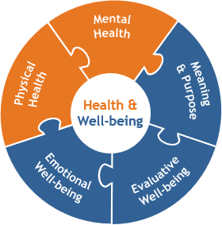
Key Concepts:
Health: Health is a dynamic state that involves physical, mental, and social aspects, not just the absence of illness (World Health Organization, 1948).
Wellbeing: Wellbeing is a broader, holistic concept that involves physical, mental, emotional, and social health. t focuses on how people feel, cope with stress, and maintain positive relationships (Kirkbride et al.,2024).
Sustainable Development: Sustainable development focuses on meeting present needs while protecting the ability of future generations to meet their own. It promotes social equity, environmental protection, and long-term well-being (Brundtland, 1987).
(HERO, 2020)

Slide 5
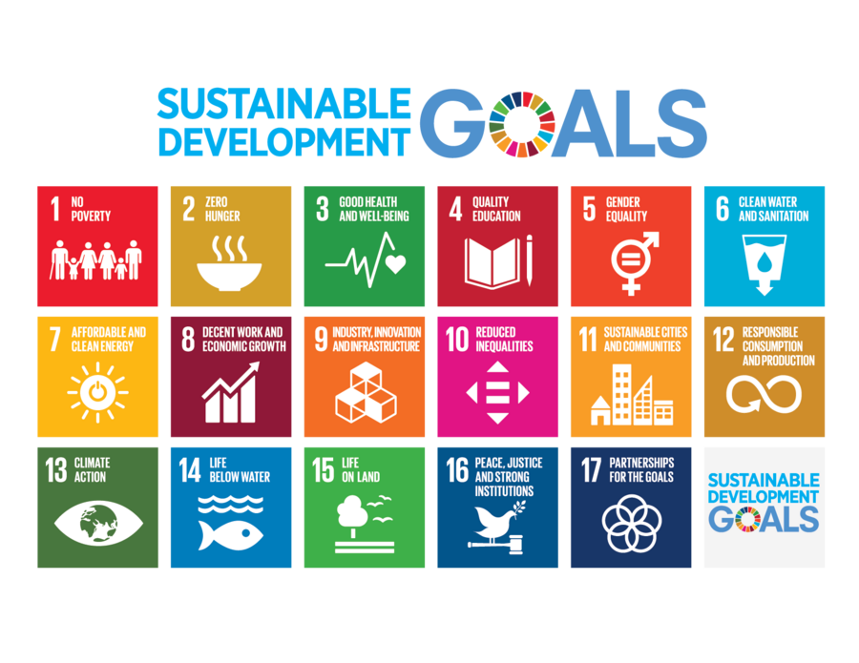
Relevance to Contemporary Healthcare Policy and Practice
Ageing populations increase demand for long-term care and integrated health and social care services (NHS England, 2019).
Increasing prevalence of non-communicable diseases (NCDs) places growing pressure on the healthcare system worldwide (WHO, 2023).
Global health challenges highlight the need for a sustainable and resilient healthcare system (United Nations, 2015).
Social determinants of health influence health inequalities, highlighting the importance of prevention and population health strategies (Marmot et al., 2020).
( United Nations,2015)

Slide 6
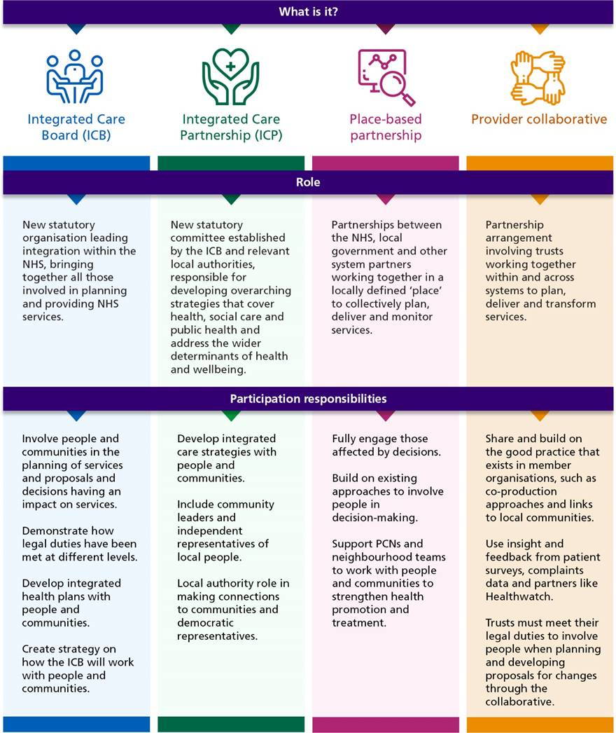
Integration of health and wellbeing approaches
Integrated care brings together physical, mental and social health within a person-centred framework (NHS England, 2022).
Health outcomes are influenced by lifestyle, psychological well-being, environmental and socio-economic factors (NHS England, 2019).
The WHO Health in All Policies framework highlights the importance of collaboration across sector collaboration such as housing, education and transport (WHO, 2014).
In the UK, Integrated Care Systems (ICS) conect the NHS, local authorities and community organisations (Charles, 2022; Ruane, 2019).
(NHS England, 2023)

Slide 7
Theoretical Perspectives:
Health and well-being are influenced by a mix of biological, psychological and social factors rather than physical health alone ( Engel, 1977).
This perspective shows that health is not only affected by medical conditions but also by emotional state and social environment.

Slide 8
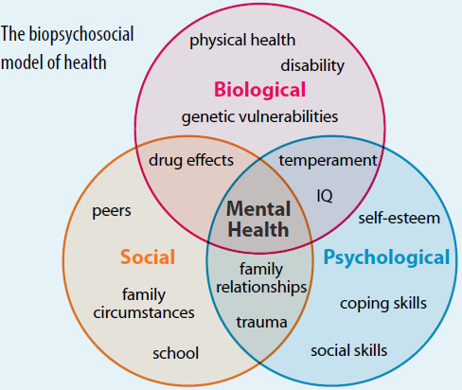
The Biopsychosocial Model
The biopsychosocial model explains health as a result of the interaction between biological, psychological and social factors.
Biological factors may include genetics, age, physical conditions and other medical aspects that affect an individual’s health.
Psychological factors refer to emotional wellbeing, coping strategies, stress levels and cognitive processes that shape how people experience illness.
Social factors such as relationships, financial stability, employment and cultural background can also impact overall health and wellbeing.
(Engel, 1977)
(Physiopedia, 2023)

Slide 9
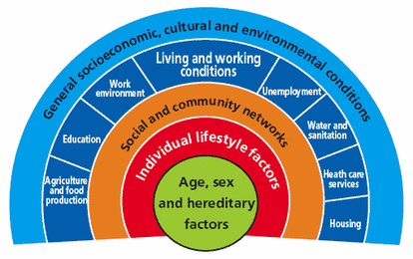
The Dahlgren and Whitehead Model
The Dahlgren and Whitehead Rainbow Model explains how different social factors influence health.
These determinants include both personal lifestyle behaviours and wider social and environmental conditions.
Factors such as housing, education and employment play an important role in shaping population health.
The model highlights how social and economic inequalities influence health outcomes.
( Dahlgren and Whitehead, 1991; Marmot et al.,2020)
.
( Practicus,2022)

Slide 10

Policy and Governance:
In the United Kingdom, health policy increasingly promotes holistic and preventative approaches, emphasising early intervention and the promotion of mental wellbeing.
Several important policy frameworks support these developments.
The Health and Social Care Act (2012) supports integrated health and social care and places patients at the centre of healthcare decision-making.
The NHS 10 Year Health Plan for England (2025) focuses on the following health priorities:
Prevention of diseases rather than treatment. Targeting major risk factors: smoking, obesity, and alcohol misuse.
Early detection (e.g., cancer screening expansion)
Commitment to parity between physical and mental health
Integrated Care Systems (e.g., collaboration between NHS organisations, local authorities and the voluntary sector).

Slide 11
Challenges: Regulatory and Financial Barriers
Complex governance structures can lead to fragmentation and delays in decision-making (Oikonomou, 2019).
Fragmented funding across NHS, local authorities, and voluntary sectors makes integrated care difficult (NHS Confederation, 2024).
Workforce shortages and staff turnover place increasing pressure on healthcare services (The Health Foundation, 2023).
Growing demand from ageing populations and long-term conditions increases system pressure. (Barraclough et al., 2021).

Slide 12
Service Delivery:
Modern healthcare is increasingly moving towards integrated and person-centred care, addressing physical health, mental wellbeing and social factors together (NHS, 2025).
Health promotion and nutritional guidance are gradually being incorporated into healthcare services to support overall wellbeing (NHS, 2025).
Digital health and telemedicine improve access to healthcare, particularly for individuals living in rural areas, people with disabilities, or those facing time and mobility constraints. These technologies can also help reduce pressure on hospital services (Brown et al., 2016).
Community-based initiatives, such as social prescribing, connect individuals with local support networks and non-clinical services that contribute to improved wellbeing (Bickerdike et al., 2017).

Slide 13
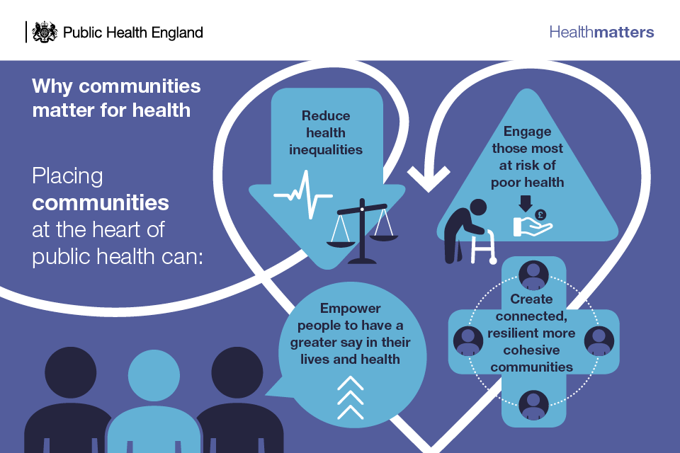
Public Health Initiatives:
National campaigns such as Change4Life promote healthier lifestyles through nutrition, physical activity, and mental health awareness (NHS, 2024).
Mental health awareness campaigns, such as Every Mind Matters, support individuals in managing stress and emotional well-being (NHS, 2021).
Community programmes such as Social Prescribing connect individuals with local support services to improve well-being (Bickerdike et al., 2017).
(Public Health England, 2021)

Slide 14
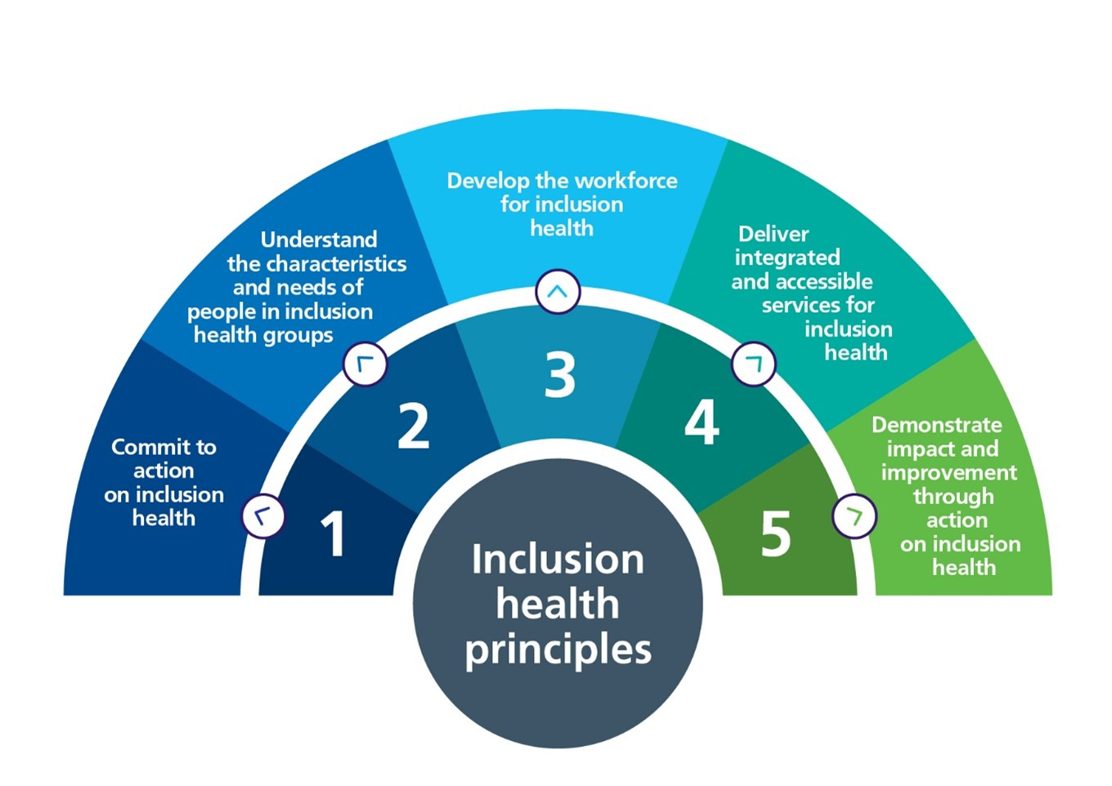
Equity and Access in Healthcare
Social determinants such as income, education, employment and ethnicity significantly influence health outcomes and access to healthcare services (Marmot et al., 2020; Kirkbride et al., 2024).
Some groups experience greater barriers to timely and appropriate care, including migrants, low-income households and people with disabilities (Marmot et al., 2020).
Integrated care system supports collaboration between health and social care services to improve population health and reduce inequalities (Charles, 2022).
National programmes such as CORE20PLUS5 supported by integrated care approaches within the NHS, aim to improve health outcomes among the most vulnerable communities (NHS England, n.d.; Raune, 2019).
(NHS England, 2023)

Slide 15
Conclusion:
Health and well-being are influenced by biological factors as well as wider social determinants such as income, environment and access to healthcare.
Public health initiatives and policies are essential for reducing health inequalities and improving population wellbeing.
Addressing social determinants and promoting equitable access to healthcare are key to creating healthier and more sustainable communities.

Slide 16
References
Bickerdike, L., Booth, A., Wilson, P.M., Farley, K. and Wright, K. (2017) ‘Social prescribing: less rhetoric and more reality. A systematic review of the evidence’, BMJ Open, 7(4), e013384. https://doi.org/10.1136/bmjopen-2016-013384 ⁠
Brown, M.R.D., Knight, M., Peters, C.J., Maleki, S., Motavalli, A. and Nedjat-Shokouhi, B., 2023. Digital outpatient health solutions as a vehicle to improve healthcare sustainability: a United Kingdom focused policy and practice perspective. Frontiers in Digital Health. Available at: https://www.frontiersin.org/articles/10.3389/fdgth.2023.1242896/full (Accessed: 27 March 2026).
Brundtland, G.H. (1987) Our Common Future: Report of the World Commission on Environment and Development. Available at: http://www.un-documents.net/ocf-ov.htm⁠ (Accessed: 12 March 2026).
Charles, A. (2022) Integrated care systems explained. Available at: https://www.kingsfund.org.uk/insight-and-analysis/long-reads/integrated-care-systems-explained⁠(Accessed: 12 March 2026).
Engel, G.L. (1977) ‘The need for a new medical model: a challenge for biomedicine’, Science, 196(4286), pp. 129–136. Available at: https://doi.org/10.1126/science.847460⁠ (Accessed: 12 March 2026).
Health Enhancement Research Organization (HERO) (2020) New well-being assessment provides a tool to measure broader health and well-being impact. Available at: https://hero-health.org/blog/new-well-being-assessment-provides-a-tool-to-measure-broader-health-and-well-being-impact/ (Accessed: 26 March 2026).
NHS (2019) Every Mind Matters. Available at: https://www.nhs.uk/every-mind-matters/ (Accessed: 27 March 2026).
NHS England (2022) What are integrated care systems? Available at: https://www.england.nhs.uk/integratedcare⁠ (Accessed: 12 March 2026).
NHS England (n.d.) CORE20PLUS5 (adults) – An approach to reducing healthcare inequalities. Available at: https://www.england.nhs.uk/about/equality/equality-hub/core20plus5/ ⁠ (Accessed: 27 March 2026).
Physiopedia (2023) Biopsychosocial Model. Available at: https://www.physio-pedia.com/Biopsychosocial_Model (Accessed: 26 March 2026).

Slide 17
References
Practicus (2022) Making data count to tackle health inequalities. Available at: https://www.practicus.com/blog/making-data-count-to-tackle-health-inequalities (Accessed: 26 March 2026).
Kirkbride, J.B. et al. (2024) ‘The social determinants of mental health and disorder: evidence, prevention and recommendations’, World Psychiatry, 23(1), pp. 58–90. Available at: https://doi.org/10.1002/wps.21160⁠ (Accessed: 10 March 2026).
Marmot, M. et al. (2020) Health Equity in England: The Marmot Review 10 Years On. Available at: https://www.instituteofhealthequity.org/resources-reports/marmot-review-10-years-on-the-marmot-review-10-years-on-executive-summary.pdf⁠ (Accessed: 12 March 2026).
Ruane, S. (2019) ‘Integrated care systems in the English NHS: a critical view’, Archives of Disease in Childhood, 104(11), pp. 1024–1026. Available at: https://doi.org/10.1136/archdischild-2018-315092⁠ (Accessed: 12 March 2026).
World Health Organization (2014) The Helsinki Statement on Health in All Policies. Available at: https://www.who.int/publications/i/item/9789241506908⁠ (Accessed: 12 March 2026).
World Health Organization (2023) Noncommunicable diseases. Available at: https://www.who.int/news-room/fact-sheets/detail/noncommunicable-diseases ⁠(Accessed: 27 March 2026).
World Health Organization (1948) Constitution of the World Health Organization. Available at: https://www.who.int/about/governance/constitution⁠ (Accessed: 12 March 2026).
UK Gov. (2025) Fit for the future: 10 Year Health Plan for England. Available at: https://assets.publishing.service.gov.uk/media/6888a0b1a11f859994409147/fit-for-the-future-10-year-health-plan-for-england.pdf (Accessed: 26 March 2026).
United Nations (2015) Transforming our world: the 2030 Agenda for Sustainable Development. Available at: https://sdgs.un.org/2030agenda (Accessed: 12 March 2026).
United Nations (2015) The Sustainable Development Goals. Available at: https://sdgs.un.org/goals (Accessed: 26 March 2026).

