Slide 1

Degree Name: BSc (Hons) Health and Social Care
Module Code: BMHP6029
Module Name: Psychological Classifications and Provisions
Assignment Title: Component 1: Individual Presentation (Academic Poster)
Student Name: Asteria Joseph Nyamhanga Wilson
Student ID: 2311121
Lecture Name: Neale Haddon

Slide 2

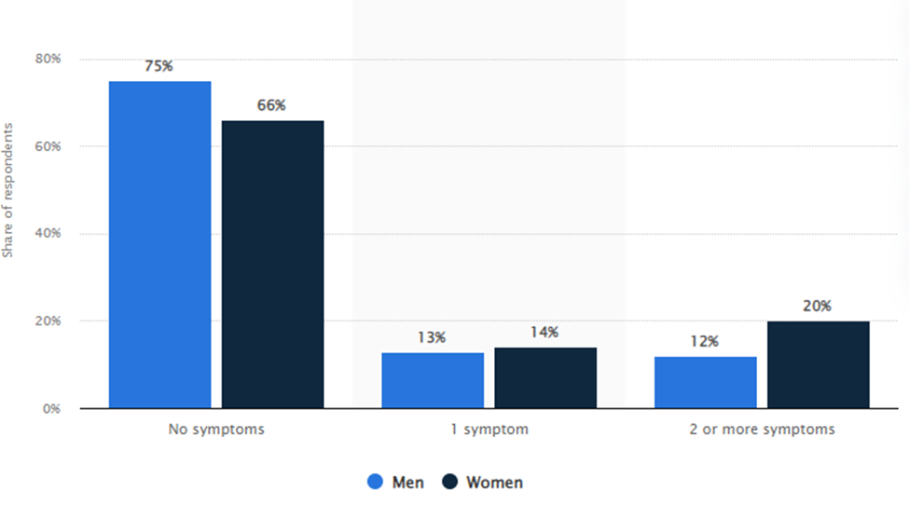
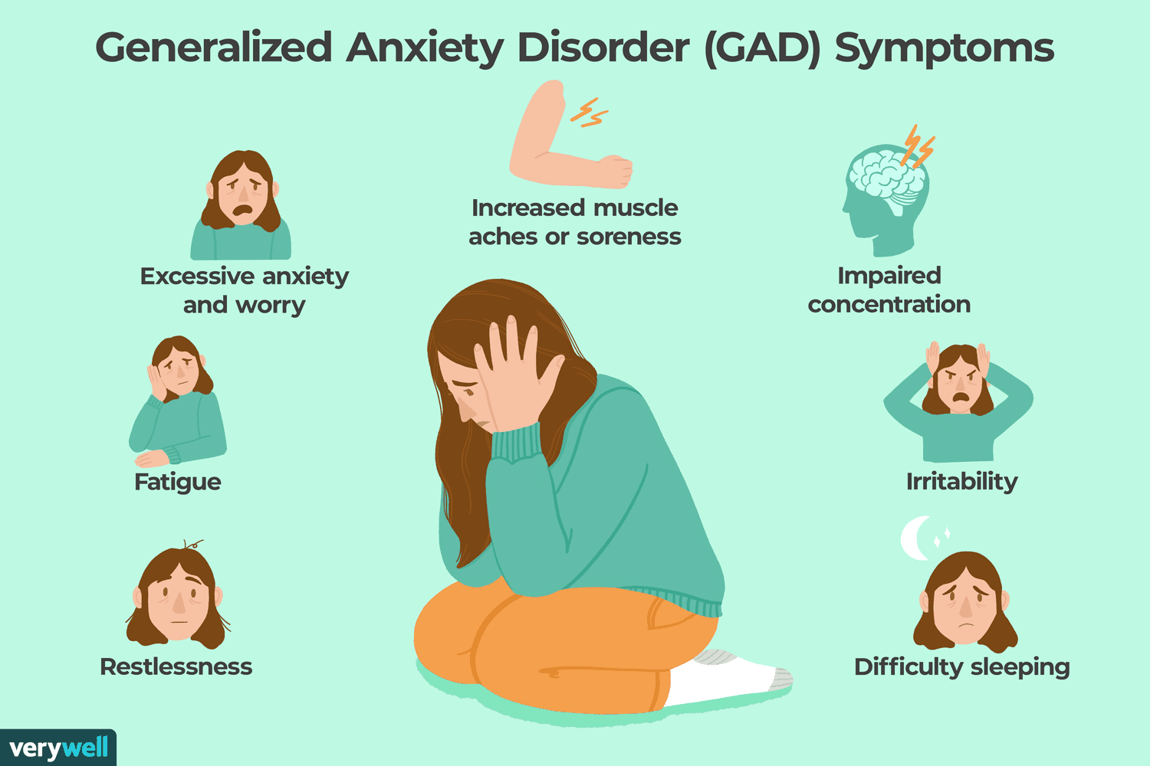
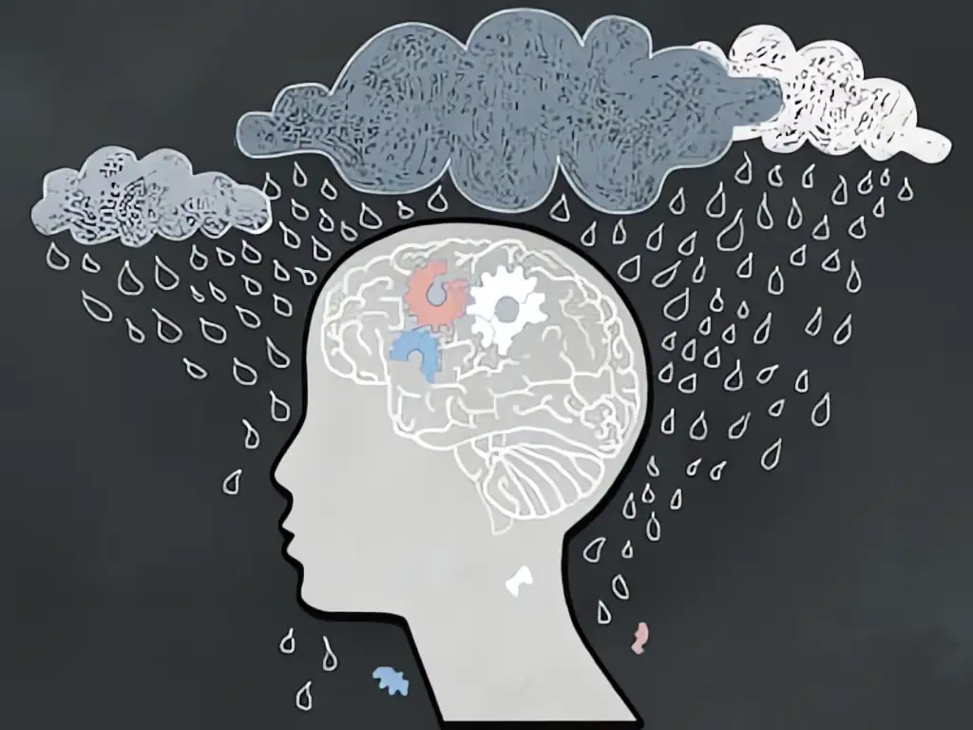


Title: Understanding Anxiety Disorders: Historical Change, Current Challenges, and Policy Recommendations
Introduction
This poster aims to discuss the ICD-11 classification of the disorders related to anxiety. This will compare ICD-11 and DSM-5, examine cultural and personal differences, and review past and present knowledge. This poster will critically evaluate attitudes and policies to develop recommendations for future practice..
Mental Health Disorder- Anxiety
Three-quarters of the population (73%) in the UK are suffering from anxiety as of 2023 (Mental Health, 2024).
12% of men and 20% of women are suffering from anxiety as of 2022 in the UK (Gagliardi, 2025).
Exploring the evolution of attitudes, practices and policies
Attitudes, historically, anxiety was considered a personal weakness which enhanced social exclusion. However, currently, the stigma related to anxiety has massively reduced in the UK through the campaign “Time to Change”. This campaign increased public awareness regarding the mental health disorder and reduced social discrimination (MIND, 2022). Practices for dealing with anxiety have progressed massively in recent days. Institutional care has changed, and it has been replaced by Cognitive Behavioural Therapy (CBT) and pharmacological interventions, which have changed the practice of clinical work. Policies regarding anxiety have changed massively in the present day. NICE promote psychological therapies, and the NHS Long Term Plan prioritises early intervention.
Comparing ICD-11 and DSM-5
ICD-11, produced by the World Health Organisation, is an international instrument of clinical care, research, and health policy (Gomez et al., 2023). It has simplified diagnostic guidelines that guide various healthcare facilities. The main advantage of ICD-11 is that it is more focused on cultural context and less biased in diagnosis among populations. However, it may be inadequate in the amount of detail compared to DSM-5. As a result, its application may be slow because of variations in health systems between countries.
(Source:Gagliardi, 2025)
Recommendations for future policy and practice
Expanding Early Intervention and Prevention Strategy: Anxiety is common among adolescents, as 25.8% of 16-24-year-olds suffered from anxiety in 2023-24 in the UK (NHS, 2025). Training through schools and youth mental health services can reduce the health risk factors of anxiety. Improving Access and Reducing Inequalities: The healthcare services to reduce anxiety need to be delivered equally in the different regions and communities of the UK and outside of the UK. Balancing Psychological and Pharmacological Treatments: The anxiety reduction services need to include therapy as well as medication equally.
Literature review to explore the historical and contemporary understanding of the condition
Historical understanding: Anxiety was known to everyone in different centuries, but the meaning has changed gradually. Through ancient medicine, fear and worry were not considered clinical disorders, but an imbalance of the body or the spirit. In the 19th century, anxiety was termed "nervous disorders" and associated with hysteria (Fox et al., 2022). This perception usually resulted in stigma and low treatment choices. Freud explained anxiety as an outcome of unconscious conflicts.
Contemporary understanding: Anxiety disorder is a common health issue in the present day. Recent statistics in England indicated that 1 in 5 adults (20.2%) aged between 16 and 64 years are suffering from anxiety. Generalised Anxiety Disorder was reported in 7.5% of the adults. Anxiety prevalence grew from 18.9% in 2014 and 22.6% in 2023-24 (NHS, 2025). The highest rates of prevalence were observed among young adults aged 16-24 (25.8%).
Individual and Cultural Differences
The level of anxiety can be highly differentiated across people and cultures. The experience and reporting of symptoms are affected by factors including age, gender and socioeconomic status (Farhane-Medina et al., 2022). As an illustration, young adults tend to be diagnosed with anxiety disorders more often than older people. The perceptions of anxiety and its expression between cultures are also influenced by culture.
Conclusion
It can be concluded that anxiety disorders are the most prevalent mental health problems globally and in the UK. The historical perception of anxiety reveals the modification of moral judgment and stigma to the understanding of anxiety as a medical disorder, whereas the current data is characterised by increased awareness and inequalities. There is a more positive attitude, but stigma is an obstacle, particularly in workplaces and minority groups. Evidence-based therapies are now being prioritised in practices. Although long waiting times and over-prescription with medication are issues.
Notes:
Introduction
Anxiety refers to excess fear and concern that causes substantial distress and a lack of functioning. These are generalised anxiety disorder, panic disorder, social anxiety disorder, phobias, and separation anxiety. This poster will discuss the anxiety disorders of ICD-11. It compares ICD-11 and DSM-5, and will explore cultural and personal variations, observe past and current knowledge and analyse the attitude, practices, and policies. The poster will emphasise the UK and global data, analyse both positive and negative issues, and evaluate the implications for mental health care.
Comparing ICD-11 and DSM-5
ICD-11 has been developed by WHO. It is open source, culture-aware and available across the world (Gomez et al., 2023). Nevertheless, it is not as detailed as DSM-5 and is slower to embrace. On the other hand, DSM-5 was published by the American Psychiatric Association, which has more specific diagnostic criteria that enhance reliability and consistency, especially in psychiatric research and practice in the US. DSM-5 is comprehensive and sound, particularly in American research and practice. It is expensive, Western-oriented and has been criticised as being over-medicalised. The key limitations are Lack of access due to high cost, a Western-centred approach, and continual criticism of over-medicalisation and cultural bias.
Individual and Cultural Differences
Symptoms of anxiety depend on age, gender and culture (Farhane-Medina et al., 2022). The higher rates are noted in women and young adults. Western cultures refer to psychological symptoms, whereas Asian cultures refer to physical symptoms. There is less stigma in the UK, and it was caused by awareness campaigns, yet there is still inaccessibility for minorities. The UK has been able to lower stigma through awareness campaigns. Although there is still inequality in terms of access to treatment, particularly in minority groups. Most Western countries would talk in terms of psychological symptoms, whereas some Asian cultures might have the symptoms in the form of physical signs. There is also a difference in the level of stigma in different cultures, whereby some communities would be more hesitant to seek help as they fear being stigmatised or discriminated against.
Mental Health Disorder- Anxiety
Anxiety is a serious mental health disorder that is characterised by excessive fear and behavioural disturbance. Anxiety disorders can be categorised as panic disorder, social anxiety, phobias and separation anxiety. Panic disorder, phobia, social anxiety and separation anxiety are all forms of anxiety. Nearly half of adults (20.2% of the adults aged 16-64) in the UK have common mental health conditions. In the world, anxiety is found in 359 million people (WHO, 2025). The likelihood of a diagnosis being made in women is nearly twice that of males. Globally, 4.4% people, around 359 million people, are suffering from anxiety as per the WHO (WHO, 2025).
Literature review to explore the historical and contemporary understanding of the condition
Historical
In the past, anxiety was considered hysteria or an unconscious struggle. CBT was informed later on by behaviourists and cognitive theorists (Fox et al., 2022). Anxiety and related conditions impact about 1 in 6 adults every week in the UK, where women are nearly twice as likely to be diagnosed compared to men. Traditionally, the recognition of morality has been enhanced to medical recognition, which is favourable to treatment. Though over-medicalisation, cultural bias in diagnosis and ongoing stigma restrict anxiety treatment (Fox et al., 2022). The historical experience demonstrates that anxiety concepts have changed, but a lack of equality and care in intercultural aspect is present. In the UK, it is on the increase today, with 25.8% of the young adults affected. There is still a treatment gap in the world, whereby only a quarter is appropriate. However, by the mid-20th century, behaviourists interpreted anxiety as a learned reaction, whereas the various cognitive theorists of the 1960s paid attention to the patterns of distorted thought. Such advances influenced existing treatments such as CBT. The prevalence of anxiety is the most widespread mental health disorder globally, as it impacts 359 million people (WHO, 2025).
Contemporary
It has some downsides, which include under-treatment, whereby the WHO reports that out of 4 individuals in the world with anxiety, 1 of them does not seek assistance (WHO, 2025). Therefore, it can be stated that, currently, Anxiety is a common mental health disease, but some people cannot get proper medical assistance to deal with the health condition properly. Women always have even greater anxiety levels than men. One of the positive aspects is that the increased awareness, national surveys, and the use of tools such as GAD-7 have given more valid data and influenced the development of specific interventions.
Exploring the evolution of attitudes, practices and policies
Attitudes: Attitudes towards anxiety have changed, and it has shifted from stigma. Social stigma has reduced, but there is a barrier. CBT and IAPT practices have been improved. There are long waiting lists, and antidepressants are widely used. Such policies as the NHS Long Term Plan and the WHO programmes foster care, but funding and inequalities restrain improvements. One of the positive facts is that the issue of mental health is discussed more openly by people nowadays, and it is less isolated. On the contrary, NHS Digital (2023) informs that 37.1% women and 29.9% men continue to have high anxiety rates, and most of them do not seek care because of the existing stigma, especially in places of work and among minority groups (Mental Health , 2023). This shows that though the attitudes have changed, there still exist obstacles.
Practice: The NHS Improving Access to Psychological Therapies (IAPT) programme has increased access to CBT, improving the delivery of CBT services to more than 1 million individuals annually (Porter et al., 2024). There is a prevalence of good, well-organised therapies, which have increased recovery rates. Though the wait lists are still lengthy, which is the core limitation. Another issue is over-prescription, as antidepressants increased to 85 million items in 2022 (Lunghi et al., 2022). This brings about the problem of over-medicalisation and a lack of emphasis on holistic treatment.
Policies: The WHO Mental Health Gap Action Programme assists countries with low incomes to scale up services on the global front. Despite that, inequalities present in the UK among populations with minority status and people living in the countryside have a lower level of access. The proportion of those diagnosed with anxiety disorders treated globally is 27.6% (WHO, 2025). These policies are favourable as they incorporate evidence-based care in national practice. For example, the UK government has invested £2.3 billion in extra mental health funding by the year 2023-24 (Government Events, 2022). Weak policy impact is a result of underfunding and an uneven implementation process.
Recommendations for future policy and practice
The policies in the future need to promote early intervention in schools and workplaces. Services are supposed to minimise inequalities through better access for minorities and the rural. The therapy and medication should be balanced, and more attention should be paid to CBT and holistic care.
Expanding Early Intervention and Prevention Strategy
Policies must focus on preventative measures that should include mental health education in schools, workplaces, and the community. In that case different intervention plan to reduce anxiety can be implemented globally through various school-based programmes as well as awareness. This can be beneficial for UK and global aspects.
Improving Access and Reducing Inequalities: The healthcare services to reduce anxiety need to be delivered equally in the different regions and communities of the UK and outside of the UK. Digital devices, such as Tele-health, can increase access in countries with low mental health systems and low income across the globe. The digital healthcare services help to reduce health inequality. Thus, the recovery rate can be increased. Despite these, some limitations exist, such as a lack of internet facilities and a poor digital literacy rate. Although through digital services, the anxiety level can be reduced.
Balancing Psychological and Pharmacological Treatments: The anxiety reduction services need to include therapy as well as medication equally. There should be develop strict policies which encourage increased access to CBT, mindfulness and peer support groups as well as medication when it is necessary. Community-based models of care may help to decrease drug reliance and enhance sustainability worldwide (Porter et al., 2024). The beneficial impact would be more inclusive and person-centred care. This may require more time and money to educate the number of therapists needed and in demand.
Conclusion
The most prevalent mental health condition in the UK and the rest of the globe is anxiety. There has been progress, but the problem of stigma, inequalities, and underfunding still exists. Through prevention, equity and evidence-based care, all can improve. The NHS Long Term Plan and WHO initiatives are good policies, but they are weakened by underinvestment in them and inequality in access. The future policy and practice should aim to provide equal treatment and be culturally sensitive to provide effective, timely, and culturally sensitive care to everyone.

Slide 3
References
Farhane-Medina, N.Z., Luque, B., Tabernero, C. and Castillo-Mayén, R. (2022) ‘Factors associated with gender and sex differences in anxiety prevalence and comorbidity: A systematic review’. Science Progress, 105(4), pp.368–504. Available at: https://doi.org/10.1177/00368504221135469
Fox, N.A., Zeytinoglu, S., Valadez, E.A., Buzzell, G.A., Morales, S. and Henderson, H.A. (2022) 'Annual research review: Developmental pathways linking early behavioural inhibition to later anxiety'. Journal of Child Psychology and Psychiatry, 64(4), pp.537–561. Available at: https://doi.org/10.1111/jcpp.13702
Gagliardi, J. (2025). Distribution of the number of symptoms of anxiety in Scotland in 2021 and 2022, by gender. [Online] Statista. Available at: https://www.statista.com/statistics/372489/symptoms-of-anxiety-by-gender-in-scotland/ [Accessed October. 2025].
Gomez, R., Chen, W. and Houghton, S. (2023) ‘Differences between DSM-5-TR and ICD-11 revisions of attention deficit/hyperactivity disorder: A commentary on implications and opportunities’. World Journal of Psychiatry, 13(5), pp.138–143. Available at: https://doi.org/10.5498/wjp.v13.i5.138
Government Events (2022). Student Mental Health: The Latest Government Policy in Improving Student Mental Health. [Online] Government Events. Available at: https://www.governmentevents.co.uk/student-mental-health-the-latest-government-policy-in-improving-student-mental-health/ [Accessed October. 2025].
Lunghi, C., Dugas, M., Leclerc, J., Poluzzi, E., Martineau, C., Carnovale, V., Stéfan, T., Blouin, P., Lépine, J., Jalbert, L., Suarez, N.R.E., Svyntozelska, O., Dery, M.-P., Ekanmian, G., Nogueira, D.M., Akinola, P.S., Turcotte, S., Skidmore, B. and LeBlanc, A. (2022) 'Global prevalence of antidepressant drug utilisation in the community: protocol for a systematic review'. BMJ Open, 12(5), pp.62–97. Available at: https://doi.org/10.1136/bmjopen-2022-062197
Mental Health (2023). Anxiety: Statistics. [Online] Mental Health Foundation. Available at: https://www.mentalhealth.org.uk/explore-mental-health/statistics/anxiety-statistics [Accessed October. 2025].
Mental Health (2024). Uncertain times: Anxiety in the UK and how to tackle it. [Online] www.mentalhealth.org.uk. Available at: https://www.mentalhealth.org.uk/our-work/public-engagement/mental-health-awareness-week/anxiety-report [Accessed Sep. 2025].
MIND (2022). Time to Change | Mind, the mental health charity - help for mental health problems. [Online] Mind.org.uk. Available at: https://www.mind.org.uk/news-campaigns/campaigns/time-to-change/ [Accessed Sep. 2025].
NHS (2025). Adult Psychiatric Morbidity Survey: Survey of Mental Health and Wellbeing, England, 2023/4. [Online] NHS.UK. Available at: https://digital.nhs.uk/data-and-information/publications/statistical/adult-psychiatric-morbidity-survey/survey-of-mental-health-and-wellbeing-england-2023-24/common-mental-health-conditions [Accessed Sep. 2025].
Porter, A., Franklin, M., Vocht, F.D., d’Apice, K., Curtin, E., Albers, P. and Kidger, J. (2024) ‘Estimating the effectiveness of an enhanced “Improving Access to Psychological Therapies” (IAPT) service addressing the wider determinants of mental health: a real-world evaluation’. BMJ Open, 14(1), pp.77220–77220. Available at: https://doi.org/10.1136/bmjopen-2023-077220
WHO (2025). Anxiety disorders. [Online] World Health Organisation. Available at: https://www.who.int/news-room/fact-sheets/detail/anxiety-disorders [Accessed Sep. 2025].

