Slide 1

How the Railways have impacted places and the environment

Slide 2
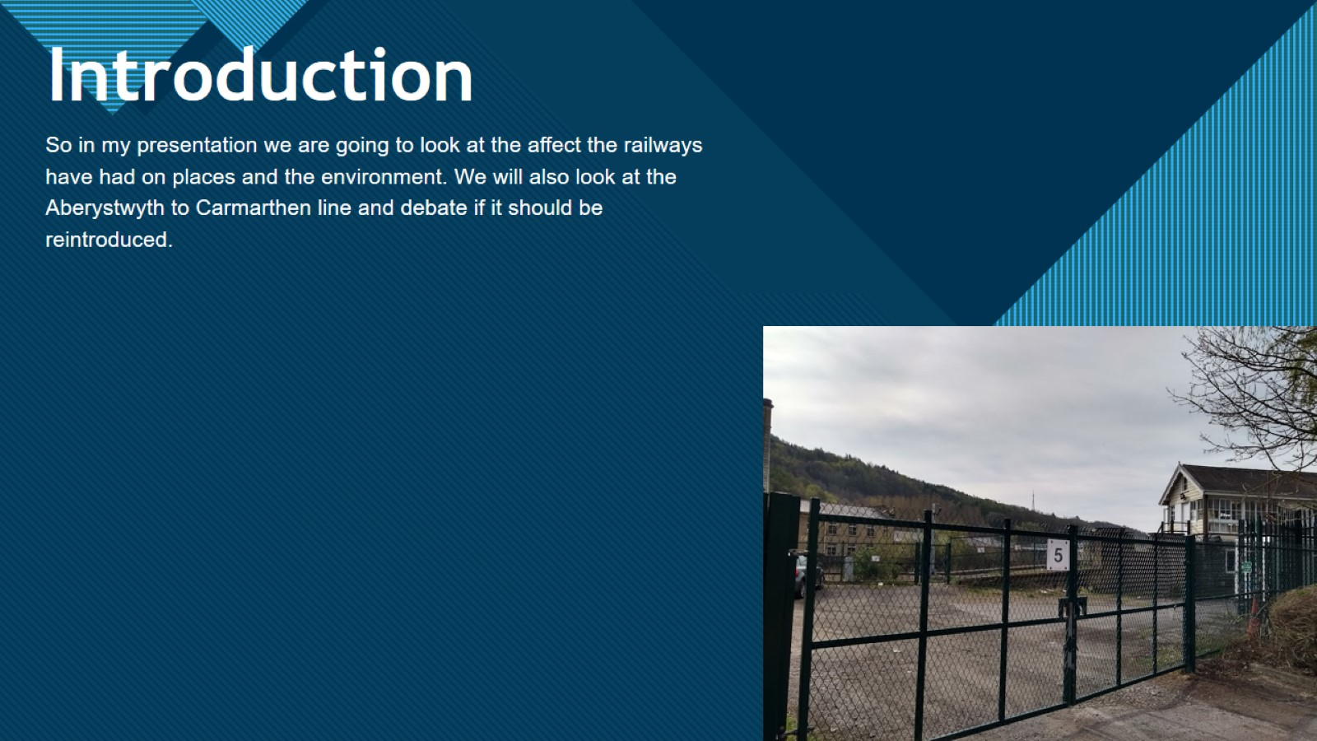
Introduction

Slide 3

How the Railways have affected the environment

Slide 4

How has railways have affected places?

Slide 5
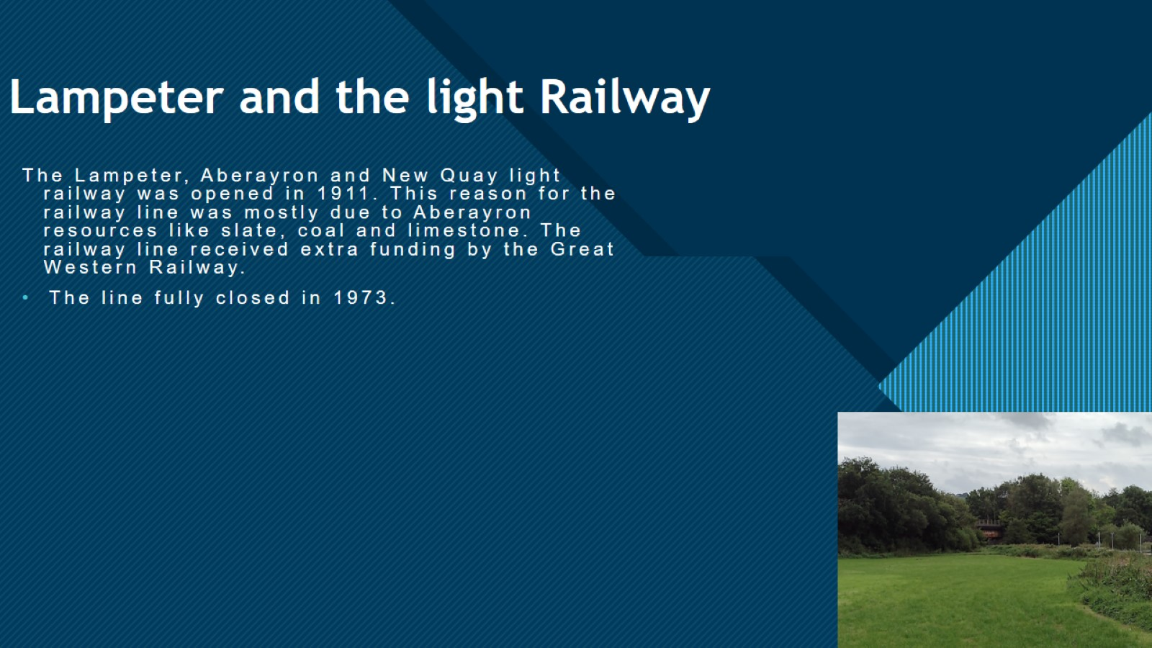
Lampeter and the light Railway

Slide 6
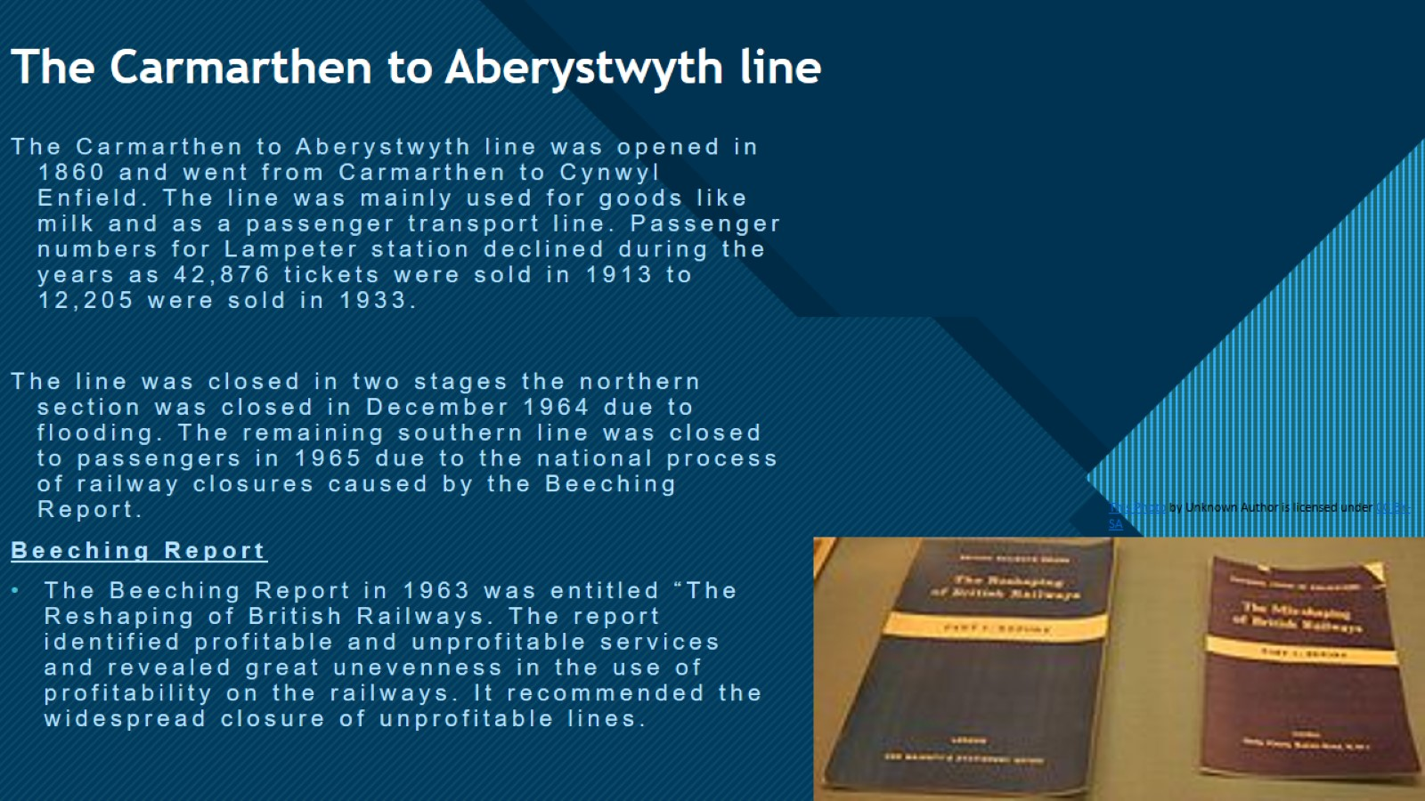
The Carmarthen to Aberystwyth line

Slide 7

Evidence of the railway in Lampeter

Slide 8

Should the railway come back?

Slide 9
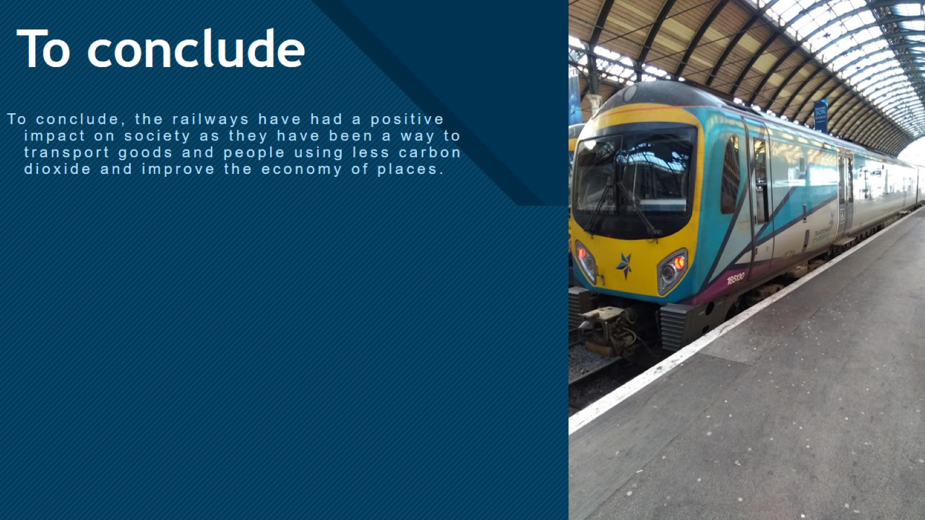
To conclude

Slide 10

Sources

Slide 11

Thank You for listening

