Slide 1


Log-in to MS-Teams
Log-in to Teams: Click here to join the meeting
Or use: https://tinyurl.com/4cwksxtd
To:
  Ask Questions in chat & DM*
  Request & receive feedback*
  Support each other
  Collaborate with others
  Share resources
* Ask Qs & for feedback during the Activity & Q&A sessions.
* Reminder: Bring Headphones with mic for 1-2-1 support.

Slide 2
Assignment 2: Task 4
Video Presentation

Slide 3

Overview
Voice-over slides
Video presentation
Activity

Slide 4
Voice-over slides in PowerPoint
Recording your voice over slides in PowerPoint is very ease.
There are several ways of doing it in PowerPoint, the 2 main ways include:
  Record Voice over individual slides, then export as a video.
  Record Voice over all slides, then export as a video.
Let’s look at these options on the next slide.

Slide 5
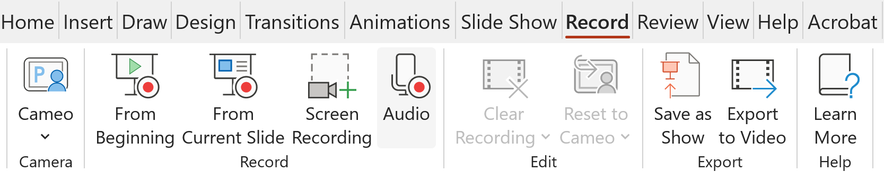

Demo: Voice over slides
Tutor show: Create new PowerPoint deck and some test slides
Record Voice over individual slides:
Record Voice over all slides: *****
Or
Notes:
Sjd jsdf jsfjsff jsfjsdfjsdfjsgdjfsjdfs jfjsf j
Sd fsfsdfsf sf sfssdfsfsf s fsdfsdfsdf sf
Sf sdfsf sdf s fsdf sd fsdf s fsdfs
Sdf s fsdfsfsdfsdfsf sdf sfs fs
Fsdf sdf sf sf sfsfsfsdf sd
Sdf sdf sfsdf sdf sdf s
Fsf s fsdf sf sdf
Sdf sdfs f.

Slide 6
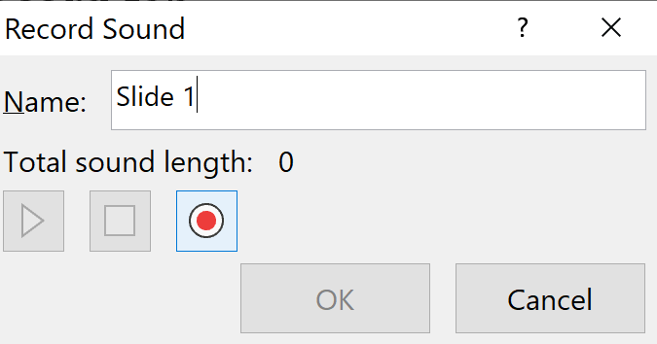
Bg. Record Voice over individual slides
Record Voice over individual slides:
Select the Record tab
Select Audio
Click the Red Record button
To stop recording, click Stop
To review your recording, click Play
  To re-record, select Record again
To save your recording, click OK.
When finished recording voice over slides, click ‘Export to Video’.

Slide 7
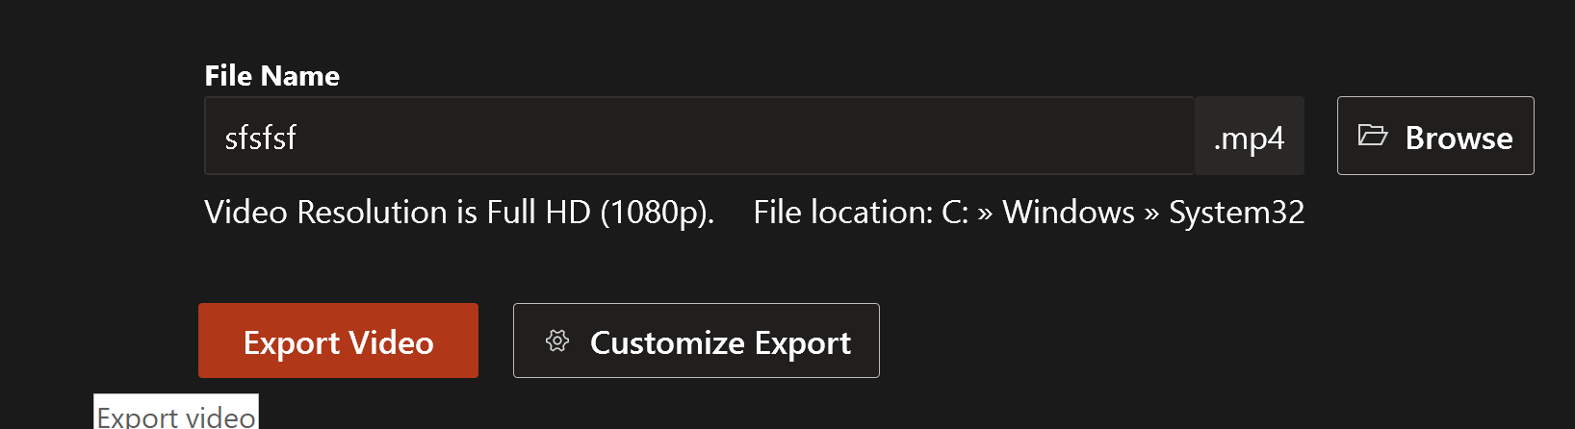
Bg. Record Voice over all slides
Or, to record Voice over all slides:
Simply click the the Record icon:
To stop recording, click Stop
To review your recording:
  Select Record tab > Preview
  To re-record, select re-take Video in editor
To export as a Video click: Export Video.

Slide 8
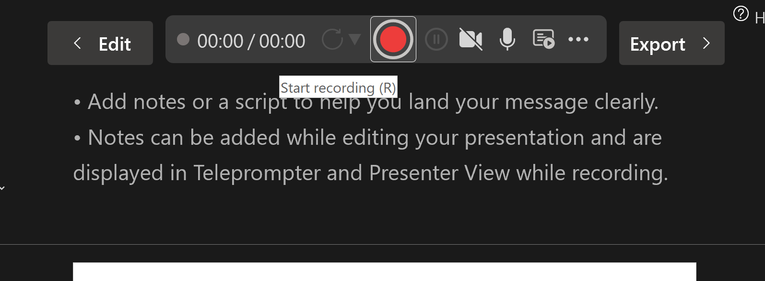
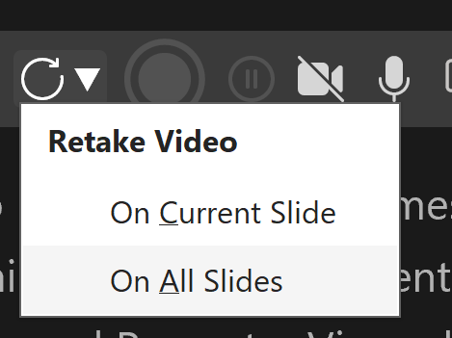
Bg. Record Voice over all slides (option 2)
To record Voice over all slides:
Select the Record tab
Select From Beginning
Click the Red Record button
To stop recording, click Stop
To review your recording:
  Select Record tab > Preview
  To re-record, select re-take Video in editor
To export as a Video click: Export Video.

Slide 9
Bg. Insert Screen-Recording & Cameo
Some other recording features of PowerPoint to be aware of, that might be useful for future presentations:
Screen recording: PowerPoint also allows use to insert a ‘screen recording’ (e.g. software demo or other activity) that we do/perform on the screen directly into a slide as a Video.
Goto: Record > Screen recording.
Cameo: PowerPoint’s ‘Cameo’ feature allows us to embed and record a video camera feed inside any or all of our slides.
Goto: Insert > Cameo
Then: Use/click the record options as previously covered.

Slide 10
3 steps: Creating a PowerPoint Video presentation
Audio: Voice over slides:
  In PowerPoint click: Record button (Top left) or Goto the Record tab > click Audio or From Beginning
Video: Export > Save an mp4 Video file.
Upload to YouTube (* set as unlisted)
  or use Vimeo or Panopto or other video streaming service.

Slide 11
Tips: Creating a Video presentation
As shown in the previous slides, PowerPoint’s ‘Record’ options and ‘Export to Video’ tool can be used to create the .mp4 video file.
The video file can then be uploaded to YouTube (as unlisted).
  Or other video streaming platform of your choice such as Vimeo, Panopto or Adobe Spark.
Please make sure the video is uploaded to a video streaming platform (such as YouTube/Vimeo) and NOT shared as a download file, as video file sizes can be very large.
The following step-by-step guide can help you to easily create a video presentation in PowerPoint.

Slide 12

How to create an ‘Unlisted’ video on YouTube
Tutor show: How to upload unlisted videos to YouTube
  Bg. Steps in text points: How to upload an Unlisted YouTube video.
* IMPORTANT NOTE: To receive marks for this
assignment, you must make sure your tutor is
able to view the video presentation online.
Make sure to set the video as unlisted.
And NOT set to PRIVATE.

Slide 13
Test Activity: Voice over slides
Test: Create a new test PowerPoint deck and some test slides:
Practice: Record Voice over individual slides:
Continue to next Activity slide to progress with and complete Assignment 2.
Notes:
Sjd jsdf jsfjsff jsfjsdfjsdfjsgdjfsjdfs jfjsf j
Sd fsfsdfsf sf sfssdfsfsf s fsdfsdfsdf sf
Sf sdfsf sdf s fsdf sd fsdf s fsdfs
Sdf s fsdfsfsdfsdfsf sdf sfs fs
Fsdf sdf sf sf sfsfsfsdf sd
Sdf sdf sfsdf sdf sdf s
Fsf s fsdf sf sdf
Sdf sdfs f.

Slide 14
Activity: Assignment 2 progress
To finish and submit Assignment 2:
Complete Assignment 2 tasks 1, 2 & 3.
Create presentation Script: Read through and refine task answers.
Create PowerPoint Content (bullet points & Visual and add script to notes).
Practice several times and update
Voice over slides
Export video as an mp4 file
Upload video to YouTube (* set as unlisted).

Slide 15
Reminder: Example PowerPoint structure
Create: a new PowerPoint presentation:
  Design: Choose a Design theme.
  Structure: Create main structure slides. Example structure:
    Title slide
    Introduction/Table of contents
    Task 1: Self-reflection
    Task 1: Self-evaluation (x4 Results) - x4 or more slides is ok
    Task 2a: Gibbs Reflective model
    Task 2b: PDP (x3 Goals) - several slides is ok
    Task 2c: Goal progress summary - several slides is ok
    Task 3: Unit 4 Topic summary (x3 sub-sections) - several slides is ok
    Conclusion
    Reference list.

Slide 16










Break time: 10/15mns

Slide 17

Show: Examples?
Tutor check: If show of 1/2 Video examples from previous submissions would be helpful?

Slide 18
Tips: Video format structure & presentation
Title: Title slide (inc. presentation title, module name, your name, student no. and course).
Introduction: Introduction slide that provides a brief overview of the presentation / content list.
Main body: slides should be clearly titled and include your task answers.
Theme: the design/theme of the presentation should be consistent.
Text font: should be an appropriate size and consistent.
Voice: clearly spoken at a good steady pace.
Visuals: create a good balance between text and images.
Animation/fx: can be used (not overused) to create a professional engaging presentation.
Content: should be clearly structured & presented, to demonstrate knowledge of the subject area.
Conclusion: a conclusion slide should provide a brief summary of the key points.
References: a reference slide should be included at the end using the IEEE referencing standard.

Slide 19
Activity: Video Presentation
To finish and submit Assignment 2:
Complete Assignment 2 tasks 1, 2 & 3.
Create presentation Script: Read through and refine task answers.
Create PowerPoint Content (bullet points & Visual and add script to notes).
Practice several times and update
Voice over slides
Export video as an mp4 file
Upload video to YouTube (* set as unlisted).

Slide 20


Notice: Christmas break
No Lecture-tutorials from: Monday 15th Dec.
Classes start back: Monday 5th January 2026
  LDE: Assignment 2 support.
Assessment & Exam Period: 12th January to 25th January 2026
  No classes during the assessment period.
To view the University's key dates and calendar please click-here:
Key Dates 2025/2026 | University of Wales Trinity Saint David

Slide 21


Check-in & Questions?
Any Qs?

Slide 22

Register
Register reminder
Thanks to D.

