Slide 1
Specifying a Project
Dr John Rees
27th Sept 2016

Slide 2
No Project Exists in a Vacuum

Slide 3
Before We Start Talking to the Client
What CONSTRAINTS?
  Technology we use/have
  Physical site issues
  Fit with the business (business issues)
    E.g. Displacement of other business
  Ethics/moral considerations
  Environment
  Staffing
  Risk

Slide 4
Architectural Issues
We have a technology map
We have a business plan
We have established ways of proceeding
Is this a job that fits?
Is this a job that distorts the existing shapes of things?
  If so, is it so significant we are willing to bend?
What impact is there on our business?

Slide 5
Risk Issues
Does the finance involved pose problems?
  Desire for the project
  Confidence in our financial stability
  Confidence in the client
  Is the risk premium sufficient?
How much risk is incurred?
How much appetite for risk do we have?
Qui bono?

Slide 6
Plausibility
Finance?
Staffing?
Facilities?
Complexity?
Technical innovation?
Credibility?

Slide 7
Strategic Evaluation
Basic, well understood techniques
  Straight cost-benefit
  PESTEL (SLEPT)
  Porter’s Five Forces
  Risk analysis

Slide 8
If We Decide to Proceed?
Upfront NRE limits or Feasibility Funding?
Establish what the client actually wants and needs: requirements elicitation
  Want/need not the same
  Particularly strong issue for IP led projects (e.g. software, contract design, etc.)
Specify the project
Establish and agree how we can demonstrate we have delivered to specification

Slide 9
Contracts
Utterly crucial
Specialist area
  Legal and illegal terms of contract
  Enforcement, jurisdiction, penalties, arbitration, force majeure, failure to deliver, terms of payment
Golden rule - no contract, no work on the project

Slide 10
How Much Work Upfront?
Examples
  EU projects
  Regional development projects
  Government projects
  Overseas government projects
  “Partner” and joint projects
    Old quip – “Who does the carving?”
  Straight commercial “for profit”
Always a decision – but make sure that decision is made, not defaulted into by increments

Slide 11
Requirements Elicitation

Slide 12
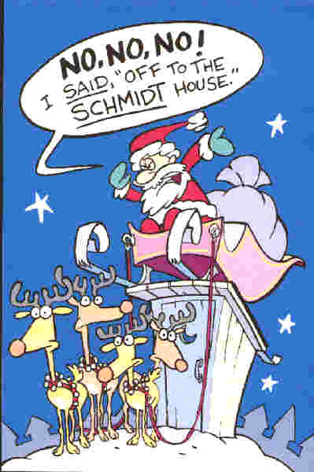
Language is an Imprecise Vehicle
Our task is to capture what the client wants
Seems obvious – ask them!
Do they know what they want?
Can they express what they want?
Can we understand what they say?

Slide 13
Requirements Elicitation
Multifaceted and iterative activity
Critically dependent on
  Communication skills of requirements engineers
  Commitment and cooperation of the system stakeholders
But what about cultural background, location, language, timescale, knowledge?
What about what they don’t articulate?

Slide 14
Processes in Elicitation
Understand the application domain
Identify the sources of requirements
Analyse the real stakeholders
Select your techniques, approaches, and tools
Then can begin to define requirements!
  Scope of system
  Defined needs
  Future business operations

Slide 15
Not in Isolation: Context is King!
Characteristics of the project, organisation, environment
Budget and schedule
Structure and maturity of the organisation
Level of volatility within the project
Novelty – technology, business, use, interface, hardware (in particular!) – to them and you

Slide 16
Not a “One Touch” Process
Usually incremental over multiple sessions
  Iteratively increase level of detail
Our target is a detailed set of requirements
  Natural language text and simple diagrammatic representations
  Additional information:
    the sources;
    priorities; and
    rationales for the project

Slide 17
Our real target is a set of explicit¹ needs²
Explicit: stated clearly by the client
Explicit needs: the problems for which the client knows, and has said, they need a solution

Slide 18
Our real target is a set of achievable expectations
No surprises on either side …
No delays in acceptance if we deliver what we said

Slide 19
What Roles Will You Adopt?
Conflicts between elicited requirements and stakeholders themselves are inevitable
  Analyst/engineer as mediator!
The client may not understand
  Technology
  Complexity of development
  How to state requirements so they can be validated
  Analyst/engineer as consultant/advisor!

Slide 20
Why System Design Fails
(Based on Lyytinen and Hirschheim, “Information failures—a survey and classiﬁcation of the empirical literature”, Oxford Surveys in Information Technology 1987;4:257–309)
Correspondence – objectives not met
Process – can’t be done in time/budget
Interaction – usage as a substitute for IS quality
Expectation – performance: actual ≠ desired
The causes?
    Poor communication between people (P, I, E)
    Lack of appropriate knowledge or shared understanding (I, E)
    Inappropriate, incomplete or inaccurate documentation (I, E)
    Lack of systematic process, lack of management (P)
    Users may not necessarily accept systems that meet design objectives and speciﬁcations (C)

Slide 21
Why Communication Fails
Articulation
  You can’t express what you mean
Misunderstanding
  You can express it, I don’t understand you
Conflict
  You can express it, I can understand it, but I don’t agree ( AKA multiple viewpoints and conflict)

Slide 22
Techniques
(Approaches to try to elicit a full picture)

Slide 23
Interviews
Unstructured interviews
  Conversational in nature
  Interviewer enforces only limited control
  Used for exploration
    Limited understanding of the domain
    Precursor to more focused and detailed structured interviews
  Focus in too much detail on some areas, and not enough in others

Slide 24
Interviews
Structured interviews
  Predetermined set of questions to gather specific information
  Needs the right questions, appropriately timed, to the right person, easy language, etc.
  Templates available for guidance on (e.g. Volere)
  Structured interviews in practice
    Tend to limit the investigation of new ideas
    Considered to be rigorous and effective

Slide 25
Questionnaires
Used during the early stages of requirements elicitation
  Open and/or closed questions
  The terms, concepts, and boundaries of the domain must be well established
    Shared understanding by the participants and questionnaire designer
  Focused questions
    To avoid gathering large amounts of redundant and irrelevant information

Slide 26
Questionnaires in Use
  Efficient way to collect information from multiple stakeholders quickly
  Limited in the depth of knowledge they can elicit
    Can’t delve further on a topic
    Can’t expand on new ideas
    Participants can’t request clarification or correct misunderstandings
  Best as informal checklists
    Ensure fundamental elements are addressed early on
    Foundation for subsequent elicitation activities

Slide 27
A Good Questionnaire?
Participant’s thinking
    Short
    Logical
    Respectful
    Relevant
Researcher’s view
    Gets completed
    Enforces qualifications
    Meets goals
    Supports needed analysis
    Precise enough to be useful

Slide 28
Questionnaire Content
Screening questions
  Is the participant qualified to answer well?
Core content – “must haves”
  Questions we need answered to make progress
Difficult questions/cognitively challenge
  Put these at the end so the subject is ready for them and to avoid losing too much if they balk (or walk!)
Conclusion
  Any last demographic data + (v. important) BE NICE – appreciative, thankful

Slide 29
Task Analysis
Top-down approach
    High-level tasks are decomposed into subtasks
    Subtasks into detailed sequences
    Recursive until all actions and events are described
Constructs a hierarchy of system tasks
Determines the knowledge used to carry them out
    User and system interactions on tasks
    Contextual description of the activities
Problems of effort and level of detail

Slide 30
Domain Analysis
Analysis by examining the existing and related documentation and applications
  Important in the replacement or enhancement of an existing system
  Types of documents
    Design documents, instruction manuals , hardcopy forms and files
    Upstream and downstream systems
    Competitor products
Produces detailed descriptions and examples

Slide 31
Introspection
Analyst develops requirements based on what s/he believes is required from the system
  We all do this at some point
  Effective when the analyst is
    Very familiar with the domain and goals of the system,
    Expert in the business processes performed
  Can be essential if the client is naïve or doesn’t know what s/he wants
  Be wary – everyone knows what they don’t want!

Slide 32
Repertory Grids
Stakeholders to develop attributes and assign values to a set of domain entities
System modelled in the form of a matrix
  Categorises elements of the system
  Instances of those categories
  Variables with corresponding values to each one
  Identify and represent the similarities and differences between the domain entities
Best used with experts (v. abstract concept)

Slide 33
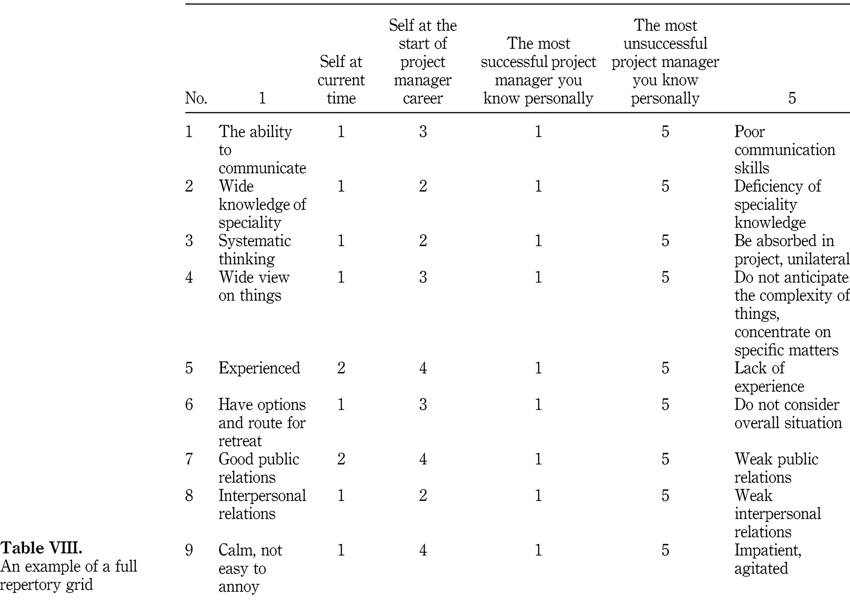
Example Repertory Grid - Evaluation
Key
1 = “Good”
5 = “Bad”

Slide 34
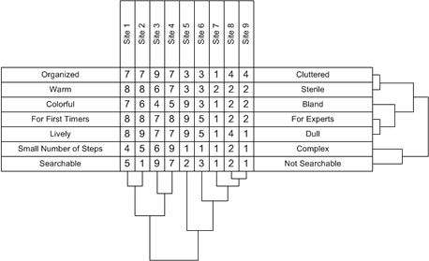
e.g. Repertory Grid - Comparison
Comparison of the “Feel” of Web Site

Slide 35
Card Sorting
Stakeholders to sort a series of cards with the names of domain entities into groups
  As they see it
  Then required to explain their approach
Possible only if the domain is sufficiently understood by analyst and participants
CRC cards an example of this approach
  Cards used to assign responsibilities to users and components
(Clarification Technique)

Slide 36
CRC Cards
Class, Responsibilities, and Collaboration (CRC) Cards
  Move away from the procedural mode of thought
  Cards are used to represent software objects
    Class of object written at the top of the card
    Responsibilities listed down the left side
    Collaborating classes listed to the right of each responsibility

Slide 37
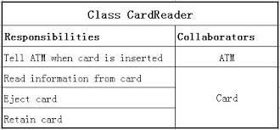
Simple Example CRC Card

Slide 38
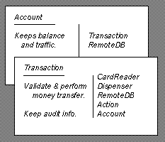
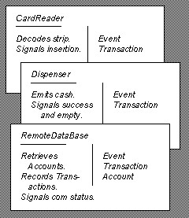
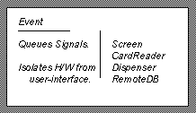
CRC Cards Describe the System
From: Beck, K., Cunningham, W., “A Laboratory For Teaching Object-Oriented Thinking”, OOPSLA'89 Conference Proceedings October 1-6, 1989, New Orleans, Louisiana. See http://c2.com/doc/oopsla89/paper.html for details!

Slide 39
CRC Cards in Operation
Simulate the system by talking about which objects send messages to other objects
Stepping through the process reveals weaknesses and problems
Design alternatives explored by simulating the proposed changes
Lack of a written specification? Ability to retain the design? Too many cooks?

Slide 40
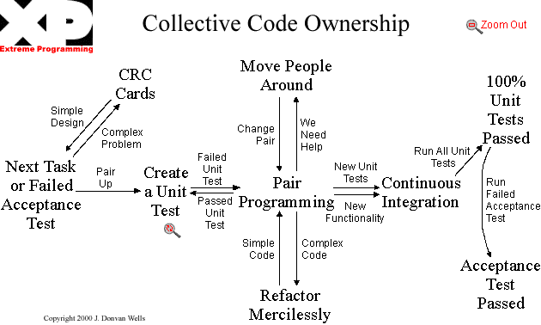
Use of CRC in Extreme Programming

Slide 41
Examples
Some examples:
http://c2.com/doc/oopsla89/paper.html
A “full design” process for an address book application (use cases, CRCs, and sequence diagrams)
http://www.cs.gordon.edu/courses/cs211/AddressBookExample/index.html
(If nothing else, explains why methods designed for big projects doesn’t go well with small jobs!)

Slide 42
Laddering
Stakeholders are asked a series of short prompting questions, known as probes
  Asked to arrange the resultant answers into an organised structure
  Needs stakeholders able to express their understanding and arrange it in a logical way
  Displayed using tree diagrams, modified dynamically as information is added
  Assumes knowledge can be arranged in a hierarchical fashion
(Clarification Technique)

Slide 43
Group Work (incl. Focus Groups)
Collaborative meetings are often the default technique for requirements elicitation
  Involves and commits stakeholders directly and promotes cooperation
  Managing group sessions requires expertise
    Ensuring individual personalities don’t dominate
  Key success factors
    Makeup and cohesion of group participants
    Group members comfortable and confident in speaking openly and honestly

Slide 44
Ethnography
The study of people in their natural setting
  Participation in the activities of the users over an extended time
  Collecting information on their normal operations
  Useful when addressing contextual factors
    Usability
    Understanding of interactions between different users
  Effective applications
    New system needs to fix existing problems with processes and procedures
    There are complex human social patterns and relationships

Slide 45
Observation
Basic ethnographic technique
  Seems obvious
  Problems
    EXPENSIVE
    High skills and high effort
    Users perform differently (better?) when watched!
Used in conjunction with interviews, task analysis, focus groups

Slide 46
Prototyping
This method works well
Provide stakeholders with prototypes of the system based on initial discussions
Gather detailed information and feedback
Excellent for
  Human-computer interfaces
  Naïve users

Slide 47
Prototypes
Storyboards, executables, throwaways and evolutionary prototypes are common
Expensive to produce
They encourage users to play an active role in developing requirements
Problems
  Users can become attached, which slows development
  Once started, being able to stop
  Avoiding micro change creating timescale drift
    Perfectionists, client-side arguments, getting paid!

Slide 48
Prototyping
Iteration
Ongoing, developmental change during design and development
If the client is honest, can improve the precision of the requirement fit
If the client is serious, prototyping maintains commitment to the solution
Expert developer + committed client = good project

Slide 49
Scenarios
Narrative and specific descriptions
  Current and future processes actions
  Interactions between users and system
  Not the internal structure of the system
Incremental and interactive approach to development
  Important to collect all the potential exceptions for each step
Very similar to use cases (of which more later!)

Slide 50
Other Methods … Just a Few
Joint application development
Requirements workshops
Protocol analysis
Apprenticing
Goal based approaches
Viewpoints
  … and these are only the well-known ones!

Slide 51
So … Let’s Do It
Let’s take a well-known business process which clearly needs converting to software
Small group activity
Read the handout and do the tasks

Slide 52
Final Comment
A lot of work is put into requirements elicitation
  Because you can’t succeed without a target
  Because you need to nail the client to the brief and the brief to the client
  (Corollary) Because you need to make clear to the supplier what you actually need
  Design, testing, validation all depend on knowing the “right” outcome

Slide 53
Generating Ideas

Slide 54
Brainstorming

Slide 55
Brainstorming?
What do you do once simple analytical thinking comes to an end?
Need ideas, but can’t derive them from systematic approaches
You know more than you think you do
Why can’t you say it?
  Subconscious, psychological pressure, shyness, “What if it’s daft?”
Let loose the “inner djinn”

Slide 56
Brainstorming
Get a group together
Doesn’t have to be all technical specialists (better if it isn’t!)
Use a clean whiteboard/large sheet of paper
Just throw in ideas – anything goes
Ideas first – analysis later!
Don’t be put off – just get them out there
Team after the fact goes through and sorts the gems from the dross

Slide 57
Brainstorming
Standard example:
We’re hungry, and all we have is some bricks.
What shall we do?

Slide 58
Brainstorming
Just throw in any ideas you have (positive ideas)

Slide 59
Negative Brainstorming
Invert the problem
Same group
Think of all the least likely things you could do to succeed at the problem
List them
Analyse them, taking the least worst or using the very worst as guidance to what NOT to do

Slide 60
Negative Brainstorming Example
What’s the best way to put students off joining a degree course?

Slide 61
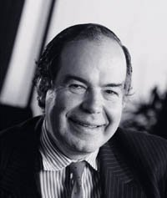

Edward de Bono’s Six Thinking Hats

Slide 62
Blue Hat Thinking- Process
Thinking about thinking
What thinking is needed?
Organizing the thinking
Planning for action
This is usually the start point, and always the end point of a session

Slide 63
White Hat Thinking- Facts
Information and data
Neutral and objective
What do I know?
What do I need to find out?
How will I get the information I need?
Often sessions will include a lengthy starting introduction to the topic

Slide 64
Green Hat Thinking - Creativity
Ideas, alternative, possibilities
Provocation - "PO"
Solutions to black hat problems

Slide 65
Yellow Hat Thinking- Benefits
Positives, plus points
Logical reasons are given
Why an idea is useful

Slide 66
Black Hat Thinking - Cautions
Difficulties, weaknesses, dangers
Logical reasons are given.
Spotting the risks

Slide 67
Red Hat Thinking - Feelings
Intuition, hunches, gut instinct
My feelings right now.
Feelings can change.
No reasons are given.
Customarily red hat sessions are kept very brief (30 secs, 1 minute) to ensure spontaneity and “gut reaction” rather than analytical thinking

Slide 68
Common Sequence
At least one experienced user recommends the sequence below
  There is no standard approach
  de Bono’s work only indicates that all hats should be adopted within the process, finishing with blue
Blue, white, red, yellow, green, red, black, red, blue
What does this mean about the way we use the tools offered?

